Slide 1
Change the way you work with SAP through automation
Scott Lewis – Strategic Account Executive
Jayasri Varyani – Sr. Sales Engineer

Slide 2

Winshuttle is now part of Precisely,
the leader in data integrity
Notes:
How many of you have ever heard of Precisely?
Chances are you have heard of Winshuttle. Right?
Well in 2021 Precisely acquired Winshuttle, adding our leading SAP automation capabilities to their already world-class data integrity portfolio.
This combination offers many benefits to SAP customers by combining SAP automation with Precisely’s data quality, governance and location intelligence (data integrity) capabilities.

Slide 3











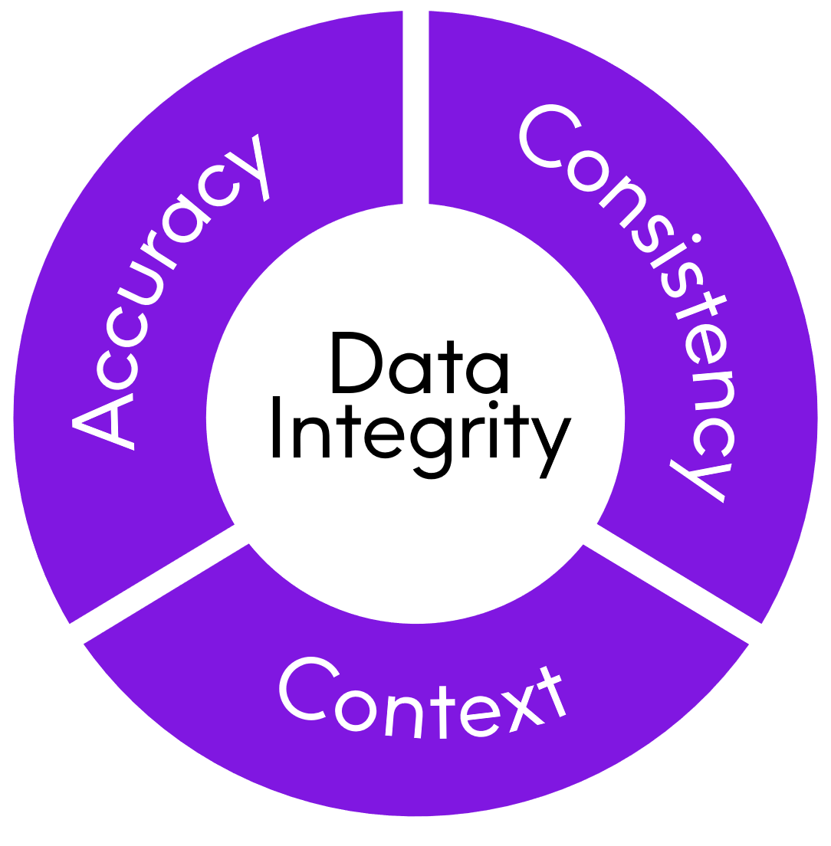















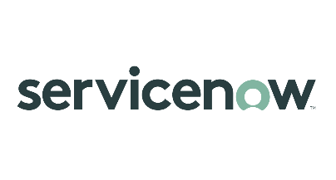









overall_0_132182146847412339 columns_1_132180489003760538 6_1_132180670009245741
Brands you trust, trust us
Integrate
Verify
The global leader
in data integrity software
Our data integrity software, data enrichment products, and strategic services deliver accuracy, consistency, and context to power confident business decisions.
Data
Integrity
Suite
Enrich
Locate
Data leaders partner with us
12,000
99
customers
of the Fortune 100
2,300
Customers in more than
100
countries
employees
Notes:
A little more information about Precisely
As I mentioned, we are the global leader in data integrity
With over 12,000 customers in over 100 countries around the world
We are in 99 of the Fortune 100 and have over 2300 employees.
Many of the worlds biggest brands trust Precisely with their data and we hope you will trust us with your SAP automation needs.
Now, let’s get started.

Slide 4
Empowering business teams to make an impact
Notes:
Used as an opening slide to all presentations –
This is why Precisely Automate exists – to help business teams in the largest organizations in the world make a real impact, whether it’s at a personal, departmental or company level.
We know from almost 20 years of automating SAP processes, that business teams are often the ones who know their processes and data the best and are most effective at developing the automation scripts.

Slide 5

Tackle process and data together
Data
Product launches
Product data management
Customer onboarding & management
Vendor onboarding & management
Asset management
Financial master data
and more…
Process
Notes:
Talk track:
You need to tackle process and data together. Here are just a few examples of core master data processes.
If you digitize these complex processes without improving the quality of the data you collect, you’re missing a big opportunity. And similarly, if you just focus on improving data quality without optimizing and accelerating the process, your efforts will short of reaching their full potential.
The fact is, you need to address both process and data at the same time to succeed and that makes these kinds of processes really challenging to digitize and manage with traditional process automation or data management platforms. So many of these processes are still manual and slow today even for the largest enterprises. That’s where Winshuttle comes in. Our software is designed to digitize these critical master data processes <click>

Slide 6








Make an impact across your SAP landscape
FI
CO
SD
MM
PM
Financial Accounting
Controlling
Sales and Distribution
Materials Management
Plant Maintenance
AM
PS
PP
QM
HR
Asset Management
Project Systems
Production Planning
Quality Management
Human Resources
Notes:
Note to sales:
Finally, we have always felt that it was critical that our platform and solutions work across the entire SAP ERP landscape. Many SAP master data processes work across modules and departments – for example vendor create that can touch on five or more different departments (procurement, finance, materials, manufacturing, logistics, etc.). You can start with one process in one area and expand as you find needs and we’re here to support you along the way.
I know this has been fast, but I hope you have a better idea of what the Precisely Automate platforms can do to help you automate and streamline your SAP processes.

Slide 7
A complete automation platform
Automate Evolve
Desktop Automation
Process Automation
Excel to SAP
Exchange data with SAP quickly and easily using Excel
Excel Workflow
Automate and accelerate SAP business processes through Excel file management workflows
Form & Workflow
Automate and accelerate SAP business processes with integrated forms and workflows
Notes:
When you choose the Automate Platform for your SAP finance and accounting processes you enable your business to develop solutions as needed across the entire platform.
From the powerful desktop capabilities of Automate Studio that automate mass data processes such as G/L account maintenance and period end journal entries.
Capabilities which we will discuss throughout this presentation:
Finance data creation and maintenance
Data migration
Financial reporting
Data stewardship capabilities
To advanced workflow automation with Automate Evolve that can manage data files like Excel with full governance and compliance
Capabilities which we will discuss throughout this presentation:
Advanced routing and governance capabilities
Server-based file management
Flexible, conditional routing
And Web forms that can simplify complex data management tasks and workflows.
Capabilities which we will discuss throughout this presentation:
Advanced, user-friendly web form and workflow capabilities
Server-based execution
Process analytics
Advanced data stewardship capabilities (via web forms)
Whatever capabilities your team needs to apply in the business, Automate offers a solution.

Slide 8
Start with desktop automation
Desktop Automation
Process Automation
Excel to SAP
Exchange data with SAP quickly and easily using Excel
Excel Workflow
Automate and accelerate SAP business processes through Excel file management workflows
Form & Workflow
Automate and accelerate SAP business processes with integrated forms and workflows
Notes:
Let’s start with Desktop automation – In our world, desktop automation means Excel to SAP automation where you manage SAP data using Excel, quickly, easily and automatically making the data exchange.

Slide 9



What you can do with Automate Studio
Automate any SAP business process
Streamline data migration and conversions
Create operational reports
Notes:
Studio is capable of automating almost any SAP business process
Can streamline mass data processes such as data migrations (which often happen as a result of M&A activities) and conversions of data from legacy systems to SAP
And with Studio you can easily create operational reports and deliver audit trails.

Slide 10

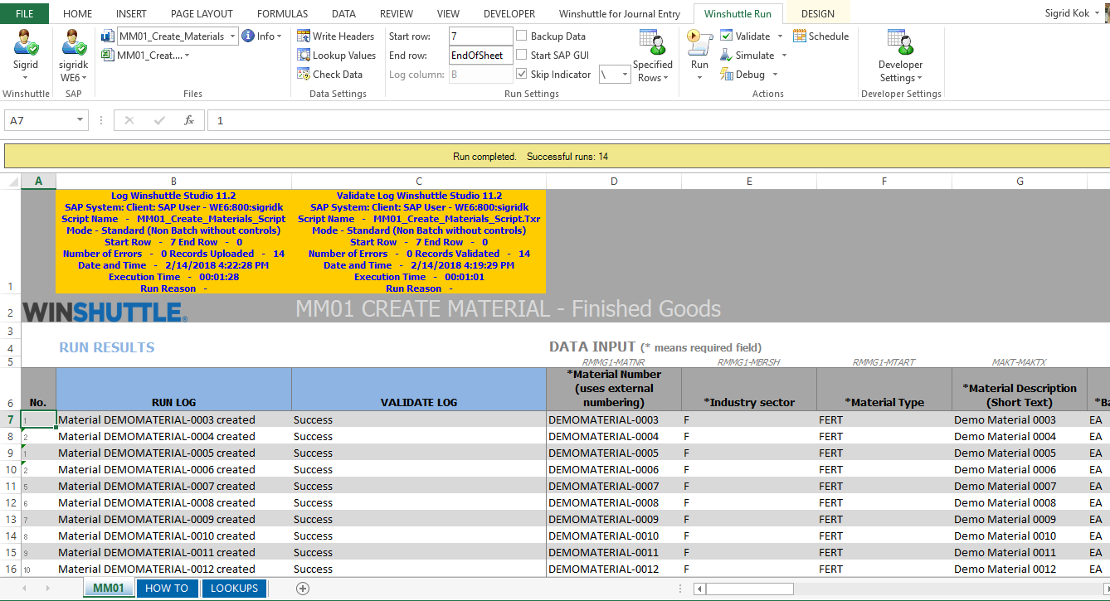
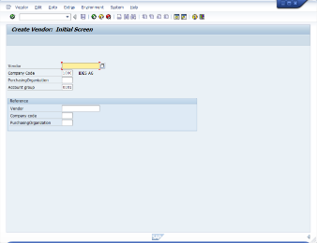
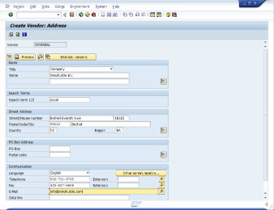
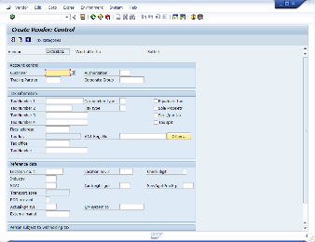
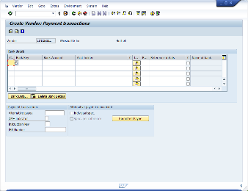
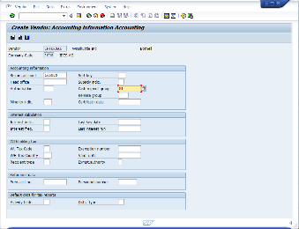
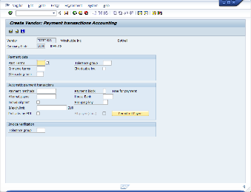
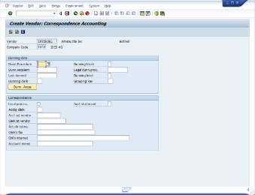
Replace multiple SAP screens with business-friendly Excel

Slide 11

Dorman speeds through master data changes
Challenge
Change subset of materials from ‘Manufactured’ to ‘Kitted’
Update BoMs and Routings
Change sales order to reflect non-kitted materials
Results
PER 100 MATERIALS
 | Hours | Total Cost | Difference
Manual Processes | 60 | $4,500
Using desktop automation | 5 | $375 | $4,125 saved
3,000 materials converted
Savings = $123,750
Minimal business impact
Improved data quality
Notes:
Talk track:
Here’s an example of one Winshuttle customer who saved time and money by automating their master data processes.
Dorman are a leading aftermarket automotive supplier who designs, package and market over 150,000 different products. This rapidly growing company has 5 plants and a high level of master data complexity.
IT were originally using LSMW for data uploads, but this technical tool was not suitable for the business so Dorman chose and deployed Winshuttle.
This particular use case was driven by the need to change the status of a subset of materials from manufactured to kitted. The process involved blocking materials, querying sales orders, cancelling applicable lines in sales orders and then updating the material master, BoMs and routings. Once the necessary changes were made, the revised order lines were added back to the sales orders.
Dorman reduced the time it took to complete this process from 60 to 5 hours per 100 materials, resulting in over 123 thousand dollars in savings, and enabling business to move faster. This approach minimized business disruption and because data was validated at point of entry, Dorman were able to also improve data quality. <click>

Slide 12
Automate Evolve
The right combination of capabilities to automate data-intensive processes.
Enterprise-grade workflow & automation
Robust data
stewardship
Deep SAP integration
Low-code/no-code design
Notes:
Automate Evolve - as I mentioned – is our complete process automation platform:
It delivers enterprise-grade workflow and automation capabilities that can streamline and accelerate the most complex SAP processes
Includes even more robust data stewardship capabilities
Has the same heritage of two decades of automating SAP processes
And a low-code/no-code design that helps you limit the amount of IT engagement needed to automate complex SAP processes

Slide 13
Automate SAP processes when:
Errors have costly consequences
Take too long, impacting business/revenue
Are complex with many participants
Contain complex data & can span many objects
With high volumes of data maintenance requests

Slide 14
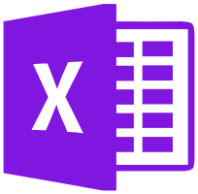
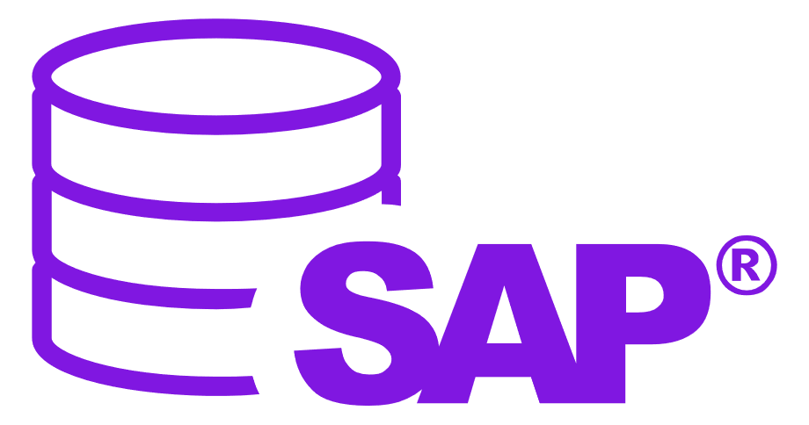



Automate Evolve
Automate and streamline SAP business processes using workflows
Advanced form and workflow capabilities
Advanced data stewardship capabilities via web forms
Detailed process analytics
Includes Automate Studio—our market leading Excel-to-SAP automation platform
Automate Studio
Exchange data with SAP quickly and easily using Excel
Data creation and maintenance
Data migration
Operational reporting
Data stewardship
Share, manage, & control Precisely solutions across the enterprise
Centralized content management
Granular control of licenses, users & policies
Extensive audit and ROI reporting
Server-side job execution
Notes:
Automate Evolve includes Studio as a core part of the platform and allows you to deploy Studio’s desktop automation capabilities where needed, while also giving you the flexibility to deploy Excel Workflow or Form and workflow where those capabilities are needed.

Slide 15






Look for a complete set of capabilities
Choice of forms or Excel front end
Smart, tailored, role-based forms
SmartTables
Dynamic process linking
Flexible, extensible solution architecture
Process dashboards & reports
Audit trails for process & data
Automated data exchange with SAP
Live SAP data validation
Granular user & policy management
Notes:
Note to sales:
Evolve offers a unique set of capabilities that have been developed specifically to automate and streamline complex, data-intensive SAP processes.
(You can talk about one or two if you have time, but it’s up to you)
Use this slide to introduce at a high level the features that make Evolve unique. You do not need to go through each one. For deeper conversations and follow-up meetings there is content around many of these features in the Evolve slide library.

Slide 16
Use Case Examples

Slide 17

Use one solution
for all your product launch types
Product launch
types
New products
Product changes
Geographical expansion
New innovation
Line
extensions
ingredient/
label change
Legal/ regulatory change
Seasonal /
Promotional products
others
Plant extensions
Sales org. extensions
Notes:
Note to sales:
This is a key message for us. Our NPI solution can be built to handle any type of launch process from a net new finished good or line extension to a simple ingredient change or plant extension.

Slide 18
Create new finished good
Create shell material
Plant A
Plant B
Plant C
BoM
Routing
PIR
Source list
Routing
PIR
BoM
Source list
Routing
PIR
BoM
Source list
Streamline complex processes
Collect global data
Dynamic process linking
Automate complex multi-layered processes
Streamline data collection across data objects and business units
Handle centralized and decentralized data in one solution
Collect plant-specific data
Notes:
Note to sales:
This is a key message for us. Our NPI solution can be built to handle any type of launch process from a net new finished good or line extension to a simple ingredient change or plant extension.

Slide 19
Modular, strategic product launch platform
FINISHED
PRODUCTS
MATERIALS
(FERT)
BILL OF
MATERIALS
(BOM)
ROUTINGS
& PV
MATERIAL
EXTENSIONS
MASTER
RECIPES
Start with the data objects that make sense for your business
Expand over time
Meet the needs of any organizational structure type
Supports high complexity and volume
TRADING GOODS
MATERIALS
(HAWA)
SEMI-FINISHED
MATERIALS
(HALB)
RAW
MATERIALS
(ROH)
PURCHASE INFO RECORD
(PIR)
SOURCE LIST
VENDOR
MASTER
COSTING
(MARK &
RELEASE)
MATERIAL STATUS
UPDATE
PRICING
PACKAGING
MATERIALS
(VERP)
Key
Master
Data
Supporting
objects
Notes:
Note to sales:
Our NPI solution is also modular and extensible, handling many SAP data objects and enabling companies to expand their digital footprint at a pace that make sense for them. It also supports the collection of centralized and decentralized data, complex processes, and high-volume scenarios.

Slide 20

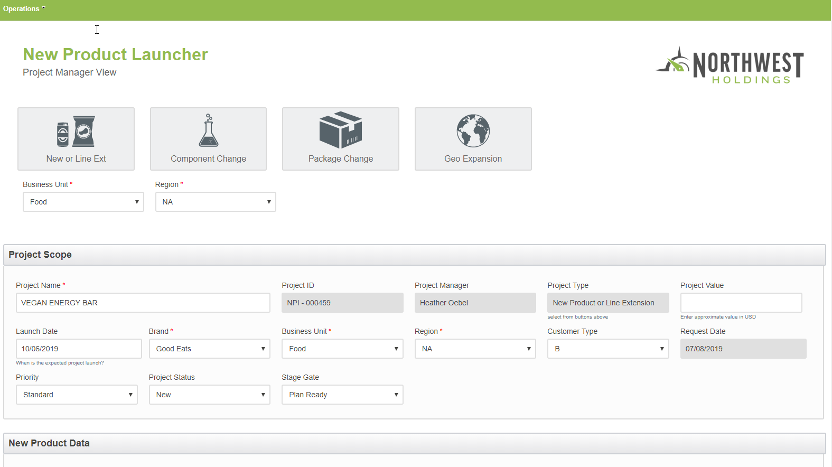
Speed up
SAP launch processes by 50% or more
Notes:
Note to sales:
A section header slide for the NPI discussion.

Slide 21

CUSTOMER STORY:
Energy Drink Company
CHALLENGE
Slow, manual processes causing product launch bottlenecks
Lack of visibility into launch project status
SOLUTION
Digitized three launch processes
Reduced product launch cycle times by 50-75%
Increased visibility and improved governance
Achieved repeatable, predictable processes
Notes:
Note to sales:
This is a quick case study from one of our customers – an Energy drinks company
They had an inefficient, but adequate Excel-based new product introduction process which was sufficient when their market was limited to a couple of countries in North America. The system captured and managed SAP data in Excel spreadsheets, which relied on email routings and manual tracking before data was manually entered into SAP. With this system they had no visibility into processes status, poor process governance and each product introduction felt like they were starting from scratch.
Then they did a deal for global distribution with a major soft-drinks manufacturer and found that their Excel-based process was a major bottleneck. There was simply no way to manage the complexities of multiple country requirements, new supply chains, packaging needs, languages, and manufacturing plants.
After carefully reviewing their processes and needs, we worked with them to develop an automated New Product Introduction (NPI) solution that centralized and streamlined three core processes.
The result was a reduction in time to market for new products of between 50 and 75%
Increased visibility into their product launch and manufacturing processes that were impossible with the old, Excel-based system
Creation of repeatable, predictable and fully governed processes

Slide 22



Solving finance’s biggest challenges
Speed up business processes
Improve data
quality
Maintain and improve compliance
Drive business results and transform digital into a competitive advantage.
Notes:
Talk track
Finance’s biggest challenges hit squarely in the middle of this intersection of process and data. Address these and you can drive better business results and transform digital into a competitive advantage.
The Precisely Automate platform enables you to get both faster processes and better data so you can drive real results and get the competitive advantage you need to thrive in the digital economy<click>

Slide 23
Core SAP Finance activities
R2R
Record to Report
G/L Master Data
Manual Journal Entries
Review and Approval Workflows
Intercompany processes
A2R
Asset Accounting
Asset Master Data
Asset under Construction (AuC)
Projects and internal orders
Asset transactions (Acquisition, Settlement, etc.)
AR
Accounts Receivable
Customer Master Data
Bank Master Data
Customer Invoices
Billing documents
Payments
Payment Advice
Credit Memos
AP
Accounts Payable
Vendor Master Data
Bank Master Data
Vendor Invoices
Payments
Down Payment
Credit Memos
Notes:
And our platform helps you automate a multitude of activities within each of these processes
You can deploy the Precisely Automate platform as a point-solution for activities like journal entries or managing vendor master data, or you can develop comprehensive solutions that automate complex workflows associated with G/L account creation, cost centers, and assets under construction just to name a few.
As we talk more about the capabilities of the Precisely Automate platform, think about what are the activities and processes where you struggle most? Chances are we can help.

Slide 24


Precisely Automate for finance & accounting
Desktop Automation
Exchange data with SAP quickly and easily using Excel.
Excel Workflow
Automate and accelerate SAP business processes through Excel file management workflows:
Form & Workflow
Automate and accelerate SAP business processes with integrated forms and workflows:
Automate Studio
Automate Evolve
Notes:
When you choose the Precisely Automate Platform for your SAP finance and accounting processes you enable your business to develop solutions as needed across the entire platform.
From the powerful desktop capabilities of Precisely Automate Studio that automate mass data processes such as G/L account maintenance and period end journal entries.
Capabilities which we will discuss throughout this presentation:
Finance data creation and maintenance
Data migration
Financial reporting
Data stewardship capabilities
To advanced workflow automation with Precisely Automate Foundation that can manage data files like Excel with full governance and compliance
Capabilities which we will discuss throughout this presentation:
Advanced routing and governance capabilities
Server-based file management
Flexible, conditional routing
And Web forms that can simplify complex data management tasks and workflows.
Capabilities which we will discuss throughout this presentation:
Advanced, user-friendly web form and workflow capabilities
Server-based execution
Process analytics
Advanced data stewardship capabilities (via web forms)
Whatever capabilities your team needs to apply in the business, Precisely Automate offers a solution.

Slide 25



Precisely Automate enterprise journal entry solution
Precisely Automate
Validate against SAP
Notes:
McKesson
The Precisely Automate Enterprise Journal Entry solution
This is an example of an SAP-only automation process where everything happens in Precisely Automate
Once the JE data is in Excel, we manage the validation against, routing of the Excel files (centralized through server) and auto-posting approved files to SAP.
Journal entries from many sources
Consolidated in to Precisely Automate enabled Excel files
Precisely Automate validates data against SAP
Files routed for approval
Approved files queued on server for auto-posting to SAP
Precisely Automate Enterprise Journal Entry Solution – Built on our Foundation platform, it offers complete control over your journal entry processes from script management to flexible, conditional file routing and tracking, to data validation against SAP, and auto-posting approved files.

Slide 26
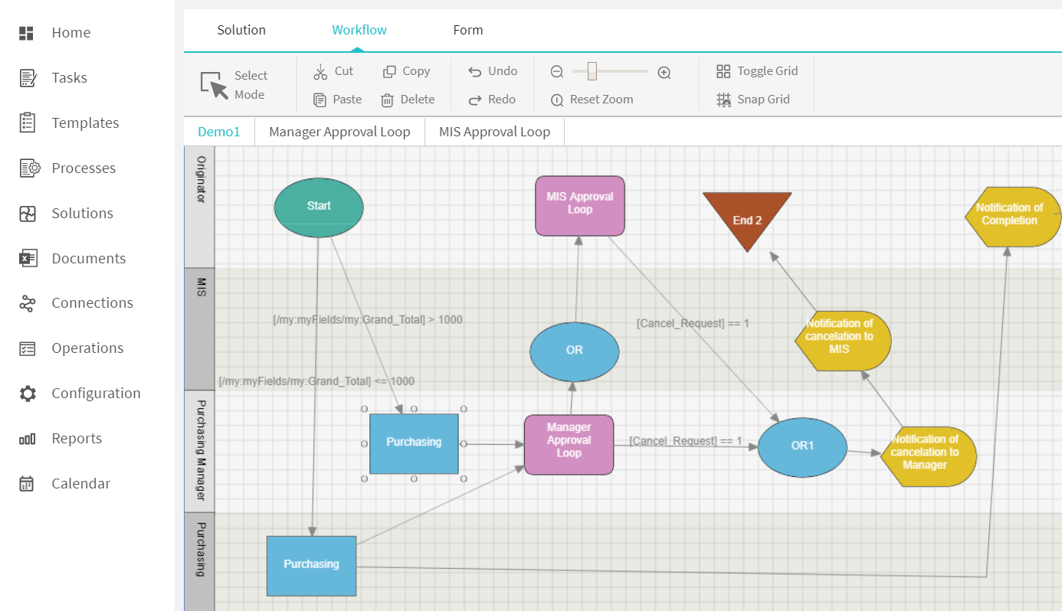
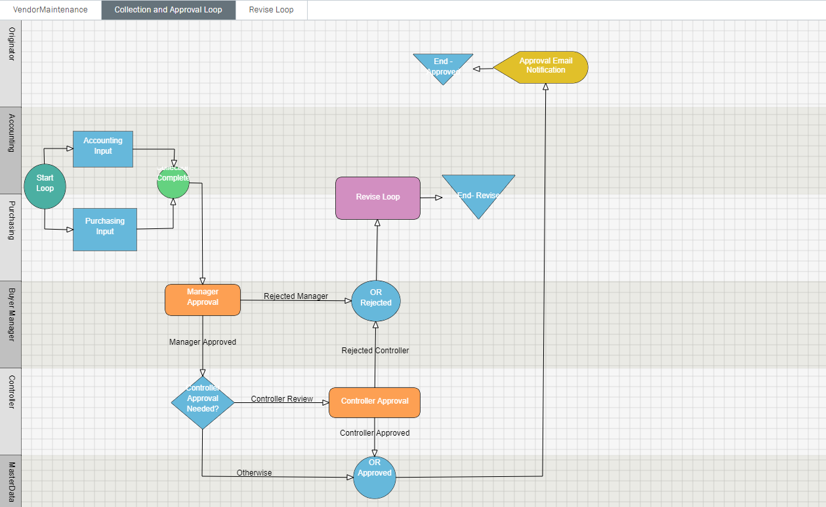
Reduce cycle times & improve compliance
Enterprise-grade workflow capabilities
Create parallel or sequential tasks
Create workflow loops
Setup task, approval, and past due, reminder, and escalation email notifications
Utilize bulk task reassignment and out-of-office functions
Collect supporting documents
Workflow Loops
Email Notifications
Parallel tasks
Notes:
Note to sales:
Use this slide to highlight some of the key features of our workflow capabilities and how we can enable customers to dramatically reduce cycle times and improve compliance.

Slide 27
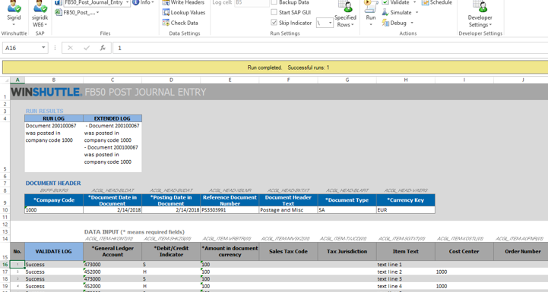
Accelerate Finance processes
Minimize journal entry errors and reduce your closing time
Validate data in real time before posting to SAP
Use ‘document splitting’ feature to upload journal entries with more than 999 lines
Safely download real-time SAP financial data for ad hoc analysis and custom reports
Notes:
Note to sales: For general accounting audiences this slide provides a high-level capabilities overview of the platform.
Precisely Automate helps accelerate many of your most tedious and manual accounting processes that support your period close.
Automating journal entries (including automatic document splitting)
Validating data against SAP before it is entered to improve data quality
Adhering to your SAP security and permissions for extracting ad hoc reporting data

Slide 28



Precisely Automate enterprise J/E solution delivers:
Excel
Workflow/ Approval Tracking
Scalability
Auto-posting
To reduce IT Engagement
Notes:
Precisely Automate J/E Enterprise Solutions delivers!!!:
Finance personnel manage SAP data using Excel(non-disruptive)
Central management and tracking of complex approval workflows (SOX Compliance)
Flexibility to scale as volume increases
Queuing and Auto-posting of approved data to SAP (Improve data quality)
Ability for business to manage SAP processes with limited IT engagement
Audience: BDM, SAP Analyst

Slide 29


It’s not just about saving time and achieving greater accuracy. Those are wonderful things, yes. But when people can eliminate mundane tasks and add greater value to the business, their job satisfaction increases.
SAP Professional
Pharmascience Inc.

Slide 30
What’s next for SAP automation?
Integration into larger, complex processes
Incorporation of AI and machine learning
Automating Fiori processes
Notes:
Benefits of Machine Learning
Improved data entry and decision-making process through recommendations
Improved data quality through ML-based checks
Create rules that are not possible without ML
Reduced effort and complexity to implement and update hard-coded rules
Reduced time to determine business rules
Reduced time to value in solution development

Slide 31

Let’s continue the conversation…
www.winshuttle.com
Demos
White Papers
Case Studies
Contact us
Set up a 30 minute personalized demo
info@winshuttle.com
Notes:
We would love to speak to you in more detail about your product data processes and how we can help you make an impact to your business , so please feel free to reach out to us.
Sample/Questions?
Can you also do Vendor and Customer masters too? Yes
I’m on S4 Hana will this work with my system? Yes
I have custom fields in my material master, does this work for those? Yes
We often have fields that the business is missing can you make them required even if SAP doesn’t require them? Yes

Slide 32
Questions!

