Slide 1
ERP Security 101: 5 Things Every Leader & Organization Should Be Doing to Secure ERP
Karl Batchelor & Steve Schliem – December 2022
Notes:
Hello I’m __________ from Onapsis and today I am going to talk about ERP Security 101 and 5 Things Every Leader & Organization Should Be Doing to Secure ERP
Now more than ever, hackers have the means, the resources and the motives to exploit and attack your organization’s most critical business systems. Ransomware attacks, application-specific vulnerabilities, such as Log4j & ICMAD, and attacks from threat actor groups, like Elephant Beetle, have introduced risk to organizations. In this session, you will learn about the growing threats to your business-critical applications, why defense-in-depth strategies are no longer as effective as they used to be and what you can do to ensure your organization is protected from these external threats.

Slide 2
Attacks Against ERP Applications Are Increasing in Frequency and Severity
2022
2021
6th DHS
US-CERT
ALERT
2020
PUBLIC EXPLOIT
64%
EXPLOIT TOOLKIT
SAP SolMan
SAP ICMAD Critical Vulnerabilities
OF ERP SYSTEMS HAVE BEEN BREACHED IN THE PAST 2 YEARS
SAP RFCpwn
2019
3RD DHS US-CERT ALERT
BigDebIT
5th DHS US-CERT ALERT
Oracle Vulnerabilities
2018
on malicious activity targeting SAP applications
for SAP 10KBLAZE Vulnerability
2017
2ND DHS US-CERT ALERT for SAP Business Applications
2016
INCREASED INTEREST ON DARK WEB
4th DHS US-CERT ALERT
1ST DHS US-CERT ALERT for SAP Business Applications
for SAP RECON Vulnerability
2015
Onapsis helps Oracle secure critical vulnerability in EBS
PAYDAY
2014
NATION- STATE SPONSORED
Oracle Vulnerabilities
2013
PUBLIC EXPLOIT
2012
CYBER
CRIMINALS
CREATING
MALWARE
Chinese breach of USIS targeted SAP
HACKTIVIST GROUPS
Chinese hacker exploits SAP NetWeaver
1st public exploit targeting SAP applications
SAP targeted malware discovered
Notes:
But before I start talking about what you can do to secure your ERP systems I’d like ot take a moment to understand the scope and significance of the challenge.
Goal of the slide: We just talked about how new challenges and initiatives around business-critical applications are introducing risk. Here we are showing that cyberattackers are taking advantage of that those risks and increasingly targeting these applications.
Example of how to introduce the slide: “This timeline shows that just as we’ve seen a lot of new dynamics around these applications over the past ten years, we’ve also seen an increase in cyberattacks. You can see how this tracks – these systems are being exposed to more risk and bad actors have taken notice.”
Supporting Concepts:
5 US CERT-Alerts in the past five years
IDC research found 64% of ERP systems (SAP or Oracle) were breached in the past two years
Sample Questions:
Were you aware that threat actors are starting to focus on business-critical applications?
Have you been following the recent CERT-Alerts around these applications?
If an issue were to occur, which part of the business would be most impacted?

Slide 3
Modern Enterprises Are Facing a Perfect Storm of Complexity...
Cloud
Digital Transformation
EVAPORATING THE PERIMETER
TO ENABLE REMOTE WORKERS, PARTNERS, SUPPLY CHAIN, ETC.
x
IT OPS
EXECUTIVES
x
FREQUENTLY FAVORING EXPEDIENCY NOT SECURITY
BUSINESS- CRITICAL APPS
COMPLIANCE & AUDIT
INFOSEC
x
x
DEVELOPMENT
Compliance
Threat Actors
DRIVING STRICTER AND MORE COMPLEX CONTROLS
EVOLVED TO TARGET MULTIPLE, NEW ATTACK VECTORS
x
Constant Change
DISRUPTING BUSINESS OPERATIONS
Notes:
Goal of the slide: Explain what we mean by interconnected risk. For a long time, people thought SAP was “safe” because it was on-premises / airgapped / behind network protection and attackers weren’t targeting it (e.g., didn’t know enough to do damage). However, that’s not the case anymore for the reasons outlined here. You can also use these items as conversation starters to ask about what projects they might have going on within their organization.
Example of how to introduce the slide: “Over the last ten years, we’ve seen a lot of change and new initiatives around these applications that has a lot of organizations taking a closer look at how they handle security and compliance. These are some of the challenges we’re hearing from organizations…”
Supporting Concepts:
More and more organizations moving their critical applications to the cloud, even compared to just a few years ago
Increasing regulations around financial and personal data that runs through these systems means there is an increasing burden to produce evidence that systems are compliant with these regulations
These applications are often undergoing change – e.g., routine maintenance and patching, modernization, new feature requests – and these changes can introduce risk (security, operational, compliance)
Threat of bad actors, both internal and external, that are going after an organization most important assets and data
All of these market dynamics combined means there are new threat vectors that put critical applications at risk
Also: Digital transformation or cloud could be an opportunity to discuss risk of interconnectivity from the extended enterprise (SaaS apps story)
Sample Questions:
Are these resonating with you? What are your largest challenges with [SAP, Oracle, Salesforce] today?
Is your organization moving / or already moved [SAP, Oracle] to the cloud? Are you concerned about keeping your critical applications secure in the cloud?

Slide 4
…And Are Overly Reliant on Traditional Defense-in-Depth Models That Surround But Don’t Secure ERP Systems
Attacks on the application layer are the #1 concern of CIOs, YoY
Over 70% say their application portfolio has become more vulnerable in the past year
Almost two-thirds of organizations have a backlog of app vulnerabilities
PERIMETER
NETWORK
ENDPOINT
APPLICATION
DATA
https://www.whitesourcesoftware.com/wp-content/media/2021/04/whitesource-ponemon-research-report.pdf
Notes:
Goal of the slide: Explain what traditional defense in depth model is and why it is not sufficient for the app layer -
Don’t Become Over-reliant on Older “Defense-in-Depth” Models - DiD models surrounded (but did not directly secure) the “crown jewels” (aka the ERP systems). However, digital transformation projects introduced new challenges for these models, with the eroding perimeter for ERP systems. - ERP systems are increasingly becoming internet-facing systems…with no security and dire consequences if exploited.
Example of how to introduce the slide: “Traditional Defense In Depth models have tried to solve this problem and protect the application layer and it’s critical core, the data center, with layers of security around it” But these layers can be breached and lateral movement within these layers can lead to an attack on the application layer. Additionally, the application layer itself is vulnerable - misconfigurations, misaligned user accounts, unapplied patches, all of these are vulnerabilities within applications themselves. It’s no wonder attacks on the application layer have been the primary concern of CIOs. Especially since nearly ⅔ of organizations have a backlog of application vulnerabilities.
Supporting Concepts:
Most vulnerability assessment tools don’t support business-critical applications like Oracle and SAP
Sample Questions:
What vulnerability assessment tools is your organization using?
What is the patch management process you have in place for keeping your business-critical systems patched?
Are you concerned your defense in depth is not adequately protecting your business-critical apps?
Source: Ponemon report https://www.whitesourcesoftware.com/wp-content/media/2021/04/whitesource-ponemon-research-report.pdf
https://www.gartner.com/en/newsroom/press-releases/2021-05-17-gartner-forecasts-worldwide-security-and-risk-managem

Slide 5
Security In Depth – Protect the Application Layer
All the solutions listed are in place to protect the APPLICATION LAYER!
Data is the Prize!
Most cybersecurity solutions do not provide a ROI
Cost of doing business
Onapsis brings efficiency/savings and increases security posture
Onapsis IS “The First & Last Line of Defense” for Bus. Critical Apps
LAYER 7
Application
LAYER 6
Presentation
Software
LAYER 5
Session
LAYER 4
Transport
LAYER 3
Network
LAYER 2
Data Link
Hardware
LAYER 1
Physical*
Application Layer ➔ Largest Surface Area for Attacks to Occur

Slide 6
This Means We May Have a Gap with Understanding The True Risk to Our ERP Systems…and Our Organization
Vulnerabilities?
Threat Monitoring?
Code Security?
ERP systems are frequently managed by other teams, with little to no visibility for InfoSec
More processes moving to SaaS applications
Increasing reliance on code or apps developed by contracted third-parties
No meaningful monitoring of ERP, with little to no visibility for the SOC
Reliance on manual log reviews to identify threat activity in ERPs
No ability to establish compensating controls
Security is frequently “bolt on” and not “built in”
Reliance on manual code reviews
Problems aren’t identified until they hit production
Notes:
Goal of the slide: Explain the implication of what we just discussed on the previous slide - their current approaches and tools don’t adequately support the critical application layer and that makes it difficult for organizations to build successful programs for these apps like they’ve done for other enterprise systems. This is an opportunity to use language that prospects are familiar with. They likely have solutions for these areas already (e.g., Tenable or Rapid7 for vulnerability management), but the problem is those existing tools don’t cover these applications.
Example of how to introduce the slide: “This leads to a practical problem - you have programs for vulnerability management, threat detection, app security testing for various other systems, but the tools you use for them don’t adequately support these critical applications like SAP and Oracle. This creates a lot of challenges when you try to address these fundamental security concepts for your business’s most important assets.”
Example of how to introduce each of the three areas on the slide:
Vulnerability management – this is about understanding the size and scope of risk within these applications
Threat detection and response - this is about monitoring your environment for both threats (e.g., we just showed how quickly the attack community can weaponize vulnerabilities, so if you can’t go in and patch right away you need to make sure you’re monitoring your systems and have a compensating control in place) and from a general hygiene perspective (e.g., monitoring user access and privileges)
Application security testing - this is about supporting / enabling DevSecOps practices
Sample Questions:
How do you currently do vulnerability management for your [SAP, Oracle, Salesforce]?
What is your process for staying up to date with any new vulnerabilities reported by [SAP, Oracle] or a government agency like DHS?
How do you handle threat monitoring for [SAP, Oracle, Salesforce]?
Are you using a SIEM? What data is collected there?
How are you identifying and investigating authorization and user access issues today?
Are you reviewing your custom code before releasing it to QA or Prod?
If any tools are being used today, which tools are being used to review custom code for quality and security issues?
How long does your code review process take today?
Supporting Concepts:
Vulnerability Management
Vulnerability management program does not currently include business-critical applications
No visibility into vulnerabilities and exploitable risk meaning potential issues with not meeting regulatory requirements
Vulnerabilities in SAP are managed by the BASIS team, InfoSec/Vuln Team has no visibility into their work/results
More business-critical processes are now running in SaaS applications, and there no processes to measure of how securely they are configured
Custom applications are developed by a third party and there is no visibility into how secure that code is
Creating reports on the security posture of my business-critical applications is manual and time consuming
Threat Detection & Response
No continuous monitoring of threat activity against business-critical applications
No or basic integration of security events for business-critical business applications into Security Operations Centers (SOC)
Lacking business-critical application incident and issue correlation with enterprise-wide security events for root cause analysis
Experiencing audit failures or expensive, time-consuming manual audit of logs
No visibility into user access abuse and privilege misuse
Application Security Testing
No ability to establish compensating controls for known vulnerabilities and potential zero-day threats
Manual code reviews are expensive, error-prone, and time-consuming
General code assessment tools do not support single vendor (SAP) technology
Lengthy review/approval processes results in incomplete check of code and project delays
Unable to accurately report on state of security/risk of custom code
Insecure and problematic code is only identified after it is deployed to production - very expensive to fix
High failure rate of new code deployed to production
Desire for security to be a consistent part of DevOps process, not a final check
Supporting SAP code issues stats (source – our Code Quality Benchmark eBook):
Average SAP system contains two million lines of custom code
1.1 critical security issues per 1,000 lines of custom code
1.1 critical performance issues per 1,000 lines of custom code
4.6 critical robustness issues per 1,000 lines of custom code
Stats sources:
1https://www.cpomagazine.com/cyber-security/application-security-backsliding-over-70-of-organizations-say-their-portfolio-is-more-vulnerable/
2https://www.helpnetsecurity.com/2019/10/15/privileged-user-abuse/

Slide 7
What Happens If You Don’t Fix This?
Data Loss or Breach
System Outages
Compliance Findings
Of breaches involved access to privileged account¹
Of security events caused operational outage that affected productivity³
Average yearly cost of business disruption due to non-compliance⁵
74%
52%
$5M
Of breaches are due to missing application patches²
over
Average yearly cost of fines and penalties due to non-compliance⁵
28%
$50k/
Average cost of ERP application downtime⁴
$2M
hour
Project Delays
Reputation Damage
Of cloud migrations are delayed due to security concerns⁶
Average decrease in stock price following a security breach⁷
52%
7.3%
¹Centrify
²DarkReading
³Fortinet
⁴Onapsis
⁵Ascent
⁶TechRepublic
⁷Forbes
Notes:
Goal of the slide: Show the potential business impact of leaving business-critical applications unprotected
Example of how to introduce the slide: “If you decide not to act on this, there are some considerations you should bear in mind. These are just a few examples from trusted resources like DarkReading, Centrify, Forbes, etc. that illustrate what happens if you don’t address the potential risks in your environment, including negative impacts on productive or availability and costs associated with non-compliance or downtime. Taking a closer look at how you approach security and compliance for your business-critical applications is something we strongly encourage all organizations to do. And in a few slides, we’ll go into the benefits of working with Onapsis and how you can avoid some of these negative consequences.”
Sample Questions:
If a major issue or downtime occurs with [SAP, Oracle], which part of your business would be the most impacted?
What are the important compliance requirements your business is subject to (SOX, GDPR, CCPA, etc.)?
Sources:
1 https://www.centrify.com/resources/industry-research/pam-survey/
2 https://www.darkreading.com/vulnerabilities---threats/missing-patches-misconfiguration-top-technical-breach-causes/d/d-id/1337410#:~:text=Nearly%2060%25%20of%20data%20breaches,or%20application%20patch%2C%20researchers%20report.
3 https://www.fortinet.com/content/dam/fortinet/assets/analyst-reports/report-cio-and-cybersecurity.pdf
4 https://www.onapsis.com/IDC-survey-ERP-security-assessment
5 https://www.ascentregtech.com/compliance/the-not-so-hidden-costs-of-compliance/ (full report: http://dynamic.globalscape.com/files/Whitepaper-The-True-Cost-of-Compliance-with-Data-Protection-Regulations.pdf)
6 https://www.techrepublic.com/article/73-of-cloud-migrations-take-a-year-or-longer-report-says/
7 https://www.forbes.com/sites/sergeiklebnikov/2019/11/06/companies-with-security-fails-dont-see-their-stocks-drop-as-much-according-to-report/?sh=e375b0a62e04

Slide 8
…And Five Things To Do Today
Treat Business-Critical Apps Like OT Critical Infrastructure
1
Timely Patch Management
2
Continuous Monitoring of Vulnerabilities and Threats to Your ERP Applications
3
Secure Your Custom Code in ERP Applications
4
Commit to Control and Governance
5
Notes:
Goal of the slide: Call out four key best practices as a takeaway for consideration
Example of how to introduce the slide: “And once you’ve thought about some of those considerations, here are four best practices as takeaways that you can implement to start answering those questions that I posted on the previous slide. “
First - treat your business critical applications like you would any other critical infrastructure - these applications are the core of your business and you should think about risk identification for them in the same way you would for your other critical infrastructure to your business since they “keep the lights on” to your business
Second - have a repeatable, scheduled, patch management process in place that is given priority. Don’t treat patching as something you will get around to eventually, prioritize, programitize and implement a program
Third - when you are building out a vulnerability management program across your organization, be sure it includes business critical systems - be sure that the tools you are using to scan for vulnerabilities also include these types of applications and that your risk identification, prioritization and mitigation strategy for vulnerabilities includes these applications
Fourth - Be sure you are not introducing new vulnerabilities into your environment by building security into your development cycle for these applications

Slide 9
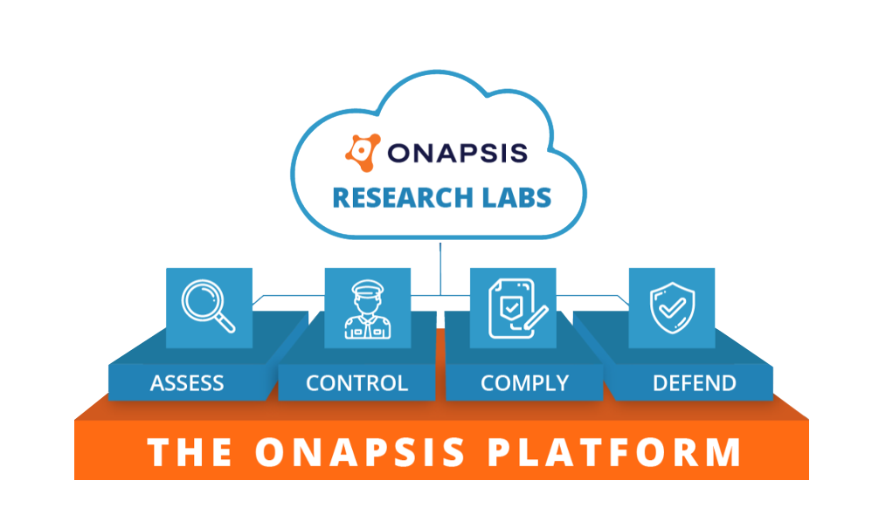
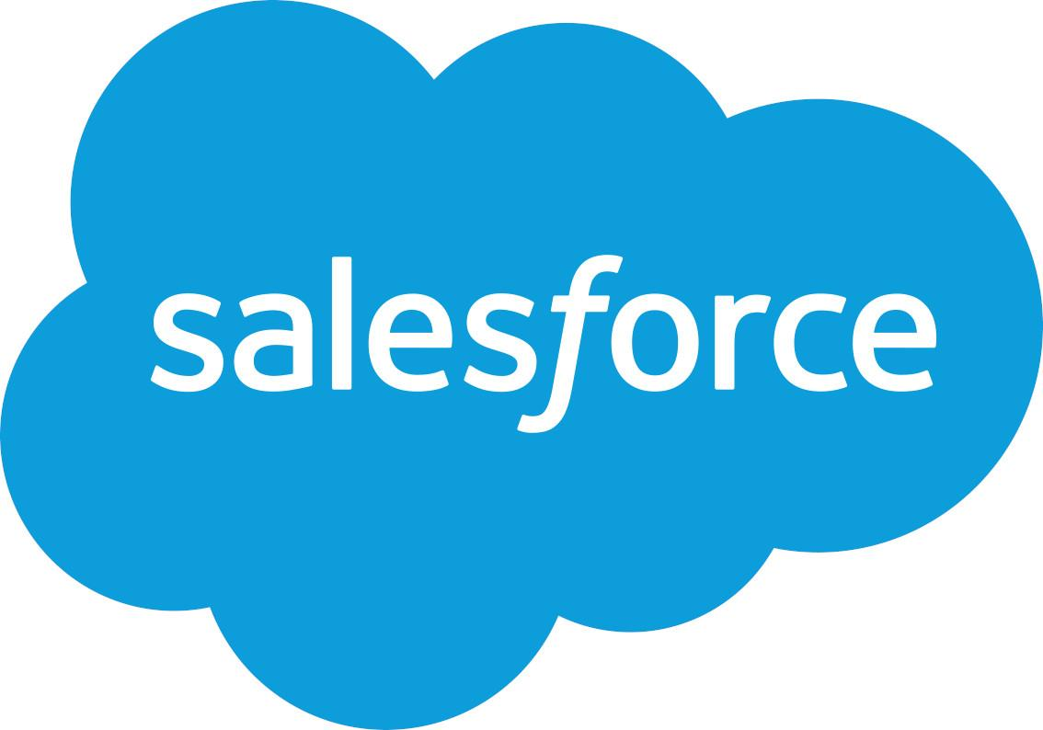
ONAPSIS GIVES YOU THE VISIBILITY AND TOOLS YOU NEED TO PROTECT YOUR BUSINESS-CRITICAL APPLICATIONS
CLOUD, ON-PREMISES OR HYBRID APPLICATIONS
Notes:
Goal of the slide: Introduce Onapsis solutions, how we address the pain points / challenges from earlier in the presentation, and how we can help organizations avoid the consequences from the previous slide
Example of how to introduce the slide and talk through the diagram: “The way that we’re doing this is through the Onapsis Platform. This structure here represents our approach to securing business-critical applications. At the foundation level, you can see we cover the extended enterprise – we’re talking about applications from SAP, Oracle, and Salesforce whether they live in the cloud, on-premises or in hybrid environments.
From there we have four product offerings: Assess – which does vulnerability management; Defend – provides threat monitoring; Control – supports DevSecOps; and Comply – which automates regulatory compliance requirements and helps organizations work toward continuous compliance. Many organizations start in one area and then expand through a maturity model – we’re happy to recommend the approach that might work best for you.
E.g., if you’ve been running on-premises for 20 years, vulnerability management is a great place to start – so you can understand existing risk
E.g., if you’re planning a greenfield implementation, it’s a great opportunity to look at the benefits of “shifting left” within the development organization and creating secure and high quality code from the start so you might want to start with our Control product
Finally, you’ll see Onapsis Research Labs, which is really the engine behind everything we do here and we’ll go into more details on that next.”
Sample Questions:
What do you see as your most pressing challenge to securing [SAP, Oracle, Salesforce]?
Are you working on any bigger transformation projects, like a cloud migration?
[IF SAP PROSPECT] What are your plans for moving to SAP S/4HANA?

Slide 10
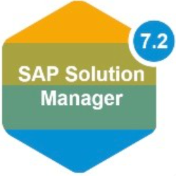
THE ONAPSIS PLATFORM | PRODUCTS & FUNCTIONALITY
ASSESS
DEFEND
CONTROL
COMPLY
Vulnerability Management
Continuous Threat Monitoring
Application Security Testing & Transport Inspection
Continuous Compliance
System misconfigurations, missing patches
Authorization issues, default accounts/roles
Assess if systems are configured in line with best practices
Real-time attack alerts
Monitor for exploits, user activity / transactions, privilege misuse
Alert for dangerous program executions
Identify security, compliance, and quality errors in SAP custom code
Identify SAP transports that would cause import errors, outages, downgrades, security or compliance issues
Evaluate compliance impact of system vulnerabilities, misconfigurations, patches, authorizations, deployed code (SAP)
Out-of-the-box & custom policies
Evaluate and verify IT controls
Integrations with SIEMs:
Integrations with change management and development environments:
Integrations with compliance automation solutions:
Integrations with workflow services:
SAP ChaRM, TMS, HANA Studio, Eclipse, Web IDE, ABAP development workbench
SAP Process Control
MANAGEMENT FUNCTIONALITY
Reporting & Analysis
Ticketing/SOC Integration
Scheduling & Workflows
Asset Discovery
Users & Role Management
Notes:
Goal of the slide: Provide a deeper dive into each of the core products within the Platform. This is an opportunity to cater the conversation to their specific pain points. You can spend more time on which product(s) addresses those and just provide a brief overview, if anything, for the others.
Example of how to introduce the slide: “This slide goes a little more in depth into the product offerings and functionality provided by the Onapsis Platform.”
Example of how to explain the bottom “Management Functionality” box: “At the bottom, you can see some of the core functionality provided by the platform, including reporting and analysis capabilities that make it easy to view trends and measure success, those integrations with ticketing systems and SIEMs that we talked about earlier, scheduling and workflows so you can easily assign tasks to people, asset discovery so you can inventory all assets in your landscape, and user roles so you can give permissions based on business need.”
Examples of how to talk through each of the product components; the key takeaways for each product:
Assess
Provides the ability to understand core vulnerability management tenets – system misconfigurations, missing patches, vulnerabilities that are available for exploitation – as well as authorization issues
Not just a list of problems, provides step-by-step instructions on how to fix
Can plug into existing workflows (e.g., via ServiceNow) so the correct people can go in and address them
Defend
Looks at your environment in real time
Going back to the small window between patch and exploitation attempts, you need a compensating control while your teams apply the patch / work on a remediation plan
If someone tries to take advantage of risk in your system, we’ll be able to trigger an alarm so you can take appropriate action
Can integrate with SIEMs / SOC so data about your business-critical apps can be correlated with other activity
Control
Gives the ability to shift left and support DevSecOps practices
Automates code and transport analysis throughout the application development lifecycle
Integrate into existing workbenches so developers can do their jobs faster and better
Comply
This is all about automating efforts around testing IT controls and collecting audit evidence
Automatically assesses application configurations, password requirements, access and authorization controls, etc. and helps you understand how errors in these areas can impact IT controls or compliance standards
Sample Questions
Do you think [product] would help solve some of those challenges you mentioned earlier? Do you see Onapsis fitting into your broader cybersecurity portfolio?
Are you interested in seeing a demo of these products in action?

Slide 11
Stay Ahead of the Threats With The World’s Leading Researchers
ONAPSIS RESEARCH LABS
Onapsis products automatically updated with latest threat intel and security guidance
Receive advanced notification on critical issues and improved configurations
Get pre-patch protection ahead of scheduled vendor updates
Discovered
1000+
zero-day vulnerabilities in business-critical apps
6
US DHS critical alerts based on our research
Knowledgebase of
10,000+
25%
vulnerabilities and attacks on business applications
17
Of critical SAP Security Notes in 2021 were influenced by Onapsis Research Labs
Patents, 8 issued & 9 pending
Notes:
Goal of the slide: Talk about Onapsis Research Labs a differentiator for us – we have a dedicated team focused just on business-critical applications; their threat intelligence allows us to be true experts in the space and thought leaders when it comes to educating both the general public and the vendors about threat, vulnerabilities, and best practices
Example of how to introduce and talk through the slide: “As I just mentioned, underpinning and powering the Onapsis Platform, and really everything we do here, is the Onapsis Research Labs, our team of cybersecurity experts that are dedicated to business-critical applications. You can see some of their achievements here, but a couple to call out – they’ve discovered over 800 zero-day vulnerabilities and multiple global CERT alerts have been based on their research. That evidence of hundreds of SAP exploits I mentioned earlier? That research came from this team. We automatically update our products with the latest threat intelligence and other security guidance from this team, so customers can stay ahead of that constantly evolving and growing threat landscape that we talked about earlier.”
Supporting Concepts:
Onapsis Research Labs works directly with SAP and Oracle product security teams to responsibly disclose this information so issues can be appropriately patches
Sample Questions:
What is your process for staying up to date with any new vulnerabilities as reported by [SAP, Oracle] or any government agency (e.g., DHS)?
How much time do you spend validating which patch you should apply?

Slide 12
1
…And Five Things To Do Today
Treat Business-Critical Apps Like OT Critical Infrastructure
1
Visibility and Risk = Inversely proportional
Increase Visibility and Assess Risk
Common Practice for critical Infrastructure
Onapsis Assess addresses Lack of Visibility all enterprise teams face
Providing focused and comprehensive vulnerability management business-critical applications from SAP
ASSESS
Notes:
Goal of the slide: Call out four key best practices as a takeaway for consideration
Example of how to introduce the slide: “And once you’ve thought about some of those considerations, here are four best practices as takeaways that you can implement to start answering those questions that I posted on the previous slide. “
First - treat your business critical applications like you would any other critical infrastructure - these applications are the core of your business and you should think about risk identification for them in the same way you would for your other critical infrastructure to your business since they “keep the lights on” to your business

Slide 13
2
…And Five Things To Do Today
Timely Patch Management
2
Patching is Difficult and Time Consuming
Create a Repeatable, Scheduled process
Map Critical & High Known Vulnerabilities into workflows for remediation
Onapsis Assess provides automated assessments with detailed solutions to help simplify the patching process
ASSESS
Notes:
Goal of the slide: Call out four key best practices as a takeaway for consideration
Example of how to introduce the slide: “And once you’ve thought about some of those considerations, here are four best practices as takeaways that you can implement to start answering those questions that I posted on the previous slide. “
Second - have a repeatable, scheduled, patch management process in place that is given priority. Don’t treat patching as something you will get around to eventually, prioritize, programitize and implement a program
Third - when you are building out a vulnerability management program across your organization, be sure it includes business critical systems - be sure that the tools you are using to scan for vulnerabilities also include these types of applications and that your risk identification, prioritization and mitigation strategy for vulnerabilities includes these applications
Fourth - Be sure you are not introducing new vulnerabilities into your environment by building security into your development cycle for these applications

Slide 14
3
…And Five Things To Do Today
Continuous Monitoring of Vulnerabilities and Threats to Your ERP Applications
3
Monitor INTERNAL, as well as External Threats
Including changes, critical transactions and user activity that introduces risk, exploit a vulnerability or takes org. out of compliance.
Driven by Onapsis Research Labs
Onapsis Defend enables real-time threat alerts to unauthorized changes, misuse, or cyberattacks targeting mission-critical apps
Hosted in cloud, hybrid and on-premises environments.
Critical for BTP, RISE, etc.
Integrates into commonly deployed SIEM systems
Pre-Patch Protection
DEFEND
Notes:
Goal of the slide: Call out four key best practices as a takeaway for consideration
Example of how to introduce the slide: “And once you’ve thought about some of those considerations, here are four best practices as takeaways that you can implement to start answering those questions that I posted on the previous slide. “
Third - when you are building out a vulnerability management program across your organization, be sure it includes business critical systems - be sure that the tools you are using to scan for vulnerabilities also include these types of applications and that your risk identification, prioritization and mitigation strategy for vulnerabilities includes these applications

Slide 15
4
…And Five Things To Do Today
Secure Your Custom Code in ERP Applications
4
Identify security, compliance, and quality errors in SAP custom code
Identify SAP transports that would cause import errors, outages, downgrades, security or compliance issues
Reduce Dev costs by 70%
Reduce insertion of Security Vulnerabilities by 75%
Real Time brings efficiency to DevSecOps
Onapsis Control for Code offers automated analysis of custom SAP code within integrated development environments (IDE) or from code repositories, whether developed in-house or from a third-party.
CONTROL
Notes:
Goal of the slide: Call out four key best practices as a takeaway for consideration
Example of how to introduce the slide: “And once you’ve thought about some of those considerations, here are four best practices as takeaways that you can implement to start answering those questions that I posted on the previous slide. “
Fourth - Be sure you are not introducing new vulnerabilities into your environment by building security into your development cycle for these applications

Slide 16
5
…And Five Things To Do Today
Commit to Control and Governance
5
GRC – Governance, Risk & Compliance
Process Controls, often an afterthought with Bus. Apps
Automate evidence collection to prepare for and support internal and external audits (e.g., SOX)
Onapsis Comply checks mission-critical applications against policies to define, identify and monitor risk that could impact cybersecurity, IT controls and compliance standards
Leverage out-of-the-box policies from Onapsis, and/or customize policies specific organization’s risk, cybersecurity and compliance standards
COMPLY
Notes:
Goal of the slide: Call out four key best practices as a takeaway for consideration
Example of how to introduce the slide: “And once you’ve thought about some of those considerations, here are four best practices as takeaways that you can implement to start answering those questions that I posted on the previous slide. “

Slide 17
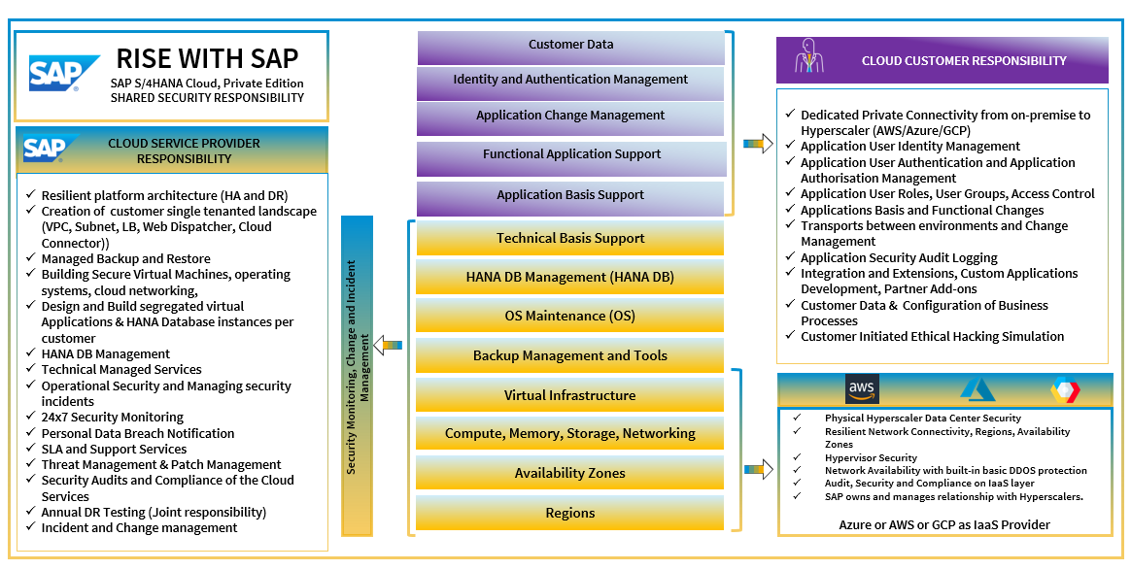
How Onapsis Assists Customers using RISE with SAP
Onapsis provides ability to address…

Slide 18
Fortune 500 Utility Company
COMPANY
2K Employees $2B revenue
INDUSTRY
Energy
CHALLENGE: A labor intensive patch and vulnerability management process created visibility and security gaps within SAP for a small team
Onapsis removes the mystery around SAP security by increasing visibility. We can see ...misconfigurations, missing patches or unusual user activity - what risk they post and how to fix them - CISO
SOLUTION: Onapsis Assess and Defend to scan and continuously monitor its SAP environment for vulnerabilities, misconfigurations, missed patches, and new threats.
RESULT: Gained visibility into SAP, including activity of third party contractors; streamlined and automated the patch and vulnerability management process, allowing the team to scale and refocus
Notes:
Customer: OG&E (Oklahoma Gas & Electric)
Use Case:Vulnerability Management
Gained visibility to assess and remediate vulnerabilities
State how this company used these FIVE practices to accomplish their goal of securing SAP

Slide 19
…Are we ready to complete our Five Tasks?
Treat Business-Critical Apps Like OT Critical Infrastructure
1
Timely Patch Management
2
Continuous Monitoring of Vulnerabilities and Threats to Your ERP Applications
3
Secure Your Custom Code in ERP Applications
4
Commit to Control and Governance
5
Notes:
Goal of the slide: Summarize and wrap up. Open up for questions on any of the five topics

Slide 20
Thank You!
U
karl.batchelor@onapsis.com
steve.schliem@onapsis.com
linkedin.com/company/onapsis

