Slide 1
Supercharging ECC and S/4HANA with the SAP Business Network
Othon Vazquez COO

Slide 2
About Optima
150+ Global Clients
80%+ Large Enterprises
20+
Industries
435,000+
Hours of quality
services delivered
440+
High Impact
Implementations
~3
implementations
per Client
What we do
SAP Spend
Management
SAP Content
Management

Slide 3
Client Success
Technology
Manufacturing
Utilities
Chemicals
Retail
Consumer Packaged Goods
Pharma/Medical
Transportation/Defense
Finance and Insurance
Construction
Oil and Gas
Public Sector

Slide 4
Business innovation is necessary for survival
Since 2000, 52% of companies in the Fortune 500 have gone out of business
From 1955 to 2011, it took Fortune 500 companies an average of 20 years to reach a billion-dollar valuation; today’s digital startups are getting there in four.
Businesses everywhere face unprecedented change, and the future will be dictated by those who innovate first.

Slide 5
Three key strategies with proven success
Companies from most industries are exploring new business models or have already evolved theirs to avoid disruption
Operational efficiency has become more important than ever as a key enabler for innovation
+SBMs & ESG strategies are not nice-to-haves anymore, today are a source of competitive advantage

Slide 6
S/4HANA is great
The best ERP in the world.
But an ERP is not enough to win today.

Slide 7
Imagine trying to run an intelligent enterprise…
… collaborating with suppliers via email, phone & paper
… having partial visibility of your supply chain with limited capacity to anticipate and resolve problems
… not being to take advantage of working capital optimization to invest in innovation
… missing the opportunity to proactively build a more sustainable supply chain on the go

Slide 8
Digital Transformation with
World’s Largest Business Network
8 M
Suppliers globally transact through this network
$ 4 T
Worth of money being transacted globally every year
270+ M
Documents are transacted globally in a year
14M
Global users are using this platform to simplify their business process
3000+
Customers across the globe have partnered with SAP to be part of this network
Connect, Transact and Collaborate in real-time

Slide 9
Three strategies to quickly supercharge your S/4HANA

Slide 10
Three strategies to quickly supercharge your S/4HANA
Efficiency
Maximize Operational efficiency by Digitizing B2B collaboration with the SAP Business Network (CA.F)
Indirect Spend
Customer Journey
Entry-point solution
Advanced solution
SBN Commerce Automation, Foundation
(SKU 8008113)
Best Practices
Rapid Deployment
Quick time to value
Indirect spend
SBN Commerce Automation
(SKU 8008788)
S/4HANA or SAP ECC
SAP Ariba Guided Buying (SKU 8008177)
SAP Ariba Sourcing (SKU 8007833)

Slide 11
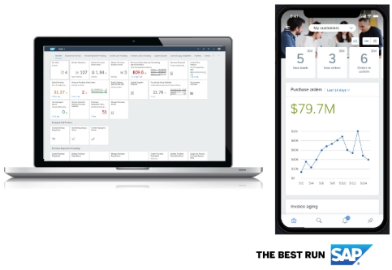
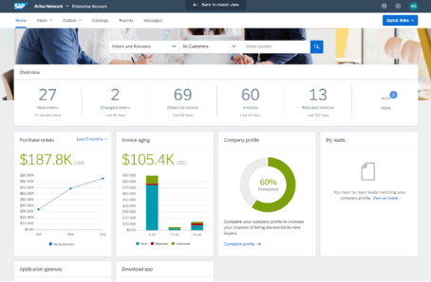
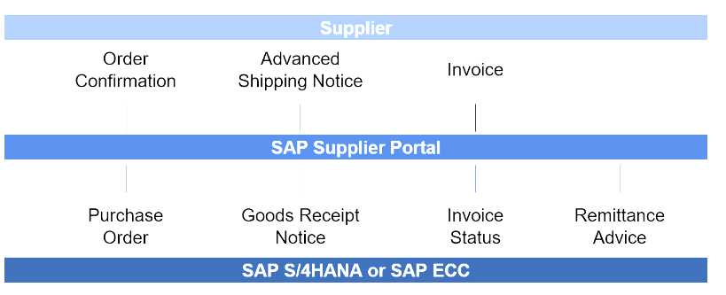
SAP Commerce Automation, Foundation (formerly DSN)
SAP Supplier Portal for customers running S/4HANA and SAP ECC – Indirect Spend
#1
An easy, frictionless way to Digitalize Transactions with suppliers from Day 1
#2
Reduce the costs of managing processes and speed up cycle times
#3
Improve Invoice Accuracy and Supplier Relationships
Smart
120+ Business Rules
SAP Business Network
Keys for Success:
Invoice Automation focus
Supplier Onboarding
Deployment Timeline: 8 – 12 Weeks

Slide 12
Three strategies to quickly supercharge your S/4HANA
Visibility
Improve your Supply Chain Visibility with the SAP Business Network (SCC.F)
Direct Spend
Customer Journey
Entry-point solution
Advanced solution
SBN Supply Chain Collaboration, Foundation
Best Practices
Rapid Deployment
Quick time to value
Direct spend
Supply Chain
SBN Supply Chain Collaboration
S/4HANA or SAP ECC
SAP Business Network for Logistics

Slide 13
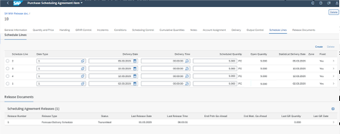
SAP Supply Chain Collaboration, Foundation (formerly DSN4SC)
Start automating collaboration with direct spend suppliers quickly and cost-effectively
#1
An easy, frictionless way to Digitalize Transactions with suppliers from Day 1
#2
Reduce the costs of managing processes and speed up cycle times
SCC Foundation
PO collaboration (PO,OC,ASN, GR)
Order confirmation approvals
Subcontracting PO without subsequent process steps
Scheduling agreement release collaboration (SAR, ASN, GR)
Due-shipments calculations (for rejected items)
SCC Monitor (deviations in quantity, dates and overdue OCs)
Return-PO
Invoice, ERS Invoice, Credit Memo, Payment:
#3
First step toward improving Supply Chain Visibility
Keys for Success:
Invoice Automation focus
Supplier Onboarding
Deployment Timeline: 10 to 14 Weeks

Slide 14
Three strategies to quickly supercharge your S/4HANA
Acquired by SAP (Mar 22’) – Not only Payables!
WCM & ESG
Leverage WCM programs to free up cash and improve supply chain ESG performance with Taulia (SAP’s SCF & DD)
Improve Visibility
Improve your Supply Chain Resilience and Visibility with the SAP Business Network (SCC)
Leverage WCM
Leverage WCM programs to free up cash and improve supply chain ESG performance with Taulia (SCF & DD)
SAP’s SCF and DD
Taulia Supply Chain Finance and Dynamic Discounting
S/4HANA or SAP ECC
Expected in SBN by Q1 23’

Slide 15
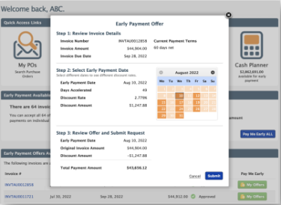
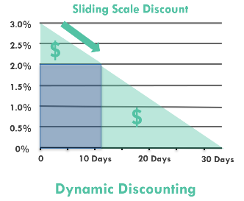
SAP Taulia Supply Chain Finance and Dynamic Discounting
Deploy a working capital optimization strategy according to your business needs
#1
Define the Working Capital Optimization Strategy you need to achieve your Business and ESG goals with Taulia
#2
Leverage Taulia’s WCM programs, (SCF & DD) to optimize your working capital and generate cash to reinvest in the business
#3
Build a more Sustainable SC by encouraging your suppliers to improve ESG performance with financial incentives
Keys for Success:
Program Strategy
ESG Goals
Supplier Adoption
Deployment Timeline: 8 to 12 Weeks

