Slide 1
The Threat Landscape is Transforming: Understand The Importance of Business-Critical Application Protection
Karl Batchelor & Steven Scheim

Slide 2
“Know thy self, know thy enemy.”
This principle addresses the importance of preparation, which begins with VISIBILITY – identifying business-critical assets and understanding and prioritizing risk.
“Subdue the enemy without fighting.”
Sun Tzu states the best tacticians are those who can control situations through intelligence and leverage information to dictate the choices of their adversaries.
Organizations need to establishes a complete understanding of its attack surface; it can then deploy security controls that protect critical assets.
Sun Tzu ‘The Art of War’ principles for Cybersecurity
Visibility and Risk are Inversely Proportional
Onapsis Increases Visibility into Business-Critical Apps

Slide 3
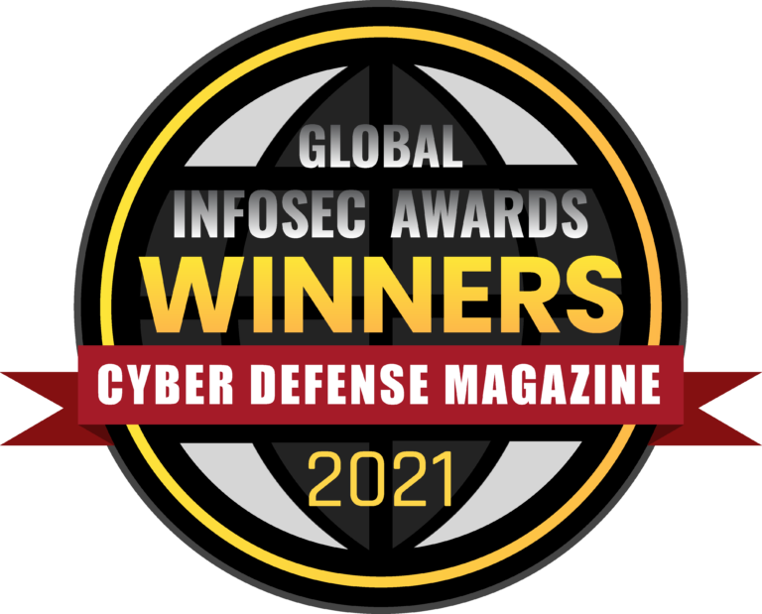
ONAPSIS HIGHLIGHTS
#1
Market Category Leader
400+ Global
Employees
300+ Customers, 20% Fortune100
94%
Customer Retention
Notes:
Goal of the slide: Highlight some differentiators for Onapsis
Example of how to introduce the slide: “Our company has been around for over a decade, focused specifically on business-critical application security – we’re the category king. We’re based in Boston, but we also have offices in Germany and Argentina. We’ve helped over 300 customers, including 20% of the Fortune100, secure their critical assets - and those are happy customers as you can see from our 94% retention rate.”
Sample Questions:
I’d love to talk about next steps. How can we move forward?

Slide 4
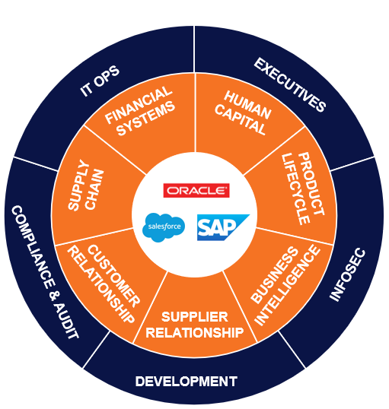
BUSINESS-CRITICAL APPLICATIONS POWER YOUR BUSINESS
92%
of the Global 2000 use SAP or Oracle¹
87%
of the world’s revenue touches these systems²
1 in 5
enterprise applications are SaaS-based³
Notes:
Goal of the slide: Establish what we mean by business-critical applications and their importance to organizations
Example of how to introduce the slide: “You might be wondering what we mean by business-critical applications and their importance within your ecosystem. We’re talking about the applications that help run your business – supporting financial systems, human capital management, supply chains, supplier relationships and more – like those from SAP, Oracle, and Salesforce. As highlighted in this diagram, given their critical nature, many stakeholders across the organization have a vested interest in these applications – whether that’s from a security perspective and trying to minimize risk, ensuring they’re meeting compliance standards, or just making sure they’re available and running properly to support the business.”
Sample Questions:
What types of applications are you running on [SAP, Oracle]?
How critical is [SAP/Oracle/Salesforce] for your business?
What are the most important business outcomes you rely on [SAP, Oracle] to deliver today?
What the Statistics Mean:
First two support why these are considered business-critical – their widespread use and how much revenue touches them
Last stat illustrates that many organizations are operating hybrid environments and using a combination of on-premises and SaaS apps to run these processes – emphasizes growing complexity of enterprise environments
Stat Sources:
https://www.sap.com/corporate/en/company.html?pdf-asset=4666ecdd-b67c-0010-82c7-eda71af511fa&page=1
https://www.sap.com/documents/2017/04/4666ecdd-b67c-0010-82c7-eda71af511fa.html#page=1
https://www.f5.com/company/blog/packing-up-and-moving-to-saas

Slide 5
BUT, WE’RE FACING A PERFECT STORM OF COMPLEXITY
Cloud
Digital Transformation
IS EVAPORATING THE PERIMETER
x
IT OPS
EXECUTIVES
x
FORCING VELOCITY NOT SECURITY
BUSINESS- CRITICAL APPS
COMPLIANCE & AUDIT
INFOSEC
x
x
DEVELOPMENT
Compliance
Cyberattackers
DRIVING STRICTER AND AUTOMATED CONTROLS
x
EVOLVED TO TARGET THE CORE
Constant Change
ERRORS CAN DISRUPT BUSINESS OPERATIONS
Notes:
Goal of the slide: Explain why the prospect needs to act now. For a long time, people thought SAP was “safe” because it was on-premises / airgapped / behind network protection and attackers weren’t targeting it (e.g., didn’t know enough to do damage). However, that’s not the case anymore for the reasons outlined here. You can also use these items as conversation starters to ask about what projects they might have going on within their organization.
Example of how to introduce the slide: “Over the last ten years, we’ve seen a lot of change and new initiatives around these applications that has a lot of organizations taking a closer look at how they handle security and compliance. These are some of the challenges we’re hearing from organizations…”
Supporting Concepts:
More and more organizations moving their critical applications to the cloud, even compared to just a few years ago
Increasing regulations around financial and personal data that runs through these systems means there is an increasing burden to produce evidence that systems are compliant with these regulations
These applications are often undergoing change – e.g., routine maintenance and patching, modernization, new feature requests – and these changes can introduce risk (security, operational, compliance)
Threat of bad actors, both internal and external, that are going after an organization most important assets and data
All of these market dynamics combined means there are new threat vectors that put critical applications at risk
Also: Digital transformation or cloud could be an opportunity to discuss risk of interconnectivity from the extended enterprise (SaaS apps story)
Sample Questions:
Are these resonating with you? What are your largest challenges with [SAP, Oracle, Salesforce] today?
Is your organization moving / or already moved [SAP, Oracle] to the cloud? Are you concerned about keeping your critical applications secure in the cloud?

Slide 6
AND ATTACKS ON BUSINESS-CRITICAL APPLICATIONS ARE INCREASING
64%
OF ERP SYSTEMS HAVE BEEN BREACHED IN THE PAST 2 YEARS
5 ALERTS
ON MALICIOUS CYBERACTIVITY OR VULNERABILITIES IN BUSINESS CRITICAL APPLICATIONS
IN 5 YEARS
Notes:
Goal of the slide: We just talked about how new challenges and initiatives around business-critical applications are introducing risk. Here we are showing that cyberattackers are taking advantage of that those risks and increasingly targeting these applications using two key stats.
Example of how to introduce the slide: “That complexity is exposing these systems to more risk and bad actors have taken notice. 64% of critical systems have been breached in the past two years and the US DHS has released 5 Cert Alerts on malicious cyberactivity targeting these applciations.”
Supporting Concepts:
5 US CERT-Alerts in the past five years
IDC research found 64% of ERP systems (SAP or Oracle) were breached in the past two years
Sample Questions:
Were you aware that threat actors are starting to focus on business-critical applications?
Have you been following the recent CERT-Alerts around these applications?
If an issue were to occur, which part of the business would be most impacted?

Slide 7
EVOLUTION OF BUSINESS-CRITICAL APPLICATION CYBERATTACKS
2022
2021
6th DHS
US-CERT
ALERT
2020
PUBLIC EXPLOIT
64%
EXPLOIT TOOLKIT
SAP SolMan
SAP ICMAD Critical Vulnerabilities
OF ERP SYSTEMS HAVE BEEN BREACHED IN THE PAST 2 YEARS
SAP RFCpwn
2019
3RD DHS US-CERT ALERT
BigDebIT
5th DHS US-CERT ALERT
Oracle Vulnerabilities
2018
on malicious activity targeting SAP applications
for SAP 10KBLAZE Vulnerability
2017
2ND DHS US-CERT ALERT for SAP Business Applications
2016
INCREASED INTEREST ON DARK WEB
4th DHS US-CERT ALERT
1ST DHS US-CERT ALERT for SAP Business Applications
for SAP RECON Vulnerability
2015
Onapsis helps Oracle secure critical vulnerability in EBS
PAYDAY
2014
NATION- STATE SPONSORED
Oracle Vulnerabilities
2013
PUBLIC EXPLOIT
2012
CYBER
CRIMINALS
CREATING
MALWARE
Chinese breach of USIS targeted SAP
HACKTIVIST GROUPS
Chinese hacker exploits SAP NetWeaver
1st public exploit targeting SAP applications
SAP targeted malware discovered
Notes:
Goal of the slide: We just talked about how new challenges and initiatives around business-critical applications are introducing risk. Here we are showing that cyberattackers are taking advantage of that those risks and increasingly targeting these applications.
Example of how to introduce the slide: “This timeline shows that just as we’ve seen a lot of new dynamics around these applications over the past ten years, we’ve also seen an increase in cyberattacks. You can see how this tracks – these systems are being exposed to more risk and bad actors have taken notice.”
Supporting Concepts:
5 US CERT-Alerts in the past five years
IDC research found 64% of ERP systems (SAP or Oracle) were breached in the past two years
Sample Questions:
Were you aware that threat actors are starting to focus on business-critical applications?
Have you been following the recent CERT-Alerts around these applications?
If an issue were to occur, which part of the business would be most impacted?

Slide 8
Threat Intelligence from Onapsis and SAP
400+
107+
18
THREAT ACTORS ARE MORE SOPHISTICATED...
...AND THE WINDOW TO DEFEND IS SHRINKING
CONFIRMED
EXPLOITATIONS
HANDS-ON ATTACKS
UNIQUE COUNTRIES
* may include VPS / TOR
<72hrs
<3hrs
SAP PATCH RELEASE TO EXPLOITATION
NEW SYSTEM ONLINE TO BEING EXPLOITED
Data based on direct observation of threat activity against OTIC, upon unmarked systems becoming online. Data is not based on exploitation on SAP customers’ environments.
Notes:
Goal of the slide: Provides evidence of why attacks have increased – not only has the threat landscape grown, but threat actors have gotten smarter (107+ hands-on attacks) and move quickly so the window to protect yourself is small (exploitation <72 hours of patch being released; <3 hrs to new systems deployed in IaaS being exploited)
Example of how to introduce the slide: “Recently we released new threat intelligence with SAP that showcases this increased threat activity. Not only has the threat landscape grown, but the attack community has gotten smarter. So much so, that you can see a tremendous amount of activity targeting SAP applications – over 400 confirmed exploitations of unprotected SAP applications over a six month time period. And the window to defend is shrinking, with exploit activity starting as early as 72 hours after a patch is released.”
Supporting Concepts:
Provides evidence to counter the theory that attackers don’t know enough about SAP to do damage – we found over a hundred examples of hands-on attacks
Shows how small the window for defenders is – critical vulnerabilities were weaponized in less than 72 hours of a patch release and new unprotected SAP applications provisioned in cloud (IaaS) environments being discovered and compromised in less than three hours.
Evidence of what we’ve been saying all along – these applications, the lifeblood of an organization, are being targeted by the attack community
Research from Onapsis Threat Intelligence Cloud released in conjunction with SAP
Data collected over 6 month time period
We published a threat report that goes into this research in detail and we’re happy to schedule a briefing where we can do a deeper dive
Sample Questions:
Is this resonating? Are you surprised at these numbers?
One key takeaway from the research is how fast these actors are moving, sot he question you should be asking your applications team is are you able to patch your production instances within 3 days of Patch Tuesday? If not, what type of risk does that leave you exposed to?

Slide 9
WHY AREN’T TYPICAL SECURITY EFFORTS EFFECTIVE HERE?
Defense-in-Depth Models Surround but Ultimately Neglect That Critical Application Layer.
Attacks on the application layer are the #1 concern of CIOs, which increased YoY
Over 70% say their application portfolio has become more vulnerable in the past year
Almost two-thirds of organizations have a backlog of application vulnerabilities
PERIMETER
NETWORK
ENDPOINT
APPLICATION
DATA
Notes:
Goal of slide: Explain why traditional security approaches aren’t effective at protecting their business-critical applications. Organizations spend a ton on security and we’re saying they’re still not doing enough? Here we are pointing out why - traditional approaches don’t cover the critical application layer, the application layer is growing increasingly complex and more vulnerable, and threat actors are targeting it directly.
Example of how to introduce slide: “What’s going on here? You’ve already made extensive security investments, so why aren’t they protecting these critical applications? The problem is that these traditional layered defense-in-depth models surround but ultimately neglect the application layer, leaving the applications more vulnerable than ever.”
Stat Sources:
Ponemon report https://www.whitesourcesoftware.com/wp-content/media/2021/04/whitesource-ponemon-research-report.pdf
https://www.gartner.com/en/newsroom/press-releases/2021-05-17-gartner-forecasts-worldwide-security-and-risk-managem

Slide 10
Security In Depth – Protect the application layer
Most cybersecurity solutions do not provide a ROI
Cost of doing business
All the solutions listed are in place to protect the APPLICATION LAYER!
Data is the Prize!
Onapsis IS “The First & Last Line of Defense” for Bus. Critical Apps
LAYER 7
Application
LAYER 6
Presentation
Software
LAYER 5
Session
LAYER 4
Transport
LAYER 3
Network
LAYER 2
Data Link
Hardware
LAYER 1
Physical*

Slide 11
THIS MEANS BUSINESS-CRITICAL APPS ARE EXCLUDED FROM EXISTING CYBERSECURITY PROGRAMS
VULNERABILITY MANAGEMENT
THREAT DETECTION & RESPONSE
APPLICATION SECURITY TESTING
Systems managed by other teams, no visibility for InfoSec
More processes moving to SaaS applications
Increasing reliance on third-party developed apps
No continuous monitoring, no visibility for SOC
Reliance on manual log reviews to identify threat activity
No ability to establish compensating controls
Reliance on manual code reviews
Problems aren’t identified until they hit production
Security is a final check, not built into DevOps process
57%
Unable to quickly identify vulnerabilities at application level¹
63%
Unable to monitor & prevent attacks at application level¹
79%
Do not build security features into app development¹
54%
Unable to effectively monitor privileged access²
¹https://www.cpomagazine.com/cyber-security/application-security-backsliding-over-70-of-organizations-say-their-portfolio-is-more-vulnerable/
²https://www.helpnetsecurity.com/2019/10/15/privileged-user-abuse/
Notes:
Goal of the slide: Explain why this problem exists – what holes do organizations have in their cybersecurity programs that are leaving their critical applications unprotected? This is also an opportunity to use language that prospects are familiar with. They likely have solutions for these areas already (e.g., Tenable or Rapid7 for vulnerability management), but the problem is those existing tools don’t cover these applications.
Example of how to introduce the slide: “Knowing all of this – the threat landscape is growing, attackers are getting smarter, and we know they’re targeting these applications – we’ve identified three key areas where business-critical applications are missing from existing programs or solutions within organizations’ cybersecurity portfolios. Looking at this, you might be thinking “I already have a solution for this”, but the problem is these applications we’re talking about generally aren’t covered.
Example of how to introduce each of the three areas on the slide:
Vulnerability management – this is about understanding the size and scope of risk within these applications
Threat detection and response - this is about monitoring your environment for both threats (e.g., we just showed how quickly the attack community can weaponize vulnerabilities, so if you can’t go in and patch right away you need to make sure you’re monitoring your systems and have a compensating control in place) and from a general hygiene perspective (e.g., monitoring user access and privileges)
Application security testing - this is about supporting / enabling DevSecOps practices
Sample Questions:
How do you currently do vulnerability management for your [SAP, Oracle, Salesforce]?
What is your process for staying up to date with any new vulnerabilities reported by [SAP, Oracle] or a government agency like DHS?
How do you handle threat monitoring for [SAP, Oracle, Salesforce]?
Are you using a SIEM? What data is collected there?
How are you identifying and investigating authorization and user access issues today?
Are you reviewing your custom code before releasing it to QA or Prod?
If any tools are being used today, which tools are being used to review custom code for quality and security issues?
How long does your code review process take today?
Supporting Concepts:
Vulnerability Management
Vulnerability management program does not currently include business-critical applications
No visibility into vulnerabilities and exploitable risk meaning potential issues with not meeting regulatory requirements
Vulnerabilities in SAP are managed by the BASIS team, InfoSec/Vuln Team has no visibility into their work/results
More business-critical processes are now running in SaaS applications, and there no processes to measure of how securely they are configured
Custom applications are developed by a third party and there is no visibility into how secure that code is
Creating reports on the security posture of my business-critical applications is manual and time consuming
Threat Detection & Response
No continuous monitoring of threat activity against business-critical applications
No or basic integration of security events for business-critical business applications into Security Operations Centers (SOC)
Lacking business-critical application incident and issue correlation with enterprise-wide security events for root cause analysis
Experiencing audit failures or expensive, time-consuming manual audit of logs
No visibility into user access abuse and privilege misuse
Application Security Testing
No ability to establish compensating controls for known vulnerabilities and potential zero-day threats
Manual code reviews are expensive, error-prone, and time-consuming
General code assessment tools do not support single vendor (SAP) technology
Lengthy review/approval processes results in incomplete check of code and project delays
Unable to accurately report on state of security/risk of custom code
Insecure and problematic code is only identified after it is deployed to production - very expensive to fix
High failure rate of new code deployed to production
Desire for security to be a consistent part of DevOps process, not a final check
Supporting SAP code issues stats (source – our Code Quality Benchmark eBook):
Average SAP system contains two million lines of custom code
1.1 critical security issues per 1,000 lines of custom code
1.1 critical performance issues per 1,000 lines of custom code
4.6 critical robustness issues per 1,000 lines of custom code
Stats sources:
1https://www.cpomagazine.com/cyber-security/application-security-backsliding-over-70-of-organizations-say-their-portfolio-is-more-vulnerable/
2https://www.helpnetsecurity.com/2019/10/15/privileged-user-abuse/

Slide 12
WHAT HAPPENS IF YOU DON’T FIX THIS?
Data Loss or Breach
System Outages
Compliance Findings
Of breaches involved access to privileged account¹
Of security events caused operational outage that affected productivity³
Average yearly cost of business disruption due to non-compliance⁵
74%
52%
$5M
Of breaches are due to missing application patches²
over
Average yearly cost of fines and penalties due to non-compliance⁵
28%
$50k/
Average cost of ERP application downtime⁴
$2M
hour
Project Delays
Reputation Damage
¹Centrify
²DarkReading
³Fortinet
⁴Onapsis
⁵Ascent
⁶TechRepublic
⁷Forbes
Of cloud migrations are delayed due to security concerns⁶
Average decrease in stock price following a security breach⁷
52%
7.3%
Notes:
Goal of the slide: Show the potential business impact of leaving business-critical applications unprotected
Example of how to introduce the slide: “If you decide not to act on this, there are some considerations you should bear in mind. These are just a few examples from trusted resources like DarkReading, Centrify, Forbes, etc. that illustrate what happens if you don’t address the potential risks in your environment, including negative impacts on productive or availability and costs associated with non-compliance or downtime. Taking a closer look at how you approach security and compliance for your business-critical applications is something we strongly encourage all organizations to do. And in a few slides, we’ll go into the benefits of working with Onapsis and how you can avoid some of these negative consequences.”
Sample Questions:
If a major issue or downtime occurs with [SAP, Oracle], which part of your business would be the most impacted?
What are the important compliance requirements your business is subject to (SOX, GDPR, CCPA, etc.)?
Sources:
1 https://www.centrify.com/resources/industry-research/pam-survey/
2 https://www.darkreading.com/vulnerabilities---threats/missing-patches-misconfiguration-top-technical-breach-causes/d/d-id/1337410#:~:text=Nearly%2060%25%20of%20data%20breaches,or%20application%20patch%2C%20researchers%20report.
3 https://www.fortinet.com/content/dam/fortinet/assets/analyst-reports/report-cio-and-cybersecurity.pdf
4 https://www.onapsis.com/IDC-survey-ERP-security-assessment
5 https://www.ascentregtech.com/compliance/the-not-so-hidden-costs-of-compliance/ (full report: http://dynamic.globalscape.com/files/Whitepaper-The-True-Cost-of-Compliance-with-Data-Protection-Regulations.pdf)
6 https://www.techrepublic.com/article/73-of-cloud-migrations-take-a-year-or-longer-report-says/
7 https://www.forbes.com/sites/sergeiklebnikov/2019/11/06/companies-with-security-fails-dont-see-their-stocks-drop-as-much-according-to-report/?sh=e375b0a62e04

Slide 13
STAY AHEAD OF EVER-EVOLVING CYBERSECURITY THREATS WITH THE WORLD’S LEADING THREAT RESEARCH ON BUSINESS-CRITICAL APPLICATIONS
ONAPSIS RESEARCH LABS
Onapsis products automatically updated with latest threat intel and security guidance
Receive advanced notification on critical issues and improved configurations
Get pre-patch protection ahead of scheduled vendor updates
Discovered
800+
zero-day vulnerabilities in business-critical apps
5
US DHS critical alerts based on our research
Knowledgebase of
10,000+
40%
vulnerabilities and attacks on business applications
17
Of critical SAP Security Notes in 2020 were influenced by Onapsis Research Labs
Patents, 8 issued & 9 pending
Notes:
Goal of the slide: Talk about Onapsis Research Labs a differentiator for us – we have a dedicated team focused just on business-critical applications; their threat intelligence allows us to be true experts in the space and thought leaders when it comes to educating both the general public and the vendors about threat, vulnerabilities, and best practices
Example of how to introduce and talk through the slide: “As I just mentioned, underpinning and powering the Onapsis Platform, and really everything we do here, is the Onapsis Research Labs, our team of cybersecurity experts that are dedicated to business-critical applications. You can see some of their achievements here, but a couple to call out – they’ve discovered over 800 zero-day vulnerabilities and multiple global CERT alerts have been based on their research. That evidence of hundreds of SAP exploits I mentioned earlier? That research came from this team. We automatically update our products with the latest threat intelligence and other security guidance from this team, so customers can stay ahead of that constantly evolving and growing threat landscape that we talked about earlier.”
Supporting Concepts:
Onapsis Research Labs works directly with SAP and Oracle product security teams to responsibly disclose this information so issues can be appropriately patches
Sample Questions:
What is your process for staying up to date with any new vulnerabilities as reported by [SAP, Oracle] or any government agency (e.g., DHS)?
How much time do you spend validating which patch you should apply?

Slide 14
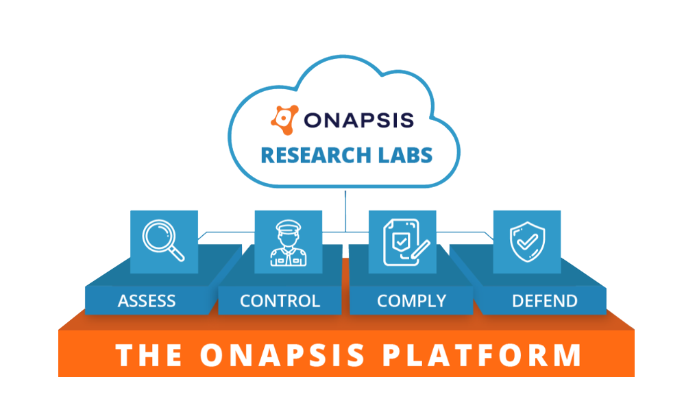
ONAPSIS GIVES YOU THE VISIBILITY AND TOOLS YOU NEED TO PROTECT YOUR BUSINESS-CRITICAL APPLICATIONS
CLOUD, ON-PREMISES OR HYBRID APPLICATIONS
Notes:
Goal of the slide: Introduce Onapsis solutions, how we address the pain points / challenges from earlier in the presentation, and how we can help organizations avoid the consequences from the previous slide
Example of how to introduce the slide and talk through the diagram: “The way that we’re doing this is through the Onapsis Platform. This structure here represents our approach to securing business-critical applications. At the foundation level, you can see we cover the extended enterprise – we’re talking about applications from SAP, Oracle, and Salesforce whether they live in the cloud, on-premises or in hybrid environments.
From there we have four product offerings: Assess – which does vulnerability management; Defend – provides threat monitoring; Control – supports DevSecOps; and Comply – which automates regulatory compliance requirements and helps organizations work toward continuous compliance. Many organizations start in one area and then expand through a maturity model – we’re happy to recommend the approach that might work best for you.
E.g., if you’ve been running on-premises for 20 years, vulnerability management is a great place to start – so you can understand existing risk
E.g., if you’re planning a greenfield implementation, it’s a great opportunity to look at the benefits of “shifting left” within the development organization and creating secure and high quality code from the start so you might want to start with our Control product
Finally, you’ll see Onapsis Research Labs, which is really the engine behind everything we do here and we’ll go into more details on that next.”
Sample Questions:
What do you see as your most pressing challenge to securing [SAP, Oracle, Salesforce]?
Are you working on any bigger transformation projects, like a cloud migration?
[IF SAP PROSPECT] What are your plans for moving to SAP S/4HANA?

Slide 15
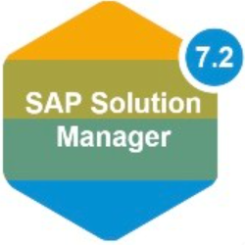
THE ONAPSIS PLATFORM | PRODUCTS & FUNCTIONALITY
ASSESS
DEFEND
CONTROL
COMPLY
Vulnerability Management
Continuous Threat Monitoring
Application Security Testing & Transport Inspection
Continuous Compliance
System misconfigurations, missing patches
Authorization issues, default accounts/roles
Assess if systems are configured in line with best practices
Real-time attack alerts
Monitor for exploits, user activity / transactions, privilege misuse
Alert for dangerous program executions
Identify security, compliance, and quality errors in SAP custom code
Identify SAP transports that would cause import errors, outages, downgrades, security or compliance issues
Evaluate compliance impact of system vulnerabilities, misconfigurations, patches, authorizations, deployed code (SAP)
Out-of-the-box & custom policies
Evaluate and verify IT controls
Integrations with SIEMs:
Integrations with change management and development environments:
Integrations with compliance automation solutions:
Integrations with workflow services:
SAP ChaRM, TMS, HANA Studio, Eclipse, Web IDE, ABAP development workbench
SAP Process Control
MANAGEMENT FUNCTIONALITY
Reporting & Analysis
Ticketing/SOC Integration
Scheduling & Workflows
Asset Discovery
Users & Role Management
Notes:
Goal of the slide: Provide a deeper dive into each of the core products within the Platform. This is an opportunity to cater the conversation to their specific pain points. You can spend more time on which product(s) addresses those and just provide a brief overview, if anything, for the others.
Example of how to introduce the slide: “This slide goes a little more in depth into the product offerings and functionality provided by the Onapsis Platform.”
Example of how to explain the bottom “Management Functionality” box: “At the bottom, you can see some of the core functionality provided by the platform, including reporting and analysis capabilities that make it easy to view trends and measure success, those integrations with ticketing systems and SIEMs that we talked about earlier, scheduling and workflows so you can easily assign tasks to people, asset discovery so you can inventory all assets in your landscape, and user roles so you can give permissions based on business need.”
Examples of how to talk through each of the product components; the key takeaways for each product:
Assess
Provides the ability to understand core vulnerability management tenets – system misconfigurations, missing patches, vulnerabilities that are available for exploitation – as well as authorization issues
Not just a list of problems, provides step-by-step instructions on how to fix
Can plug into existing workflows (e.g., via ServiceNow) so the correct people can go in and address them
Defend
Looks at your environment in real time
Going back to the small window between patch and exploitation attempts, you need a compensating control while your teams apply the patch / work on a remediation plan
If someone tries to take advantage of risk in your system, we’ll be able to trigger an alarm so you can take appropriate action
Can integrate with SIEMs / SOC so data about your business-critical apps can be correlated with other activity
Control
Gives the ability to shift left and support DevSecOps practices
Automates code and transport analysis throughout the application development lifecycle
Integrate into existing workbenches so developers can do their jobs faster and better
Comply
This is all about automating efforts around testing IT controls and collecting audit evidence
Automatically assesses application configurations, password requirements, access and authorization controls, etc. and helps you understand how errors in these areas can impact IT controls or compliance standards
Sample Questions
Do you think [product] would help solve some of those challenges you mentioned earlier? Do you see Onapsis fitting into your broader cybersecurity portfolio?
Are you interested in seeing a demo of these products in action?

Slide 16
WHY ONAPSIS?
Gain visibility into risk and business impact
Monitor for internal and external threats
Build security into app development lifecycle
Maintain compliance and enforce baselines
PROTECT YOUR BUSINESS-CRITICAL APPS.
PROTECT YOUR BUSINESS.
Notes:
Goal of the slide: Wrap up the presentation by summarizing the main ways we can help the prospect (i.e., our four main use cases)
Example of how to introduce the slide: “By moving forward with Onapsis, you’re able to gain:
Understanding and visibility where you previously weren’t able to see; you’ll understand holistic risk within your business-critical applications
The ability to continuously monitor for both internal and external threats
Shifting left and strengthening devsecops practices in your application development lifecycles; making sure changes aren’t introducing risk
Automation and clarity around what issues within your business-critical application controls prevent a system or process from passing compliance checks
Sample Questions:
I’d love to talk about next steps. How can we move forward?

Slide 17
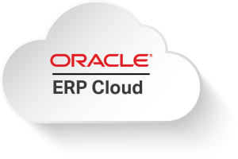
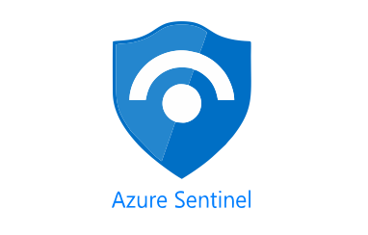
ONAPSIS PARTNERS | APPLICATION PROTECTION ECOSYSTEM
TECHNOLOGY ALLIANCES
CLOUD
PROVIDERS
SYSTEM INTEGRATORS
& MSSP
Notes:
The Onapsis partner program encompasses the world's most accomplished and trusted strategic alliances, consulting firms, systems integrators, MSSPs, resellers and technology providers.
They are professionals who can help you buy, implement, support, assess, analyze and remediate security and compliance gaps within your business-critical infrastructure.

Slide 18
THANK YOU
@onapsis
linkedin.com/company/onapsis

