Slide 1
The Precisely Automate Platform
Hyperautomation for complex, data-intensive SAP®️ processes
Name | Precisely
Notes:
Alternative Headlines:
-
Alternative Sub-Headlines:
Hyperautomation for your digital transformation dreams
Driving digital transformation success

Slide 2
Applying Hyperautomation to drive business success
Hyperautomation for complex, data-intensive SAP®️ processes
Andrew Hayden | Precisely
Notes:
Alternative Headlines:
-
Alternative Sub-Headlines:
Hyperautomation for your digital transformation dreams
Driving digital transformation success

Slide 3
Agenda: 2023 Automate platform
Why Automation?
Hyperautomation?
Why Precisely Automate?
Key Takeaways
Questions
Notes:
What are we going to talk about today…

Slide 4
Why Automation?
Notes:
Why is automation such a hot topic in the IT world these days? The pandemic showed many of the shortcomings of our decades of digital transformation efforts. We have spent years and countless dollars digitizing our data and processes, but when the pandemic hot, many of us were caught flatfooted by it’s limitations. As a result, we are now seeing that for many of us, the next step on our digital transformation journey is automating our critical business processes. Many of these are centered on SAP ERP systems and involve creating and managing master data.
Now, let’s look at the needs and wants that companies have coming out of the pandemic and how they can be addressed through automation.

Slide 5



Customer needs:
Be more agile
Go faster
Improve the quality and integrity of your most important data
Notes:
Talk track:
Coming out of the pandemic, many of the critical needs our companies have are the same as they were before the pandemic, but now there is a more urgent need to address them before we are faced with another sudden, existential disruption.
Talking with our customers we believe the three core needs that companies have, which can be addressed by automation are:
1.) The need to be more agile, with the ability to pivot and adapt when our businesses or markets are disrupted.
2.) We continue to need to go faster to meet competitive threats and keep up with the ever-accelerating changes we see in the marketplace
3.) We need to do these first two while improving the quality and integrity of our most important data – our master data. Since data has become the fuel we use to make critical business decisions, we need to make sure that it is of the highest quality and that we can rely on it.

Slide 6

Customer wants:
Optimize staff
Reach ROI faster
Realize Digital Transformation dream
Notes:
Talk track
In addition to the critical needs our businesses have, we also want to achieve a number of objectives that will help us remain competitive, these include:
1.) The desire to optimize our staffs – We have spent the better part of the past two decades right sizing, down sizing, and scaling our organizations to be as efficient as possible for today’s business conditions. The problem is that the market keeps evolving, and we gather more business-critical data every day. We want to find ways to help make the staff we have today more efficient and effective.
2.) We want to reach ROI faster. One of the early struggles with automation has been that it can be difficult to measure, or has a return on investment horizon that is too long to justify the up-front cost.

Slide 7

Accelerating digital transformation
Data is the fuel for decision-making today
$1.04 trillion spent
on Hyperautomation by 2026
80% of CEOs accelerating digital transformation
67% spending
more on technology than people
45% of enterprises using SAP are leveraging automation
Market is growing at 12% per year
Notes:
Gartner – And growing at 12% CAGR
KPMG
KPMG
ASUG
Gartner

Slide 8
- HfS Blog
Technology is a means to an end: Data is the currency of digital transformation
Notes:
This quote does a great job of summing up the importance of data in executing digital transformation. It sets up our discussion for the interdependence of process and data and sets Precisely apart from many of the other process automation providers.

Slide 9

Interdependence of process and data
Interdependence of process and data
Data
Process

Slide 10
Hyperautomation?
Notes:
Why is automation such a hot topic in the IT world these days? The pandemic showed many of the shortcomings of our decades of digital transformation efforts. We have spent years and countless dollars digitizing our data and processes, but when the pandemic hot, many of us were caught flatfooted by it’s limitations. As a result, we are now seeing that for many of us, the next step on our digital transformation journey is automating our critical business processes. Many of these are centered on SAP ERP systems and involve creating and managing master data.
Now, let’s look at the needs and wants that companies have coming out of the pandemic and how they can be addressed through automation.

Slide 11
Gartner
Hyperautomation is a business-driven, disciplined approach that organizations use to rapidly identify, vet and automate as many business and IT processes as possible. It involves the orchestrated use of multiple technologies, tools or platforms
Notes:
Gartner coined this term to represent a broader set of technologies, solutions and capabilities that were increasingly converging into a newer market than what used to be called the business process automation market.
Hyperautomation is a business-driven, disciplined approach that organizations use to rapidly identify, vet and automate as many business and IT processes as possible.
Note there is no single process automation technology that provides every capability required to deliver hyperautomation across an organization. For instance process mining isn't the same as process automation yet both are a part of the hyper automation market.
In many cases, selecting technologies is not about simply comparing one tool to another tool. Rather, customers are increasingly focused on determining the best combination of complementary technologies. Hyperautomation involves the orchestrated usage of multiple technologies. This means customers have a toolbox for automation and we need to fight for the right to be not just one of the tools in their automation toolbox but the selected tool for a given business problem.

Slide 12
Gartner
Do not try and make one tool answer all your organizations automation needs.
Notes:
This quote is from a number of years ago, but it still remains true. In the context of Hyperautomation, Gartner continues to recommend that companies adopt a best-of-breed approach to automation. In their own words “It [Hyperautomation] involves the orchestrated use of multiple technologies, tools or platforms”.
Adopting a Hyperautomation strategy means not getting locked into a single technology ecosystem or platform. Find the best, most flexible combination of technologies that are going to help you achieve your goals.

Slide 13
Robotics Program Director – Global beverage and spirits company
We have Blue Prism and Precisely Automate and we choose the best tool on a case-by-case basis.
Notes:
Remember what Gartner said about Hyperautomation: It involves the orchestrated use of multiple technologies, tools or platforms
This is one of our customers that are currently using Precisely Automate as well as a generic RPA solution. In this case, it’s Blue Prism but there are other examples where customers have chosen at least 2 automation tools— Precisely Automate for SAP processes and an RPA bot provider for non-SAP processes.
This was quoted during an RPA Automation Breakfast Hosted by PwC

Slide 14
Why Precisely Automate?

Slide 15


Precisely Automate Platform
Automate Evolve
Automate Studio
WORKFLOW-ENABLED PROCESS AUTOMATION
Automate and streamline SAP processes using workflows
Advanced form and workflow capabilities
Advanced data stewardship capabilities via web forms
Data automaton and management (Excel – SAP)
Extensive Audit and ROI reporting
Detailed process analytics
Process governance
Centralized management
Server-side file management and execution
Attended or unattended automation
Business-focused, low-code environment
STANDALONE DESKTOP
Exchange data with SAP quickly and easily using Excel
Data creation and maintenance
Data migration
Operational reporting
Data stewardship
+
Business users work
in Excel or web forms
Business users work in Excel
Notes:
Buying in to the Automate Platform gives you the combined capabilities of Evolve and Studio to deliver end-to-end automation for complex, data-intensive SAP-centric processes. When you adopt a Hyperautomation strategy as the heart of your digital transformation efforts, the Precisely Automate platform gives you a solid foundation on which to achieve tangible, measurable digital transformation and business goals.
In a few minutes we’ll talk more about the capabilities of the Precisely Automate platform and how they deliver on the promise of Hyperautomation.

Slide 16
A complete automation platform
Data Automation
Process Automation
Excel to SAP
Exchange data with SAP quickly and easily using Excel
Excel Workflow
Automate and accelerate SAP business processes through Excel file management workflows
Form & Workflow
Automate and accelerate SAP business processes with integrated forms and workflows
Notes:
Our Automate platform delivers a complete set of automation capabilities from data automation to complex process automation.
Data automation enables you to automate mass data creation and management activities such as pricing or materials changes using Excel.
On the process automation side
Excel workflow enables you to manage the data automation files through a complex workflow. A prime example of Excel workflow is for journal entries in finance. There is a good chance that you are already managing your journal entries in Excel. Excel workflow allows you to manage these Excel files through a contingent review and approval process that uses your business rules to determine the routing and approval process. And once the final approval is received, the data is automatically posted to SAP. No manual data entry at the end of the process.

Slide 17






The Automate platform delivers: Hyperautomation
Workflow
Connectivity (APIs)
Self-service
Data Management
Cloud deployment
Governance
Low-code development
Attended & unattended automation
Forms
Data quality
Notes:
One of the core, defining characteristics of Hyperautomation is the broad set of capabilities to look for when adopting a hyperautomation strategy. Let’s look at some of the featured capabilities that the Precisely Automate platform has which help it form the center of yout Hyperautomate strategy:
- Workflow is how we achieve flexible process automation and the workflow engine in the Precisely Automate platform has been specifically developed for complex, data-intensive SAP-centric processes
Connectivity through APIs enables you to automate complex processes where your SAP ERP system is the heart of a process that includes coordinating data across multiple systems of record, or where the data needs further enhancing from third-party sources
Self-Service capabilities help further enhance automated processes by allowing outside parties to contribute to the process. A great example of this are portals that allow constituents, such as vendors, to access, enhance or modify their SAP data through a secure web page. This can kick off a workflow to review and approve the data, or directly post data to your system.
Data Management automate and streamlines mass-data processes
Cloud Deployment to support your company’s move to the cloud activities and better connect to multiple SaaS platforms that are engaged in SAP-centric processes.
Governance often presents one of the greatest challenges to manual data management processes and to automated processes that rely on multiple technologies to automate a single process. By adopting a centralized approach to automation, you can achieve end-to-end governance for improved visibility and auditability of complex, data-intensive processes
Low-code development which is often referred to as “citizen development” enables business teams to develop and deploy automation solutions, relieving much of the burden from our often overworked IT teams. And, by moving the automation development process closer to the people who own the processes and data, it can significantly lower the time it takes to deploy automation across your business.
Attended & unattended automation recognizes that while there are processes we can automate that do not require human intervention (unattended), many of the complex processes that are core to the success of our business are “human in the loop” meaning that people are required to input, review or modify data. Having the flexibility to develop solutions for both attended and unattended scenarios can give more flexibility than solutions centered on unattended processes.
Forms are perfect for complex processes that require input from multiple parties across your organization. For example, creating a new vendor in your SAP system, often requires data or review from people in multiple departments either in parallel or sequentially. By deploying role-based forms, you are just requesting or displaying the information that an individual needs to see at a [particular stage of the process. The ability to quickly develop and deploy forms in an automated process can improves efficiency in multiple ways.
Data Quality - Finally we get to improved data quality. We talked earlier about the interdependence of process and data in achieving automation success. With data stewardship integrated throughout a complex automated process, the Precisely Automate platform offers a more comprehensive set of data quality tools than automation tools that are only focused on process automation.
As a complete set of capabilities, the Precisely Automate platform is the right combination of capabilities on which to center your Hyperautomation strategy and build for success.

Slide 18
Precisely supports the Digital Transformation journey
Automation
AI/ML
End-to-end process integration
Business Networks and
cross-company collaboration
SAP Master Data
processes
Cloud
User Experience
Process Intelligence
Self-service
Digitalization
Notes:
In this vast market each player has its specific strength and focus. Remember there is no single Hyperautomation technology but Hyperautomation means bringing multiple tools together in an orchestrated way. Orchestrated means to find the best tool for a specific set of business problems. SAP Build Process Automation, Microsoft Power Automate and Evolve might be in the same market all delivering benefits like speed, agility, compliance etc but all with a different focus and ours are the data-intensive processes, specifically the SAP Master Data processes that require a combination of Process automation, Digitalization and Data Stewardship.
And the good news is that we have our clear strength and the experience to stake our claim in this attractive market. Evolve is much more than just an Automation platform. It supports Digital Transformation not only through Workflow Automation and Digitalization, but with our APIs, Portals, Forms and SaaS offering also for End-to-end process integration, cloud capabilities, self-service and User Experience. What we see is that customers are looking for these benefits and this is where we provide value to customers in the Hyperautomation market.
We are well positioned to win in the market with a combination of relevant capabilities and a clearly defined focus that helps customers to choose us for their Hyperautomation initiatives. And Andrew will talk about how to position Evolve in his GTM session tomorrow.

Slide 19
Automate platform: Benefits
Agility
Speed
Improved data quality
Process visibility
Business team focus
Automation flexibility
Scalability
Proven track record
Notes:
Agility to quickly adapt to changes in your business environment through flexible workflow automation
Also – Low code/no code environment enables faster solution development through citizen development
Speed for faster, more efficient processes
Improved initial data quality through elimination of manual data entry and integrated data stewardship capabilities
Visibility throughout a complex process for:
Reporting
Process Intelligence
Process linking - real-time process tracking (Does this get called out separately?)
Audit support
Historical comparison/analysis
Business team focus – Low code/no code environment enables business teams and those closest to a process to develop automation solutions
Automation flexibility - to determine best automation route (attended vs unattended, form or Excel interface, connection to other systems of record through APIs for end-to-end process automation)
Scalability to process almost any amount of SAP data as needed by a process step
Proven track record – Nearly twenty years of SAP ERP process automation success has demonstrated why Evolve is the leading process automation platform/solution for thousands of customers world-wide.

Slide 20
Empowering business teams to make an impact
Notes:
Mention citizen development and our history of enabling business teams to develop and deploy automation

Slide 21




Automate business-critical data processes and any business process across your SAP landscape
Materials management & product launches
Customer onboarding & maintenance
Vendor onboarding & maintenance
Finance & accounting data and processes
Plant maintenance assets, plans & processes
Notes:
Note to sales:
You don’t need to go through each of these features on the slide. There are corresponding slides to each of these in section 2 of the slide library. The key message to get across here is that we’ve assembled a unique combination of features based on many years of experience. This feature set is specifically designed to solve the challenges around automating the creation and maintenance of strategic data assets.

Slide 22
All use cases
Eliminate
Improve
Manual data entry
Agility and speed
Improve team productivity
Initial data quality
Data quality & governance
Eliminate manual data entry errors
Standard features delivering value across the Automate platform
Citizen Development
Stewardship
No code/Low code platform
Fewer IT resources needed
Faster time to implement
Develop closer to the process owners
Integrated into the platform
Process governance
Data validation throughout
Notes:
Note, these are common benefits that the Automate platform delivers across use cases and business functions
Other features/benefits
Ability to develop solutions that work across the entire SAP ERP landscape
Studio template library
Professional and Strategic Services available through Precisely
Active and engaged online community

Slide 23
Materials
50%-75%
90%
Reduction in time to market
Agility and speed
Increases competitive advantage
Reduction in cost to process materials changes
Lower costs
Maintain current staffing levels
Faster ROI
Examples of the Automate Platform delivering customer value delivered through material master and related processes
90%
$1.3 million
Time reduction in materials data collection
Agility and Speed
Increased competitive advantage
Savings in materials management productivity
Measurable ROI
Optimize process
Notes:
50-75% reduction in time to market (Monster) (Note: Cannot use Monster name in marketing or promotional materials)
90% reduction in cost to process materials changes (Dorman)
90% reduction in materials data collection time (Cooper Tires)
$1.3M productivity savings in materials management (PACTIV)

Slide 24
Customer & Vendor
97%
6 Days
Reduction in time to create a customer
Agility and speed
Increases competitive advantage
Eliminated from customer create process
Speed
Improved employee productivity
How the Automate Platform is helping SAP enterprises optimize customer and vendor management
87%
75%
Reduction in time needed to qualify vendors and materials
Speed
Process visibility
Improved productivity
Reduction in SAP data entry time
Agility and speed
Improved process efficiency
Notes:
97% reduction in time to create new customer (Exxon Mobile) (NOTE: Cannot use EM name in marketing or promotions)
6 Days eliminated from customer create process (Multinational oil & Gas company – Not Exxon Mobile)
87% reduction in time needed to qualify vendors and materials (Ascend Performance Materials) (2 years to 3 months)
75% reduction in SAP data entry time (Multinational Oil and Gas company)

Slide 25
Other Use cases
9 months
1.4 Million
Return on investment in Automate
Measurable ROI
Sustainable approach to automation
Pricing records changed with no additional headcount
Agility
Improved staff productivity
Value delivered through the Automate platform across the SAP landscape
Replace paper
20,000
with online Evolve forms for processing customer refunds
Improved customer satisfaction
Increased process visibility
Reduced time of refund by up to three weeks
Journal entries processed during 4-day close window
Speed and improved data quality
Auditability
Team continued to work in Excel
Notes:
9 months to realize full return on investment in Studio from improved accounting efficiency (Global logistics company)
1.4 million pricing-change records processed – no additional headcount needed (Home Meridian) (Note: Cannot use Home Meridian name in marketing or promotional materials)
Replaced paper forms with online forms for processing customer refunds (RSA Insurance) (Note: Cannot use RSA name in marketing or promotional materials)
300 Journal entries per hour using Excel Workflow (McKesson) (Note: Cannot use McKesson name in marketing or promotional materials)

Slide 26
Key Takeaways
Hyperautomation is not a single solution: “It involves the orchestrated use of multiple technologies, tools or platforms”
Automation success depends on equal consideration of process and data
The Precisely Automate platform has the capabilities to be the heart of a successful Hyperautomation strategy
We have an established track record of delivering automation success for our customers
Our focus is on complex, data-intensive, master data use cases that are centered on SAP ERP
Hyperautomation success depends on adopting a best-of-breed portfolio approach

Slide 27

Winshuttle is now part of Precisely,
the leader in data integrity

Slide 28









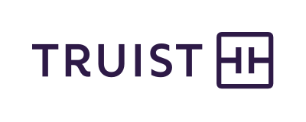

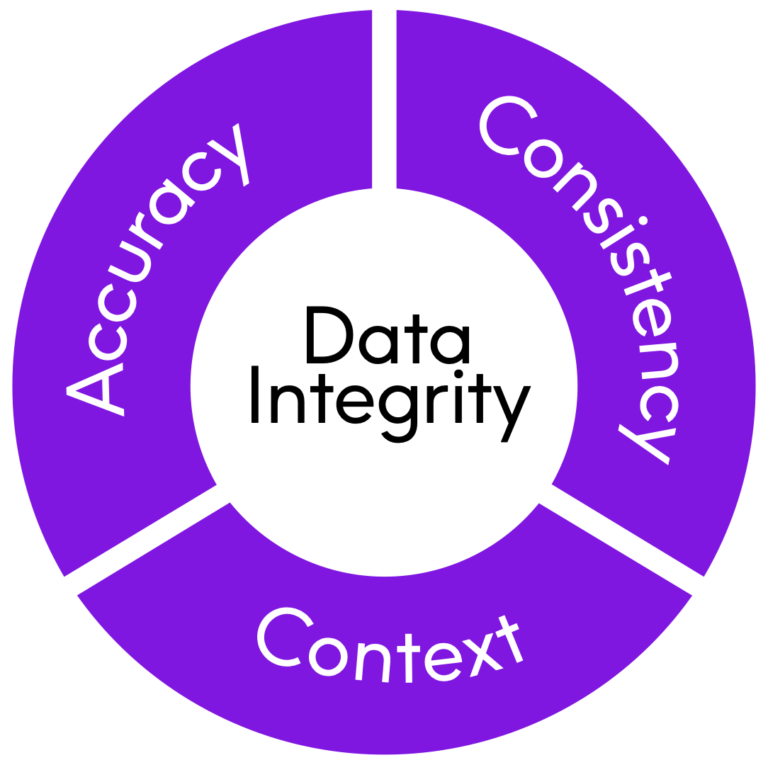















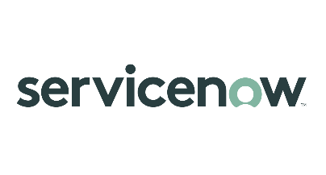






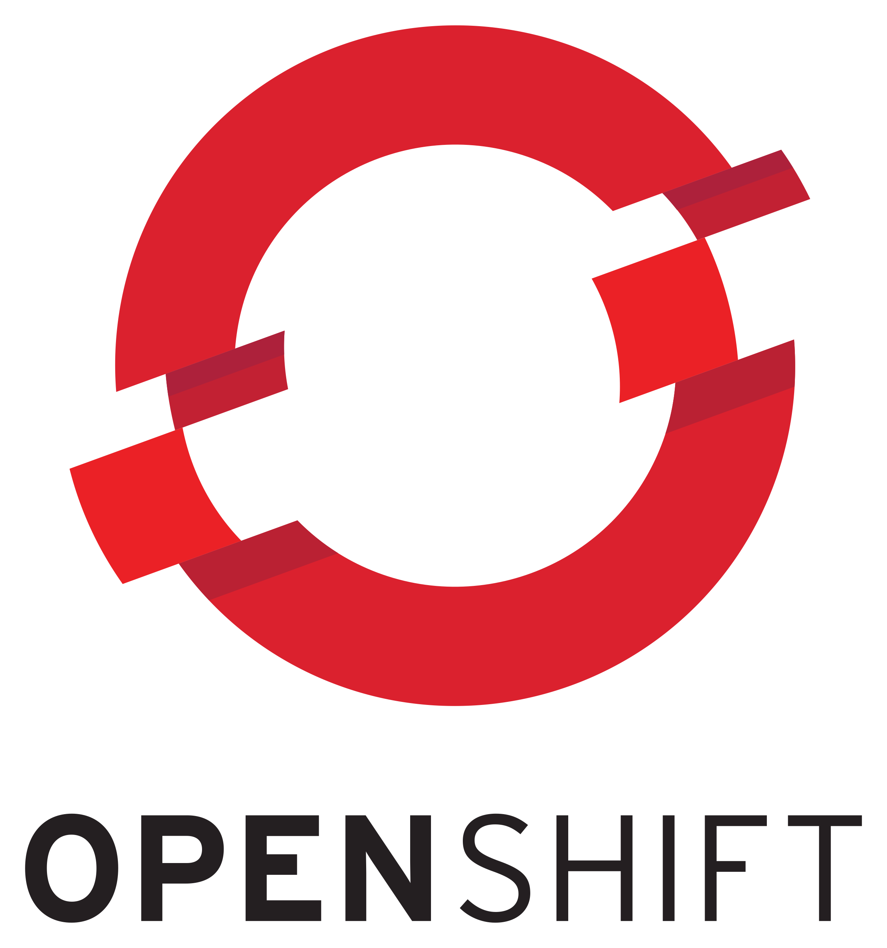


overall_0_132182146847412339 columns_1_132180489003760538 6_1_132180670009245741
Brands you trust, trust us
Integrate
Verify
The global leader
in data integrity software
Our data integrity software, data enrichment products, and strategic services deliver accuracy, consistency, and context to power confident business decisions.
Data
Integrity
Suite
Enrich
Locate
Data leaders partner with us
12,000
99
customers
of the Fortune 100
2,500
Customers in more than
100
countries
employees

Slide 29
Questions?

Slide 30
Thank you!

