Slide 1
Answer the data challenges for SMEs in 2024
ASUG Chicago Chapter Meeting
Chicago IL March 14, 2024
Peter Huegel Customer Solutions Architect

Slide 2
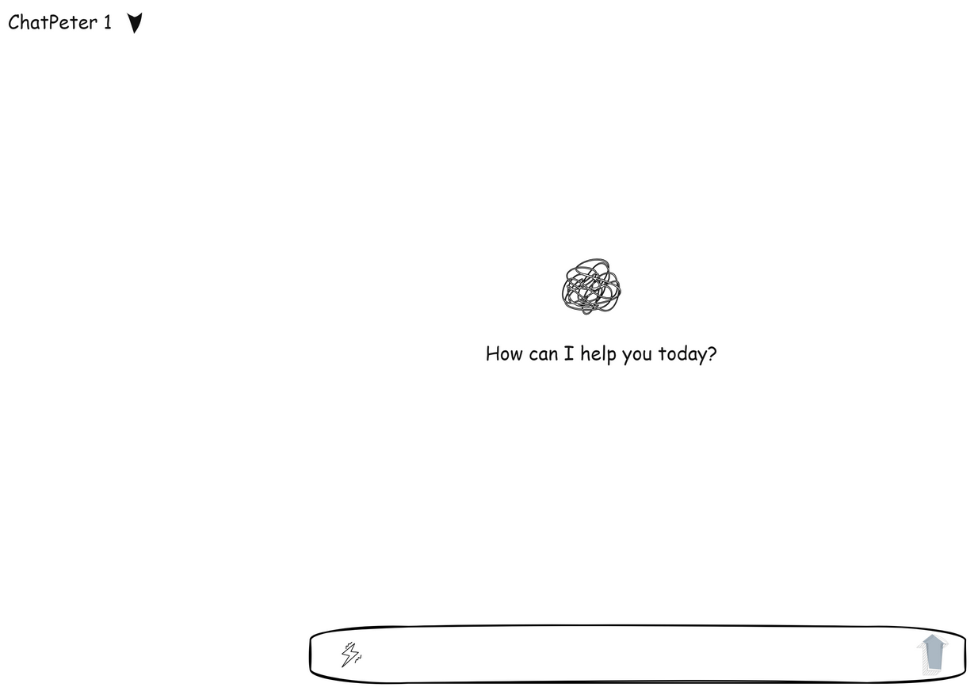

Slide 3
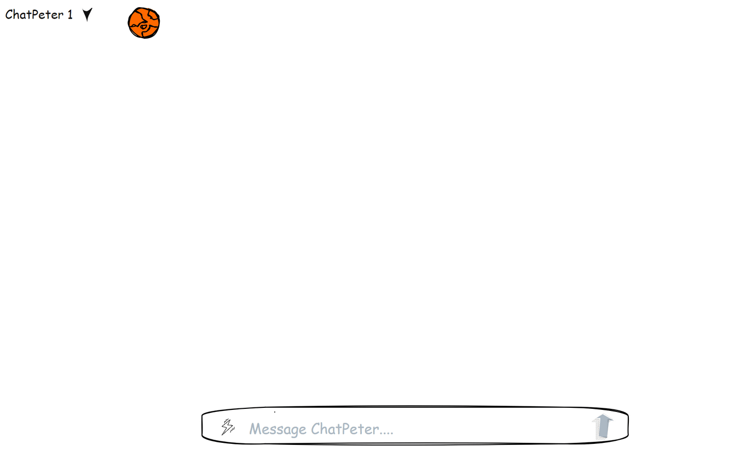

Slide 5
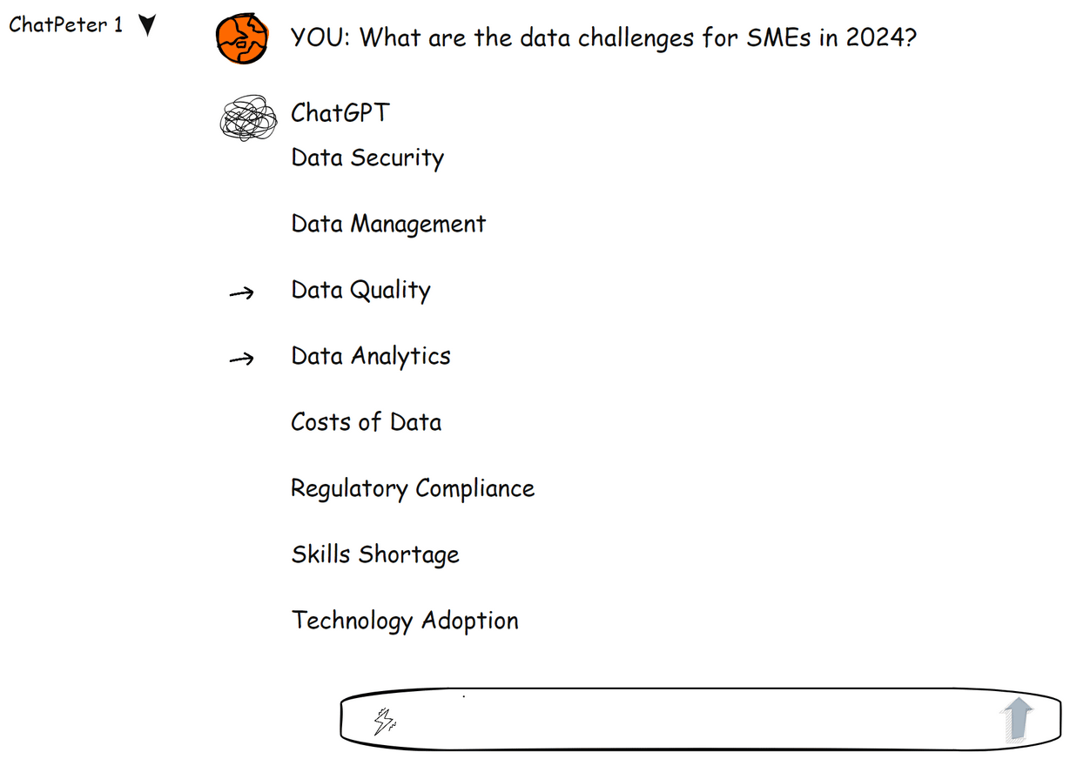

Slide 8
How do we get to Plan A then?
Let’s call this plan B
as this is usually not the default SME approach
Starting position:
Generative AI will not fix your data challenges,
but quality data is needed to get (any) AI going
Conclusion:
Data quality should be the priority
Everything else must follow

Slide 9
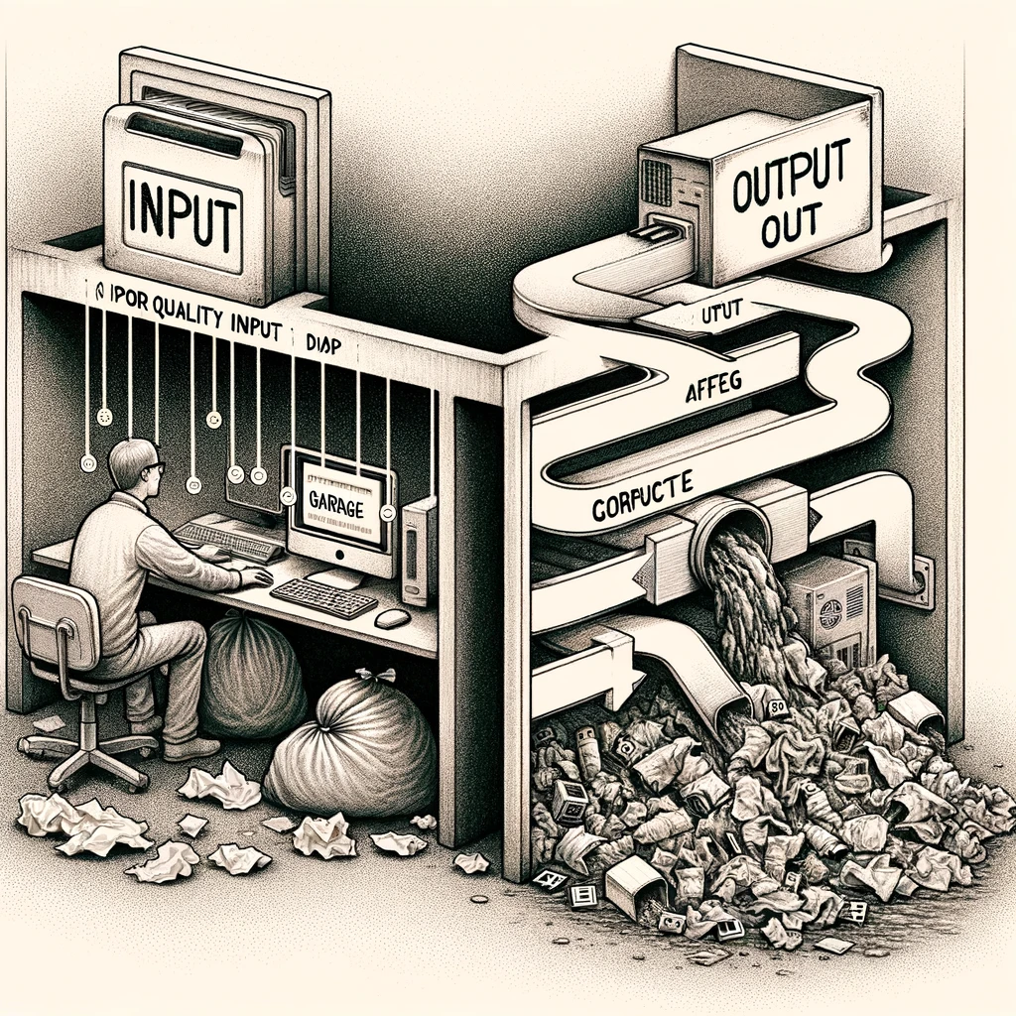
Why emphasizing Data Quality?
Data quality defined as <The right data, at the right moment, at the right place >
is the driver for the success in production, inventory, sales, analytics and AI projects.
Garbage in – Garbage out is still a thing.
Created by DALL.E based on this quote

Slide 10
How do data and (Generative) AI relate?
Let me let Generative AI draw us a picture to explain
AI using sound data
AI using subpar data
Prompt: ‚Draw a sketch of a basketball slam dunk, pls.‘

Slide 11
This is what a Plan A can look like

Slide 12
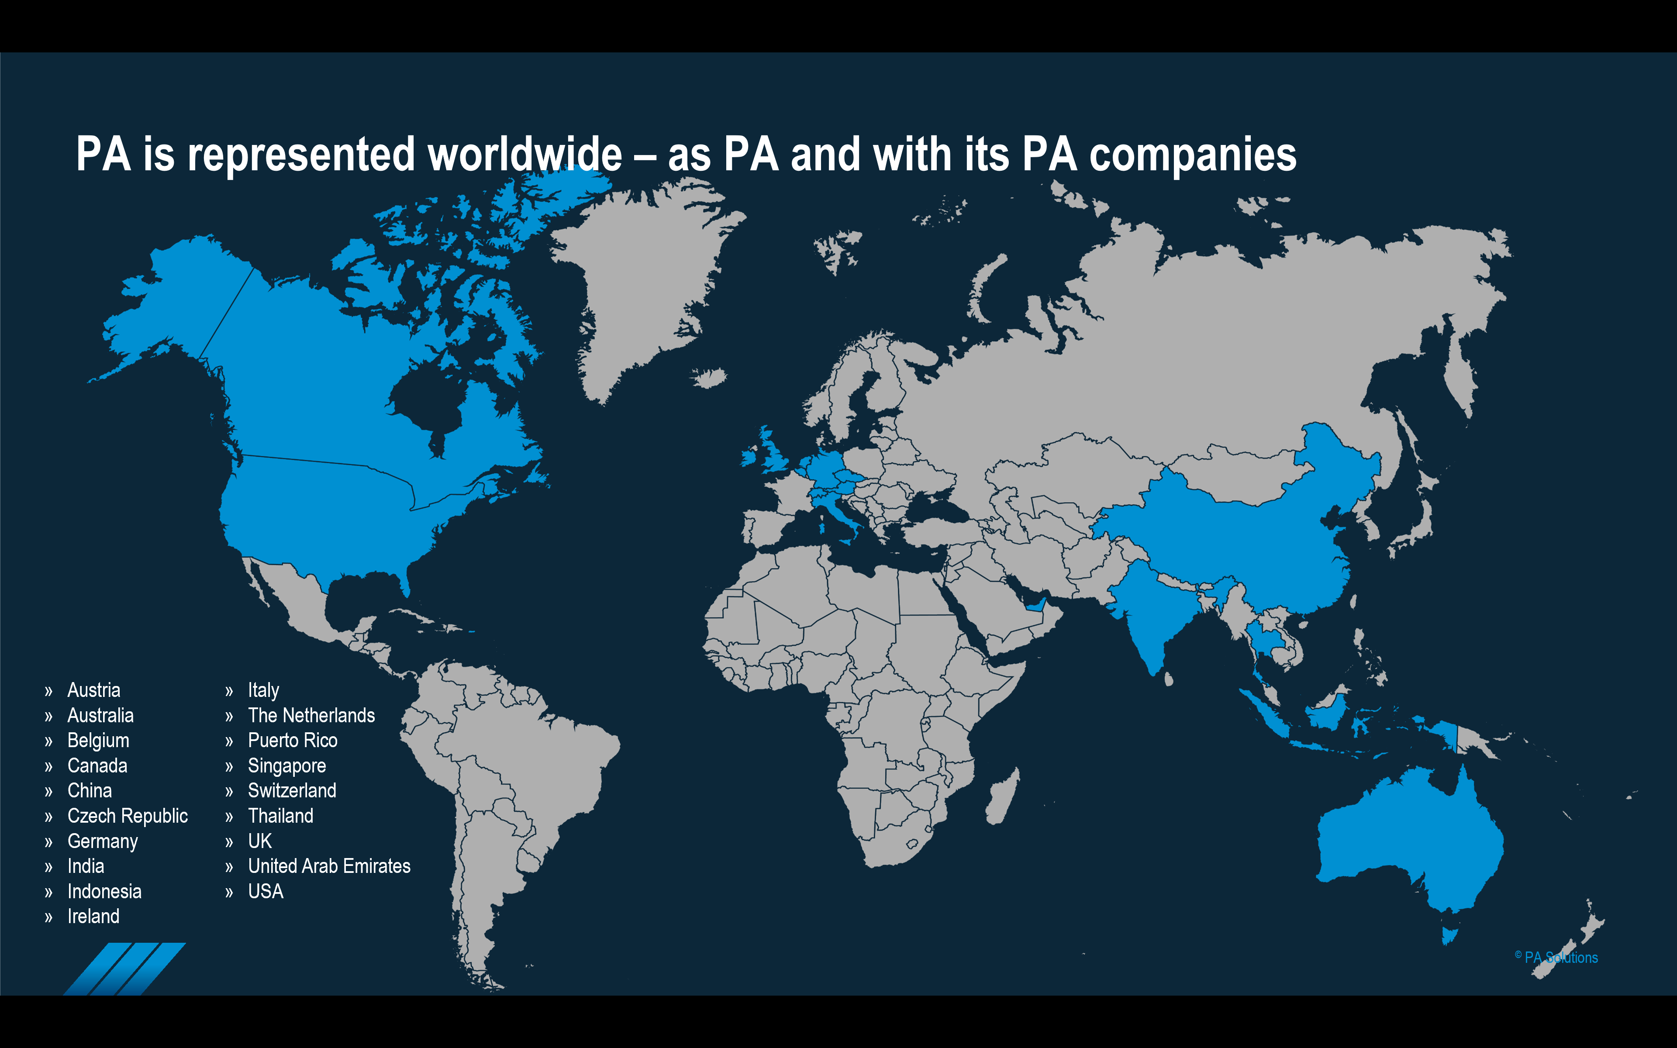
How does Process Automation fit into this picture?
We can help you every step of the way.
What we do.
Where we do it.
How we are doing.

Slide 13
How does Process Automation fit into this picture?
Looking into optimizing your shipping processes? Advanced Shipping for S/4HANA
Automation
Process definition
Process optimization
Workflow definition
Workflow optimization
Shopfloor automation
Shopfloor integration
Data Preparation Data Analytics
Reducing error
Less exception handling
Higher throughput
SAP R/3 SAP ECC
SAP ECC
SAP4/HANA
Non SAP
Data warehouse
Non SAP Applications
SAP R/3 SAP ECC
SAP BW
SAP S/4HANA
SAP BW/4HANA
Non SAP
Data lake/mesh/ warehouse
Non SAP ERP, Applications

Slide 14
How does Process Automation fit into this picture?
Data processing challenge answered by AI based document processing for S/4HANA
Automation
Process definition
Process optimization
Workflow definition
Workflow optimization
Shopfloor automation
Shopfloor integration
Data Preparation Data Analytics
Reducing error
Less exception handling
Higher throughput
SAP R/3 SAP ECC
SAP ECC
SAP4/HANA
Non SAP
Data warehouse
Non SAP Applications
SAP R/3 SAP ECC
SAP BW
SAP S/4HANA
SAP BW/4HANA
Non SAP
Data lake/mesh/ warehouse
Non SAP ERP, Applications

Slide 15
How does Process Automation fit into this picture?
You have multiple plants or ERP systems. PA Facts: Production.IoT.Analytics.AI - all integrated
Automation
Process definition
Process optimization
Workflow definition
Workflow optimization
Shopfloor automation
Shopfloor integration
Data Preparation Data Analytics
Across systems:
Transparency
Predictive maintenance
Resource
SAP R/3 SAP ECC
SAP ECC
SAP4/HANA
Non SAP
Data warehouse
Non SAP Applications
SAP R/3 SAP ECC
SAP BW
SAP ECC
SAP S/4HANA
SAP BW/4HANA
Non SAP
Data lake/mesh/ warehouse
Non SAP ERP, Applications

Slide 16
How does Process Automation fit into this picture?
You are committed to an SAP Integration solution. Leverage SAP Analytics
Automation
Process definition
Process optimization
Workflow definition
Workflow optimization
Shopfloor automation
Shopfloor integration
Data Preparation Data Analytics
Integrated reporting
Integrated planning
Inside the SAP stack
SAP R/3 SAP ECC
SAP ECC
SAP4/HANA
Non SAP
Data warehouse
Non SAP Applications
SAP R/3 SAP ECC
SAP BW
SAP ECC
SAP S/4HANA
SAP BW/4HANA
Non SAP
Data warehouse
Non SAP Applications

Slide 17
How does Process Automation fit into this picture?
You are on-prem or not looking for integrating in the SAP stack now. You look for a solution for Analytics and Planning.
Automation
Process definition
Process optimization
Workflow definition
Workflow optimization
Shopfloor automation
Shopfloor integration
Data Preparation Data Analytics & Planning
Analytics
Fast implementation
Gartner MQ Leader planning
Easy to adopt
Budget friendly
MM
FI
SD
CO
Available Modules
HR
SAP R/3 SAP ECC
Non SAP
Data warehouse
QM
SAP ECC
SAP4/HANA
Non SAP Applications
SAP R/3 SAP ECC
SAP BW
SAP ECC
SAP S/4HANA SAP BW/4HANA
Non SAP
Data warehouse
Non SAP Applications
CS
PP
PM
PS

Slide 18
Executive Summary
(Generative) AI will come – one way or the other
Getting your data right is key. (Before you can use AI)
Utilizing these data along the way is smart
Be smart.

Slide 19
Peter Huegel
Customer Solutions Architect
(703) 463-9801
peter.huegel@pa-ats.com
Let’s get our data challenges behind us, so we can attack new challenges

