Slide 1
American Air Filters Case Study
S/4HANA Cloud with SAP RISE on AWS
Raymond Smith, North America SAP Practice, Principal Technical Architect, SoftwareOne Manoj Muthukrishnan, Sr. Manager, Americas SAP on AWS, Partner Solution Architect Leader, Amazon Web Services
Larry Rodgers, North America SAP Practice Executive, SoftwareOne
SoftwareOne

Slide 2
Brian Duffy
SoftwareOne Welcomes New CEO
SoftwareOne announces Brian Duffy as new Chief Executive Officer | SoftwareOne media release

Slide 3
Happy Hour Info
Time:
3:00PM – 4:00PM
Location:
General Session

Slide 4
In this session
You’ll learn about:
Greenfield SAP S/4HANA cloud implementation with RISE with SAP on Amazon Web Services (AWS)
Best-practice implementation processes and key advantages of the SAP Business Technology Platform (SAP BTP)
The successful engagement of AWS and a trusted SAP and AWS advisor

Slide 5
Meet American Air Filters (AAF) Flanders
World’s largest manufacturer of air filtration solutions, operating production, warehousing, and distribution facilities in 22 countries across four continents.
Global headquarters in Louisville, Kentucky
Provides air filters and ventilation systems for large buildings, including convention centers, office buildings, hospitals, manufacturing facilities, cleanrooms, and nuclear power applications.
Supported in international ventures through the resources of the parent company, Daikin Industries Ltd.
When a global pandemic caused the demand for air filtration solutions to surge, AAF sprang into action to meet demand.
But would its legacy SAP ERP system be up to the task?

Slide 6
Business challenge
The challenge:
"There was not enough capacity to support the growth, and we had product allocation problems and delivery problems.”
Bob Betts, SAP Programs Director, AAF
Need of a common ERP platform to accommodate current and future growth.
Minimize the amount of manual activity required to conduct business, manage processes, and maintain systems.
Notes:
Ideal solution AAF was looking at should include:
Integrated Systems starting with a single, modern ERP platform integrated with the suite of SAP solutions already in use
Standardized Processes based on best and next practices to minimize manual activities
End-to-End Visibility to support high-quality products and meet customer needs now and in the future

Slide 7
How SAP RISE, AWS, & SoftwareOne helped
RISE with SAP, Private Edition running on Amazon Web Services (AWS) to fast-track the journey to S/4HANA and AAF becoming an intelligent enterprise.
RISE on AWS selected for its superior performance, resilience and unrivalled support for BTP and cost.
S/4HANA and SAP cloud solutions to standardize processes across AAF while simplifying and unifying licensing.
SoftwareOne as a RISE with SAP Partner provided the BASIS and BTP expertise to make it all happen, as AAF did not have in-house resources.

Slide 8
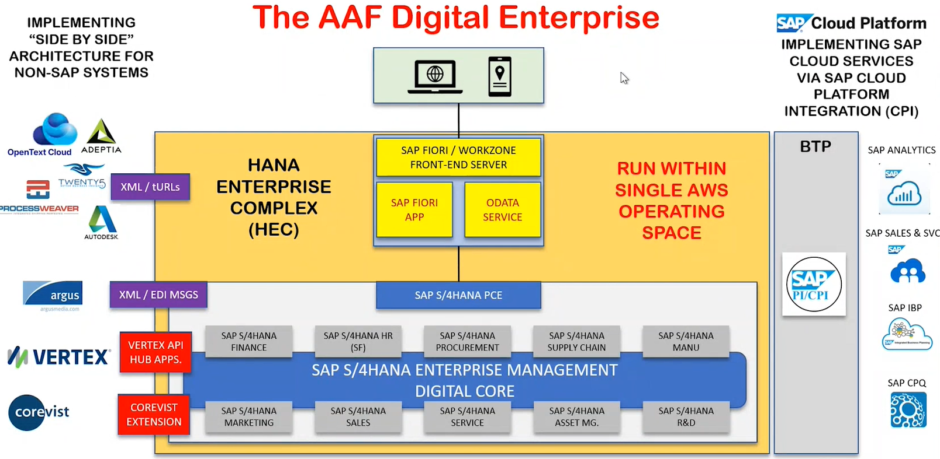
Leveraging BTP to support the integration requirements
The AAF Digital Enterprise

Slide 9
Managing technical changes across RISE and other SAP cloud services
RISE vs. native (hybrid)
ChaRM / manual
DS4 – QS4 – PS4 Transport Strategy
Notes:
RISE with SAP S/4HANA on AWS enables AAF to provide the tools necessary for everyone to execute against their top priority—providing a safe working environment through clean, filtered air for customers and their businesses—leading to an improved customer and employee experience
Compared to ECC 6 and 7 systems, RISE with SAP S/4HANA is more flexible and has tremendous capabilities, including ways that AAF can adapt to its business
From a business process perspective, new RISE with SAP S/4HANA systems will help keep accuracy and consistency in tracking materials—from production to inventory and supply chain—giving end-to-end visibility to historical customer interactions
Overall, the digital transformation journey is poised to help AAF produce high-quality products and scale the business with a growing customer base

Slide 10
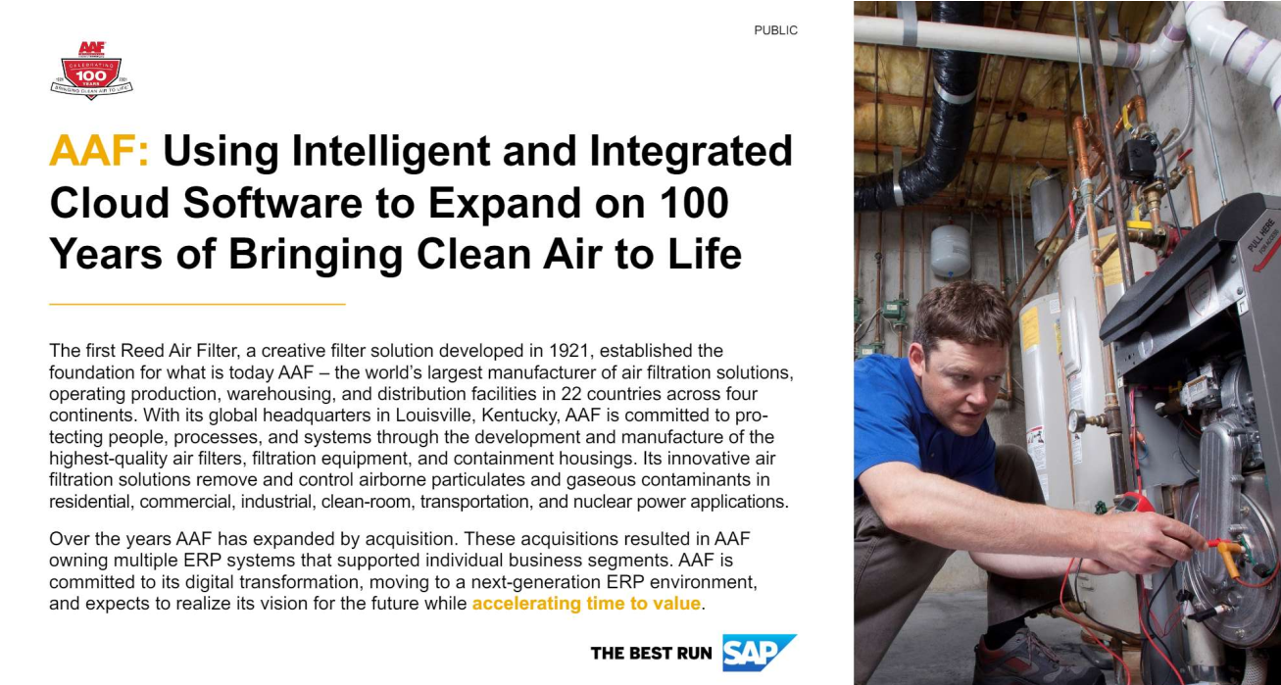
Results and benefits
Improved customer and employee experience
More flexible capabilities to adapt to its business
Accuracy and consistency in tracking materials
End-to-end visibility to historical client interactions
Production of high-quality products to scale the business with a growing client base
SAP Customer Reference: AAF using RISE to accelerate transition to S/4HANA
Notes:
RISE with SAP S/4HANA on AWS enables AAF to provide the tools necessary for everyone to execute against their top priority—providing a safe working environment through clean, filtered air for customers and their businesses—leading to an improved customer and employee experience
Compared to ECC 6 and 7 systems, RISE with SAP S/4HANA is more flexible and has tremendous capabilities, including ways that AAF can adapt to its business
From a business process perspective, new RISE with SAP S/4HANA systems will help keep accuracy and consistency in tracking materials—from production to inventory and supply chain—giving end-to-end visibility to historical customer interactions
Overall, the digital transformation journey is poised to help AAF produce high-quality products and scale the business with a growing customer base

Slide 11
Lessons learned
Change Management – Technical and Business
RISE – service model
Best Practices Deployment
Business Engagement
Quality of data
Single Sign-on
Integration Client Testing

Slide 12
Why Select SoftwareOne as a partner?
Unique combination of SAP, AWS and licensing and commercial expertise
Experience supporting RISE with SAP clients for advisory, implementation and managed services
Extremely positive feedback from all our customers on current and past SAP engagements
SAP
Commercial
Advisory
Certified SAP and AWS
Technology
Experts
Unbeatable
AWS Expertise

Slide 13
Important factors impacting a decision to use RISE with SAP
Experience
Reliability
Performance
Global footprint
Partner ecosystem
Tap into the 14+ years AWS has been supporting mission-critical SAP workloads to accelerate your success
Run critical SAP workloads on the world’s most secure, extensive, and reliable global cloud infrastructure
Improve SAP application performance with EC2 Instances running Nitro hypervisor
Extend to the SAP Business Technology Platform in 9 AWS Regions globally to modernize and innovate your core business processes
Tap into the SAP on AWS Competency Partner ecosystem for migration and transformation of RISE with SAP on AWS landscape
Notes:
Speaker Outline:
Based on that same SAPInsider research among 152 members, 83% of those planning to move to RISE with SAP are considering RISE because of capabilities for innovation for example through SAP BTP.

Slide 14
The world’s most secure, extensive, and reliable global cloud infrastructure
Europe
Frankfurt (3)
Ireland (3)
London (3)
Milan (3)
Paris (3)
Spain (3)
Stockholm (3)
Zurich (3)
Asia Pacific
Beijing (3)
Hong Kong (3)
Hyderabad (3)
Jakarta (3)
Mumbai (3)
Ningxia (3)
Osaka (3)
Seoul (4)
Singapore (3)
Tokyo (4)
United States
GovCloud (U.S.): U.S.-East (3), US-West (3)
U.S. West: Oregon (4), Northern California (3)
U.S. East: N. Virginia (6), Ohio (3)
Canada
Central (3)
Africa
Cape Town (3)
Middle East
Bahrain (3) UAE (3)
Australia
Sydney (3) Melbourne (3)
South America
São Paulo (3)
31 Regions | 99 AZs
Announced Regions: 4 Regions and 12 AZs in Canada, Israel, New Zealand, and Thailand

Slide 15
Clean core + SAP BTP + AWS = vast innovation options
Delight customers
Increase production
Data-driven decision making
Optimize supply chain
Red- Shift
AI/ML
HANA
Cloud
SAP AI
New revenue sources
200+ AWS
services
Glue (ETL)
Amazon Forecast
SAC
90+ SAP
BTP
services
Increased efficiency
S3 (Storage)
Amazon Lookout
DW Cloud
SAP Build
AppFlow
Lambda
ABAP
SAP Business Technology Platform
DIFFERENTIATION LAYER
SAP+AWS = Better Together
AWS Cloud Services
Legend
Data lakes
SaaS
OLTP
OLTP
OLTP
OLAP
OLAP
Third
party applications
SAP
ECC
SOH
S/4 HANA
BWoH
BW/4
APPLICATION LAYER
Build to consume
AWS
SAP
INFRASTRUCTURE
CORE SERVICES
SECURITY AND COMPLIANCE
MANAGEMENT TOOLS
INFRASTRUCTURE LAYER
Build to last
Notes:
Clean core + SAP BTP + AWS = Vast Innovation Options
++This slide has 2 builds included to make it easier to consume
Bulleted Talk Track:
Starting at a base level, you’ll see an SAP Landscape running on AWS
RISE customers now have an innovation platform with 300+ services across AWS and SAP BTP to deliver on your Modernization strategy
This lead to a reduction on Infrastructure and general overhead costs while developing new business models to empower your teams and move your business forward
We first start by being customer obsessed and understand our customers’ transformation goals such as driving new revenue or reducing costs. Then we think about the needed strategic capabilities to achieve those goals and the solutions to enable them.
We have leading infrastructure and we have the application layer with a clean core, but where this gets interesting is in the differentiation layer, where we have SAP solutions and our own AWS solutions that extend beyond the SAP estate to complete end to end business processes. This is where we join up to extend machine learning, drive big data, enable automation or even enhance SAP itself
What do I mean by this? Maybe it is a best kept secret how our solutions work together. I will give you a few examples
Amazon Forecast ML: Enhances S/4 and IBP by applying ML to demand signal data to help those solutions provide more accurate forecasting
Amazon Lookout for Equipment: Extends SAP Asset Management by identifying equipment anomalies using ML for more accurate predictive maintenance
(optional) Amazon Lookout for Vision: Extends SAP Quality Management by using AWS image recognition capability to spot defects during quality inspections
All of the above improves SAP without customizations and the list goes on and on. Simply said we make SAP run better for our customers in all parts of the stack when we do it together.

Slide 16
RISE on AWS with BTP accelerates client value
11
30/42
6X
24
100%
AWS Regions* for BTP only vs 10 total from other CSP’s combined
More BTP services available on AWS than competition
Less downtime than the next hyperscaler in 2022
BTP services available only on AWS
New BTP Services launched on AWS in 2022 (vs 33% for next CSP)
AWS is a trusted SAP partner for BTP performance
Higher performance from lower latency
Higher availability from simplified environment
More BTP Services across more Regions to support your Modernization Strategy
*Includes AWS GovCloud region
(as of Feb 2023 - SAP Discovery Center Link)

Slide 17
SoftwareOne & AWS
A strong partnership beyond SAP
Multi-year Strategic Collaboration Agreement signed in 2022 to accelerate our customers’ cloud journey
Additional funding available to support clients’ cloud adoption*
SoftwareOne is an AWS migration and modernization specialist
With deep expertise in critical workloads, including SAP RISE and S/4HANA on native cloud
Driving commercial transformation with FinOps to drive cost optimization
SoftwareOne adds AWS Marketplace to extend its digital software sourcing services
SAP RISE reseller
Find us on AWS Marketplace
*Applicable to SoftwareOne’s unique RISE Advisory services

Slide 18
RISE on AWS client testimonials*
Accelerating Innovation and Improving agility with SAP on AWS
“Helped us achieve significant savings during our RISE on AWS negotiation”
18 © 2023 ASUG
*Includes RISE Advisory

Slide 19
Thank You! Any Questions?
Raymond Smith
SAP Practice Executive, North America
SoftwareOne
raymond.smith@softwareone.com
https://www.linkedin.com/in/raymonddeesmith/
Manoj Muthukrishnan
Senior Manager, Americas SAP on AWS, Partner Solution Architect Leader
Amazon Web Services
muthmano@amazon.com
https://www.linkedin.com/in/manoj-m-b58b5a4/
Larry Rodgers
SAP Practice Executive, North America
SoftwareOne
larry.rodgers@softwareone.com
https://www.linkedin.com/in/larry-rodgers-b2126a21/

Slide 20
Get in Touch
ASUG.com
ASUG is passionate about helping people and organizations get the most value from their SAP investment. Through networking opportunities, education, research, and ongoing advocacy, ASUG helps our members make more possible.
Copyright© 2015 to 2023 ASUG®
All SAP products are the trademarks or registered trademarks of SAP SE in Germany and in several other countries. All other brands, logos, and product names are registered trademarks or service marks of their respective owners. Americas' SAP Users' Group is a membership-driven organization that is independent of SAP SE.

