Slide 1

Microexcel
Redefines Digital Innovation for Life Sciences

Slide 2

QUICK FACTS
Microexcel Redefines Digital Innovation for Life Sciences
The client was a clinical stage pharmaceutical innovator and early adopter of S/4HANA
Current SAP system was rapidly approaching the end of their mainstream maintenance
The client required self-sufficiency on a validated FDA compliant work product
Empower and train the client’s employees on the critical SAP processes
Incorporate the capabilities of the full potential of SAP Solution Manager
Enhance existing SAP processes, add warehouse management and quality inventory controls with GxP validation
Notes:
Microexcel Redefines Digital Innovation for Life Sciences
A clinical stage, pharmaceutical innovator, and early adopter of S/4HANA was rapidly approaching the end of their mainstream maintenance. The client team required a collaborative partner with an industry solution that could cost-effectively upgrade their S/4HANA instance, enable self-sufficiency, and ensure a validated FDA compliant work product. Microexcel was acknowledged by the client team as the only integration partner for their needs with the industry depth and end-to-end GxP SAP compliant solution that could satisfy their complex goals.
To ensure a rapid transformation, our engagement team successfully delivered in three parallel workstreams, while leveraging Microexcel's proven collaborative implementation approach. The resulting success ensured that the client team was fully empowered and trained on the critical SAP processes, capabilities, and practical use in the full potential of SAP's Solution Manager. Lastly, validating that their GxP system was compliant, including the existing SAP processes and the latter implementations of warehouse management and the quality inventory control processes.
Client is a biopharmaceutical company focused on developing and commercializing innovative monoclonal antibody-based therapeutics for the treatment of cancer. The Company generates its pipeline of product candidates primarily from its proprietary suite of next-generation antibody-based technology platforms, which have applicability across broad therapeutic domains. The combination of client’s technology platforms and protein engineering expertise has allowed them to generate promising product candidates and enter several strategic collaborations with global pharmaceutical and biotechnology companies.

Slide 3

Health Life Science – Trends and Challenges
Regulatory - Compliance
Big Data – Health Networks
Patient Centricity –Personalization
Navigate Regulatory pressures, fluid changes and rising healthcare costs:
Redesign complex channel models and R&D that are raising healthcare costs making it unsustainable
Build new ecosystems that integrate suppliers, contractors and regulatory agencies to create a continuous value chain and reduce costs.
Empowered patients and personalization:
Create outcome-based patient engagements and develop direct patient connect.
SAP’s industry solution is the leading platform to capitalize and support these trends. Microexcel has developed the method to rapidly and effectively address these challenges.

Slide 4






OUR PRACTICE Leaders & Presenters
DEREK LIGHT
GLOBAL LEAD
Innovator & enabler of digital & business transformation supported by Enterprise(ERP), Cloud and Digital capabilities that support business strategies. 18+ years with Accenture. Completed a comprehensive analysis across the industries leading system integrators.
JASON COMBS
NA Delivery
Comprehensive cloud and digital transformation experience to support business strategy, cost optimization, Industry 4.0, M&A and global delivery model. Solution & delivery leadership for over 17 years with Accenture.
TONY BARBERA
FINANCE
Demonstrated history of working in the information technology and services industry. Skilled in SAP Finance implementations, SAP S/4HANA, SAP strategy and assessment. A strong finance professional with both industry practice and Tier 1 consulting experience.
SUHAIL JAFRI
SUPPLY CHAIN
Platinum level consultant with over 20 years’ experience in Supply Chain re-engineering and SAP implementations, including working directly for SAP product development. Successfully completed over 15 end-to-end project implementations in a lead and/or architect role.
CATHY THORNTON
Change Management
Transformational track record of developing learning organizations, implementing strategic change and partnering with senior business executives to drive strong positive business results. Over 25 years of experience working for Wipro, IBM, Coca-Cola, BofA, and American Airlines.
BRIAN FREYMANN
Health Life Science
A senior ERP Practice Leader with over 25 years of international experience including; delivery, enterprise consulting practice development, global quality assurance, change management, training and custom technology program management. Completed several international SAP and other Enterprise projects over his career.

Slide 5
SAP SERVICES
Microexcel as a Global System Integrator with focus on products companies delivering end to end SAP transformation and migration services increasing value & compliance through change management, automation, analytics and an optimized global delivery & partner model.
Strategy & Assessment
Change Management & Enablement
Migration & Implementation
Automation, Data & Analytics
Intelligent Services & ExcelCare
SOLUTIONS, TOOLS & ASSETS
PARTNER ECOSYSTEM

Slide 6





COMPREHENSIVE TOOLS & ASSETS
Embedded Learning
• OnScreen User Guides
• SOP
• Process Videos
Accelerated Industry Solutions
• Process Design
• Work Products
• Tools & Methods
Microexcel Improved ​
transformational outcomes with capabilities, solutions and accelerators to achieve the goals for a strategic ​
transformation
Enhanced Solutions
• Process Automation
• AI MRP
• Collaboration Apps & Services
• Integration-Quality
• Analytics
• Data Management
• RPA/IPA
• ExcelCare & Managed Services
Validated by Kymanox*
• GxP
• CSV
• Process Mapping
• QMS
SAP S4 HANA Best Practice
• Strong Core Solution Architects
• Efficiencies with the Global Delivery Network
Manufacturing
Consumer Products
Health & Life Sciences
* Kymanox is a Market Leader in FDA Compliance Strategy within HLS industry

Slide 7

STRATEGY & ASSESSMENT
Integrated Co-creation Assessment
Aligning your organizations SAP Strategy & Roadmap considering People, Process, Technology, Data Value, and Key Compliance factors
S/4 FUNCTIONAL CAPABILITY WORKSHOPS
1
FUTURE SAP S/4 ENTERPRISE
FUNCTION PROCESS REVIEW
BUSINESS CASE
2
TECHNOLOGY ECOSYSTEM
APPLICATION ARCHITECTURE
INTEGRATION APPROACH
DATA / SECURITY ARCHITECTURE
TECNOLOGY ARCHITECTURE
CHANGE IMPACT & STRATEGY
CHANGE IMPACT & STRATEGY READOUT
3
ROADMAP & DEPLOYMENT PLAN
ROADMAP DEPLOYMENT LEVERS
PROACTIVE LEADERSHIP ENABLEMENT
ROADMAP & DEPLOYMENT PLAN
4
ASSESSMENT PHASE
Key Activities
Plan/ Mobilize
Define key stakeholder & governance
Stakeholder/ Governance
Workplan development
Request & collect key data & inputs
Assessment
Describe prelim. Future state processes
Processes and application mapping
Describe & decide on automation and analytics opportunities
Decide technology, organization, value, experience and data impact
Process segmentation & value
Decide on future s4 processes
Decide on automation and analytics priorities
Align and decide on change impacts
Build and validate business case
Recommendation to board
Multi phase plan: prioritized & sequenced multi-year implementation roadmap
Resources documented for all future phases within the roadmap
Advanced business capability recommendations
BROAD & DIVERGENT THINKING
CONVERGING FOCUS

Slide 8
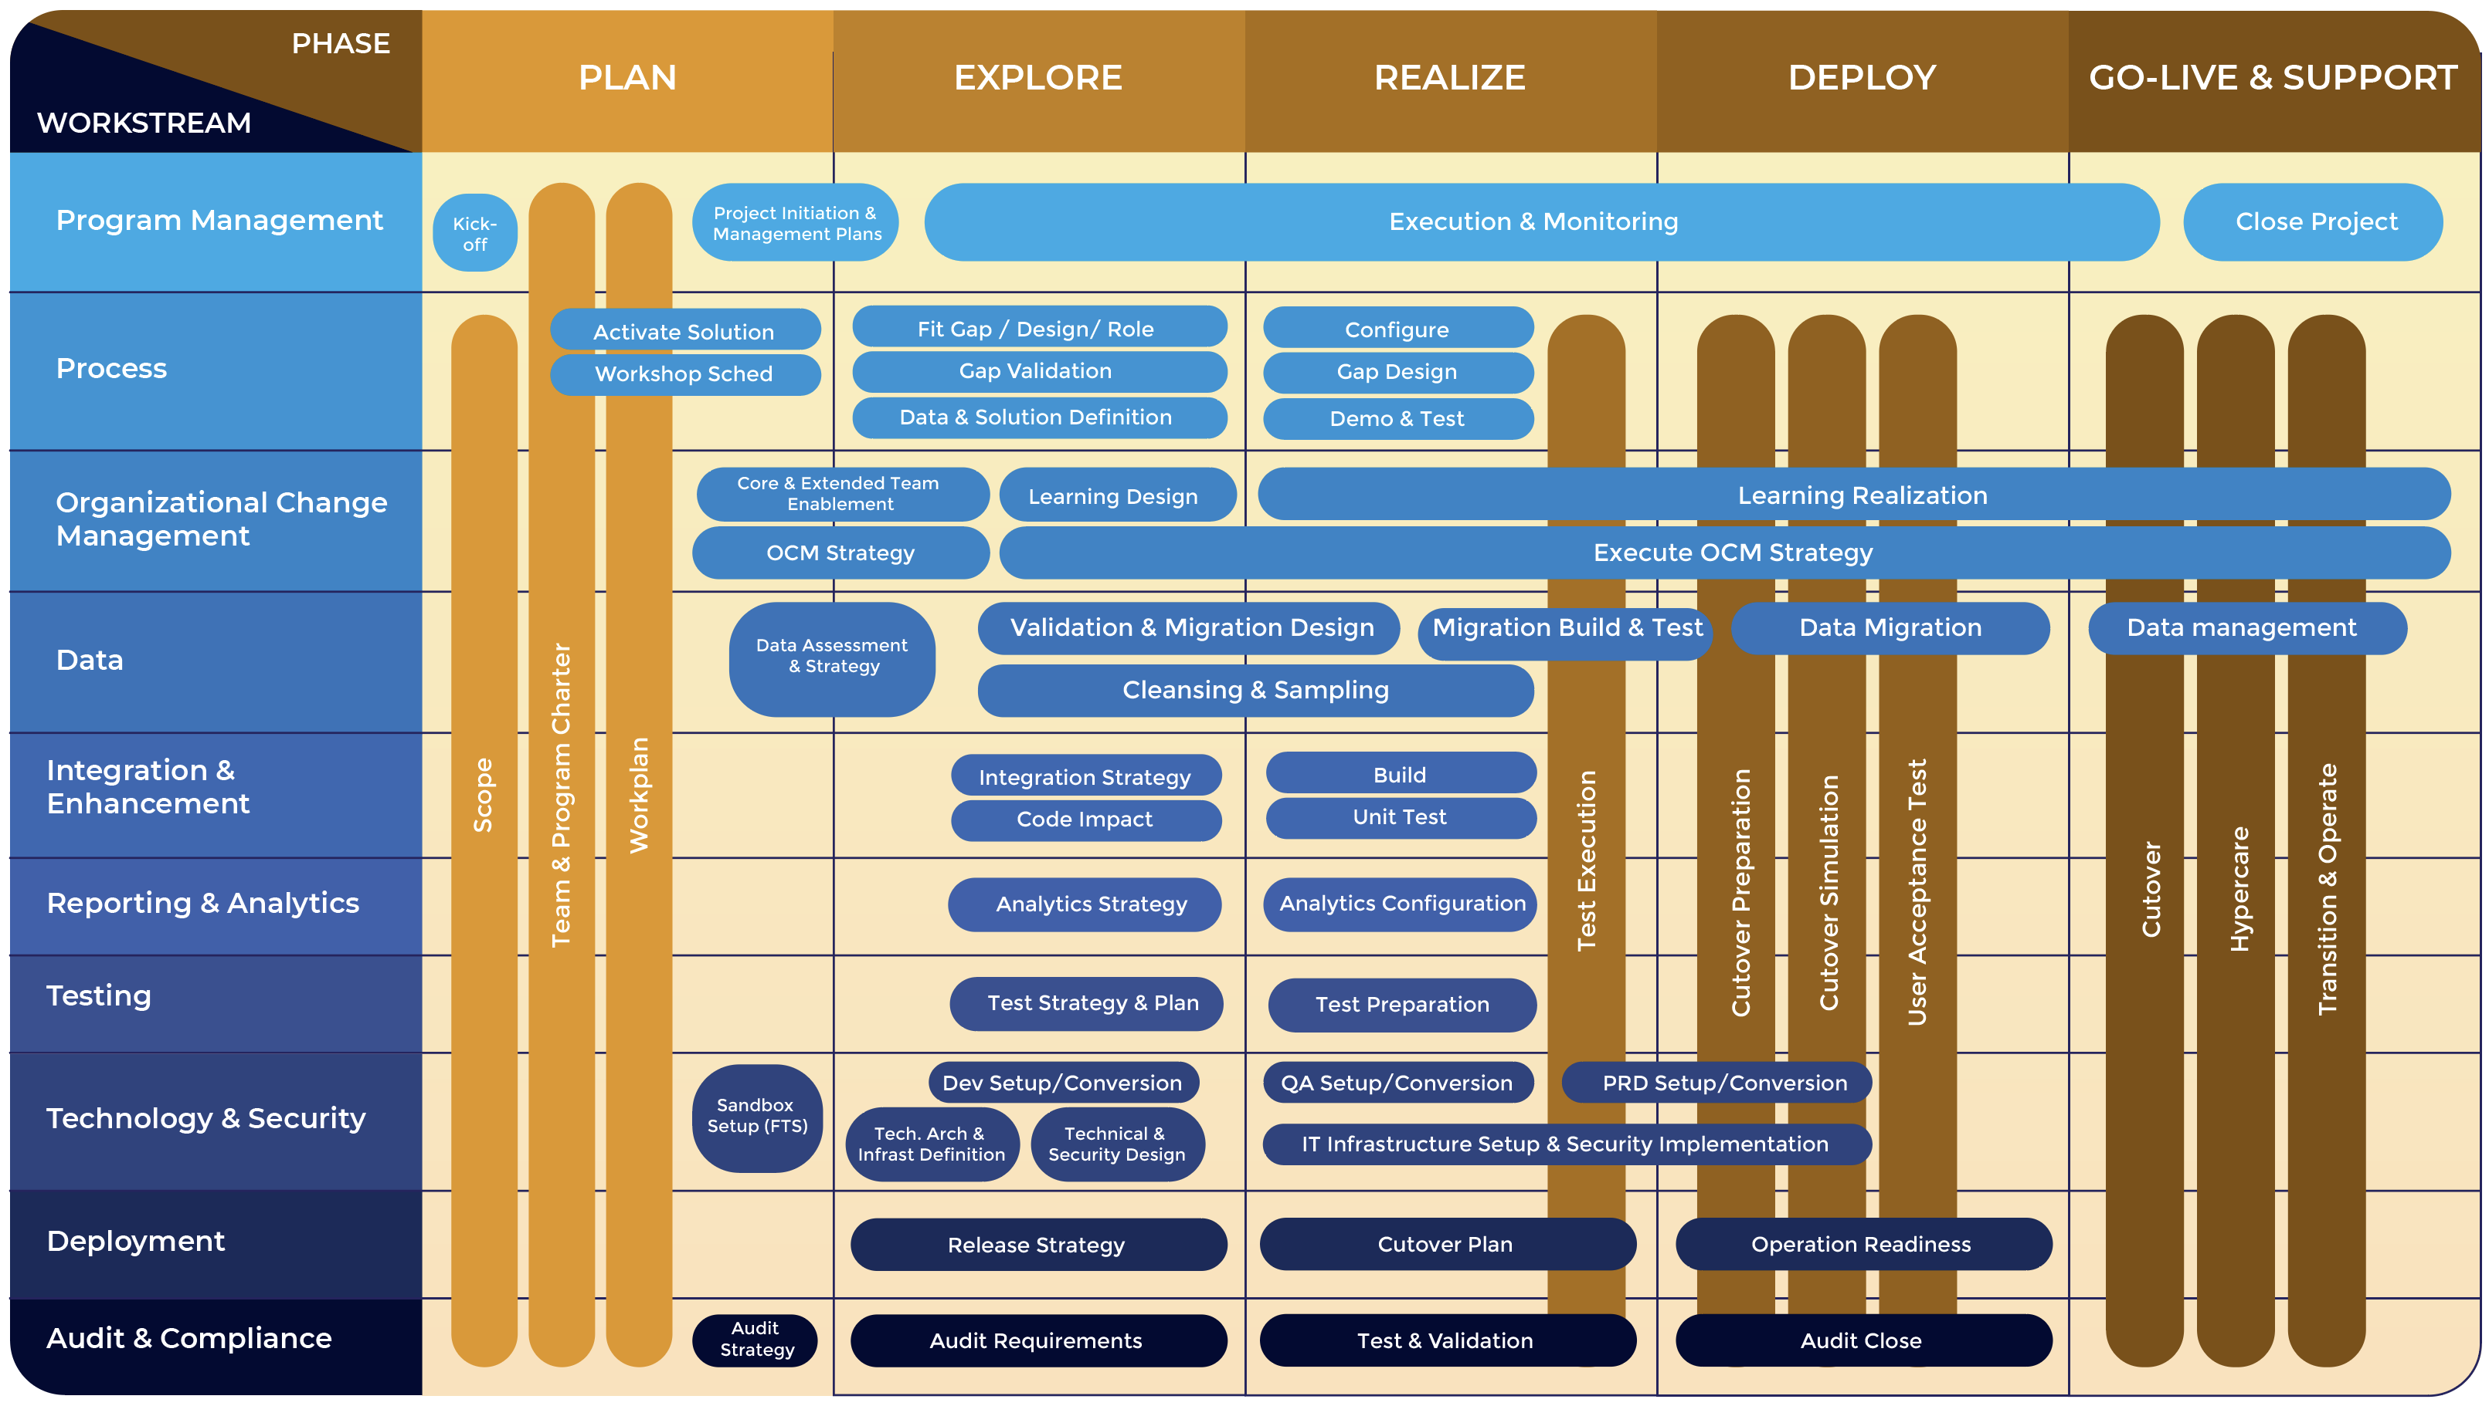
COMPREHENSIVE TOOLS & ASSETS
Activate Project Management Methodology
SAP Core Accelerators
PMO Toolset
Onscreen Guides
Fit to Standard Videos
Industry Solutions
Automation
Compliance

Slide 9


CHANGE MANAGEMENT & ENABLEMENT
Our Change Management offerings improve user adoption, addresses continuous change and promotes self sufficiency
Change Management Evolution
Solution
Process Driven
Data Driven
➔
➔
Organizational
Alignment
& Governance
Change
Strategy
SAP S4 HANA Self-Enablement
Digital Operating Model
Continuous Change & Learning
Learning Content
Process Driven
Big Bang
Continuous
Training &
Knowledge Transfer
TARGET OPERATING MODEL
Organizational
Impact & Readiness
➔
➔
Marketing &
Communications
Stakeholder
Engagement
New User Base
Experienced User Base
➔
➔

Slide 10







DATA – QUALITY, COLLECTION, MANAGEMENT & GOVERNANCE
Microexcel’s Data Governance Mantra
Orchestrating Right Mix for Optimum outcome
Bringing the change for effective Data Governance
People
Process
Technology
Quality
  Accuracy
Completeness
Data Collection & Transformation
Data Governance
Data Quality
Data Management
From
To
To
From
‘Data Management’ centric and not ‘Data Governance Inclined
Instituting data governance organization by formalizing necessary roles and responsibilities
Establish automated data quality measures and practice with ‘Data Quality Analyst’
‘Reactive’ data quality measures and not ‘Proactive’
Limited focus on data stewardship and data standardization
Emphasis on data stewardship and standardization with dedicated ‘Data Steward’ role
Data entry processes using standardized mechanisms and templates
Manual Data entry process and not standardized

Slide 11

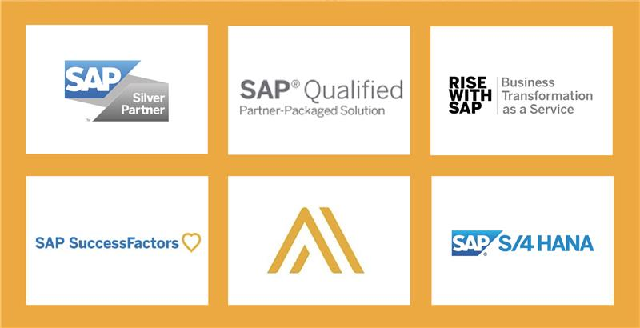

926 Bloomfield Ave, Suite #BB,
Glen Ridge, NJ 07028, USA
O: 201-866-6789, F: 201-221-7825
For more information
Visit: www.microexcel.com/sap or Email: info@microexcel.com

Slide 12
Internal Project Notes – Background, Deployment & Benefits

Slide 13
Background
Our journey with our pharma client began when Microexcel was presented an opportunity to present our capabilities against an RFP which described the customer’s need to upgrade their existing SAP S/4HANA Environment.
During this process, we quickly recognized the customers ambition to obtain better value out of their S/4HANA investment and to better understand the best practices that are baked into the latest release.
We then walked the customer through the core tenets of upgrading to S/4HANA 1909, opportunities to remediate and/or improve the existing implementation and activate new functionality. As their potential partner of choice, our mission was to establish a foundation of people, process, and tools to care & improve S/4HANA with a sound IT strategy and provide a Center of Excellence concept and We partner with SAP in transforming businesses into intelligent enterprises by deploying solutions catering to industry specific needs around change management, automation solutions, analytics, cloud, and intelligent outsourcing… Together with SAP, we deliver efficiency, productivity, scalability, and cost benefits through innovative use of technology.
The first instance; our pharma client approached Microexcel to help them with an issue related to SAP Solution Manager (SolMan).
Now our partnership has grown from strength to strength. Starting from a single, small engagement, our pharma client has progressed to rely on Microexcel for several of its crucial SAP deployments and we become a trusted partner to deliver solutions that are on point has earned them the reputation for being reliable, timely, committed, and competent.
Background
Solution
Deployment
Benefits
Success Stories

Slide 14
Background
Our pharma client was using SAP Solution Manager (SolMan) 7.2 for Early Watch Alert and Maintenance activities. They had decided to implement the core SolMan functionalities to optimize the utilization of SolMan.
For this, they sought an expert SAP partner to evaluate their technical and business landscape, discuss their requirements, determine the most appropriate approach, and provide recommendations on implementation of ChaRM, ITSM, Technical monitoring, and Quality Gate Management.
Our pharma client’ expectations around this project related to three broad areas.
SAP Solman IT Service Management which would entail organization setup for a company code, incident management, problem management, request for change, knowledge management, service requests, service desk, email response management, rich text management besides standard analytics and reporting.
SAP Solman Change Control Management that would again require organization setup for 1 company code besides change & release flows for 2 types – normal change and urgent change, change request management, central transport management, quality gate management, e-signature on workflows, transport analysis and standard analytics & reporting.
SAP Solman Technical Monitoring included one SAP S/4HANA instance and one SAP Solman instance, standard SAP Solman monitoring KPIs and alerting and email notifications and integration with ITSM.
Background
Solution
Deployment
Benefits
Success Stories

Slide 15
SOLUITON
Microexcel took on the challenge. The team’s approach to the engagement focused on ensuring complete alignment with our pharma client in terms of their expectations and objectives. Microexcel’s main considerations were One, to enable a Collaborative implementation approach with our pharma client to empower and train our pharma client internal team on the exercise; and Two, to Enable our pharma client team to discover the full potential of Solman.
The outcome of the exercise was a conclusive success. Microexcel carried out the implementation in a controlled and phased manner. The targets were achieved in a timely manner as per the schedule.
The Solution Manager ITSM Configuration met all the set requirements. These included prerequisites check and standard configuration, maintenance of transaction types, template user creation, automatic and optimal configuration, email notifications, external integration, systems selection and administrative tasks, organizational model creation and UI configuration, testing and documentation and end-user training.
In the Solution Manager -ChaRM Configuration, the team successfully carried out prerequisites check and mandatory configuration, standard configuration, additional configuration and testing documentation and end-user training.
In the Solution Manager - Technical monitoring configuration activity the team conducted the prerequisites check, system monitoring setup, customization of templates, dashboard setup for availability and alerts documentation of alerts handling.
In the Solution Manager - Quality Gate Management Configuration, activities included basic setup and prerequisites check, enable gateway services, and implement master note, setup downgrade protection and retrofit, configure retrofit and create template users, and testing.
Microexcel’s help to support their operations with SAP Application Management and Services covering Administration and Monitoring services and As per the client requirement, Microexcel sourced and deployed a highly competent team to deliver Application Managed Services that encompassed transition services and operate services. Additional enhancements incorporated:
Ensured quality performance processes.
Refined IT support organization.
Established a Super user community and enabled them to run Level 1 and 1 support activities independently.
Enabled servicing of SAP tickets raised through ITSM tool.
Ensured compliance with ISO-9000, ITAR, DCAS, MMAS, FAA, EVMS, SEC, ADS, FDA, GxP, etc.
Microexcel delivered on all specifications through an approach that included detailed schedule planning out each stage with adherence to strict timelines.
Background
Solution
Deployment
Benefits
Success Stories

Slide 16
dEPLOYMENT
Microexcel become the clients first choice for the consultation and support (SAP Upgrade and Functional Deployment) The success of consecutive assignments created a sense of trust and reliance enriching the collaborative partnership between Microexcel and the client and this project was a “Two Part Implementation” - The Part1, Consisted of Configuration Remediation. The client required an upgrade and improvement of the existing SAP Application Scope.
Correction of Split Valuation Designation in Mass for some 1000 Materials. Specifically, the ask was to remove split valuation from materials that had activity executed against them. Microexcel developed a detailed conversion plan with sequenced steps and timing to achieve the removal. From an execution standpoint, mass change scripts using LSMW and validation protocols to confirm data before and after changes were developed to help realize the conversion.
Correction of Unit of Measure for some 50 Materials. Like the split valuation requirement, Microexcel developed a detailed conversion plan as well as mass change scripts and validation protocols to execute the change and verify the completeness of changes postscript execution.
Comprehensive review and rationalization of recipes & recommended use of correct production versions
In Part2, Microexcel would cover the Functional Expansion Phase implemented capabilities that enabled –
Creation of a central receiving warehouse to supply satellite warehouses at both plant sites, raw material sampling plans for composite representative of the whole lot/batch for testing and a system flag to communicate raw material testing status (timing, pass/fail).
The deployed solution encompassed the following features:
Mechanism for QC to sample and deduct raw material amounts from GMP inventory using sampling size derivation based on number of containers being received rather than the standard functionality which derives sample size based on quantity being received and A separate GMP inventory category for Quality to place restricted material.
Enable raw material inventory tracking to storage unit level.
Enable system generated materials requirements in support of manufacturing runs (KANBAN).
Facilitate comprehensive raw material supply process to manufacturing that streamlines in-suite and in-plant on-hand inventory, improves material inventory accuracy, and delivery (KITTING) .
Comprehensive security design to restrict authorized manufacturing personnel to modify BOM components and perform completion activities on existing process orders.
Implementation of custom enhancement to allow automatic determination of storage unit in warehouse receiving for internal transfer of material between plants. The developed solution automatically derived the storage unit to be received based on the issued storage units in the shipping location thereby eliminating the need for redundant scanning.
Background
Solution
Deployment
Benefits
Success Stories

Slide 17
BENEFITS
The project was planned and executed exactly as per the SAP framework. Microexcel created a table to show how work would progress. and the covering workstreams that covered in detail the 5 stages from Prepare, Explore, Realize, Deploy to Go-Live and Prost Production support.
The enduring engagements between Microexcel and the client highlights the mutual benefits that accrue from long standing partnerships. Executing multiple projects for the client has accorded to Microexcel a deep understanding of their technologies and processes. The insights gleaned through their experience places Microexcel in a unique position where they can fully align with the client’s needs and objectives to provide solutions that are optimal, appropriate and deliver value every time.
Background
1
2
4
7
The solution has provided an assurance by validating the Readiness check
Cost savings by optimizing the Software BOM items
Provided a risk-free and non-disruptive way to migrate S/4HANA with the least amount of time and effort.
Solution
5
Deployment
Smoother adoption of S/4HANA and better management of Change.
3
Benefits
Training the internal technical team for effective monitoring of the migration exercise.
Success Stories

Slide 18






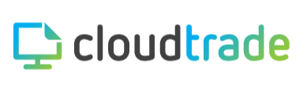

KEY STRATEGIC ALLIANCES
Strategy
& Assessment
Implementation
& Migration
Process Automation
Core Partnership
Automation, Data
& Analytics
Change Management &
Enablement

