Slide 1
Sap User administration
Clean Up Tools

Slide 2
Content
Introduction
Jessica
Our company
Environment, challenges
SW Implementation
Standardize Approval Workflows
Remove Unused Roles
Periodic Access Review
Wrap-Up & Questions

Slide 3
Introduction
Jessica Goldsmith – Lead System Administrator
jngoldsmith@cooperstandard.com
Cooper Standard
Global material science & manufacturing
Develop materials, systems & components
21 countries
25K employees
SAP Shop – 74 sites on SAP
Moved to S/4 Hana February 2020

Slide 4
Challenges
Access Requests
Roles & Violations
Periodic Access Reviews
Multiple access request systems
Proper approver channels
Ticket/email exchange
Manual process
No control
SAP requests increasing dramatically
Managing SAP Go-Lives
No one reviewing historical access
Users normally copy others
Too many controls to perform
Too many violations total
Audit pushing to clean up
Done manually in SharePoint
Reports run
Reports posted
Send email
Gather approvals/changes
Get sign off
Difficult for admin to manage and track

Slide 5
Standardizing Workflows
What issues were we trying to solve?
Correct/complete approvals
Efficiency, ticket and email back and forth
What process needed for which IT application
Allows for automated approval workflows
Streamline approval process
Same UI for multiple ERP Systems
SOD or no SOD
SAP is auto assign, no touch by administrator
Other ERP systems (non SAP) get alerted by email
CS has email to generate ticket

Slide 6
SecurePro – Front End
Connections
CooperStandard & Security Weaver
Requester

Slide 7
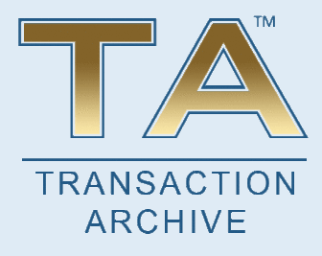
Removing Unused Roles
What does it tell you?
What can it help you do?
How it helped Cooper Standard
Who used a specific transaction code?
Who used a specific role in a time period – or ever?
How many roles do they have that are currently unused?
Which transactions are they using in each role?
Which ones aren’t they using?
Remove unused transactions in role design
Remove unused roles
Remove unnecessary violations
Verify changes
Provides action details
61K roles of 76.5K removed
80% reduction
4.5K SOD violations of 11K eliminated
40% reduction
3700 users
SAP Go Live process
Ongoing maintenance

Slide 8
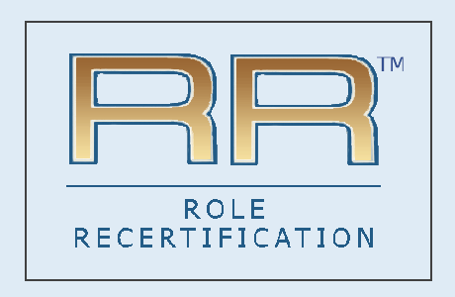
Periodic Access Review
Previous process:
Created reports manually
Posted reports to SharePoint site
Cumbersome, confusing, manual process via email & tickets
Automated workflow approval process
Automatically remove unapproved roles or user IDs for SAP systems
Only create ticket if changes are needed for non-SAP systems
Common, streamlined process for all systems
Same UI and concept

