Slide 1
Robotic Process Automation (RPA) and Accounting processes
Rahul Goyal, Senior Director (SAP and RPA)
Kartik Dua, Principal Business Analyst (SAP and RPA)
Ellucian

Slide 2
Agenda
Presentation (30 mins)
Robotic Process Automation (RPA)
Accounting processes
Q&A
Optimize Accounting Processes with RPA
Follow-up Topics
Customer Case Study
Discussions (15 mins)

Slide 3
RPA – What is & What is Not
RPA is
Group of robots known as Bots, to do computer based monotonous tasks
Effective in doing RRF(repetitive, rule-based, frequent) tasks
RPA is not
Physical Robot
Ineffective where composite decision making is required
Solution which Complements & Supplements human workforce
Business oriented - streamline business process to drive revenue, reduce costs, surge accuracy, refine compliance
Intended to replace human workforce
Single dimensional – only focused on one business or to only reduce cost
Based on electronic or machine-readable inputs

Slide 4
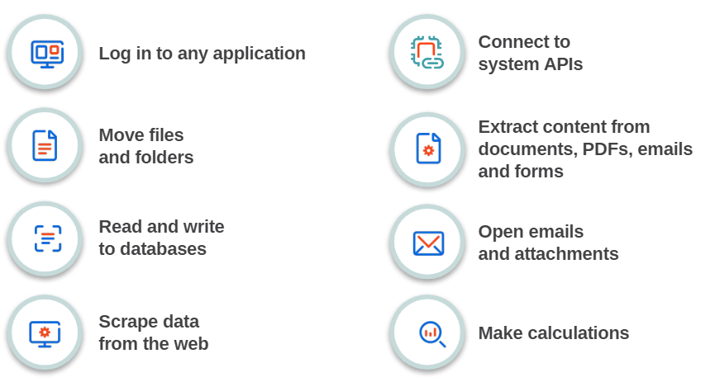
Tasks we can Botify

Slide 5
Accounting Processes (As an example)
Daily Transactions
Journal Entries
Reporting
Month End Close
Open/Close Accounting Periods
Maintain Exchange Rates
Mid-Close Reconciliation
Financials and Calendar Close
Reporting
Operational reporting
Enterprise reporting

Slide 6
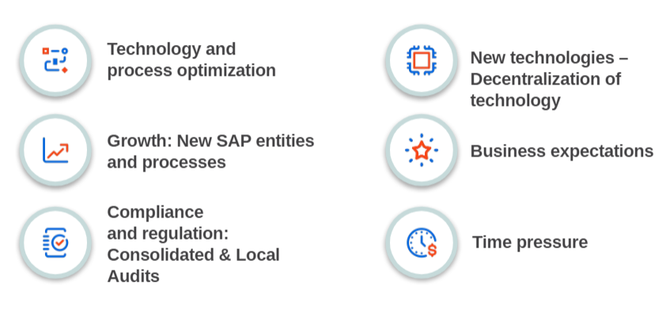
Challenges in Accounting Workspace

Slide 7
Financial Accounting – RPA entry points
Record to Report | Procure to Pay | Quote to Cash | Acquisition to Retire | Tax and Treasury | Strategic Reporting
General ledger reconciliation Intercompany reconciliation Financial Close activities Open Close Accounting Periods Maintain monthly exchange rates Manual journal entries Bank reconciliations Intercompany settlements | GR/IR Analysis and Reconciliation PR to PO Conversion Vendor invoice processing 2-way/3-way match reconciliation Vendor notifications Accrual journal entries and reconciliation | Sales order creation Sales order updates Customer invoices generation Customer notifications Monthly reconciliation (unbilled, deferred) Closing activities | Fixed Assets Creation Mass updates Monthly closing runs Periodic reconciliation | Data aggregation for filings Bank reconciliation Prepare tax returns Monthly reconciliation | Financial statements Aggregation of data Management reports Excel processing

Slide 8
Financial Accounting – RPA View
100% Human
Business As-Usual
For example:
Team meetings and planning
Front end – Human
Back end – Bot
For example:
AP robot works with AP staff on auto processing invoices once 3-way match has been completed
Front end – Person & Bot
Back end – Bot
For example:
Invoicing (scanning & processing). If no GR, email to requisitioner to perform GR
Project Accountant kicks off modernization job which helps automate the update to the bill plan process.
100% Automation
For example:
PR to PO to email pdf to vendor
Monthly Open Close Accounting Periods
Intercompany balancing reports are run automatically every 4 hours. A report is automatically sent to Accounting team containing variances

Slide 9
Ellucian Case Study Process – Open and Close Accounting Periods (FI, CO and MM)
THE CHALLENGE
User dependency (to open calendars first of the month, regardless of weekend, holiday)
No value-added task including mass notification
THE SOLUTION
Unattended robot running 1st of the month (as scheduled, 1am) to change FI, CO and MM periods and send notification
Unattended bot running last day of the close (using slack bot) to close FI, CO and MM period and send notification

Slide 10
Ellucian Case Study Process – SAP Data Extraction, Reporting and Reconciliation
THE CHALLENGE
Manual data extraction – running SAP reports (for example GL Line-item Report)
Download in excel and reconciliation which is time consuming and inefficient
User dependency for time sensitive tasks
THE SOLUTION
Unattended robot running at scheduled interval to download SAP data (direct table extract or through GUI), excel processing and building monthly file
Sending notification to end user with variance
Efficient and on-time closing

Slide 11
Ellucian Case Study Process – Purchase Requisition Status (for requisitioners)
THE CHALLENGE
End user (requisitioner) not getting direct notification about PR status (Approved, PO issued, Invoiced or not etc.)
Required them to login to SAP, navigate screens to get the information
End user training and learning curve
THE SOLUTION
Unattended robot triggered via Slack
Bot in the backend establish connectivity with SAP as API calls, get PR status, formats it in excel and send email attachment to requester
Bot also checks any pending GR or IR and accordingly notify AP clerk or PO requester

Slide 12
Ellucian Case Study Process – Sales order updates (Bill Plan)
THE CHALLENGE
Manual exercise to update sales order line items (for multiple bill plans)
Time consuming
THE SOLUTION
Attended bot for excel data processing to trigger VA02
Bot process through SAP Screens to make necessary updates
Bot update excel file back with status for reconciliation
Bot notify user for any errors and keep track of pending transactions

Slide 13
Polling Questions
How familiar are you with RPA?
Familiar (Use it for everyday work)
Have heard about it, but do not use it
New to RPA
Which RPA solution have you heard of or used?
SAP iRPA
UIPath
BluePrism
Automation Anywhere
Others
N/A

Slide 14
Questions
Rahul Goyal: rahul.goyal@ellucian.com
Kartik Dua: kartik.dua@ellucian.com

