Slide 1
Workforce Planning with SAC and S/4HANA Cloud
Mike Staszewski
Account Executive, Avvale
Zack Suarez
SAC Team Lead, Avvale
© Avvale, 2023

Slide 2
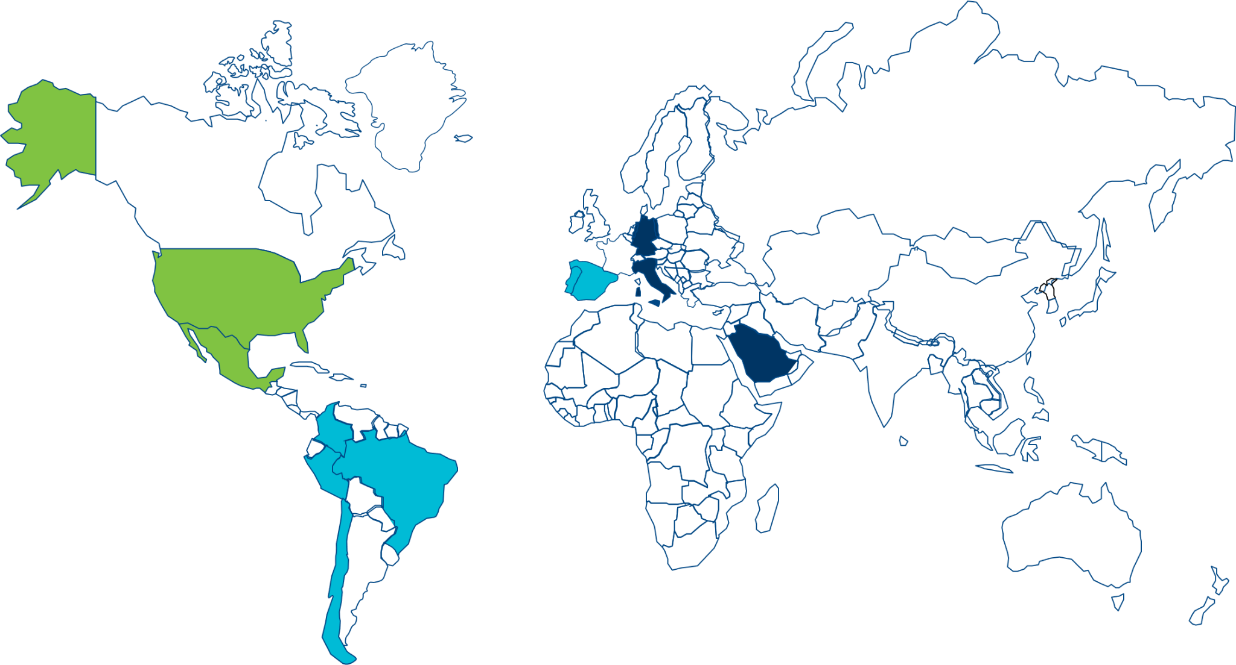
About Avvale
OUR PURPOSE
OUR PRESENCE
GROWTH
We transform our clients into digital, sustainable leaders through innovation
3000+ People
$350M
Revenue
An inclusive mix of
cultures, competences, attitudes and experiences to create One Unique Company
Double digit growth
year over year
since 2004
WHAT WE DO
CPM FOCUSED CLIENTS
HYBRID BY DESIGN
Digital Advisory
Software Atelier
System Integration
The premium quality of local niche players, the coverage & portfolio of global partners
Supporting both Fortune 500 and Midmarket in 15 industry sectors
Notes:
We are built upon our people’s digital competences, shared commitment and trust

Slide 3
Avvale’s Key Offerings
Avvale is a boutique consultancy that enables mid-size and large enterprises to efficiently and cost-effectively ramp up, scale, and optimize digital transformation for today’s circular economy and increasingly dynamic partner ecosystems.
Our company’s in-depth technical knowledge, advisory expertise, thought leadership, and implementation services are what make us not just a “vendor,” but a strategic partner.
Pillars
SAP Products
Key Offering
Key References
(public & non-public)
ERP
S/4HANA RISE + Native
S/4 Extensions (EWM, L&T, etc.)
GRC, SSO
ECC
SAP S/4 Greenfield Implementation
SAP S/4 Brownfield (Technical Upgrade or Business Transformation)
65+ transformation projects
SAP Carve Outs (M&A)
Packaged Offerings (t-shirt sized)
Cerapedics (S/4 Greenfield)
Pacific Coast Companies (S/4 Migration)
Vertex, GE Current (Carve Out)
Good Foods – RISE to SAP
Kwik Trip - (S/4 Greenfield)
Corporate
Performance
Management
IBP
Analytics Cloud for Planning
Group Reporting
BPC
Financial Consolidation
Planning
Reporting
Callaway - SAC for Planning
Alix Partners - SAC for Planning &
workforce planning
BDG - SAC Planning, Mktg Forecast
Amyris - SAC Planning Implementation
3000+ Team Members & Growing
Data &
Analytics
Analytics Cloud
Data Warehouse Cloud
HANA & HANA Cloud
BW & BW/4HANA
BOBJ
Advanced analytics & Data modeling
Reporting/dashboarding
HANA modeling & Optimization
Migrations from NEO to Cloud Foundry
San Francisco 49rs – Venue Analytics
Milliken - Digital Boardroom
Blue Diamond Growers
John Manville - BW to BW/4
20+ Offices globally
65+ S/4HANA Projects
Dev &
Integration
Business Technology Platform (All Services)
Fiori
Application Development & Modernization
Integration & API Management
Robotic Process Automation & Conversational AI
Vertex Aerospace – Supplier Portal
Gates – Crimping Machines
US Sugar – Mobile Applications
Onshore & Nearshore capabilities
Industry Focuses:
Manufacturing (w/ food niche)
Cloud
Migration
Strategy
Continuous cross-sell and upsell opportunities
Cloud Migrations (AWS, GCP, Azure)
Upgrades
Application Lifecycle Management
Disaster Recovery
Hallmark - AWS Migration
Cricut - AWS Migration
Southwire - GCP Migration
CPG & Retail
Professional Service
Managed
Services
Continuous cross-sell and upsell opportunities
Functional Managed Services
Technical Managed Services
Cintas, Culligan (Application)
GE Current, Vertex (Appl. & Technology)
Automotive
High Tech

Slide 4
Interactive Section
How many people are from Seattle?
How many people travelled here today?
100 miles…
200 miles…
How many SAP Partners are out there?
How many developers are here?
What planning tools are currently being used out there?
What is SAP Analytics Cloud?
What is BPC?
What is BTP?
What is SAP S/4 HANA?

Slide 5
Our Success Story
A global golf equipment company, partnered with Avvale to streamline its People Planning
11+ countries
40+ years in business
More than 2,000 employees
Real-time financial planning and analysis
Notes:
Our Success Story. I am excited to share our success story with SAP Analytics Cloud.
Our client, a professional services company with a global presence in over 11 countries, has been in business for over 40 years and has more than 2,000 employees.
To ADDRESS THEIR NEEDS, we leveraged the power of SAC for planning. We CREATED A CUSTOMIZED WORKFORCE PLANNING SOLUTION that allowed their end-users to plan and analyze data in real-time.
With SAC, they were able to GAIN VALUABLE INSIGHTS INTO THEIR WORKFORCE DATA, enabling them to optimize their workforce planning and make data-driven decisions to achieve their business goals.
If you have similar challenges or would like to know more about our success story, please feel free to stop by our booth today.

Slide 6
What We’ll Cover
Need for SAC Planning
Life Before SAC
From Idea to Implementation
The Solution
Planning for Future Success and Growth
Key Wins
Key Takeaways
Notes:
WHAT WE'LL COVER
First, we are going to ESTABLISH a need for SAC Planning
We are also going to talk about LIFE BEFORE SAC
From there, we are going to talk about Avvale’s METHODOLOGY to get from IDEA to IMPLEMENTATION
After the design is finalized, the SOLUTION will finally be realized
This SOLUTION will also need to be SCALABLE and RELEVANT for the future growth of the company
We will FINALLY talk about KEY WINS and KEY TAKEAWAYS

Slide 7
Need for SAC Planning
Financial planning and analysis (FP&A), specifically Workforce Planning, is one of the most powerful processes for Professional Services companies to effectively manage and execute strategic steps to drive significant business results in an increasingly competitive market.
Notes:
Now we are going to discuss a NEED FOR SAC PLANNING.
As you may know, FOR PROFESSIONAL SERVICE COMPANIES, REVENUE IS PRIMARILY DRIVEN BY THEIR WORKFORCE. At this particular client, the workforce was planned at a high level of detail to generate an accurate forecast. However, with SAC, we now have the ABILITY TO FORECAST BY EMPLOYEE INSTEAD OF BY DEPARTMENT/REGION, which provides a more granular and accurate forecast.
One of the key features of SAC is the ABILITY FOR USERS TO INPUT UTILIZATION, which directly impacts the revenue in the Profit and Loss (P&L) statement.
In summary, SAC Planning offers professional service companies the ability to forecast by employee, input utilization for more accurate revenue forecasting, and provides detailed expense classification for BETTER FINANCIAL MANAGEMENT.

Slide 8
Life Before SAC
More than 15 people forecasting in separate spreadsheets
5 users working solely to consolidate data
Difficulties to create analysis and visualization scenarios
No real-time integration or connectivity with the ERP
Notes:
Let's take a look at life before SAC. It was a VERY MANUAL PROCESS, with about 20 people spending valuable time entering forecasts for the entire firm. After that, 5 different people worked a lot to consolidate these spreadsheets and manually enter the data into their HR system. Can you imagine the effort and time that went into this process?
As you can imagine, MANAGING MULTIPLE VERSIONS OF SPREADSHEETS MADE IT DIFFICULT to analyze and visualize scenarios. Even the LACK OF REAL-TIME INTEGRATION OR CONNECTIVITY WITH THEIR ERP SYSTEM added more complexity to their data management and decision-making process.

Slide 9
Action Plan
Found a great partner team – SAP & Avvale
Performed an in depth analysis in Phase 1 to discover the improvement opportunities
“Sustainable” design approach
Notes:
Now we're going to talk about the action plan and the PROVEN METHODOLOGY behind it.
As you may know, our CLIENT HAS ALREADY FOUND A GREAT PARTNER TEAM IN SAP AND AVVALE. Avvale, in particular, has conducted in-depth analysis in multiple Phase 1 discovery and design sessions. This methodology that we're going to share with you today is not only proven, but also sustainable.
The first step is the discovery phase, where we WORK CLOSELY WITH OUR CLIENTS TO UNDERSTAND THEIR UNIQUE BUSINESS REQUIREMENTS AND GOALS. We analyze their current processes and data landscape to identify areas for improvement and opportunities for leveraging SAC.
Once we have a clear understanding of the client's needs, we move on to the design phase. This is where we CREATE A HIGHLY CONFIGURABLE SOLUTION USING SAC that aligns with the client's business objectives. We design the system architecture, data models, and reporting dashboards to ensure optimal performance and usability.

Slide 10
From Idea to Implementation
A “Sustainable” CAPEX and OPEX Planning Solution was designed
Real-time SAP ECC Cloud ERP Integration
Highly configurable CAPEX and OPEX Planning models and dashboards
Data management leveraging SAP Best Practices
KPI Enablement
Notes:
After the design phase, we move on to the Phase 2 implementation phase. Our team of experts will WORK CLOSELY WITH THE CLIENT’S BUSINESS AND IT TEAM TO DEPLOY AND CONFIGURE the SAC solution. We also PROVIDE COMPREHENSIVE TRAINING to ensure that the client's users are proficient in using the platform.
The BELOW HIGHLIGHTS some of the key outcomes from the implementation Real-time SAP S/4HANA Cloud Integration, Highly Customized Planning Models and Dashboards, SAP Best Practices for Data Management, and KPI Enablement.
In conclusion, our action plan and proven methodology, combined with the powerful capabilities of SAC, provide a comprehensive solution for our clients. We are confident that this approach will drive significant business outcomes and help our clients achieve their strategic goals.

Slide 11
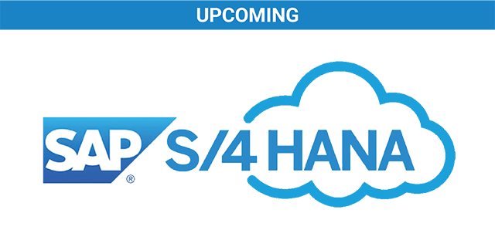
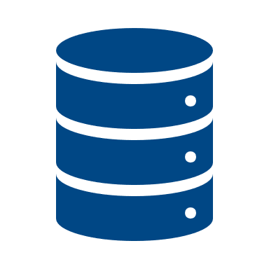
Solution Architecture
Flat File Integration
Reporting Model
Workforce Model
Balance Sheet Model
Currency Model
Cloud Connection
Cloud Integration
SAC Cloud
connector
Flat File
HCM Platform
Data Lake
Notes:
Here we are going to dive into the architecture of our system, which is a CRUCIAL PART OF THE WORKFORCE PLANNING PROCESS.
SAC is designed to capture data from various source systems such as the data lake, HCM platform, and SAP S/4HANA.
Our main Workforce planning model is located at the center of the architecture, where we can perform headcount planning and control various costs. This model is supported by the consolidation model, which is responsible for GL financial planning.
We also developed Balance Sheet and Currency models to PROVIDE ESSENTIAL SUPPORT FOR FP&A REPORTING.
In summary, our system is designed to PROVIDE A COMPREHENSIVE VIEW OF THE WORKFLOW PLANNING PROCESS, from data capture to financial reporting.
We believe that this architecture is CRUCIAL TO OUR SUCCESS AND WE ARE COMMITTED TO CONTINUOUSLY IMPROVE IT.

Slide 12
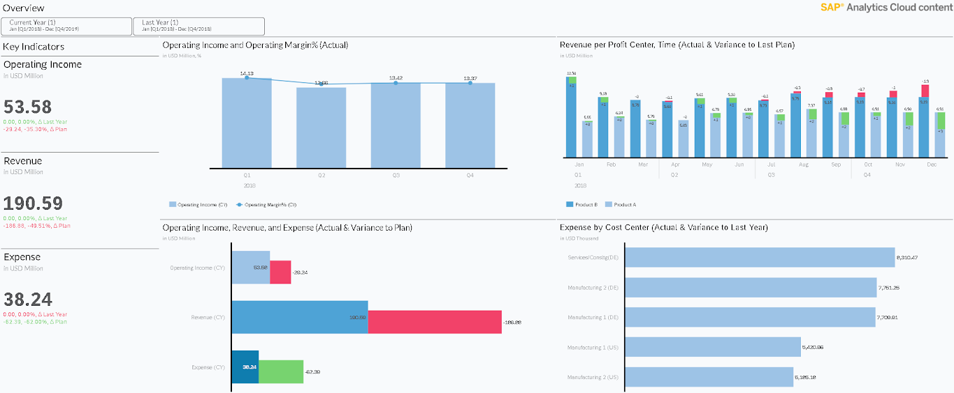
Dashboards
Notes:
I would like to share an example of our interactive dashboard capabilities. This particular dashboard is an excellent illustration of the SAC content, which can be customized to meet specific client needs.
Our dashboards offer a multitude of features that enhance data exploration, such as drill-downs, filters, and data manipulation options. Moreover, they are designed to be user-friendly, with an INTUITIVE INTERFACE THAT REQUIRES MINIMAL TRAINING to use. Whether you are building a dashboard from scratch or working with one of our pre-existing templates, we ensure that the end result is a robust and user-friendly solution for your data visualization needs.

Slide 13
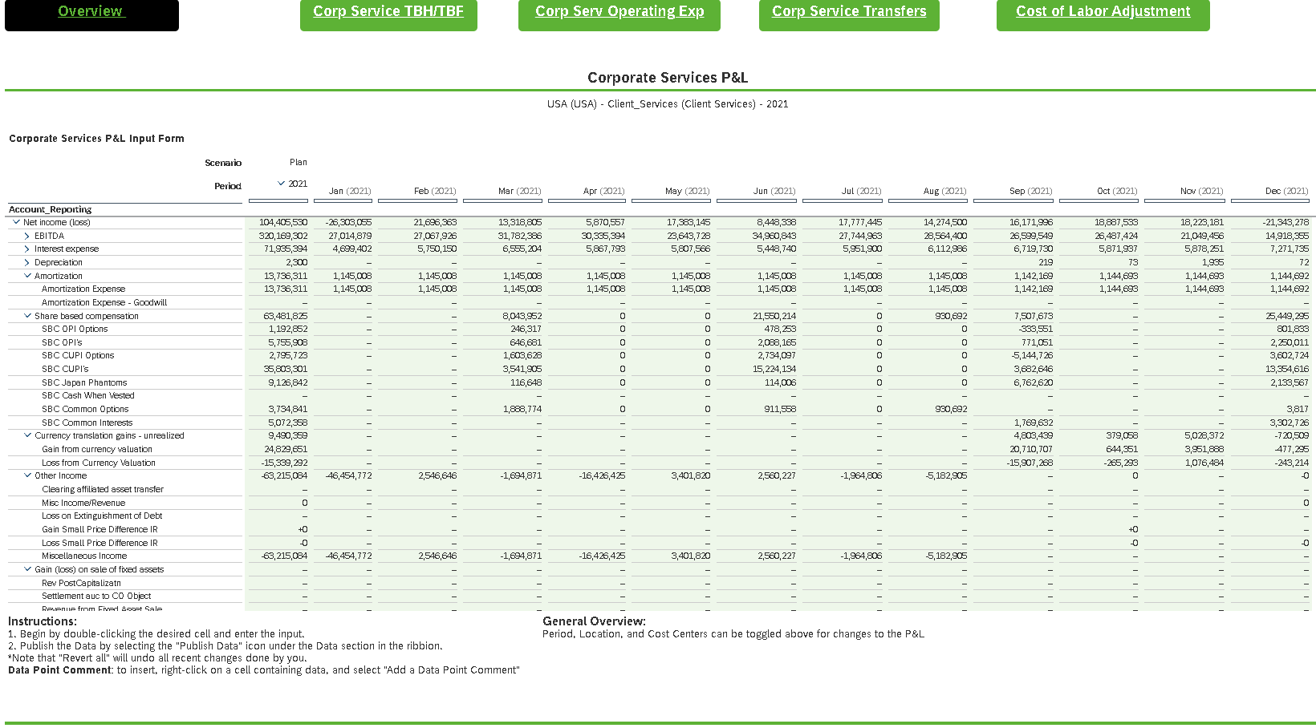
Dashboards

Slide 14
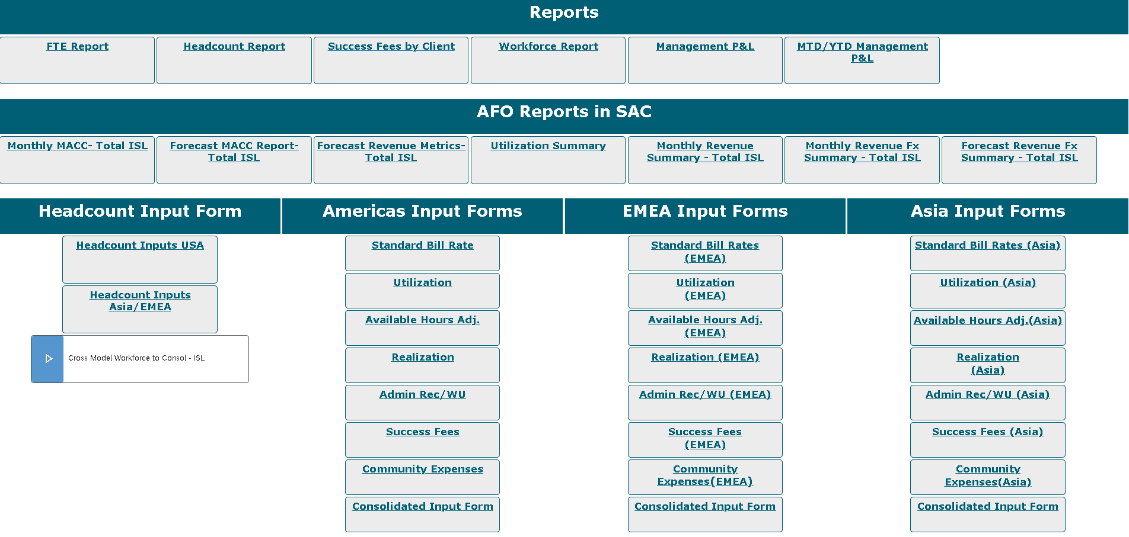
End-User Cockpit

Slide 15
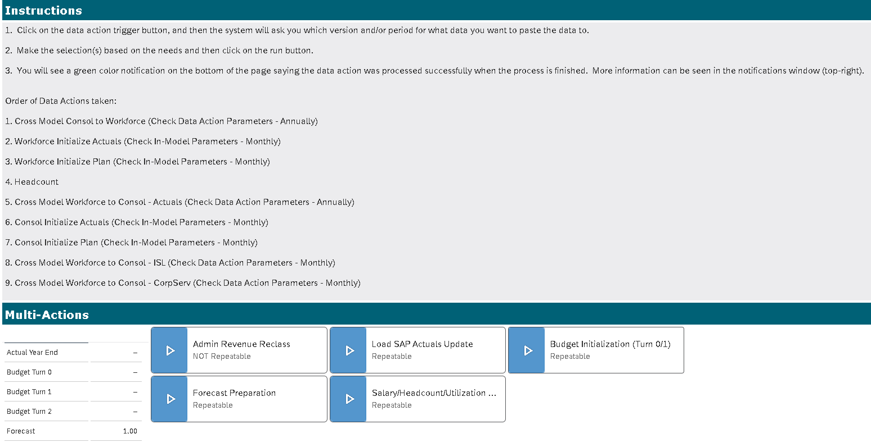
Admin Cockpit

Slide 16
Planning for Future Success and Growth
Decreased Forecasting Time
Efficient FP&A Process
Scalable Design to adopt future requirements
Notes:
Planning for Future Success and Growth
Let's start with the FIRST BENEFIT - DECREASED FORECASTING TIME. With SAC, you can streamline your forecasting processes, enabling you to QUICKLY GENERATE ACCURATE FORECASTS and make informed decisions based on REAL-TIME DATA. This can HELP YOU SAVE TIME AND RESOURCES, allowing your finance team to FOCUS MORE ON STRATEGIC ACTIVITIES.
Next, SAC offers an efficient FP&A process. The platform PROVIDES ADVANCED FINANCIAL PLANNING AND ANALYSIS CAPABILITIES, allowing you to create sophisticated financial models, PERFORM WHAT-IF SCENARIOS, and conduct comprehensive financial analysis. This EMPOWERS YOUR FINANCE TEAM to make data-driven decisions and collaborate effectively with other departments to align business objectives and drive better financial performance.
Lastly, SAC offers a SCALABLE DESIGN TO ADOPT FUTURE REQUIREMENTS. The platform is DESIGNED TO EVOLVE WITH YOUR BUSINESS, enabling you to easily adapt to changing business requirements, new data sources, and growing data volumes. You can QUICKLY CREATE AND MODIFY reports and dashboards to meet the dynamic needs of your organization. This flexibility ensures that SAC remains a valuable TOOL FOR YOUR ORGANIZATION'S LONG-TERM PLANNING AND GROWTH STRATEGIES.

Slide 17
Key Wins
Financial forecasting and workforce planning timeline Decreased from 7 to 4 days a month
Headcount Updates Takes five minutes instead of more than one hour
User Adoption SAC’s Excel add-on allow users to build reports easily
in (fewer sheets using) Excel
SAP S/4HANA Integration Enable real-time actual data to be analyzed into SAC
Notes:
Let's talk about the key wins of using SAP Analytics Cloud for financial forecasting and workforce planning. With our solution, we have achieved SIGNIFICANT IMPROVEMENTS in several areas, providing TANGIBLE BENEFITS.
First, we have decreased the time spent on monthly tasks from 7 days to just 4 days. This means a more efficient and streamlined process, allowing you to get FINANCIAL INSIGHTS FASTER and make INFORMED DECISIONS.
Next, we have streamlined headcount updates, reducing the time required from over one hour to just five minutes. This has SAVED OUR CLIENT VALUABLE TIME AND RESOURCES, freeing up their teams to FOCUS ON MORE STRATEGIC ACTIVITIES.
Our solution's Excel add-on has also greatly IMPROVED USER ADOPTION. Users can now easily build reports using Excel, with fewer sheets required. This intuitive integration has made it simpler and more convenient for our clients to create reports, INCREASING USER SATISFACTION AND PRODUCTIVITY.
Finally, our successful integration of SAP S/4HANA has enabled us to analyze real-time actual data in SAC. Thus, providing us with more accurate insights and has helped us make more informed decisions.

Slide 18
Key Takeaways
Understanding how SAP BTP can seamlessly integrate with other data platforms
Iterative development is key
An Intelligent Planning Solution can be realized in as little as 4 months
This use case applies beyond professional services
Unbounded potential for integrations between SAP BTP and other platforms
Notes:
SAP Business Technology Platform (BTP) PROVIDES A POWERFUL AND FLEXIBLE PLATFORM for integrating various data platforms seamlessly.
With iterative development, BUSINESSES CAN UNLOCK THE POTENTIAL of SAP BTP and SAC to create intelligent planning solutions in as little as four months.
This USE CASE IS NOT LIMITED TO PROFESSIONAL SERVICES, and there is potential for integrations between SAP BTP and other platforms.

