Slide 1
Choosing the Right Platform
for your SAP Workloads
Bob Friske
IBM Brand Manager
robert.friske@tdsynnex.com
Alfred Freudenberger
SAP HANA Infrastructure Subject Matter Expert
afreude.asiconsultingllc@gmail.com

Slide 2
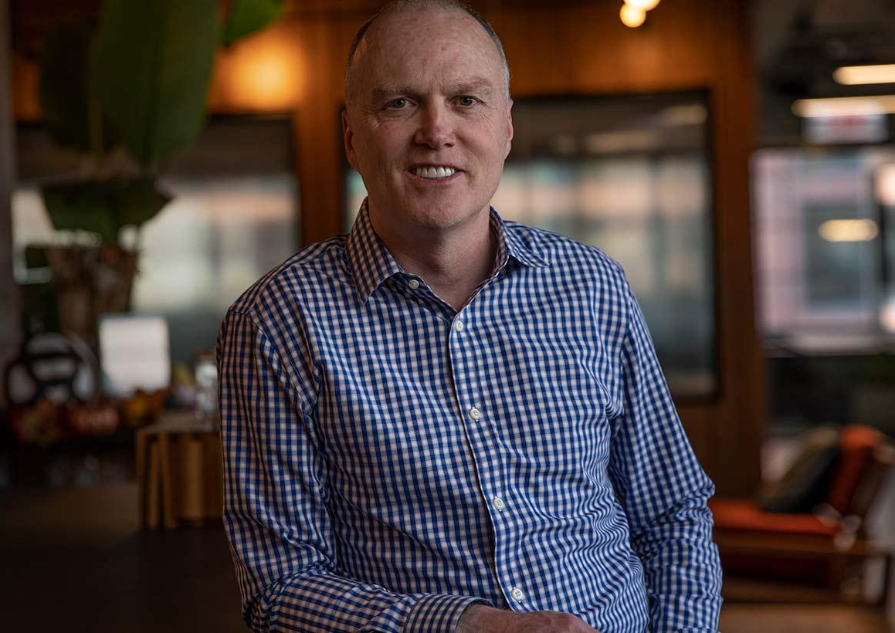
Meridian IT helps businesses solve their complex technical IT problems through a unique strategic perspective, deep expertise, and a personalized proactive approach.
Best-in-class on-prem, private / public, and hybrid cloud solutions for your mission critical workloads, with flexible pricing models and award-winning managed services.
Meridian IT works with each client to create a customized plan to help solve their IT obstacles.
Tom Horan,
Vice President, Cloud and Managed Services
tom.horan@meridianITinc.com
http://www.meridianitinc.com

Slide 3
$$$
!
HYBRID
!!
Reliability
Persistent memory
HA
2027!
Maybe 2030?
Beyond 2030?
Systems
&
Memory
Flexibility
Granularity

Slide 4
Want to learn more! Schedule a Zoom meeting with Meridian IT and your infrastructure or SAP Basis team and get a free
DRONE!
Tom Horan,
Vice President, Cloud and Managed Services
tom.horan@meridianITinc.com
http://www.meridianitinc.com

