Slide 1


S4/ECC Integration with Amazon Seller Central, using SAP BTP Integration Suite
Sridhar Oruganti
Global Lead – SAP Platform, Technology & Infra Services, YASH Technologies

Slide 2

Agenda
About HB Fuller
Integration Requirement with Amazon
Initial vs Current Simplified Automated Process
Automated Integration with Amazon - Solution Architecture
Key Benefits
Key Learnings
SAP’s Recognition
Future Roadmap

Slide 3

H.B. Fuller is a Global Market Leader in Adhesives
H.B. Fuller (NYSE: FUL) – Connecting What Matters™

Slide 4
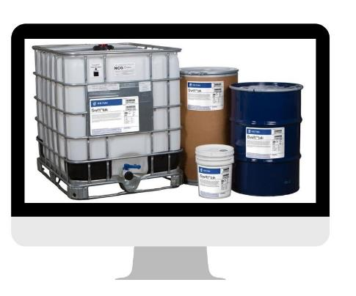
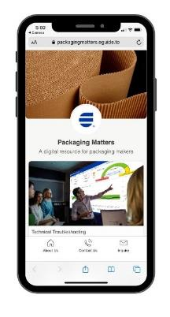
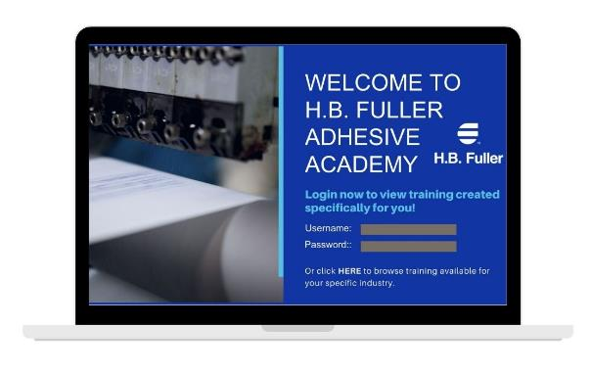
Improving Customers’ Experience through eCommerce
e-Service
e-Commerce
e-Learning
HBF e-Store
e-Marketplaces (Amazon, Alibaba)
SEO/SEM focus to increase lead generation
Sourcing Platform
On-Demand Tech Service
Market segment focused progressive web apps (PWAs)
“Contact Us” routing software
Training, troubleshooting, expert features
Gated and non-gated content

Slide 5
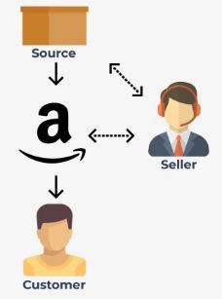
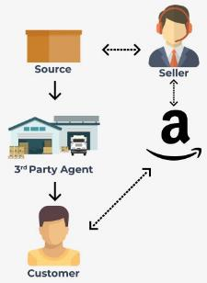
3P Fulfillment Models
3P Model | Fulfilled by Merchant (FBM) | Fulfilled by Amazon (FBA)
Recommended for…
Advantages | Full control over pricing, inventory, packaging and shipment Access to POS data | Access to Prime perks Faster start up Logistics and customer service are managed by Amazon
Disadvantages | No access to Prime Extra resources to manage packaging, shipping, returns and customer service to meet AB SLA Investment in system’s automation with increased sales | Inventory and returns fees can pile up in case of poor forecasting Not a good model for large/bulky slow-moving products No access to full POS data (zip-code level only)
Mid-large sized products
Slow-movers
New products
Seasonal products
Products distributer out of Aurora DC
Smaller products
B2C products
Categories where successful competitors using Prime

Slide 6
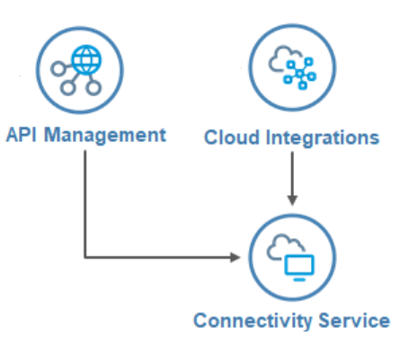









Solution Architecture
INTRANET
Firewall
INTERNET
Customer Center
SAP Business Technology Platform
SAP Business Suite
SOAP PROXY
Inbound/Outbound
SP-API
SAP Web IDE
UI theme
designer
SOAMANAGER web-service configuration
(SOAP ENVELOPE)
MWS API
Custom UI5/ Fiori Application
Portal
launchpad
Cloud connector
Secure tunnel

Slide 7
Initial vs Current Process (Simplified, Automated)
 | Process | Initial Process | Current Process with Automation
Dashboard | Fulfilled By Amazon (FBA) | Only available on Amazon Seller Central | SAP dashboard of stock levels at Amazon warehouses, safety stock etc. The user then can select the stocks to replenish and navigate to create KB order for consignment fill-up In transit status has been automated and available in dashboard
 | Inventory Fill-up order | Manual analysis between Seller Central and H.B. Fuller to determine fill-up | H.B. Fuller fills up Products inventory as a Consigned Stock to Amazon Distribution center. Consigned stock levels are maintained thru HBF manual analysis that in principle is not too low to be stock-out and not too much to accrue storage fees.
 | Notification to Amazon of Inventory in Transit | Go to Seller Central to acknowledge the shipment | In transit status has been automated
Settlement | Consignment Issue Order (FBA) | Manually create consignment issue with pricing conditions and SKU’s | Pay H.B. Fuller through bi-weekly settlement process Automation of process flowing in via pricing conditions, FI and then COPA
 | Settlement Report | Post FBA & FBM Revenue and Expense manually | Automation of process flowing into FI and COPA
Returns | Sellable Returns | Review sellable returns and manually add back to inventory | Run process in SAP to automatically retrieve sellable returns and add back to inventory

Slide 8
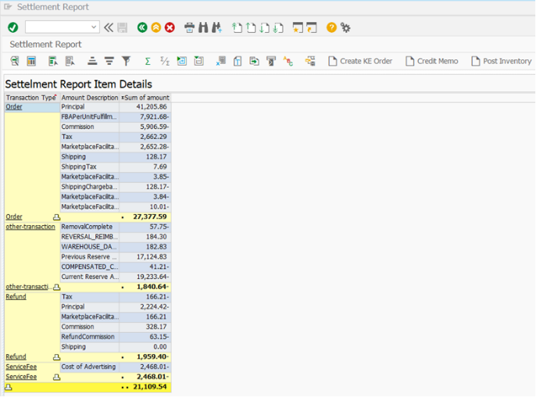
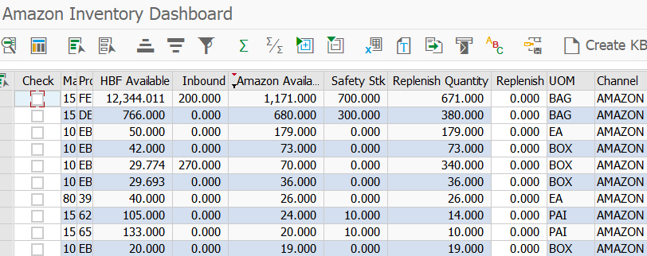
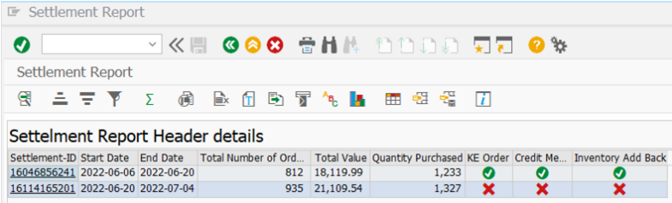
Inventory Dashboard for FBA & Settlement Process
One screen to quickly analyze by SKU what needs to be replenished at Amazon warehouse
Efficiently create the Consignment fill up (KB) by SKU
Automation of settlement process for both FBA and FBM setting up the Consignment Issue (KE)
Pricing conditions for Amazon fees to properly flow through FI and COPA at the SKU level

Slide 9

Benefits
Replenishment Process
Remove manual sales order entry need (~10 minutes/order)
Eliminate manual comparison of SAP and Amazon to confirm shipments (~25 minutes per order)
Significant accuracy improvement
Ease of analysis in replenishing with sortable safety stock
Sellable Goods Process
Automated adding back inventory
Smoother settlement process
Higher accuracy of stock at Amazon warehouse
Settlement Process
Time savings of ~2 hours/settlement with current volumes
Enhanced reporting with automation of pricing conditions along with proper ledger and COPA classifications
Improved coordination of revenue, inventory reduction and expense recognition
Improved cash application process
Automated credit process removes the need to go through manual QN processing

Slide 10

Key Learnings
Run on Amazon for a while to understand your requirements
  Our initial thought was focus on FBM but have moved to FBA model
  Business processes were not yet defined when we started project lengthening engagement
Pick a good third party who understands Amazon (Seller Central reports, fees etc) will help the technical teams
  We had to draw it out of them rather than them offering best practices upfront
Keep asking questions to gain knowledge
Understand the process flows and know you cannot change Amazon
Register one Legal Entity with Amazon – pick the right entity
Make sure you have a dedicated resource to run
the process

Slide 11

Technical Learnings during Implementation
Connectivity
  SP- API is very new and still it is getting stabilized
  Pre-requisites like developer registration, application registration etc. takes time
  Rest based API through access token, security token and signing requests with AWS4 signature
Adherence with Amazon security policies
  Additional accesses (PII) will be provided only in compliance with Amazon’s security policies
  Quite a lot of configuration for accessing the Amazon APIs (network protection controls, encryption, privacy and data handling policies etc.)
SAP Integration Suite – Open Connectors is not yet fully compatible with SP-API. Hence, iFlow/Groovy development is involved

Slide 12


Solution Showcase & SAP’s Recognition
SAP’s Winner Accouncement Blog
“Yash Technologies demonstrated the integration of SAP S/4HANA with Amazon Marketplace. In general, smooth interaction between online marketplaces and SAP solutions provides a lot of opportunities for our customers. SAP Integration Suite is a platform of choice for such complex yet very relevant scenarios. Congratulations to Yash Technologies for winning Hack2Build in the Americas for SAP Integration Suite. It marks a milestone in the innovation journey, and we are looking forward to the solution that our customers will be able to enjoy.”
- Rudolf Held, Head of Global SAP Co-Innovation Lab, Judge of Hack2Build, SAP Integration Suite, 2022
Notes:
Blog link to be inserted

Slide 13












YASH’s Solution – Future Roadmap
INTRANET
Firewall
INTERNET
Customer Center
SAP Business Technology Platform
SP-API
SAP Web IDE
MWS API
SAP ECC/S4 HANA
UI theme
designer
Custom UI5/ Fiori Application
OData/ SOAP
Portal
launchpad
Secure tunnel
Cloud connector
Notes:
Blog link to be inserted

Slide 14
Thank You

