Slide 1
Disruptive Trends & Technologies Reshaping SAP Integration
Chris Swift Senior Solution Engineer, enosix
John Campbell
Senior Manager of Customer Technology Strategy, Mannington Mills

Slide 2
Sponsored by:

Slide 3
By 2023, use of packaged integration processes will grow from less than 30% in 2020 to above 65% of new integration projects. Gartner Accelerate Your Integration Delivery by Using Packaged Integration Processes, 2020
Notes:
3 Years ago, Gartner observed the early adoption and use of prepackaged integrations and coined the term “Prepackaged Integration Processes” or PIPs.
Back in 2020, they predicted significant growth in this space and enosix, as well as other providers have been seeing double digit growth as this approach continues to mature and serve as a competitive advantage for organizations.

Slide 4
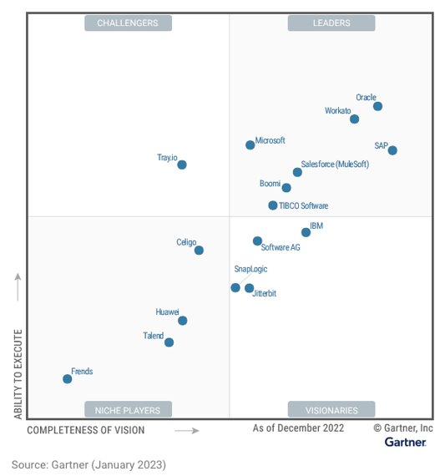
iPaaS Market Growth
The market for application architecture, development, integration and platform technologies has experienced consistent double digit growth YOY. ​
Integration platform as a service (iPaaS) emerged as the fastest-growing segment, exhibiting 40.2% growth.​
The top five iPaaS providers’ command about 60% of the market, and only eight providers have more than a 2% share.​
Integration represents up to 65% of the cost when implementing a new ERP or CRM system. ​
​
Sources:​
Gartner Market Share Analysis: Application Architecture, Development, Integration and Platforms, Worldwide, 2021​
Hype Cycle for Application Architecture and Integration, 2022​
Magic Quadrant for Integration Platform as a Service, Worldwide, 2023

Slide 5
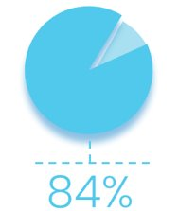
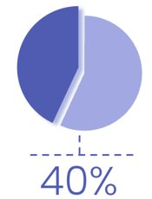
iPaaS Growth Drivers & Considerations
Growth Drivers​
By 2025, over 50% of the organizations that are using older-generation integration platforms like ESBs will migrate their business-critical integrations to cloud-based integration solutions.​
40%+ of integration projects are migration projects from one integration platform to another. ​
Integration migration projects often involve dozens of applications, data sources, APIs and a wide range of technologies. ​
Considerations​
Leaders responsible for integration should develop a strategy and plan, based on an analysis of existing integrations, tackling each incrementally and employing vigorous stress testing before switching over.​
Testing is a substantial part of the migration effort and it consumes somewhere around 60% to 65% of the overall migration effort​
​
Sources​
Gartner How to Successfully Migrate to a New Integration Platform, 2021​
Gartner, IT Symposium/Expo Oct. 2019; 2020 DSAG-ASUG survey​
​
of projects are stalled by integration challenges
of project budget is spent on integration​

Slide 6
iPaaS Challenges with Business Process Optimization
Service CRM
Sales CRM
I want to update an SAP Order from Salesforce
Integration Platform
Logistics
Supply Chain
ERP
Commerce

Slide 7
#1 – Integration Platform Not Established
Service CRM
Sales CRM
I want to update an SAP Order from Salesforce
Integration Platform
Logistics
Supply Chain
SAP
ERP
Commerce

Slide 8
#2 – Build Effort vs. Business Value = Low Prioritization
Service CRM
Sales CRM
I want to update an SAP Order from Salesforce
Integration Platform
Logistics
Supply Chain
SAP
ERP
Commerce

Slide 9
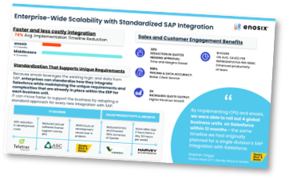
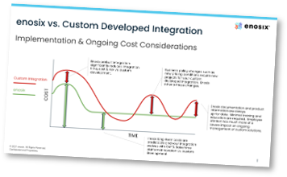
The Emergence of Prepackaged Integration Processes (PIPs)
PIPs enable integration teams to deploy integration work faster and deliver return on investment quickly. ​
Implementation time saved between 40% and 70% vs. build​
PIPs are not pure plug and play — PIPs are generally not 100% “plug and play” and typically require some customization. ​
Source:​
1 - Accelerate Your Integration Delivery by Using Packaged Integration Processes, 2020
PIP Examples​
enosix (SAP Communication Framework)​
SAP Cloud Platform (Prepackaged Integration Content)​
Mulesoft (Accelerators)​
Workato (Recipes)​
Boomi (Integration Packs)​

Slide 10
Trends for Utilizing Prepackaged Integration
Revenue Generation​
Streamlined product configuration & quoting ​
Pricing ​
Seamless B2B commerce & portal integration ​
Profitability ​
Margin integrity​
Customer service i.e. warranty, repairs, replacements, returns
Reduce Risk & Increase Agility​
Reduced implementation risk ​
Reduced impact for S/4HANA migration

Slide 11
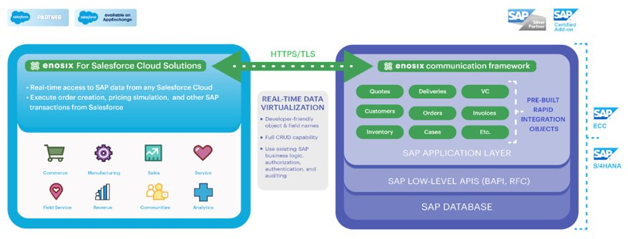
Enosix Prepackaged Integration

Slide 12
Mannington Mills Inc.
108 years old, Five Generations of Family Ownership​
Residential Floor Covering (Mannington & Phenix Carpet)​
Commercial Floor Covering (Mannington Commercial)​
​
SAP ECC 6.05 (Netweaver 7.02)​
Mill Solutions, Pricing, Inventory Controls . . .​
Salesforce.com (Single Org/Instance)​
Sales, Service, Claims, and Customer Portals

Slide 13
Challenges Prior to enosix
Sales needs information in SAP (Stock, Pricing, Order Status)​
Email/Phone Burden on Sales and Customer Service​
“Swivel Chair” Business Processes​
Price Level Changes​
Pricing Approvals​
Poor Data Visibility​
Customer Master​
Account Order Data​
Invoices​
Multiple Expensive Integration Systems​
Multiple Customer Portals for Different Functions

Slide 14
enosix for Sales
enosix Surface (Real-time SAP Data visibility)​
Provide Real Time Order Status​
Forward BOL and Shipping Information​
Access Invoices​
See Complex Customer Data ​
enosix Transact (SAP Transactions)​
Download Price Sheets​
View Inventory​
Change Pricing for Customers​
View Realtime ATP for Product

Slide 15
enosix for Customers (SFDC B2B Commerce)
enosix Commerce​
Residential B2B Order Portal​
Real Time Pricing Calls​
Real Time Inventory Stock Check​
Provide ATP to Customers​
Minimal Interaction needed by Customer Service​
enosix Surface​
Order Status, Invoice Lookup​
enosix Transact​
Customer Price Sheets, Pricing Portal​
Results​
250% increase in Portal Utilization, 100% increase in Portal Users

Slide 16
enosix for Internal Business Apps
enosix Connect – REST APIs​
Manufacturing Production System Integration​
Creating Production Orders for Rubber Systems​
Bi-directional updates between Manufacturing Systems​
B2C Commerce Order Creation​
Creating Sample Orders via API from Residential Website

Slide 17
Recommendations
Accelerate your existing integration initiatives​
Continue integration modernization & iPaaS platform adoption + Consider PIP solutions for quick-to-market business process integration. ​
​
Proactively pursue operational differentiation ​
Collaborate with front-end users to uncover opportunities for business impact​
Evaluate PIP market for prebuilt, process-oriented integration solutions​
Establish cost/benefit analysis (Tip: Leverage identified solution provider)​
Present story to leadership for approval & next steps

Slide 18
For questions after this session, contact us at chris.swift@enosix.com and marketing@enosix.com

