Slide 1

Are you Missing Out on What’s Yours? Understand and get More Value from your SAP Support Investments
NOTE: Delete the yellow stickers when finished.
See the SAP Image Library for other available images.
VerNeil Mesecher Jr. – Sr. Dir. – Regulated Industries (US) – Customer Engagement
Customer Evolution Program
August 25, 2022

Slide 2










SAP Enterprise Support
The foundation for customer success
Collaboration
Empowerment
Innovation and
value realization
Mission-critical support
Proactive
and preventive
support
SAP Enterprise Support
The foundation for customer success
Across all deployment options
Consumption of innovation I Value realization I Business outcomes I End-to-end optimization
Intelligent enterprise
Cloud
Digital core
Innovations

Slide 3


Collaboration
As part of SAP Enterprise Support you have access to multiple collaborative resources, that have a defining impact on your success.
  Leverage expert access through collaborative social communities
  Get in touch with SAP experts 24x7, e.g. via the SAP ONE Support Launchpad
  Benefit from targeted reports and analyses
  Rely on functional and technical expertise on key areas
  Benefit from advice on the right support deliverables and assets
  Get help to drive innovations
I want to get guidance from SAP to help me realize more value from my investment.”
Further information on how to enable the Intelligent Enterprise with SAP Enterprise Support can be found within this brochure
Notes:
At SAP, we believe that collaboration is one of the keys to maximizing the value you derive from SAP Enterprise Support. Therefore, it’s important for us to help you connect with SAP experts and other SAP customers – always with the goal of guiding your people to master the skills they need to help your organization thrive.

Slide 4
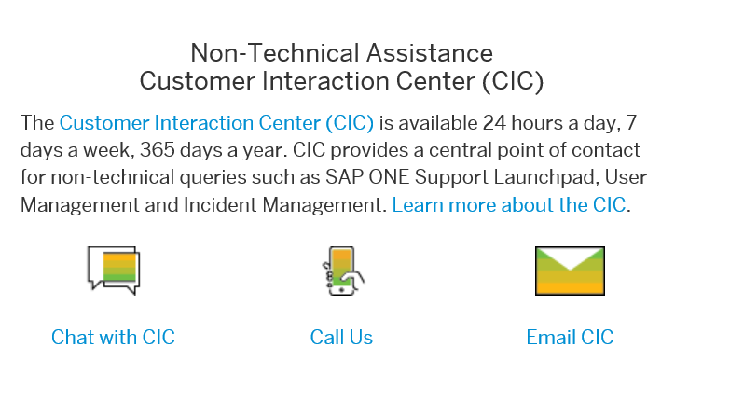
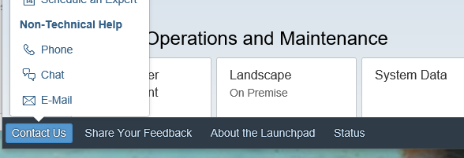
GETTING STARTED with Collaboration
SAP Customer Interaction Center
Overview | Benefits | Access | Preview
The SAP CIC is the contact channel for any non-technical questions including Existing incidents SAP ONE Support Launchpad and supporting applications S-user queries and support SAP remote service requests The SAP CIC may be reached by phone, chat, or email. | The SAP CIC is available 24 hours a day, 7 days a week, 365 days a year, and provides a central point of contact for assistance with non-technical queries. A universal free phone number for contacting SAP support in most countries through landline phones and some mobile providers. Access to a product area specific IVR call routing menu. | You may access the SAP CIC from the SAP Support Portal or through SAP ONE Support Launchpad. Direct access Chat with CIC Call CIC E-mail CIC Learn more Access to CIC Topics to contact CIC Reference Guide
SAP Support Portal
SAP ONE Support Launchpad

Slide 5




GETTING STARTED with Collaboration
Customer Center of Expertise–Overview
The Customer Center of Expertise is a central point of contact for interaction with SAP. It is building the bridge between IT and business and is one of the main contacts within your company for SAP-related topics.
All SAP customers may establish the Customer Center of Expertise to gain and use full value from SAP.
SAP Support Portal
  Customer Center of Expertise (CCOE)
  Primary Customer COE
PDF
      Getting Started with Primary CCOE Certification
      Learn about the Value of a Primary Customer Center of Expertise
Lines of Business
Customer with a
Center of Expertise

Slide 6
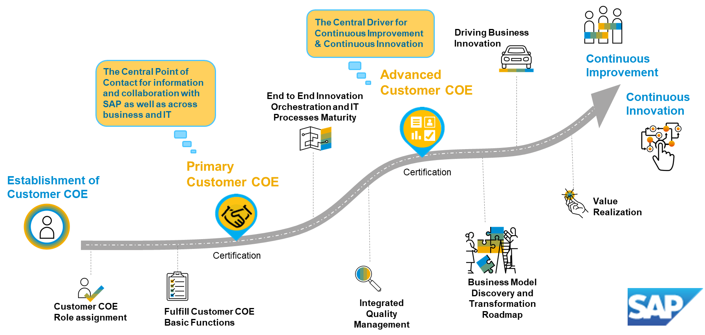

GETTING STARTED with Collaboration
Customer Center of Expertise–Lifetime Journey of IT for Business
Start your Customer COE Journey

Slide 7




GETTING STARTED with Collaboration
Customer Center of Expertise–Basic Functions
Customer COE Setup – the 4 basic functions | Details
Information | Start new communication channels for end users (such as with SAP Jam, blogs, chats, etc.) Position direct, fast and open communication hubs Information about company IT strategy / security guidelines and best practices Trainings, Knowledge Transfer and Learning Curriculums Success Stories and Best Practices
Contract and License | License / subscription Customer COE internal fees and service catalog Existing internal IT pricing models might become obsolete Alignment for all SAP related contract activities with cloud offerings in hybrid use cases Integration / harmonization of SAP support offerings
Innovation | Collect and bundle the company demand for innovation Enhance the scope with line-of-business expertise into to relevant communities Manage overall innovation road map together with the business key contacts in the relevant areas Create hybrid visibility for your innovation demand and collaborate cross-solution focused Consider SAP Tools and Services like SAP Pathfinder, S/4HANA Readiness Check, etc.
Support Operations | Analyze the existing SAP Support process landscape Follow new features from SAP Support Define the hybrid support process project if applicable Governance of Support Processes Design authority Seamless support for hybrid solutions with enhanced responsibilities if applicable

Slide 8
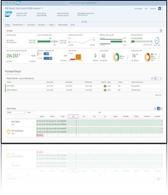
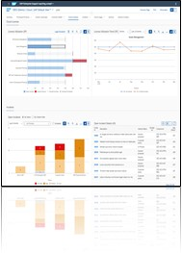
GETTING STARTED with Collaboration
SAP Enterprise Support reporting cockpit
The SAP Enterprise Support reporting cockpit is an interactive dashboard analyzing and documenting the status of your SAP solution, support services, and achievements based on solution-monitoring capabilities, usage of KPIs, consumption of SAP Enterprise Support offerings, support case status, and other support-relevant metrics.
You may interact, personalize, and design your SAP Enterprise Support report by adding or removing data sections, statistics, and tables; drill down into detailed views across products, systems, services, incidents, and status. Save your settings as your individual variant or print it as a report.
SAP Support Portal
  SAP ES reporting cockpit portal
  Release Notes for Wave Releases
SAP ONE Support Launchpad
The SAP Enterprise Support reporting cockpit replaces the PDF-based SAP Enterprise Support report in SAP ONE Support Launchpad.
Please note: You’ll see the data sections for the LOBs/installations you are authorized for. For more information please check KBA 2835500.
      SAP Note 2835500
SAP Community
      Blog announcement

Slide 9
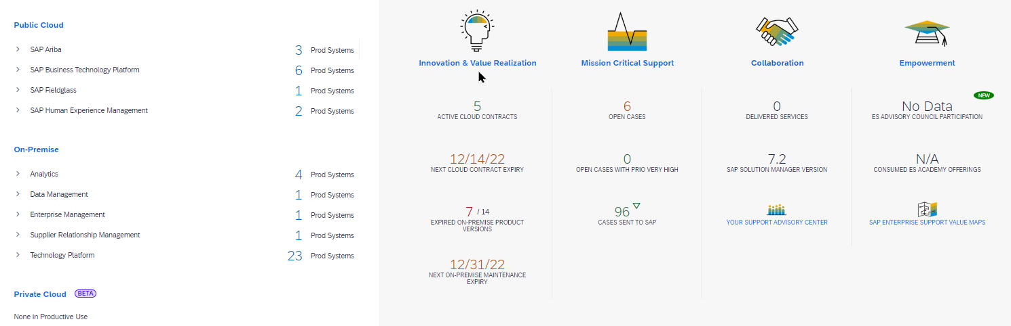
Enterprise Support Reporting Cockpit – Sample Portfolio View

Slide 10
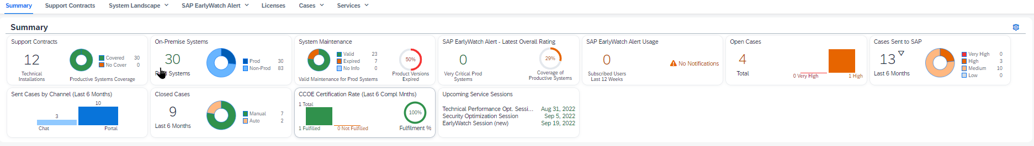
Enterprise Support Reporting Cockpit – Sample On-Premise View

Slide 11
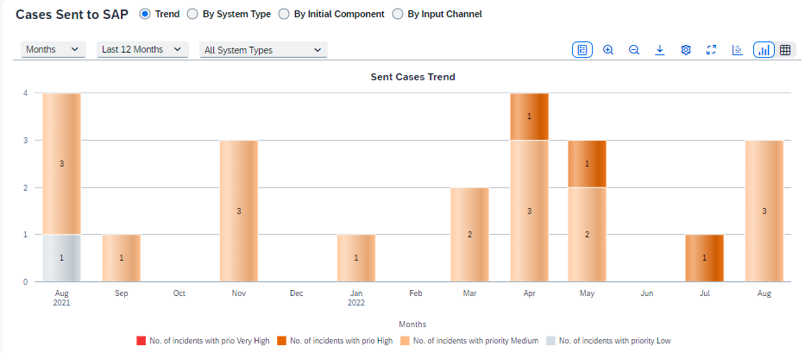
Enterprise Support Reporting Cockpit – Sample Incident Trend View

Slide 12









GETTING STARTED with Collaboration
SAP Enterprise Support–next-generation value maps
SAP Enterprise Support value maps – an empowerment and support program, which leads you through the knowledge, skills, and services needed to address business challenges and adopt intelligent technologies. Value maps provide direct access to SAP experts, collaboration forums, high-impact learning, and prescriptive guidance, to help you achieve meaningful results and unlock new potential for growth.
Expert Access
Prescriptive Guidance
SAP Enterprise Support value maps
Social Collaboration
powered by SAP Enterprise Support Academy
Structured content enables guided journey, simplification, and accelerated consumption of needed enablement content across the entire lifecycle.
Empowerment
Collaboration forums allow you to get guidance and exchange ideas, and best practices with SAP experts and peers.
Social Collaboration
Prescriptive Guidance
Empowerment
Expert Access
Interactive learning formats to empower you with the knowledge and skills for realizing your deployment strategy.
Access to SAP experts and industry peers for professional advice, best practices, business insight, and technology know-how.
Your Benefits
 | Advance digital skill level with interactive learning formats |  | Maximize the value of your SAP solutions |  | Get quick advice form SAP experts and peers |  | Access to virtual events with leading specialists
 | Achieve deployment and Operational goals |  | Reduce training expenditures |  | Easy access to latest news and releases |  | Record of learning accomplishments

Slide 13


SAP Enterprise Support Value Maps
Portfolio
Available SAP Enterprise Support value maps
SAP S/4HANA |  | SAP Business Technology Platform
SAP S/4HANA Cloud |  | Application Lifecycle Management
SAP S/4HANA Cloud, private edition |  | Business Process Intelligence
SAP SuccessFactors |  | Business Process Improvement
SAP Customer Experience solutions |  | Data Volume Management
SAP Analytics Solutions |  | Security
SAP Ariba |  | SAP Jam Collaboration

Slide 14

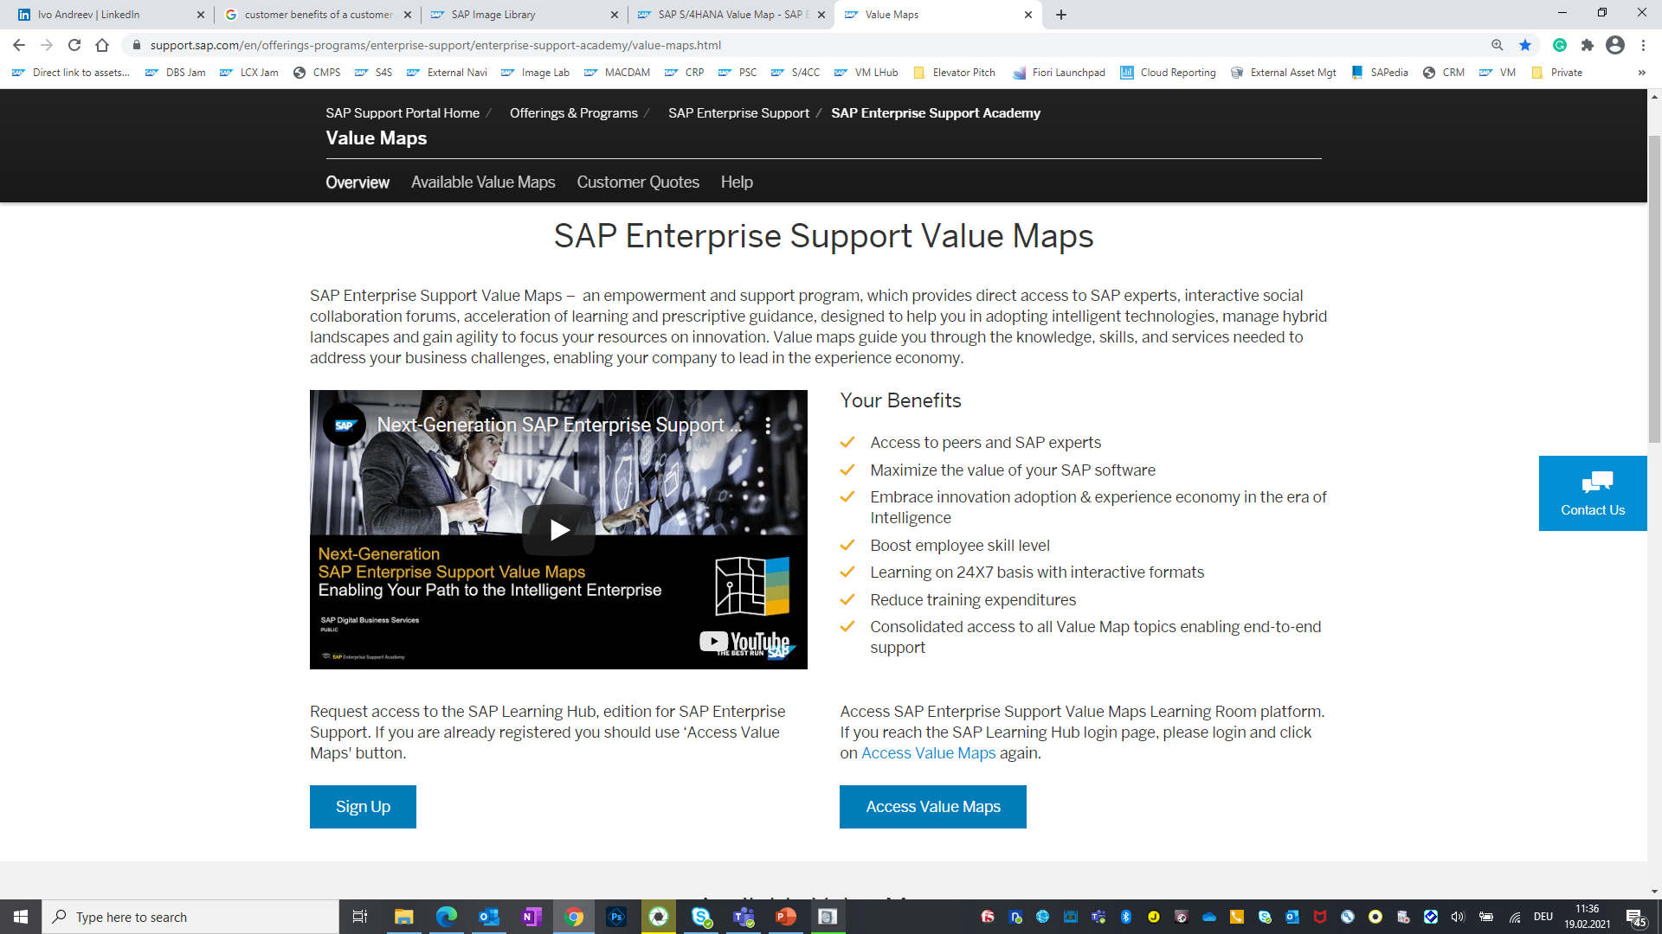



SAP Enterprise Support Value Maps
How to register and access value maps
http://support.sap.com/valuemaps
  SAP Enterprise Support Value Maps
  SAP Enterprise Support Value Maps – an empowerment and support program, which leads you through the knowledge, skills, and services needed to address business challenges and adopt intelligent technologies. Value maps provide direct access to SAP experts, collaboration forums, high-impact learning, and prescriptive guidance, to help you achieve meaningful results and unlock new potential for growth.
Your Benefits
Achieve deployment and operational goals with prescriptive guidance
Advance employee skill level with interactive learning formats
Maximize the value of your SAP software
Reduce training expenditures
Access to SAP experts and industry peers for advice and recommendations
Stay informed with latest news and releases
Attend virtual events with leading specialists
Request access to SAP Learning Hub, edition for SAP Enterprise Support. Watch the video and refer to our tutorial to learn how to sign up and use the hub.If you are already registered you should use ‘Access Value Maps’ button.
Access SAP Enterprise Support Value Maps Learning Room platform. If you reach the SAP Learning Hub login page, please login and click on Access Value Maps again.
Step 1
Sign Up
Step 2
Access Value Maps

Slide 15







GETTING STARTED with Collaboration
Example: SAP S/4HANA Cloud Value Map Learning Journey
Discover Discover the value of SAP S/4HANA Cloud |  | Prepare Plan, prepare, and start the implementation |  | Explore Define all the details
Discover SAP S/4HANA Cloud (self-paced) openSAP course: How to Best Leverage SAP S/4HANA Cloud for Your Company Meet-the-Expert: The Essentials for Country Localization for SAPS/4HANA Cloud Demo: SAP S/4HANA Cloud Trial …* |  | Meet-the-Expert: SAP S/4HANA Cloud Onboarding Roadmap Viewer: Implementation roadmap for SAP S/4HANA Cloud Meet-the-Expert: SAP S/4HANA Cloud with SAP Activate Meet-the-Expert: Customer Organization Readiness for SAPS/4HANA Cloud Meet-the-Expert: Data Protection and Privacy in SAP Cloud …* |  | Tutorial + Meet-the-Expert: Finance Overview Meet-the-Expert: Requesting the Q-system in SAP S/4HANA Cloud Meet-the-Expert: General Data Protection Regulation Meet-the-Expert: Integration Overview openSAP course: Extending SAP S/4HANA Cloud and SAPS/4HANA …*
Run Optimize the operability |  | Deploy Prepare to go live |  | Realize Implement technical and functional changes
Meet-the-Expert: Get Prepared for the Quarterly Release Upgrade SAP S/4HANA Cloud Portal: SAP S/4HANA upgrade process and upgrade schedule Meet-the-Expert: SAP S/4HANA Cloud Release Assessment & Scope Dependency Tool …* |  | Roadmap Viewer: End user solution adoption Blog: The key to a successful implementation of S/4HANA Cloud …* |  | Blogs: Performance Best Practices in SAP S/4HANA Cloud Meet-the-Expert + SAP Note: Test Automation Tool for SAP S/4HANA Cloud Meet-the-Expert: Data Migration with SAP S/4HANA Cloud Meet-the-Expert: SAP S/4HANA Cloud Extensibility …*
*Please note that the complete content of the learning journey is available within SAP Enterprise Support value maps learning room.

Slide 16


Empowerment
Through the SAP Enterprise Support Academy program we help you build competency and expand your skills easily.
  Get empowered through extensive learning and education elements of the SAP Enterprise Support Academy
  Easily access learning content and services via the new SAP Learning Hub platform
  Leverage expert content in various delivery formats and levels of detail
  Making sure you address and cover the right skills gap
  Learn how to run your software solution at peak performance
  Get your organization ready for innovation and accelerate innovation throughout the company
“I need to make sure that both, business and IT, have the right knowledge and skills.”
Notes:
The SAP Enterprise Support Academy is an award-winning program and your one-stop shop for exploring and leveraging SAP Enterprise Support offerings. It helps you increase the speed in integrating digital projects and developing digital capabilities and skills within your project teams. The program includes high impact knowledge transfer services (live and on-demand) and accelerated learning with prescriptive and social-driven guidance through SAP Enterprise Support value maps. The learning assets are developed by SAP support experts and engineers for roles involved in implementation, deployment, integration, and system operations of an SAP solution.

Slide 17


GETTING STARTED with Empowerment
SAP Enterprise Support Academy–SAP Learning Hub and Newsletter
Tap into SAP Support expertise fueled by the SAP Enterprise Support Academy to achieve your business outcomes while boosting proficiency and fostering continuous innovation.
Additional Information
  SAP Enterprise Support Academy
  Sign up for access
  Topics to contact CIC (S-user request)
  SAP Enterprise Support value maps
  Subscribe for the newsletter
Increased speed in integrating digital projects and developing digital capabilities and skills within your project
Access our learning environment that is intuitive, social, collaborative, and reactive to your learning needs. We use SAP Learning Hub, edition for SAP Enterprise Support to bring you knowledge transfer services. Accelerate your learning with prescriptive and social-driven guidance with a customizable learning plan Registration via S-user may be required to consume the learning material
Stay informed about the range of services and educational content offered by subscribing to the SAP Enterprise Support Academy update.
Video
      How to sign up
      How to search in SAP Learning Hub

Slide 18











GETTING STARTED with Empowerment
SAP Enterprise Support Academy–delivery formats
Value maps
Accelerated innovation enablement
Expert-guided Implementations
Meet-the-expert sessions/recordings
Tutorials
Videos
Continuous quality check and improvement services
Guided
self-services
Programs
Best practices
Collections
Visit us on SAP Support Portal at SAP Enterprise Support Academy

Slide 19
GETTING STARTED with Empowerment
Continuous Quality Checks (CQC)
SAP Continuous Quality Checks |  | SAP Improvement Services
SAP CQC Business Process Improvement (only applicable for SAP ERP software) SAP CQC Business Process Performance Optimization SAP CQC Configuration Check SAP CQC Data Consistency Management SAP CQC Data Volume Management SAP CQC Downtime Assessment SAP CQC EarlyWatch Check SAP CQC Going Live Support SAP CQC For Implementation | SAP CQC Interface Management SAP CQC OS/DB Migration Check SAP CQC Security Optimization Check SAP CQC Technical Performance Optimization SAP CQC Transport Execution Analysis SAP CQC Upgrade SAP CQC Upgrade Assessment | SAP CQC SAP Modification Justification Check SAP CQC SAP Custom Code Maintainability Check
SAP Support Portal
  SAP Enterprise Support Delivery (CQCs & Improvement Services)
  Remote Support
SAP Note
  Central preparatory note (91488)
    Open a customer incident on component “SV-BO-REQ” to request a remote service
    Contact your SAP Enterprise Support advisory to get a tailored service plan

Slide 20


Innovation & Value Realization
We provide you with tools and proactive services that help in identifying and realizing business value.
  Benefit from usually quarterly releases to develop an appropriate strategy that increases feature adoption
  Co-innovate with SAP on SAP solution deliverables to become an early adopter of support innovations and to help improve the support offering
  Leverage built-in SAP ONE Support capabilities to manage hybrid software landscapes more successfully
  Implement and manage hybrid IT landscapes and leverage the full potential with the help of SAP Solution Manager – if already in place to cover the on-premise solution
“I want to have a great customer experience, facilitating success and rapid adoption of innovation.”
Notes:
The third pillar of SAP Enterprise Support -- INNOVATION AND VALUE REALIZATION -- is designed to help you unlock the business value of existing investments in a way that makes it easier to introduce new innovations quickly.

Slide 21


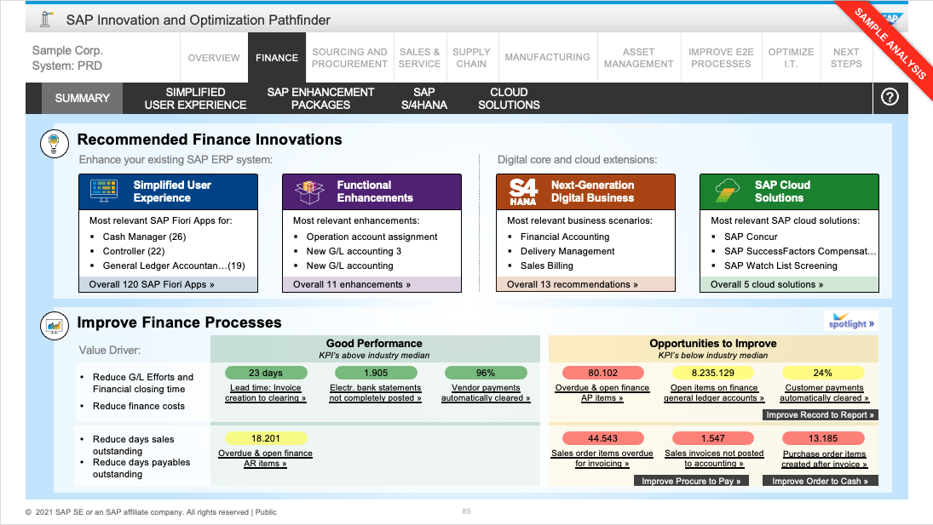

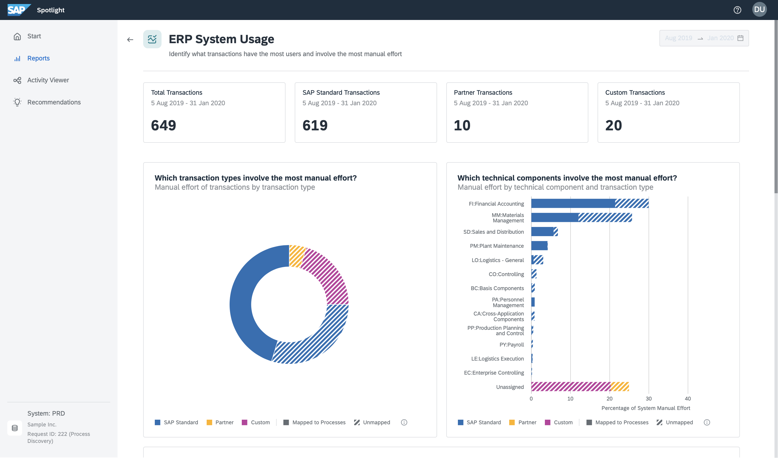


GETTING STARTED with Innovation & Value Realization
Tailored Recommendations
I Starting Point
I Detailed Recommendations
Process Discovery
SAP S/4HANA recommendations
www.s4hana.com
SAP Innovation and Optimization Pathfinder
on Spotlight
Innovation recommendations, industry benchmarks, and optimization potentials for business and IT
http://www.sap.com/pathfinder
SAP Fiori Apps Library – Recommendations Self Service
Improvement through SAP Fiori Apps
http://www.sap.com/fiori-apps-library
SAP Roadmap Explorer
Roadmap of software innovations
http://www.sap.com/innovationdiscovery
SAP Transformation Navigator
Creation of the plan for your digital transformation journey
http://www.sap.com/transformationnavigator
SAP Readiness Check
Identification of prerequisites to a migration to SAP S/4HANA
https://help.sap.com/viewer/p/SAP_READINESS_CHECK
Find more information here.

Slide 22
Agenda - Quick Wins
Using Your SAP Support Investment to
Research, Plan and Move to SAP S/4HANA
Discover the value with Process Discovery for SAP S/4HANA Transformation
www.s4hana.com or www.sap.com/process-discovery
Start your Readiness Check for SAP S/4HANA https://help.sap.com/viewer/product/SAP_READINESS_CHECK/200/en-US
Join the S/4HANA SAP Enterprise Support Value Maps
http://support.sap.com/valuemaps

Slide 23

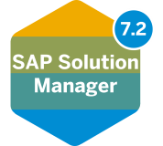

Application Lifecycle Management
Manage the Lifecycle of Your Landscape
Build
the configuration
Test
the quality
Application lifecycle management assists
the implementation and operations
of SAP-centric solutions
  Accelerate time-to-value
  Safeguard business continuity
  Reduce cost of ownership
  You can learn more here.
Design
business processes
Deploy
to production
Automate
problem resolution
Detect
incidents
Correct
the problem
Analyze
the root-cause
  for hybrid solutions
  included in on-premise maintenance agreements
  for hybrid cloud solutions
  included in SAP Enterprise Support, cloud editions

Slide 24


Co-innovate with SAP on strategic support topics
SAP Enterprise Support Advisory Council
As part of the SAP Enterprise Support Advisory Council program, participants become early adopters of the latest support innovations. They also profit from a bigger investment from SAP’s side and have the opportunity of directly influencing SAP’s support offering in a meaningful way based on their own requirements.
SAP
Early adopter
Pilot new offerings
Expert access
Direct feedback
Direct influence
Transparency
CUSTOMER
Co-innovation, close collaboration and co-investment
New technologies
New content
New tools
Engagement experience

Slide 25






Move to the cloud with SAP Enterprise Support
SAP Enterprise Support
Transition from on-premise to cloud solutions
Adopt and run
SAP cloud solutions with optimal performance
Discover
Prepare
Explore
Realize
Deploy
Run
Evaluate the opportunities and value of cloud |  | Pick the right cloud solutions and integration scenarios |  | Focus on simplicity and fit-to-standard but also rely on flexibility |  | Implement technical and functional changes |  | Execute the new implementation or landscape transformation |  | Focus on continuous optimization of adoption and consumption
Close the
skills gap
SAP Enterprise Support Academy,
Value Maps, and Advisory
Pinpoint relevant services and tools
Identify value potential
Intelligent Tools, e.g.
SAP Pathfinder
Realize value and measure success
Co-innovate
SAP Enterprise Support
Advisory Council
Collaborate
Transition
SAP Cloud
Application Lifecycle Management
Operate

Slide 26


Mission-Critical Support
We relieve you of any critical situations and provide various cutting-edge access points to facilitate rapid collaboration with SAP support experts.
  Rely on service-level agreements for faster issue resolution, whereat initial response time typically already includes a first qualified answer
  Benefit from Next-Generation Support features such as Schedule an Expert product sessions and Expert Chat, if available for the solution
  Count on 24x7 mission-critical support and speed up incidents through the Customer Interaction Center if needed
“In case of a production-down situation, I need to resume business operations as quickly as possible.”
Notes:
The fourth pillar of SAP Enterprise Support is mission-critical support, an essential requirement for your daily business
Regardless of your deployment scenario and the issues that arise, mission-critical support is a cornerstone of SAP Enterprise Support. It gets you the attention you need at the speed you expect.
This means accelerated problem resolution, fewer business disruptions, and less unforeseen downtime so that you can keep operating at peak performance

Slide 27
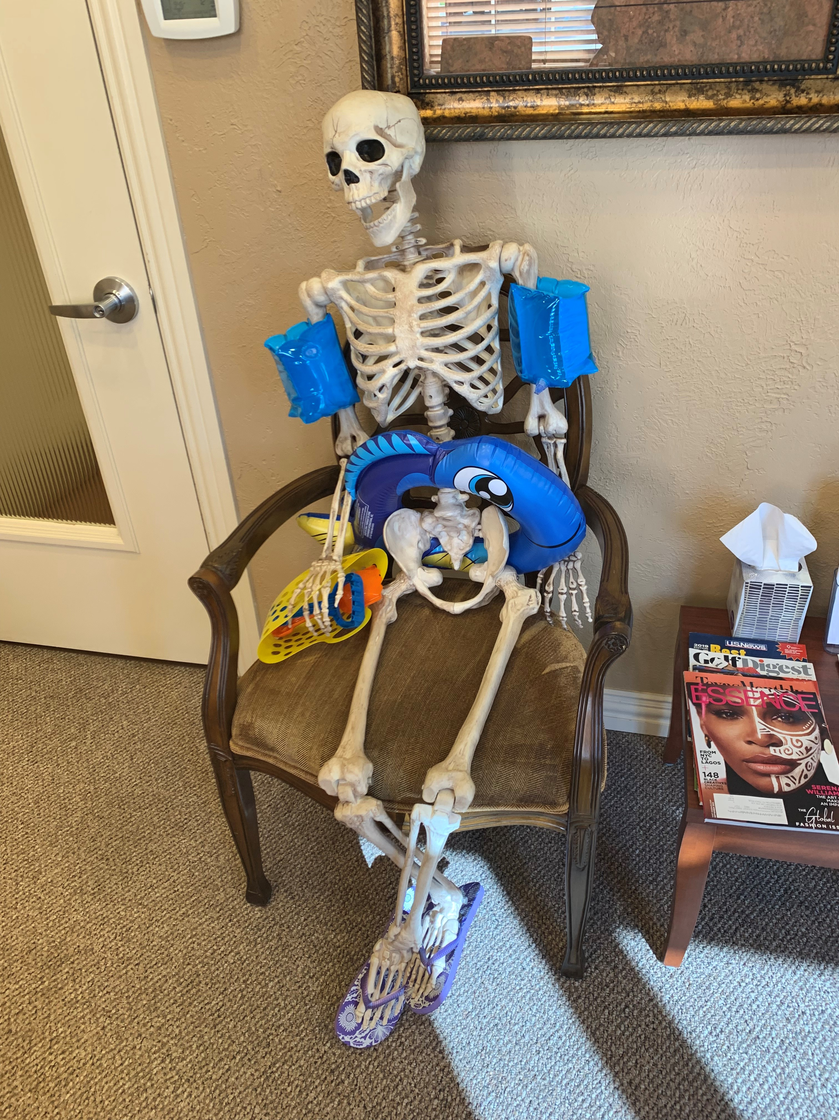
How some customers feel before learning about SAP Support
Incident Management Tips and Tricks

Slide 28

How most customers feel after learning about SAP Support Incident Management Tips and Tricks

Slide 29
GETTING STARTED with Mission Critical Support
Next Generation Support
Next-Generation Support has several comprehensive solutions – so you never have to ask a question, and if you do have a question, you receive an answer instantly. SAP Support Portal SAP Knowledge Base Articles (KBAs) via Google search Automatic translation SMS notifications Guided Answers SAP BusinessObjects BI support tool Automated search for SAP Notes Performance Assistant SAP Community Support by Product | We offer real-time support channels with live and direct access to SAP’s support experts. Expert Chat Schedule an Expert Ask an Expert Peer Schedule a Manager Call-1-SAP & Customer Interaction Center (CIC) | Benefit from a seamless and intuitive omnichannel support experience with personalized, context- sensitive support when and where you need it. SAP ONE Support Launchpad Incident creation application Social Media integration Built-in support Cloud Availability Center SAP Cloud Trust Center | SAP constantly innovates to improve our products and provide you with a world-class support experience. Thought leadership Artificial Intelligence / Machine Learning Incident Solution Matching
Self-service and
incident prevention
Real-time
interactions
Digital support
experience
AI / Machine Learning

Slide 30

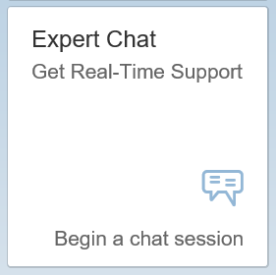
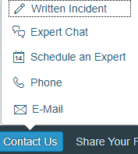
Real-time interaction
Expert Chat
Expert Chat provides a live chat function that connects you to SAP technical support experts instantly.
Overview
Benefits
Access
Preview
    Live support from SAP experts for any technical question related to a product
    Improves support experience with real-time interaction
    Available for all support levels and almost all solutions
    For more information:
      Learn more about Expert Chat on SAP Support Portal
      Expert Chat video
    Connects you real-time with SAP support
    Offers screen-sharing option
    Provides access to the same technical experts
    as in the incident channel
    Resolves incidents significantly faster than those
    reported through traditional SAP support channels
    Offers quicker and more efficient issue resolution
    Reduces your project and operational costs
    Access Expert Chat through the SAP ONE Support Launchpad (several options):
      Access through the Expert Chat tile on your SAP ONE Support Launchpad on the My Home screen.
      Carry out a search in the launchpad’s database. Click on the Expert Chat-button in the upper area.
      Access Expert Chat through the “Contact Us”-menu
      Access Expert Chat while going through the incident submission process. Chat functionality is built into the incident form.
Expert Chat tile on My Home in
SAP ONE Support Launchpad
Contact Us menu in SAP ONE
Support Launchpad‘s footer bar
Notes:
The Expert Chat service provides a live-chat experience well-suited for medium- or high-priority issues. Available for all support levels and virtually all SAP solutions at no additional cost, the service connects you instantly to SAP technical support experts. This fast, interactive, and direct route to issue resolution not only improves user satisfaction, but also reduces project and operational costs.
With Expert Chat, you can take achieve significant improvements including:
Time savings: Experience substantially more value from your maintenance and support agreements with SAP.
Reduced downtime: Shrink the amount of time dedicated toward supporting SAP solution investment, especially when resolving incidents and issues.
Efficient issue resolution: Optimize your support process by consolidating all necessary information at an early stage to solve an issue during the interaction.
Eliminated duplication of efforts: SAP technical expert creates a follow-up incident for you based on the details you entered in the ticket. For complex cases, resolution will be provided through a regular incident or through a Schedule an Expert session.

Slide 31
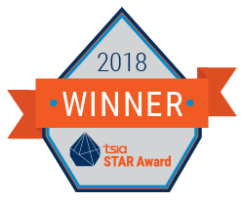


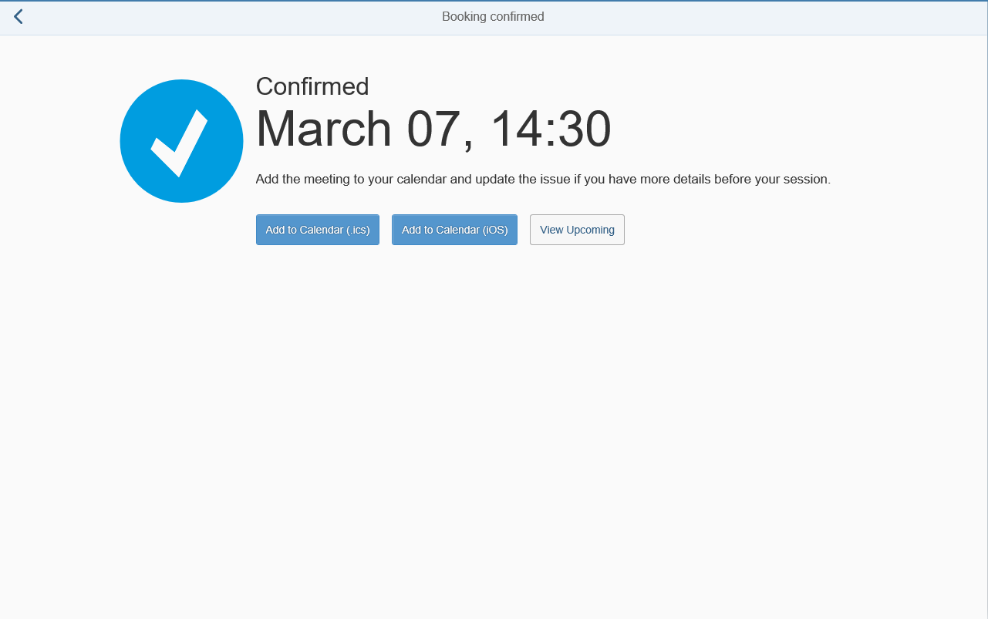
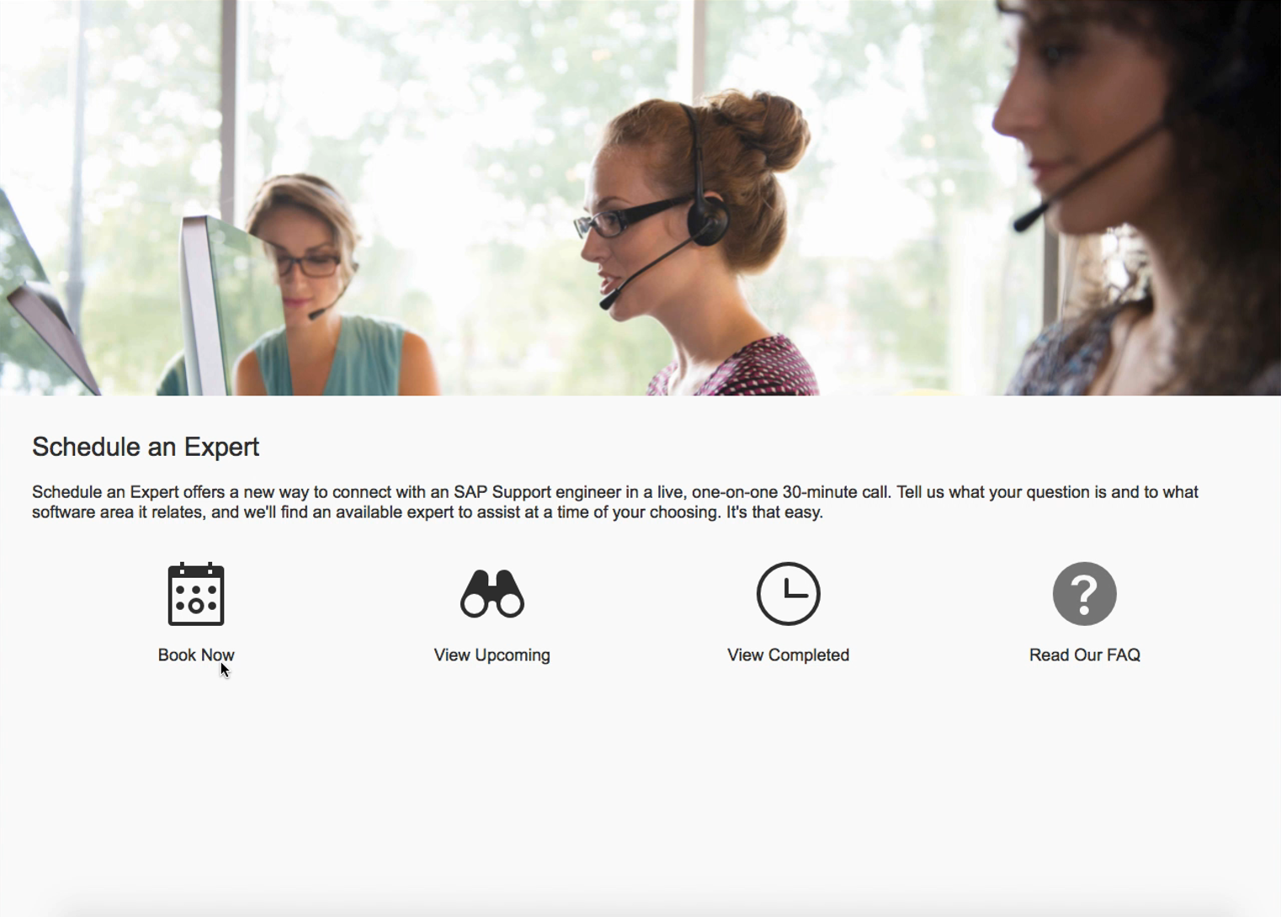
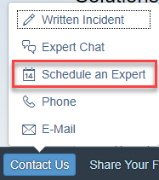
Real-time interaction
Schedule an Expert
Schedule an Expert connects you live with SAP Support in a one-on-one 30-minute call to discuss a technical topic of your choosing – at a time that is convenient for you.
Overview
Benefits
Access
Preview
    One-to-one 30-minute call delivered remotely through Skype for Business
    Book an appointment at least three business days in advance to allow engineers
    to prepare
    Check out the Schedule an Expert video
    Visit SAP Support Portal to learn more
    Learn more on how to join your Schedule an Expert call
    Live channel option for you
    Interact one-to-one with a support engineer
    Get answers when and where you need them
    Get help and direct support for any technical question
    Have access to the same engineers that you would create an incident with
    Reduce your waiting time for response and resolution
    Access Schedule an Expert through the SAP ONE Support Launchpad (several entry options):
      Access through the Schedule an Expert tile on your SAP ONE Support Launchpad home screen.
      Carry out a search in the Launchpad’s database. Click on the Schedule an Expert-button in the upper area.
      Access Schedule an Expert through the “Contact Us”-menu in SAP ONE Support Launchpad’s footer bar
„Contact Us“-menu in SAP ONE Support Launchpad‘s footer bar
Notes:
The Schedule an Expert service lets you connect one-on-one with SAP support experts in a live, 30-minute Skype call. Talk to the same engineer that created your incident ticket. But more importantly, spend less time waiting for a response and resolution with fewer interactions, compared to traditional written incidents, at no additional cost.
Schedule an Expert is an ideal choice for SAP customers that:
Prefer a live conversation with a support expert, instead of instant messaging or submitting written incidents
Find screen sharing as a useful tool for illustrating an issue
Need to schedule colleagues on a call with SAP support
Look for tips that can help them prevent incidents
Want to schedule an expert to address an open incident
Available for all support levels, Schedule an Expert is a useful tool for addressing new incidents or booking a session to work through open, existing incidents.

Slide 32

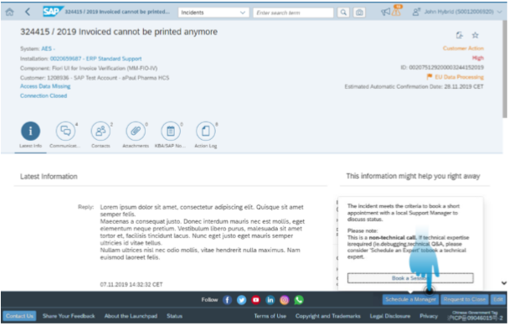
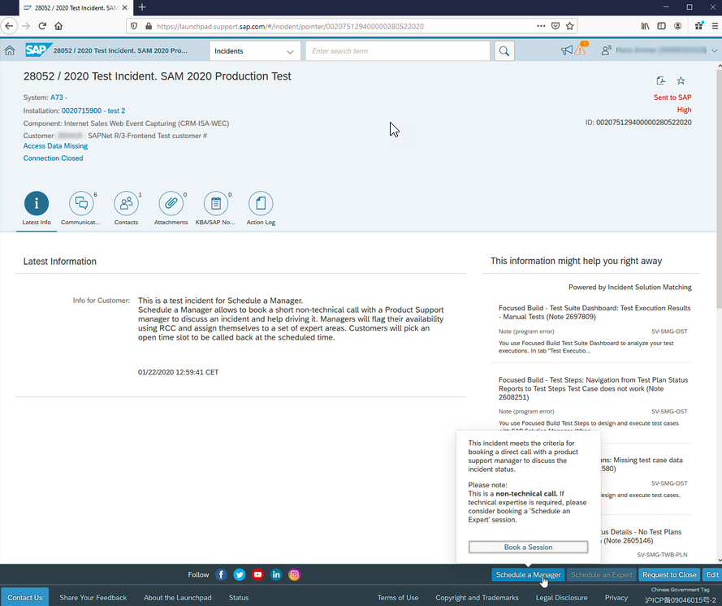
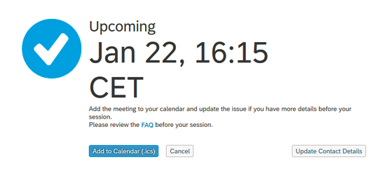
Real-time interaction
Schedule a Manager for high priority incidents
Schedule a Manager for high priority incidents enables you to schedule a 15-minute call with an SAP Product Support manager to help manage or prevent potential service exceptions
Overview
Benefits
Access
Preview
    15 minute call booked with a Product Support manager from the related product area
    Available for incidents within Product Support
    Incident is on high priority for at least 2 days
    Book an appointment minimum 2 hours in advance
    Sessions delivered via phone
    Click here to lean more, or check this FAQ
    Have live one-on-one discussion on your high priority incident with a Product Support manager
    Schedule a call at a time that is convenient for you and matches with the availability of the manager
    Experience a more enhanced communication with SAP’s Product Support management
    Schedule a Manager button appears in the incident editing page in SAP ONE Support Launchpad and is active when the following conditions are met:
      The incident has been at priority High for at least 2 days
      The incident is within Product Support
      A Product Support manager is available for the session
    Click the Schedule a Manager button and then click Book a Session
    Add the appointment to your calendar and receive your callback at the scheduled time
    Please note: this service is not offered for incidents processed within development support !

Slide 33

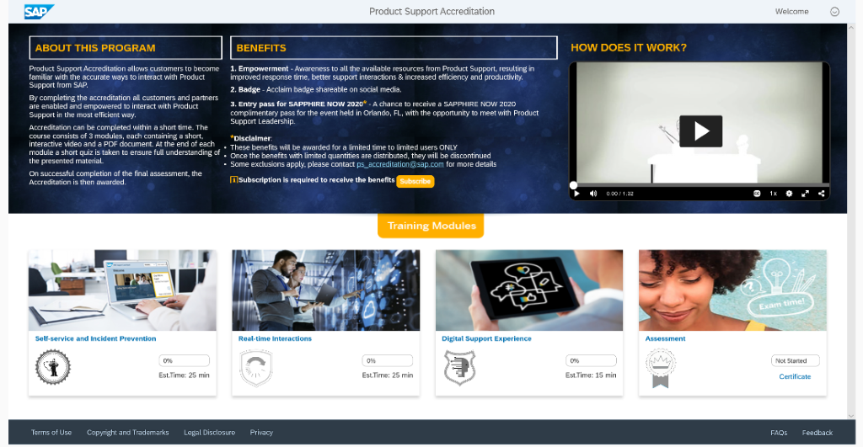
Product Support Accreditation
Self-enablement program for customers and partners for Product Support
Product Support Accreditation program enables you to make the best out of SAP’s product support tools and Next-Generation Support offerings
Overview
Benefits
Access
Preview
    Easy to consume interactive program.
    Available to all SAP Customers at no additional cost. It can be accessed via S-user login.
    It consists of 3 modules and a final assessment.
    The modules cover incident prevention offerings, real-time interactions and digital support experience.
    Informative: Gain empowerment and awareness to all the available resources from Product Support
    Efficient: The easy to consume enablement with SAP’s Product Support Accreditation program helps users to increase their efficiency in working with Next-Gen Support tools by selecting the best channel.
    Rewarding: A Product Support Accreditation badge is awarded once the final assessment is completed. This badge can be shared in social media.
    Easy to access: simply use your s-user via SAP ONE Support Launchpad to enroll for program.
    Easy to consume: The accreditation modules can be taken at your own pace and time. Easy to consume content will be provided on demand.
    Interactive: Learnings can easily be validated in interactive quizzes supporting the user in their progress.
    Click here to access the accreditation and here to learn more.

Slide 34




Product Support Accreditation
Self-enablement program for customers and partners for Product Support
Product Support Accreditation
Module 1
Self-service and
incident prevention
Module 2
Real-time
interactions
Module 3
Digital support
experience
Final
Assessment
What’s next?
Annual enrollment is encouraged to keep up to speed with all tools and improvements in Product Support.
Successful completion confirmed
Customer interaction
Self-enablement program for customers at no additional cost.

Slide 35
GETTING STARTED with Mission-Critical Support
Service level agreements
SAP Enterprise Support
SAP Enterprise Support, cloud editions
SAP Enterprise Support Scope Description
SAP Cloud Support Policy
Priority | Initial Response Time | Corrective Action Plan | Initial Response Time | Corrective Action Plan
1 | 1 hour (real time) | 4 hours (real time) | 1 hour (real time) | 4 hours (real time)
2 | 4 hours (business hours) |  | 4 hours (real time) | -
3 |  |  | 1 business day | -
4 |  |  | 2 business days | -

Slide 36
GETTING STARTED with Mission Critical Support
Customer Incident - SAP ONE Support Launchpad
Details | SAP Note
How to create a support incident (contact SAP Product Support) - SAP ONE Support Launchpad | SAP Note 1296527
What important information must be included in order to create a perfect SAP Support incident? | SAP Note 1922545
Choose the right System (and Product) for your Incident in the SAP One Support Launchpad: Selecting an incorrect system/product or installation for the incident may have negative impact on the processing of the incident you submit The support contract depends on the installation, and if an incorrect system/product is selected, different SLA’s and resulting different processing times will apply to the incident. | SAP Note 2848890
Enter S-user/person getting the error message
Provide a meaningful short text description and a step-by-step description including navigation and description of expected results
Add screenshot of error message and inform about any SAP Notes Search which was done
Open service connection and provide login data (if required) | SAP Note 1773689
Carefully select the incident priority | SAP Note 67739
Record only one issue per incident | SAP Note 50048
SAP Support Portal
  Incidents
  Knowledge Base
PDF
  Support Essential: What a customer should know about SAP incident processing
  For any problem with this application create an incident under component:
  “XX-SER-SAPSMP-IBX”

Slide 37

Questions?

Slide 38



Thank You
VerNeil Mesecher Jr.
Sr. Dir. – Regulated industries (US) – Customer
Engagement | Customer Evolution
Mobile +1 (214) 517-6668
E-Mail: verneil.mesecher@sap.com
Maximize The Value You Get from SAP
Visit sap.com/CustHubIT to connect with peers, stay abreast of trends and know your support benefits.

