Slide 1
Change the way you work with SAP through automation

Slide 2

Winshuttle is now part of Precisely,
the leader in data integrity
Notes:
How many of you have ever heard of Precisely?
Chances are you have heard of Winshuttle. Right?
Well in 2021 Precisely acquired Winshuttle, adding our leading SAP automation capabilities to their already world-class data integrity portfolio.
This combination offers many benefits to SAP customers by combining SAP automation with Precisely’s data quality, governance and location intelligence (data integrity) capabilities.

Slide 3











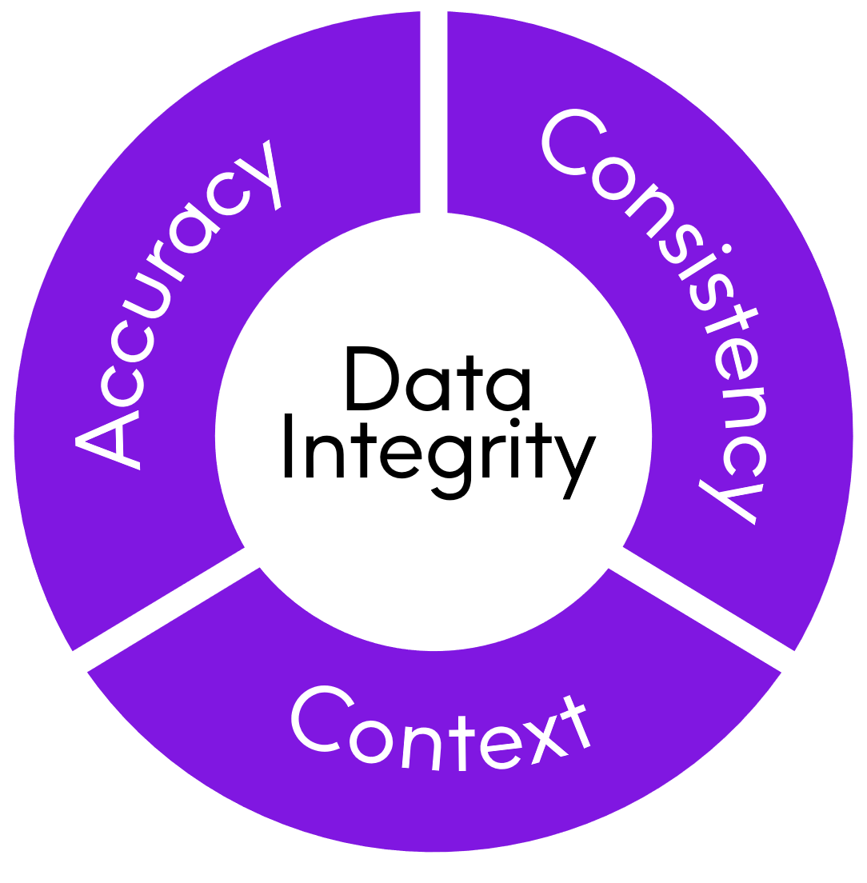















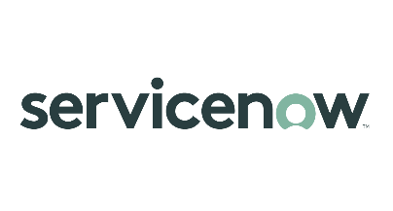









overall_0_132182146847412339 columns_1_132180489003760538 6_1_132180670009245741
Brands you trust, trust us
Integrate
Verify
The global leader
in data integrity software
Our data integrity software, data enrichment products, and strategic services deliver accuracy, consistency, and context to power confident business decisions.
Data
Integrity
Suite
Enrich
Locate
Data leaders partner with us
12,000
99
customers
of the Fortune 100
2,300
Customers in more than
100
countries
employees
Notes:
A little more information about Precisely
As I mentioned, we are the global leader in data integrity
With over 12,000 customers in over 100 countries around the world
We are in 99 of the Fortune 100 and have over 2300 employees.
Many of the worlds biggest brands trust Precisely with their data and we hope you will trust us with your SAP automation needs.
Now, let’s get started.

Slide 4
Empowering business teams to make an impact
Notes:
Used as an opening slide to all presentations –
This is why Precisely Automate exists – to help business teams in the largest organizations in the world make a real impact, whether it’s at a personal, departmental or company level.
We know from almost 20 years of automating SAP processes, that business teams are often the ones who know their processes and data the best and are most effective at developing the automation scripts.

Slide 5

Tackle process and data together
Data
Product launches
Product data management
Customer onboarding & management
Vendor onboarding & management
Asset management
Financial master data
and more…
Process
Notes:
Talk track:
You need to tackle process and data together. Here are just a few examples of core master data processes.
If you digitize these complex processes without improving the quality of the data you collect, you’re missing a big opportunity. And similarly, if you just focus on improving data quality without optimizing and accelerating the process, your efforts will short of reaching their full potential.
The fact is, you need to address both process and data at the same time to succeed and that makes these kinds of processes really challenging to digitize and manage with traditional process automation or data management platforms. So many of these processes are still manual and slow today even for the largest enterprises. That’s where Winshuttle comes in. Our software is designed to digitize these critical master data processes <click>

Slide 6



Compete and thrive in today’s dynamic world
Go faster
Be more agile
Improve the quality of your most important data
Notes:
Talk track
Because, to compete and thrive in today’s dynamic business market, you need to be able to do these three things:
Go faster – The world is constantly accelerating and you need automation to help you go faster and keep up with the rate of change
Be more agile – Going faster is important, but if you are not able to pivot, or change the trajectory of your business on a moments notice, you can often be left behind by the market. Being agile can give you a significant competitive advantage
While doing those two, you also need to improve the quality and integrity of your most important data – SAP master data

Slide 7


Precisely Automate portfolio
Automate Studio
Automate Studio Manager
Automate Evolve
STANDALONE
Exchange data with SAP quickly and easily using Excel
Data creation and maintenance
Data migration
Operational reporting
Data stewardship
GOVERNED
Share, manage, & control Precisely across the enterprise
Basic 2-step workflow
Centralized management
Granular control of licenses, users & policies
Extensive audit and ROI reporting
Server-side job execution
WORKFLOW-ENABLED
Automate and streamline SAP processes using workflows
Advanced form and workflow capabilities
Advanced data stewardship capabilities via web forms
Detailed process analytics
+
Business users
work in Excel
Business users
work in Excel
Business users work
in Excel or web forms
Notes:
Here is how we deliver these capabilities:
Automate Studio is our industry leading Excel to SAP desktop automation platform. With Studio, you manage your SAP data in Excel, but get a full suite of data stewardship capabilities – like the ability to validate data against SAP before posting – while maintaining the complete Excel functionality.
Automate Studio Manager enhances Studio capabilities by enabling centralized license management and governance, while also enabling simple, 2-step workflow and server-side job execution. And Studio Manager is available in the cloud as a SaaS offering, simplifying your IT management and deployment options.
Automate Evolve is our complete process automation platform that delivers all of the capabilities of Automate Studio, plus adds two ”flavors” of workflow automation in the form of Excel Workflow and Form & Workflow
- Excel workflow enables you to manage Studio-enabled Excel files through a complex workflow for things like review and approvals
- Form and Workflow has the flexibility to streamline and simplify highly complex SAP processes like account creation or new product introduction where the process involves multiple people throughout the organization, or many associated complex master data processes (such as the interdependent vendor, materials, project planning and logistics often needed for manufacturing)

Slide 8
Automate Studio
The right capabilities to get SAP work done faster and improve data quality.
Mass create & update using Excel
Data
stewardship
Deep SAP integration
Low-code/no-code design
Notes:
Let’s start with Studio and how it delivers the right combination of capabilities to speed up SAP processes and improve data quality.
It’s perfect for mass data create and management processes
Incorporates multiple data stewardship capabilities to help you post the right data the first time
Is built on nearly 20 years of SAP automation experience
And is a low-code/no-code solution that enables your business teams to create, manage and maintain automation scripts without requiring IT intervention.

Slide 9

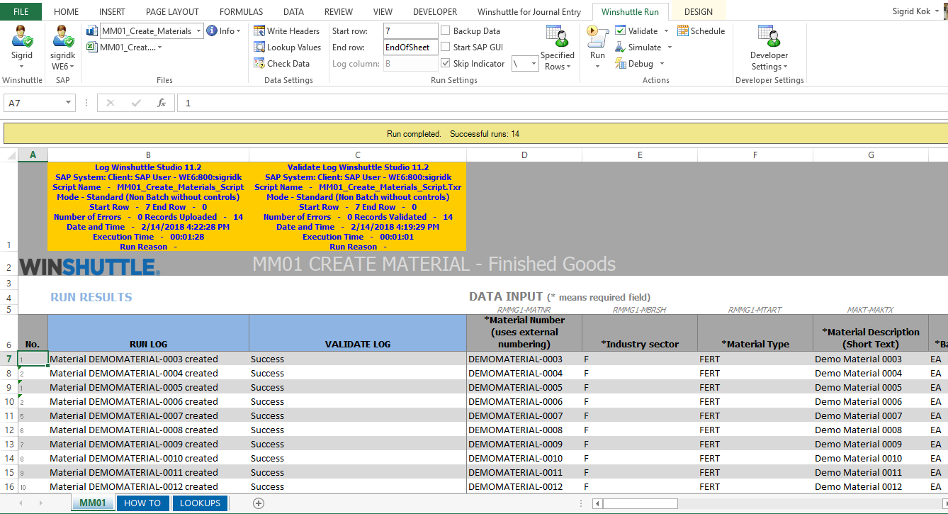
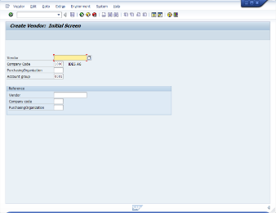
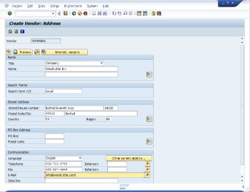
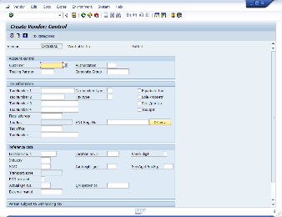
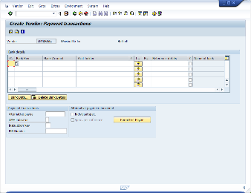
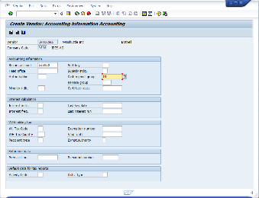
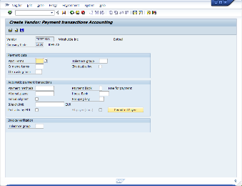
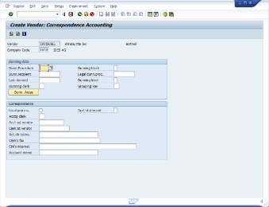
Replace multiple SAP screens with business-friendly Excel
Notes:
With Studio, you are replacing multiple, complicated SAP screens with business-friendly Excel sheets for streamlining your SAP data management.

Slide 10


What you can do with Automate Studio
Automate any SAP business process
Streamline data migration and conversions
Create operational reports
Notes:
Studio is capable of automating almost any SAP business process
Can streamline mass data processes such as data migrations (which often happen as a result of M&A activities) and conversions of data from legacy systems to SAP
And with Studio you can easily create operational reports and deliver audit trails.

Slide 11

Dorman speeds through master data changes
Challenge
Change subset of materials from ‘Manufactured’ to ‘Kitted’
Update BoMs and Routings
Change sales order to reflect non-kitted materials
Results
PER 100 MATERIALS
 | Hours | Total Cost | Difference
Manual Processes | 60 | $4,500
Using desktop automation | 5 | $375 | $4,125 saved
3,000 materials converted
Savings = $123,750
Minimal business impact
Improved data quality
Notes:
Talk track:
Here’s an example of one Winshuttle customer who saved time and money by automating their master data processes.
Dorman are a leading aftermarket automotive supplier who designs, package and market over 150,000 different products. This rapidly growing company has 5 plants and a high level of master data complexity.
IT were originally using LSMW for data uploads, but this technical tool was not suitable for the business so Dorman chose and deployed Winshuttle.
This particular use case was driven by the need to change the status of a subset of materials from manufactured to kitted. The process involved blocking materials, querying sales orders, cancelling applicable lines in sales orders and then updating the material master, BoMs and routings. Once the necessary changes were made, the revised order lines were added back to the sales orders.
Dorman reduced the time it took to complete this process from 60 to 5 hours per 100 materials, resulting in over 123 thousand dollars in savings, and enabling business to move faster. This approach minimized business disruption and because data was validated at point of entry, Dorman were able to also improve data quality. <click>

Slide 12
Automate Evolve
The right combination of capabilities to automate data-intensive processes.
Enterprise-grade workflow & automation
Robust data
stewardship
Deep SAP integration
Low-code/no-code design
Notes:
Automate Evolve - as I mentioned – is our complete process automation platform:
It delivers enterprise-grade workflow and automation capabilities that can streamline and accelerate the most complex SAP processes
Includes even more robust data stewardship capabilities
Has the same heritage of two decades of automating SAP processes
And a low-code/no-code design that helps you limit the amount of IT engagement needed to automate complex SAP processes

Slide 13
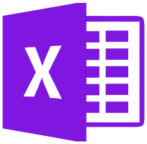
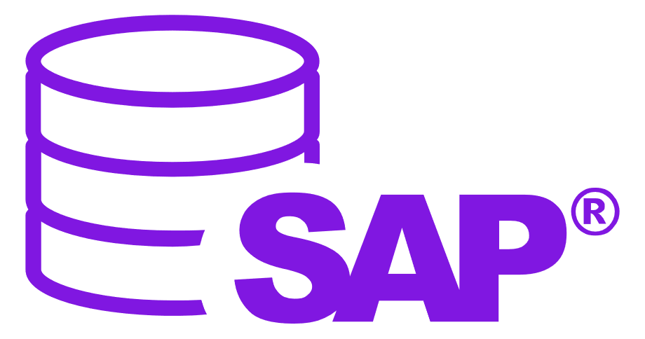



Automate Evolve
Automate and streamline SAP business processes using workflows
Advanced form and workflow capabilities
Advanced data stewardship capabilities via web forms
Detailed process analytics
Includes Automate Studio—our market leading Excel-to-SAP automation platform
Automate Studio
Exchange data with SAP quickly and easily using Excel
Data creation and maintenance
Data migration
Operational reporting
Data stewardship
Share, manage, & control Precisely solutions across the enterprise
Centralized content management
Granular control of licenses, users & policies
Extensive audit and ROI reporting
Server-side job execution
Notes:
Automate Evolve includes Studio as a core part of the platform and allows you to deploy Studio’s desktop automation capabilities where needed, while also giving you the flexibility to deploy Excel Workflow or Form and workflow where those capabilities are needed.

Slide 14






Evolve’s complete set of capabilities
Choice of forms or Excel front end
Smart, tailored, role-based forms
SmartTables
Dynamic process linking
Flexible, extensible solution architecture
Process dashboards & reports
Audit trails for process & data
Automated data exchange with SAP
Live SAP data validation
Granular user & policy management
Notes:
Note to sales:
Evolve offers a unique set of capabilities that have been developed specifically to automate and streamline complex, data-intensive SAP processes.
(You can talk about one or two if you have time, but it’s up to you)
Use this slide to introduce at a high level the features that make Evolve unique. You do not need to go through each one. For deeper conversations and follow-up meetings there is content around many of these features in the Evolve slide library.

Slide 15

CUSTOMER STORY:
Energy Drink Company
CHALLENGE
Slow, manual processes causing product launch bottlenecks
Lack of visibility into launch project status
SOLUTION
Digitized three launch processes
Reduced product launch cycle times by 50-75%
Increased visibility and improved governance
Achieved repeatable, predictable processes
Notes:
Note to sales:
This is a quick case study from one of our customers – an Energy drinks company
They had an inefficient, but adequate Excel-based new product introduction process which was sufficient when their market was limited to a couple of countries in North America. The system captured and managed SAP data in Excel spreadsheets, which relied on email routings and manual tracking before data was manually entered into SAP. With this system they had no visibility into processes status, poor process governance and each product introduction felt like they were starting from scratch.
Then they did a deal for global distribution with a major soft-drinks manufacturer and found that their Excel-based process was a major bottleneck. There was simply no way to manage the complexities of multiple country requirements, new supply chains, packaging needs, languages, and manufacturing plants.
After carefully reviewing their processes and needs, we worked with them to develop an automated New Product Introduction (NPI) solution that centralized and streamlined three core processes.
The result was a reduction in time to market for new products of between 50 and 75%
Increased visibility into their product launch and manufacturing processes that were impossible with the old, Excel-based system
Creation of repeatable, predictable and fully governed processes

Slide 16








Make an impact across your SAP landscape
FI
CO
SD
MM
PM
Financial Accounting
Controlling
Sales and Distribution
Materials Management
Plant Maintenance
AM
PS
PP
QM
HR
Asset Management
Project Systems
Production Planning
Quality Management
Human Resources
Notes:
Note to sales:
Finally, we have always felt that it was critical that our platform and solutions work across the entire SAP ERP landscape. Many SAP master data processes work across modules and departments – for example vendor create that can touch on five or more different departments (procurement, finance, materials, manufacturing, logistics, etc.). You can start with one process in one area and expand as you find needs and we’re here to support you along the way.
I know this has been fast, but I hope you have a better idea of what the Precisely Automate platforms can do to help you automate and streamline your SAP processes.

Slide 17

Let’s continue the conversation…
www.precisely.com
Demos
White Papers
Case Studies
Contact us
Set up a 30 minute personalized demo
info@precisely.com
Notes:
We would love to speak to you in more detail about your product data processes and how we can help you make an impact to your business , so please feel free to reach out to us.
Sample/Questions?
Can you also do Vendor and Customer masters too? Yes
I’m on S4 Hana will this work with my system? Yes
I have custom fields in my material master, does this work for those? Yes
We often have fields that the business is missing can you make them required even if SAP doesn’t require them? Yes

Slide 18
Questions!

