Slide 1

Data Analytics for Pharma (Panel Discussion)
Panelists: Neeraj Shah (BMS), Amish Patel (J&J), Mandar Paralkar (SAP)
Moderator: Thomas Justin
09 December 2022

Slide 2
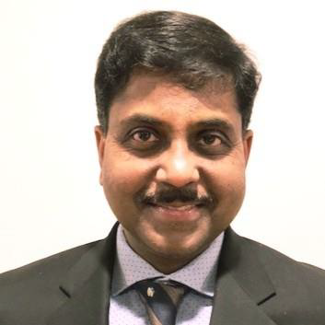
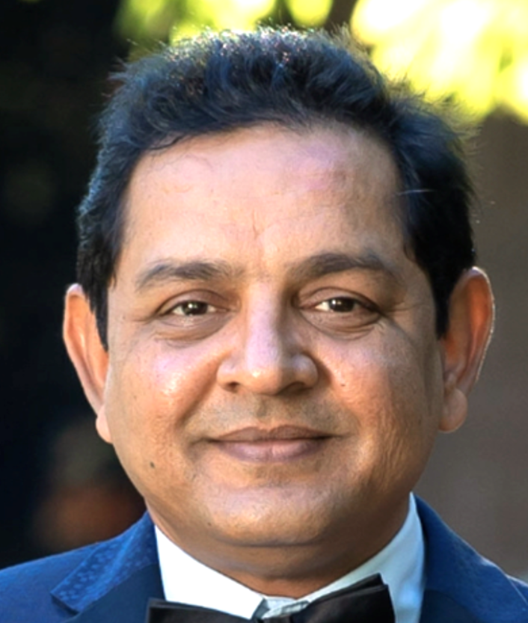




Our panelists:
NEERAJ SHAH
Clinical Trials Lead
AMISH PATEL
SC,Technology Leader
MANDAR PARALKAR,
Head, Global LS

Slide 3
BMS

Slide 4
JNJ

Slide 5
SAP

Slide 6
Analytics in Pharma
PROCESS
DATA SOURCES
BUSINESS USE CASES
TECHNOLOGY/ARCHITECTURE
Notes:
Serialization – requires track and trace down to the unit of 1. Not possible without technology – storing and processing tens of billions of records with sub-second response times
IoT – if humans are creating data, sensors will created even more data; 43 zetta bytes in the next 5 years.
Blockchain – a must to preserve sanctity of records, counter fraudulent activity in a long, cross-border supply chain
New-generation therapies such as CRISPR editing and CAR-T; think personalized vaccines….highly controlled processes, that manage potent therapies with very low shelf lives, call for digitized supply chain

Slide 7





Simplified Architecture
User Interface: SAP Analytics Cloud
Business Use Cases: Analytics Cloud provides business users huge data accessibility to data
Integration: API processing layer
IT supported: Built and supported by internal or external IT
Source Systems: SAP ERP, other ERP, other internal & external data
Under contract: For external data sources; ideally APIs are provided

Slide 8
Questions
What does analytics mean to you? – All three
What are the trends and what do you see as future? BMS
How J&J is managing their demand for data analytics – J&J
What are the challenges faced by industries in terms of developing the analytical platform, the related data and the quality of the data? SAP

Slide 9
Questions ?
Thomas Justin, IBM,
NJ ASUG Chapter Chair
E : Thomas.justin@us.ibm.com
T : +1 (484) 250-9451
https://www.linkedin.com/groups/5071456

Slide 10

Follow Us
Thank you for your time
Follow us on at @ASUG365

