Slide 1
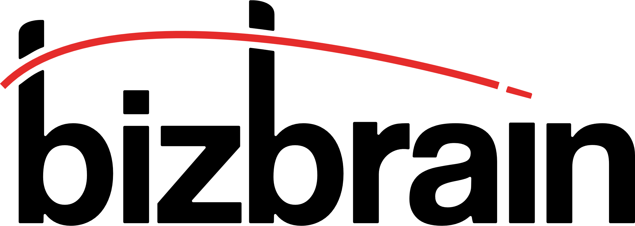
SAP Integrated Business Planning
Fast Adoption
March, 14 2024

Slide 2
When you think of a Supply Chain project.
What we deliver.
Been there, done that. More than ten years of unique customer’s experiences, based on flawless delivery in SAP Digital Supply Chain. Bizbrain is an independent consultancy, chosen by over 50 customers, in over 15 distinct industries.

Slide 3
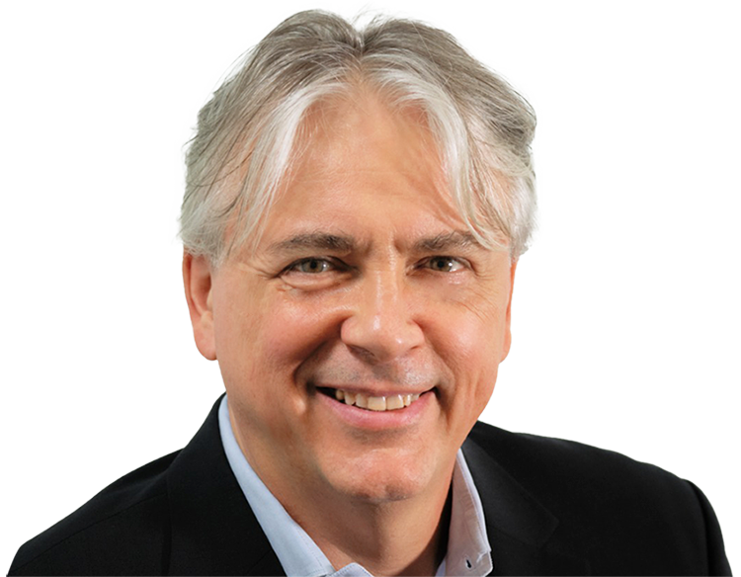
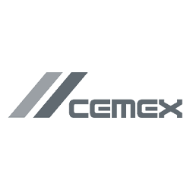
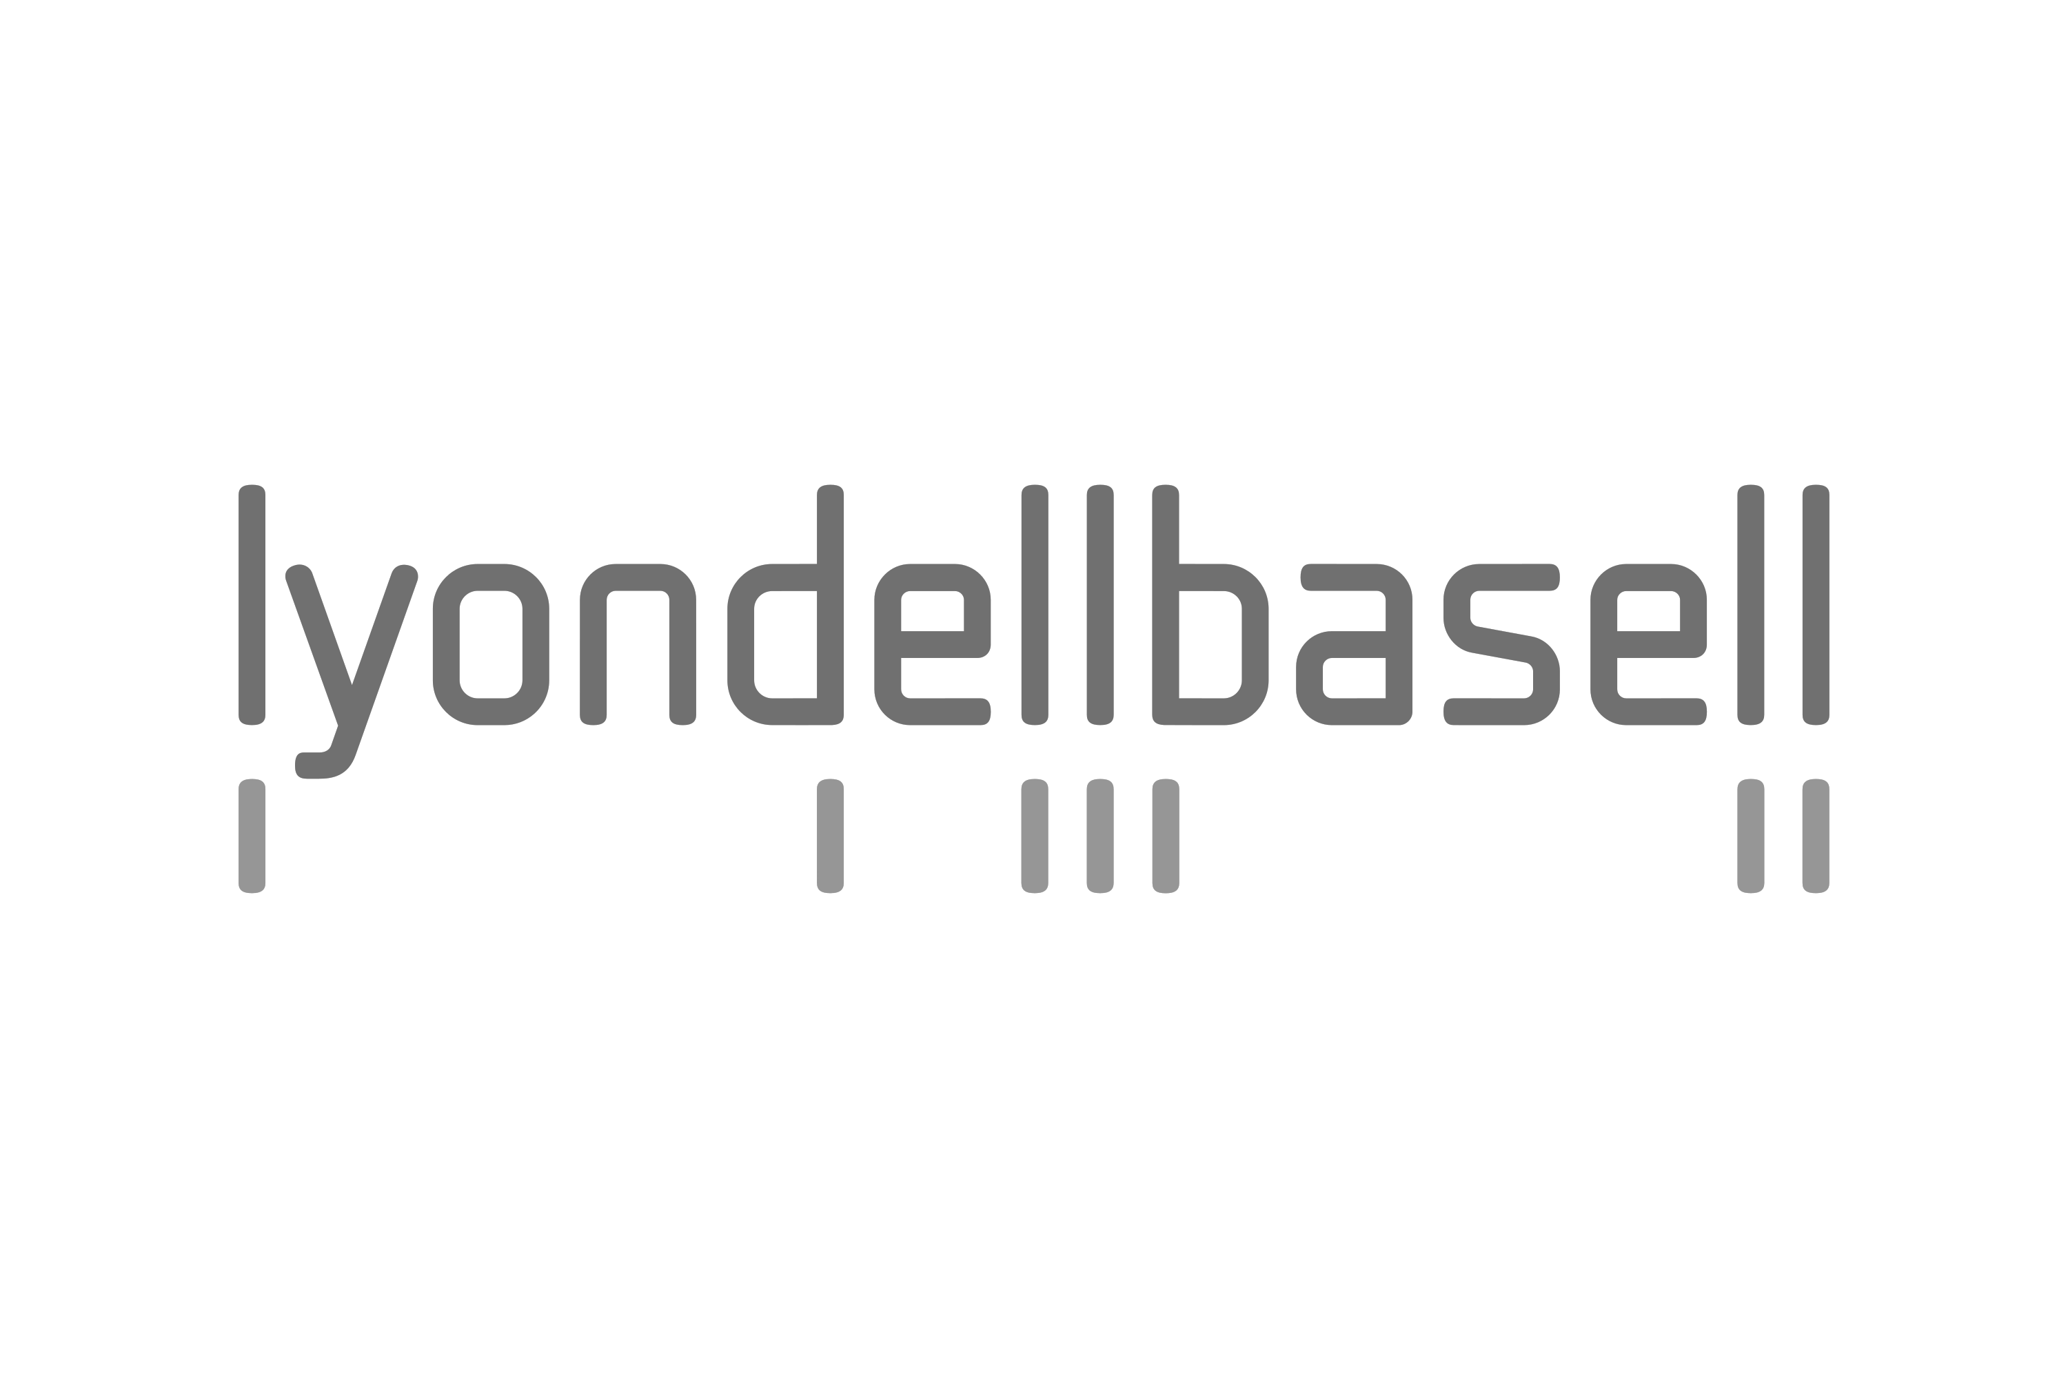
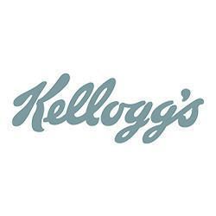
Who we are and why this information is relevant to you
Luca Massasso
100%
Co-founder Bizbrain Technologies.
success rate (no failed projects)
20+ years experience in enterprise software. Eleven years of work experience at SAP in various roles (SAP SCM Development Architect, Business Development Manager, Global New Product Introduction Program Manager). Co-founded Bizbrain in 2013.
50+
LINKEDIN PROFILE
customers served in first 10 years.
Key initiatives
15+
industries experience

Slide 4
Your concerns about adopting a Supply Chain solution
Current
Process
vs change
mgmt
Your
concerns
Time to value
Data
Quality
Business Case
Fear
of
complexity
Community
Sentiment
Readiness
Partner
Readiness
Expertise

Slide 5
Our approach
Shorten
time-to-value
Utilize best practices
Minimize rework
Engage your team

Slide 6
Mid-term forecasting replacing obsolete solution
Company or Organization A.O. Smith Corp. Headquarters Milwaukee, WI Employees ~15,000 Revenue US$ ~3 Bi Industry Specialty Industrial Machinery Products and Services Water Heaters, Water Treatment systems, Air Purification systems IBP Modules SAP IBP for Demand
Fast Implementation Best practice demand process implemented with Rapid approach
Business Objectives Replace Logility solution for forecast Align Forecast process with Sales and Finance Remove limitation of existing process with SAP IBP for Demand Best-practice business process Fast implementation using the bizbrain accelerator: Rapid Value Realization Use Cases Implemented Statistical Forecasting Collaborative Demand Planning Forecast Accuracy – Forecast Optimization KPIs New Product Introduction Revenue Projection and Financial target alignment Value to Customer What-if Analysis Planning combinations segmentation Alignment with the office of the CFO Alignment of the Product data structure across various departments One unique global, scalable, standard and central model for Forecast Fast delivery of the initial step in implementing a central planning solution Initiative driven by the planners
Focus on planners Three levels of enablement to empower the users
Replaced Logility solution with SAP IBP Demand Planning
Planners’ enablement
Accelerated implementation
Standard Integration
Project Governance
Train the planners before the implementation (BizTrain)
Train the planners on the implemented solution
Planners’ handholding
Implement the Best-practice forecast process
Original plan of 18 weeks delivered in 20 weeks (delay due to data quality)
Integration with one SAP ECC instance
Standard SAP ECC Add-on integration
Unconstrained Demand outbound integration
Tight project control and budget management
Close relationship with Management
Trusted advisors
Highlights

Slide 7
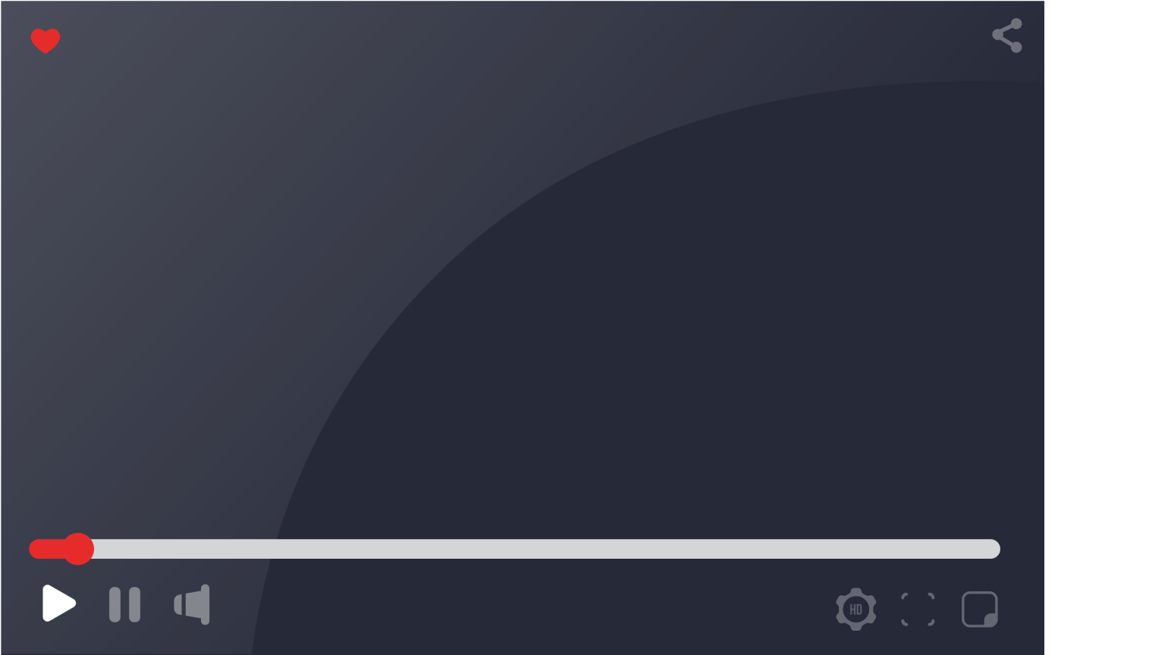
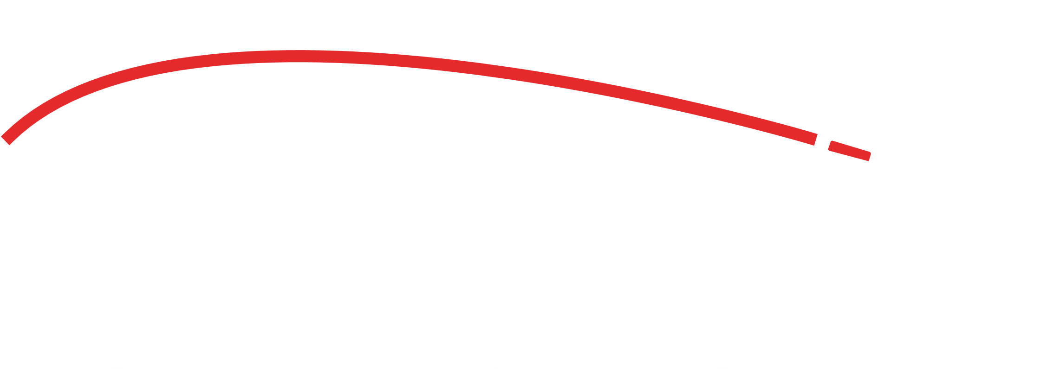
Glatfelter’s feedback
Company Details
Glatfelter is a global manufacturer of engineered materials. The company's products are found in tea and single-serve coffee filtration, personal hygiene and packaging products as well as home improvement and industrial applications.
Year Founded: 1864
Ticker: NYSE: GLT
What has been your experience with
Why would you recommend
Click to watch the videos:

Slide 8
Milliken’s feedback
Company Details
Milliken company is a global manufacturer, active across a breadth of disciplines including specialty chemical, floor covering, performance, and protective textile materials, and healthcare.
Year Founded: 1865
What has been your experience with
Why would you recommend
Click to watch the videos:

Slide 9
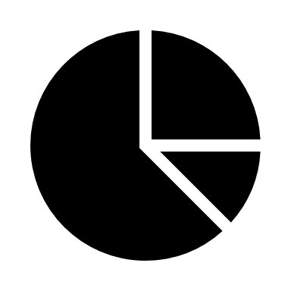
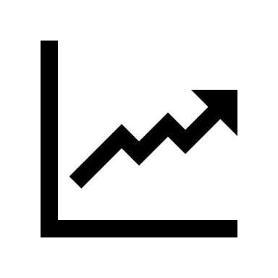
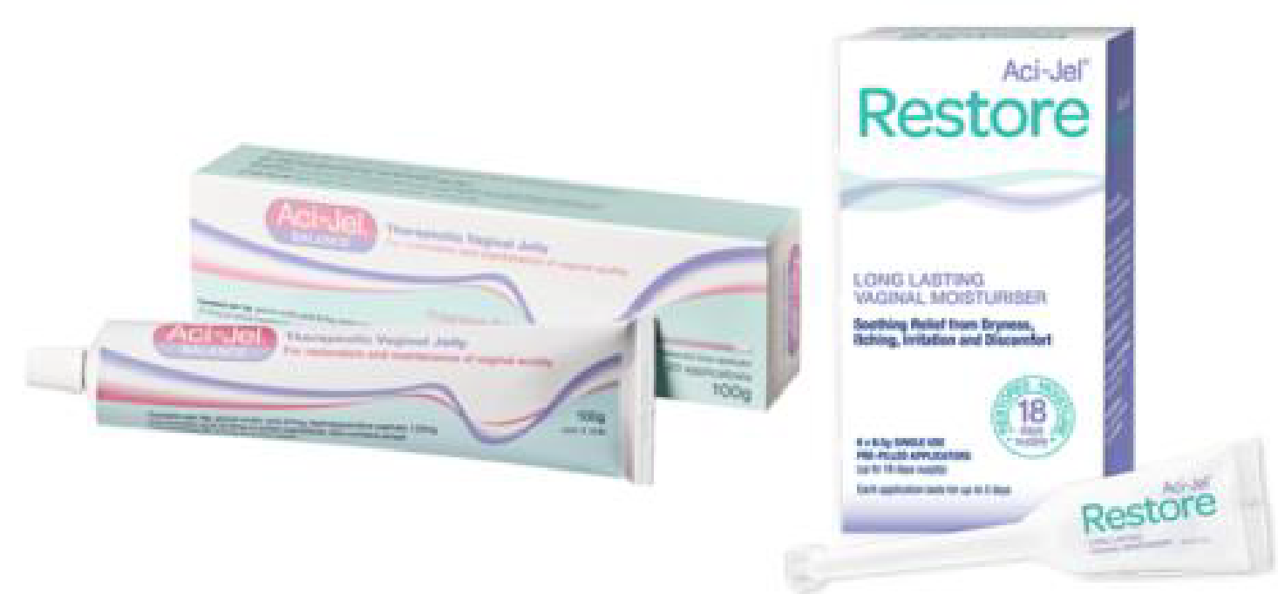
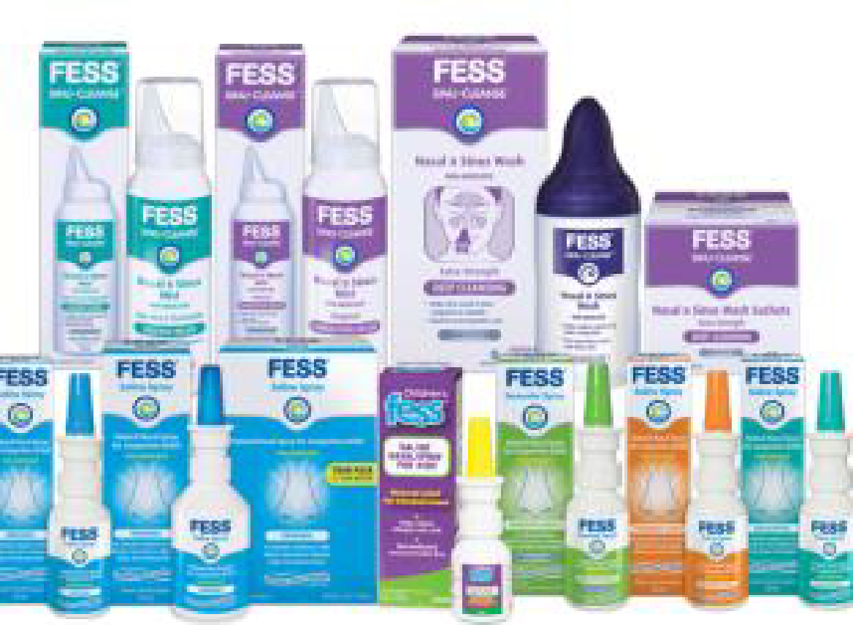
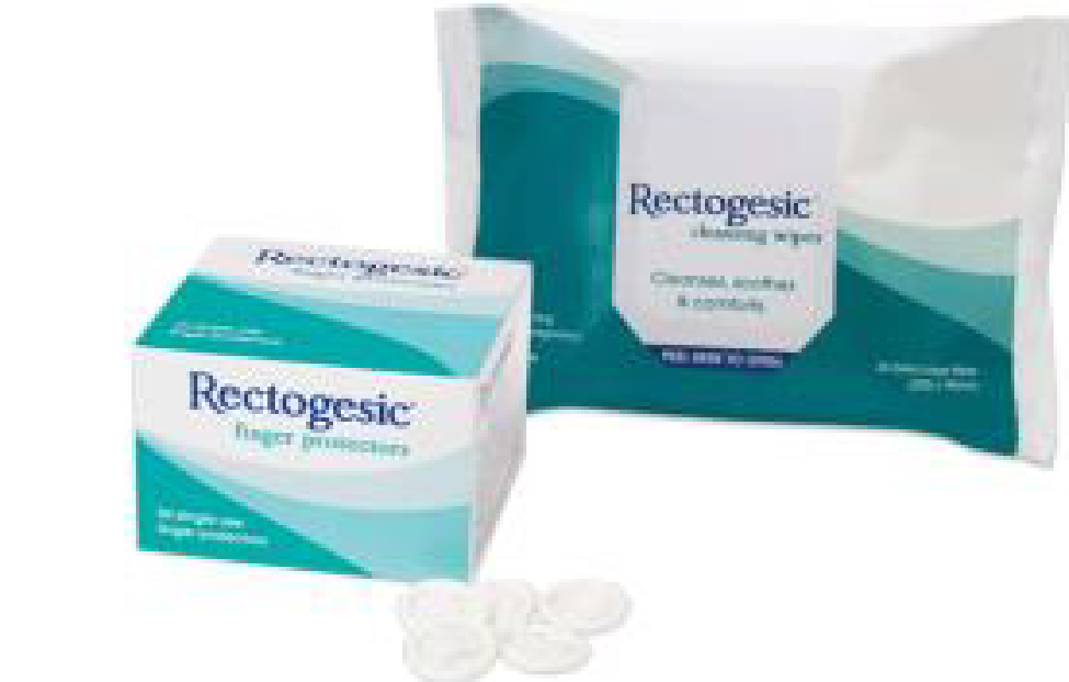
IBP Retired the use of Excel-based Demand Planning
Reporting Automation Automated Demand and Revenue reports
Business objectives Retire current use of multiple manual and disconnected excel spreadsheets used to handle the Demand Planning process Enable the Demand Planning to send streamlined information through IBP to the drive planning, operational and execution effectiveness and efficiencies Use Cases Implemented Historical outliers' corrections and Statistical Forecast generation Collaboration process considering new/lost distribution and cannibalization Product Life Cycle planning driven product phase-outs Annual budget driven financial KPI reporting of Demand plan Product and Product group-based Demand accuracy visibility Value to Customer Unique data model to support Sales organization based planning Integration with financial planning to align the demand revenue Using multiple prices like List price and projected sale price to analyze the revenue Automation of the reporting requirements in IBP to avoid excel sheets
Company or Organization Care Pharmaceuticals Headquarters New South Wales, Australia Employees 100+ Revenue US$ ~1+ B Industry Heath Care Products and Services Tablets, capsules, powders, Soft-gels, granulates and more IBP Modules IBP Demand Planning
Financial Alignment Demand planning aligned with financial KPIs
Simulation What-if simulations added new insights to Supply chain planning
Assets
Webinar
Products

Slide 10
SAP IBP for Demand for Planners
A trained team is the key to success

Slide 11
Your users must…
1
Learn about the SAP IBP Technology
2
Know how to formulate the requirement intelligently
3
Have shadowing support
Train your users on SAP IBP for Demand Best Practices
Implement SAP IBP for Demand
upon requirements formulated
by trained business users
Gain autonomy and ability to provide actionable information
to the management
LEARN
MAP
APPLY
…to maximize the adoption

Slide 12
Rapid Value Realization for Demand
Accelerate the implementation

Slide 13
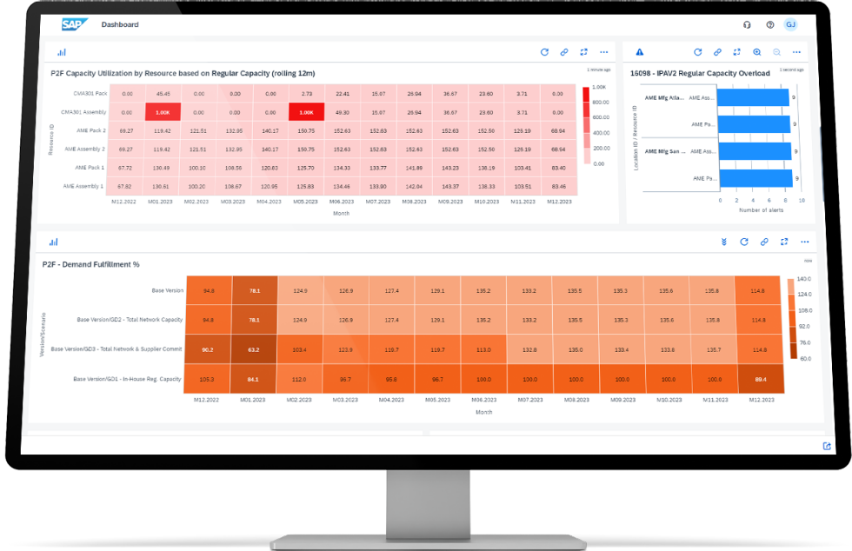
SAP IBP FOR DEMAND Business Accelerator
SAP Integrated Business Planning (SAP IBP) for Demand Planning solution empowers you to create an accurate forecast and a consensus demand plan using statistical forecasting algorithms enriched with segmentation and time-series analysis.
Best Practice
Statistical Forecast
Sales Enrichment
Revenue Projection
LEARN MORE ABOUT RVR
WATCH VIDEO

Slide 14
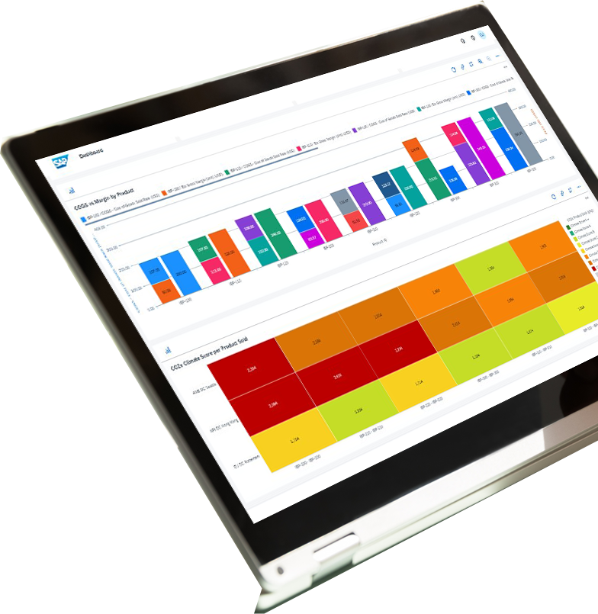
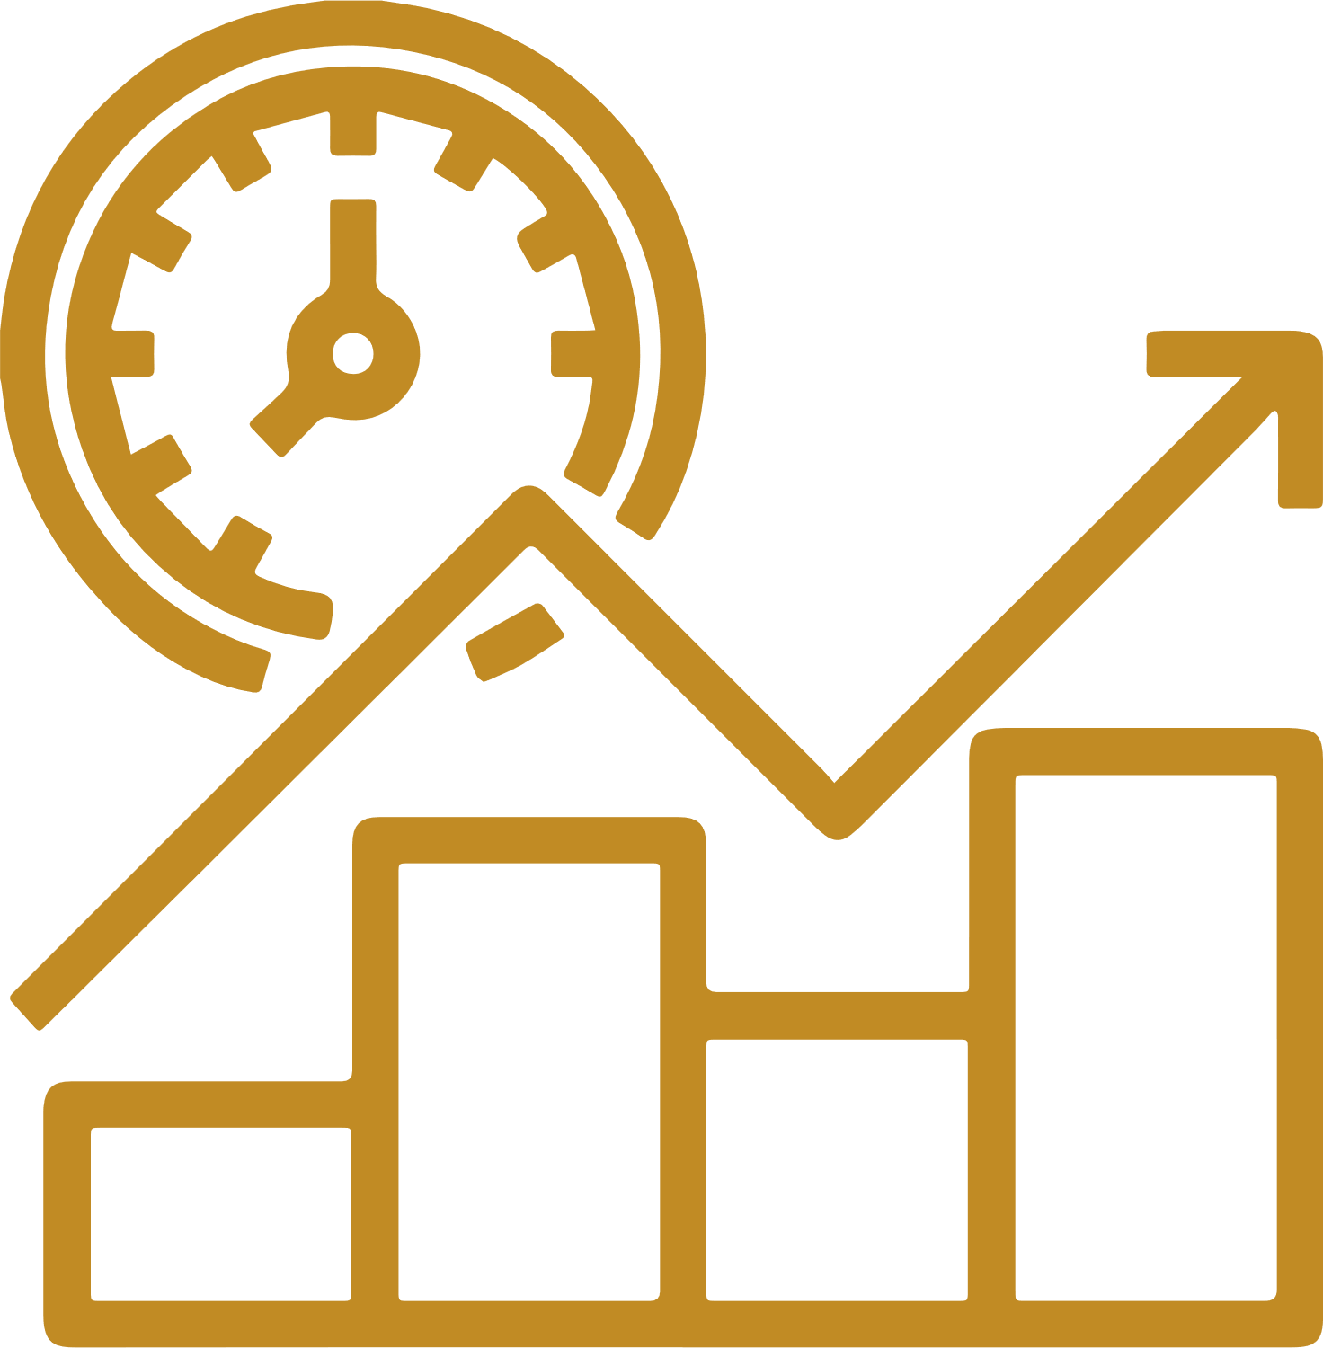
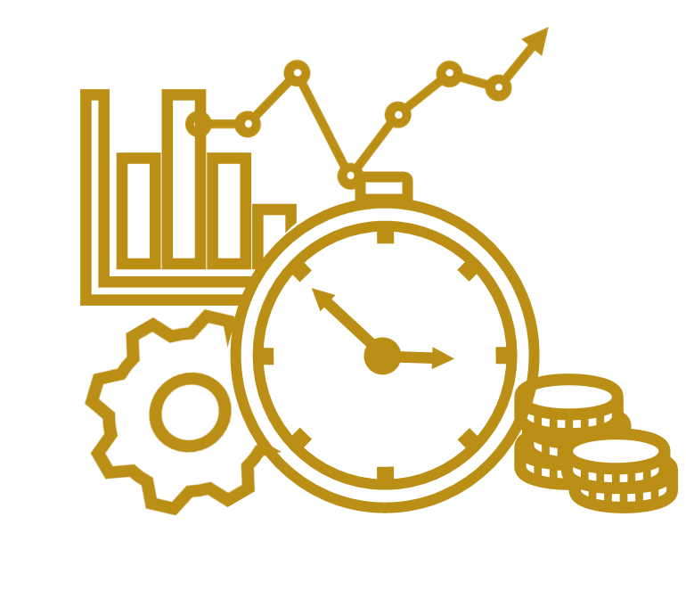
RVR Demand
Leverage learnings from Bizbrain’s numerous successful implementations to drive quality and efficient projects for an all-around improved Demand Planning adoption experience with RVR from Bizbrain Technologies.
The RVR for Demand Planning solution empowers you to create a consensus demand plan using statistical forecasting algorithms enriched with segmentation and a time-series analysis.
KEY BENEFITS
Receive a single, comprehensive demand plan, integrated with the consensus forecasting process.
Improve service levels, reduce stock-outs, and lower expediting costs through more accurate forecasts.
Speed up implementation phase, and reduce time to value, by leveraging best practices.
Maximize demand planner’s adoption when coupled with BizTrain.

Slide 15
When you think of a Supply Chain project.
What we deliver.
Been there, done that. More than ten years of unique customer’s experiences, based on flawless delivery in SAP Digital Supply Chain. Bizbrain is an independent consultancy, chosen by over 50 customers, in over 15 distinct industries.
CONFIDENTIAL INFORMATION: this presentation deck contains confidential and proprietary information belonging to Bizbrain Technology LLC. The information herewith in may not be disclosed, copied, or distributed to any other party without the express written consent of Bizbrain. Unauthorized use or disclosure of this information may result in legal liability and significant damages.
Contact us
www.bizbraintech.com

