Slide 1
SAP SuccessFactors The New Age of Data Protection: How It Impacts You -- and How SAP Helps
Barbara O’Cain, J.D.
SAP SuccessFactors
September 2022

Slide 2
Legal Disclaimer
The information in this presentation is confidential and proprietary to SAP and may not be disclosed without the permission of SAP. This presentation is not subject to your license agreement or any other service or subscription agreement with SAP. SAP has no obligation to pursue any course of business outlined in this document or any related presentation, or to develop or release any functionality mentioned therein. This document, or any related presentation and SAP's strategy and possible future developments, products and/or platforms directions and functionality are all subject to change and may be changed by SAP at any time for any reason without notice. The information on this document is not a commitment, promise or legal obligation to deliver any material, code or functionality. This document is provided without a warranty of any kind, either express or implied, including but not limited to, the implied warranties of merchantability, fitness for a particular purpose, or noninfringement. This document is for informational purposes and may not be incorporated into a contract. SAP assumes no responsibility for errors or omissions in this document, and shall have no liability for damages of any kind including without limitation direct, special, indirect, or consequential damages that may result from the use of this document. This limitation shall not apply in cases of intent or gross negligence.
All forward-looking statements are subject to various risks and uncertainties that could cause actual results to differ materially from expectations. Readers are cautioned not to place undue reliance on these forward-looking statements, which speak only as of their dates, and they should not be relied upon in making purchasing decisions.
NOTE: The information contained in this presentation is for general guidance only and provided on the understanding that SAP is not herein engaged in rendering legal advice. As such, it should not be used as a substitute for legal consultation. SAP SE accepts no liability for any actions taken as response hereto.
It is the customer’s responsibility to adopt measures that the customer deems appropriate to achieve compliance.

Slide 3
Security is more important than ever for business
$600 billion
lost to cybercrime each year ¹
3.6 million
unfilled cybersecurity jobs in 2022²
85%
of consumers will not do business with a company if they have concerns about its security practices³
1: Economic Impact of Cybercrime— No Slowing Down, McAfee 2021, 2: Cybersecurity Ventures report 2021, 3: PwC US Protect.me Survey 2021
Notes:
PwC US Protect.me Survey 2017 https://www.pwc.com/us/en/advisory-services/publications/consumer-intelligence-series/cybersecurity-protect-me.html.
In 2015, 83% of large companies were targeted by cybercriminals (a 40% increase year-over-year).
200 million records were hacked last year in business, including high profile companies such as Neiman Marcus, Goodwill, PF Changs, Sony. We’ve also heard of what happened at Ashley Madison..
Billions of dollars in fraud exist in North America alone, and that number multiples significantly on a global scale. According to McAfee – 200,000 jobs and between $375-$575 billion are lost every year due to cyber crime.
Security breaches should not be seen as a “fact of life”. They should be at the forefront of every business and security initiative taken by a company.

Slide 4
Cost of Non-Compliance : reputational, legal, financial,…
Damage to Reputation
Bad Press
Loss of Trust
Civil & Criminal Litigation
Government Action
Agency Fines & Sanctions
Foregone Business Opportunities
85 % of consumers will not do business with a company if they have concerns about its security practices¹
1 PwC US Protect.me Survey 2020

Slide 5
Considerations when choosing an HCM cloud vendor
Comprehensive Security
Other HCM Cloud Venders
Internal – Data Center, Operations, encryption
Internal Threats
External Threats
External – Data Center, network, encryption, intrusion prevention, application features
Data center locations, data center operations
Enabling Global/Local Compliance
Notes:
One of the greatest misperceptions of cloud is that it has weaker security, scores lower on privacy and has less availability than on-premise solutions. As a cloud provider at SAP SuccessFactors, we must secure our customers data better than they can and meet regulatory standards better than they can. The right combination of deployment models and best practices can help IT overcome these challenges. While it may feel safer to store your data on site, it has not protected against the recent high-profile hacks at JPMorgan or Target.
How do you protect against external and internal threats?
Internal – Data Centers, Operations, encryption
External – Data Centers, network, encryption, intrusion prevention, application
How do you ensure global and local compliance?
Data center locations, data center operations
How does SAP SuccessFactors cloud security differentiate from other cloud vendors?
15 years of delivering SaaS solutions. We take a global and comprehensive approach to security (next slide)

Slide 6
Unparalleled Data Protection with SAP SuccessFactors Defense-in-Depth approach provides multilayered defense at all touchpoints in the information flow
Physical
Network
Application
18 global data centers in 8 countries and 5 continents to support data residency and redundancy needs
Bulletproof walls; closed-circuit cameras; card-key, biometric, and ID-badge systems
ANSI/TIAEIA-942 Tier III + facilities
Perimeter protection firewalls
Intrusion detection
Regularly scheduled infrastructure scans
Multitenant architecture
Role-based permissions
Single sign-on
Activity monitoring
Multiple encryptions
Notes:
Summary: SAP, including SAP SuccessFactors, takes a holistic approach to information security in the cloud. We have implemented a multilayered defense at all the touch points in the information flow— both the physical and logical, applied across the database, middleware, application, and network and communication layers — to offer complete data privacy, transparency, and audit controls.
We have 13 global data centers covering 8 countries and 5 continents. These are detailed in the appendix. As compared to WD who has 5 data centers in 3 countries and 2 continents. And, WD is now using IBM data centers for development and test environments and Amazon AWS for production.
Most vendors providing multi-tenant web access have one set of database tables in a normalized database shared by many customers. This is not the case with SAP SuccessFactors. We do not co-mingle customer data into a single shared database.
Unlike some of our competitors, SAP SuccessFactors does not store customer data or database backups with off-site third party vendors. We believe in the “chain-of-custody” process, and feel that off-site data storage vendors provide an additional hole with regards to information security and data privacy. SAP SuccessFactors makes it transparent where your data is stored and backed-up, how it is secured at all times, who can access or process data at all different layers at any given time and for what purposes.
SAP SuccessFactors provides a minimum of 99% application uptime SLA as standard. Actual historical uptime, measured across all data centers over the past 3 years, exceeds 99.96%.
Additional Notes on our Data Centers: SAP SuccessFactors utilizes its own world-class data centers around the globe to manage its web hosting services. Customers have their primary database located in one data center based on the customer’s geographic location and preference, with a secondary data center aligned for backups and business continuity in the same geographical region. Hourly database snapshots, daily incremental database backups, and weekly full database backups are all standard and provided as part of the hosted service.
SAP’s Cloud Trust Center provides real-time insight into availability, downtime, and maintenance of SAP SuccessFactors instances so they can plan ahead and optimize resources: https://www.sap.com/about/cloud-trust-center/cloud-service-status.html
As part of our ongoing commitment to compliance, SAP plans to be fully compliant with the new General Data Protection Regulation (GDPR) in the EU by May 2018. We are also building a Privacy Center into our solution which will allow you to more easily visualize and manage your compliance and regulatory activities.
Additional Notes on General Data Protection Regulation (GDPR) in EU: SAP has been consistent in its approach to data protection as part of SAP’s general product standards. This is now being extended in order to reflect the new requirements of the GDPR. SAP is committed to ensuring all SAP products, including SAP SuccessFactors, provide the product features that enable our customers to be compliant with the GDPR. This is a Board-level mandate and development priority #1. SAP SuccessFactors already contains many features that will help customers comply with the GDPR. Enhancements are being developed in the following areas. Note: you can mention these verbally, but do not provide to customers in writing and be sure to make a disclaimer that these are subject to change:
Ability to obtain consent when candidate (a) applies, (b) agrees to receive future job postings (recruiting marketing/ management), or (c) is an external learner (LMS).
Data subject can access data and customer can report on data stored in the cloud service.
Data can be corrected and changed subject to data retention and customer policies.
Data deletion will be supported by purge tools.
Access to historical data (for example, past performance reports) can be limited (through role-based permissions).
Data is portable – that is, exportable in standard format during and shortly after subscription term.

Slide 7
Data Protection and Privacy Data privacy is more than just the General Data Protection Regulation (GDPR)
Continued explosion of data protection and privacy regulations across the globe
Multitude of features and solutions built by SAP SuccessFactors
2000+ security, compliance & localization experts on staff
Australia
Chile
India
Russia
USA federal
↓↓↓↓↓
Privacy Shield, US Patriotic Act,
Others Federal and State Laws
National Privacy Principals, State Privacy Bills, E-mail Spam and Privacy Bills
Law for the Protection of Private Life
IT Rules (2011); Pending laws under discussion
Russia Data Privacy regulations Cryptographic enforcements
California
Brazil
Colombia
Mexico
South Africa
Article 5 of Constitution
Data Privacy Law 1266
Personal Data Protection Law
Electronic Communications and Transactions Act
Canada
European Union
New Zealand
United Kingdom
PIPEDA, FOIPPA, PIPA
EU Data Protection Directive
General Data Protection Regulations
Privacy Act
ICO Privacy and Electronic Communications Regulations
↓↓↓↓↓
Over 100 different jurisdictions with 450+ data privacy laws and counting.
And now California, Connecticut, Utah, Colorado & Virginia.
Notes:
Over 100 different jurisdictions with 450+ data privacy laws and counting. And now, California.

Slide 8
GDPR Protects fundamental rights related to the processing of personal data
Individual rights
…to be informed
…of access
…to rectification
…to erasure (to be forgotten)
…to restrict processing
…to data portability
…to object
auto. decisions and profiling
Lawful processing always requires legal permission
Consent
Contract
Legal obligation
Vital interest
Public interest
Legitimate interest
Personal data Sensitive personal data
Notes:
But the grand daddy of all these laws is the General Data Protection Regulation arising out of the EU. As a review it have 8 key individual rights for its data subjects. And legal permission is required before PII (personally identifiable information) can be processed.
And there are two types of PII – personal and sensitive personal data.

Slide 9
Secure Your Organization
Right Laws
Do not assume immunity
Location not determining factor
Specialized counsel
Multi-team environment
Will need audit or review
Right Mindset
DP by design
Clear leadership understanding & commitment
Good for business
Better data = insight & productivity
Communication & training to all
Right Org Structure
DP is everyone’s duty
Data Protection Officer
Clear lines of reporting & responsibility
Capable staff must know where data housed, map flow in & out of organization
Right Tools
Technology can assure compliance, efficiency & ease
HCM must search, store, audit, process, track and manage data
HCM must integrate with all HR solutions
HCM must be localized in all countries or regions & must update laws
Notes:
Right laws:
Have a website and drop cookies? Then you are subject to GDPR
Post jobs online? Then you are subject to GDPR
Remember Google? GDPR has fined them $57 M. The long arm of GDPR reached U.S.
Tip of the iceberg conversation.
Right Mindset – Establish the “tone at the Top”

Slide 10
How SAP SuccessFactors helps

Slide 11
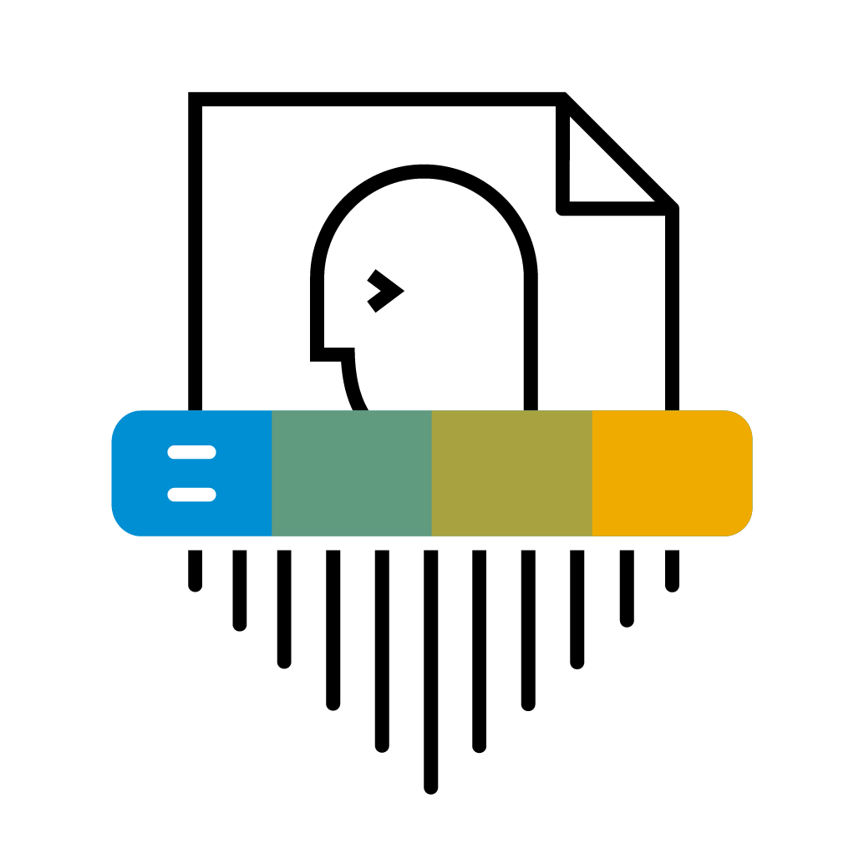
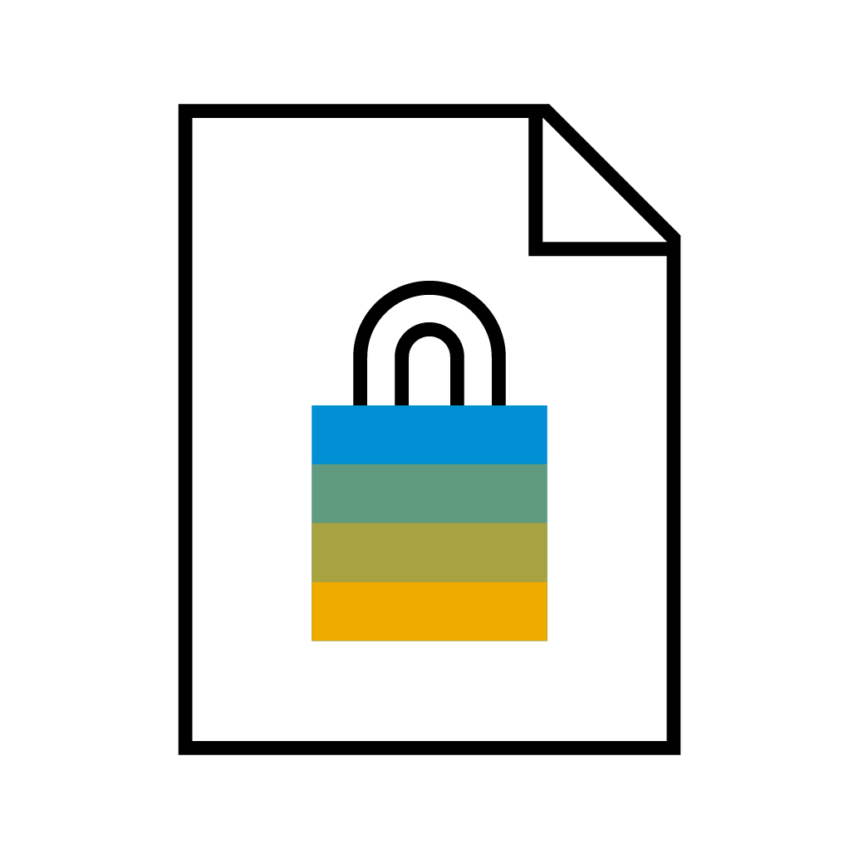
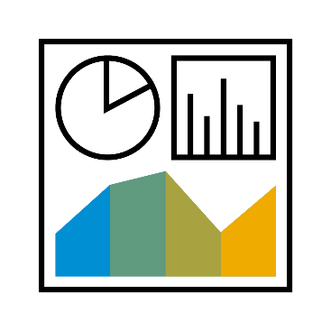
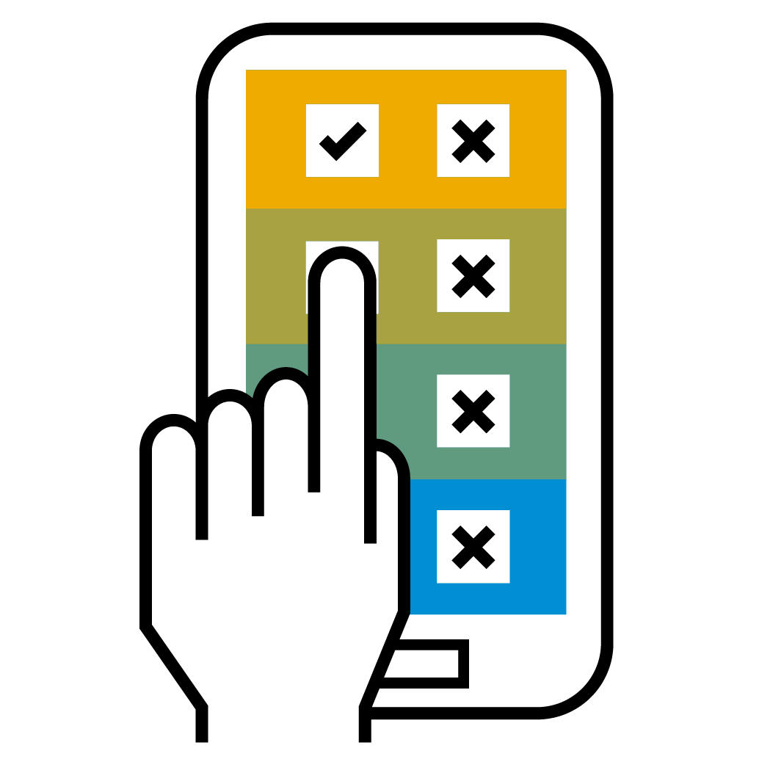
Data protection and privacy features in SAP SuccessFactors solutions Features built into SAP SuccessFactors products
Data purge: Configure data retention rules, and permanently delete personal data from SAP SuccessFactors solutions
Consent Configure and manage consent statements as well as their acceptance where needed
Role-based permissions
Data purge
Consent
Data protection and privacy strategy
Data blocking: Limit access to historical data within SAP SuccessFactors Employee Central
Personal and sensitive personal data
Data subject info reporting Generate a data subject report containing all the data subject’s personal data available in SAP SuccessFactors solutions
Data blocking
Data subject info reporting
Change audit: Manage, record, and report on personal data changes across most SAP SuccessFactors solutions
Change audit
Read audit logging
Read audit logging Allows customers to log read access to sensitive data fields

Slide 12
Data Purge

Slide 13
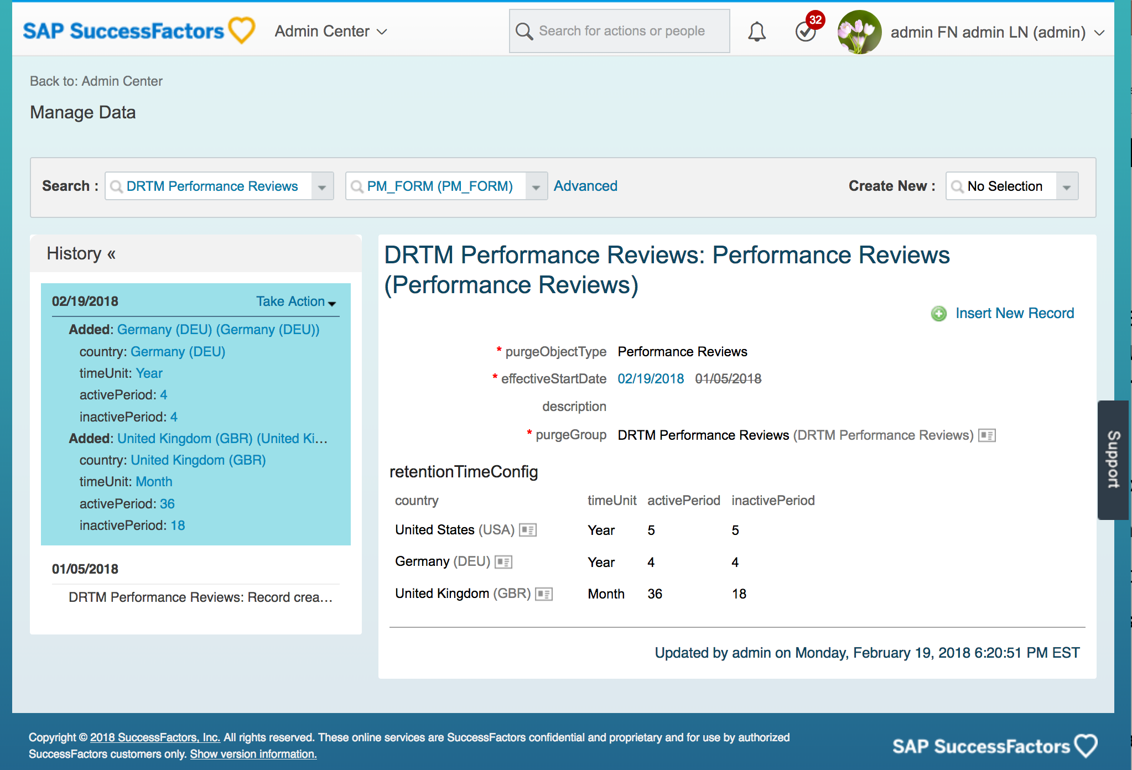
Data Purge Configure Country-Specific Retention Times
Supports good business practices of removing personal data when it is no longer needed
Allows you to define country-specific retention times that provide the boundaries for data purges
Note that when you purge data you permanently delete the data and it cannot be retrieved later.
Notes:
Prerequisites
Role-based permissions (RBP)
Metadata Framework (MDF)
Use this feature if any of the following are applicable:
• A legal requirement to purge all personal data for at least some of your employees in any country
• Different retention times need to be configured for different countries
• Need ability to put a legal hold on data for specified users so that it is excluded from purge
• Need to setup Data Retention Management in SuccessFactors for the first time

Slide 14
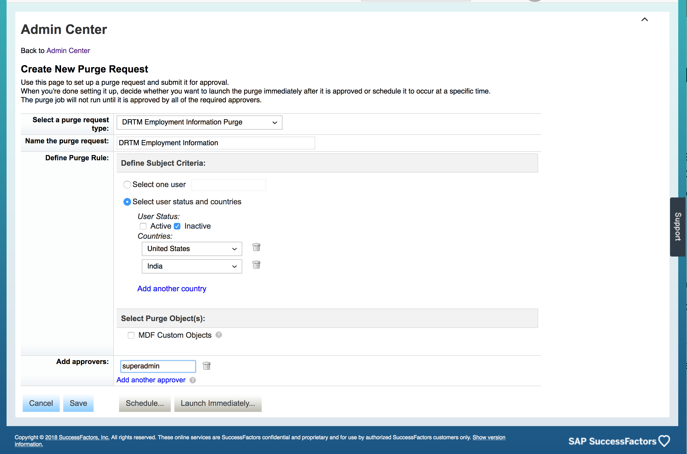
Create and Schedule Data Purge Request
Restrict access to who can create and approve purge requests
Schedule report or launch immediately following approval
Approvers receive a preview report to help determine whether to approve or decline the request
When the purge job completes, requestors and approvers can use the final purge report to confirm the successful purge of each record

Slide 15
Data Blocking

Slide 16
Data Blocking
Data privacy best practice is to limit access to personal data to those who need to see it. Different roles may have a different need-to-know requirement
Data blocking allows you to restrict access to historical, personal data that is within a retention period and therefore still in the system
You can grant one role access to the data, while blocking access for another role
Data Blocking is supported in Employee Central and Reporting. In other modules, all roles need access to all historical data

Slide 17
Data Blocking – Concepts
Data Purge
Retention Time
Blocking for Role A
Data usage for Role A
Blocking for Role B
Data usage for Role B
Data usage for Role C (e.g. Auditor, Employee)
Time
Historical records
Start and End Date in the past
Reference Date in the past
Today
Notes:
Best data privacy practice is to only grant access to personal data to those who need to see that data. This can already be done today with permissions, but this feature goes further.
Data Blocking can be used to restrict access to historical, personal data which is within a retention period and therefore still in the system
One role may still have access to the data, while access for another role may be blocked

Slide 18
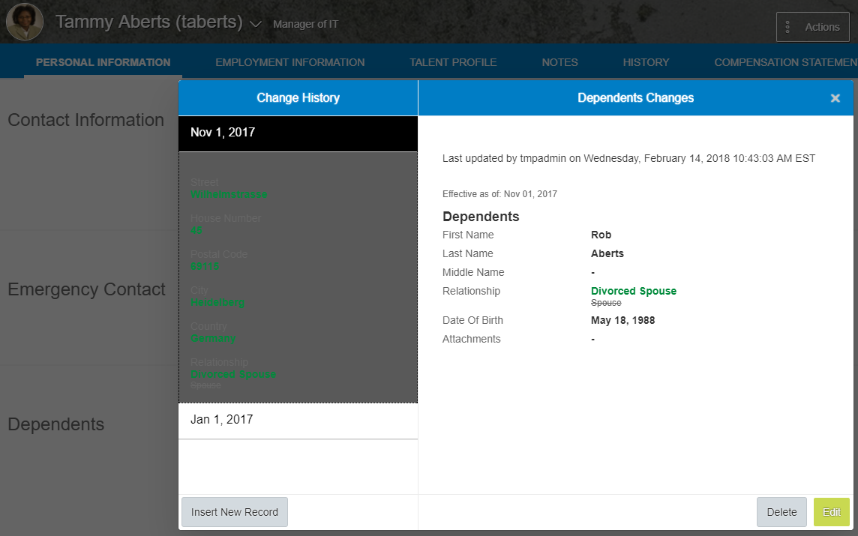
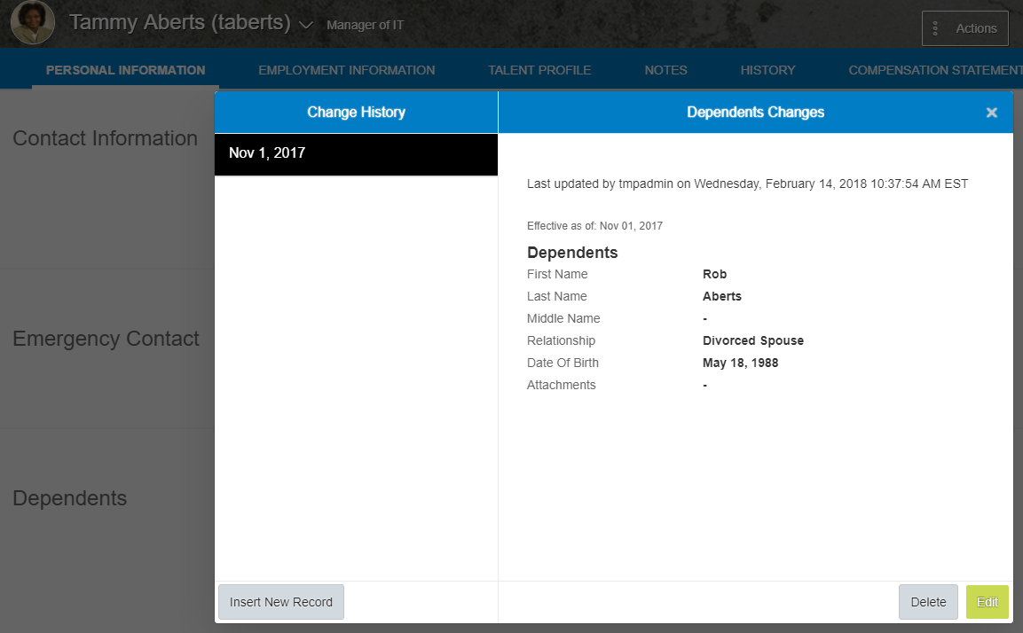
Example of Data Blocking in Use
Without an access period defined for data blocking, the first role can access all historical Dependents records.
With an access period defined for 3 months, the second role can only see the current Dependents record.
1
1
2

Slide 19
Change Audit
Notes:
We don’t generally comment on our release strategy and when and how we make releases available. We currently don’t provide for an exact date when we will turn the full Read Audit and Change Audit features on, but we strive to make them available as soon as possible.
We provide product documentation that allows customers to configure and use the features when we make them generally available. There is a lot of work you can do to prepare for these features in the meantime. For example
Change Audit
Determine if your organization needs to enable Change Auditing
Identify the users who need access to create the Change Audit report – given that it contains personal data and it should have restricted access
Set up Role-Based Permissions and roles
Assign Role-Based Permission roles to the appropriate individuals with authorization to access personal data

Slide 20
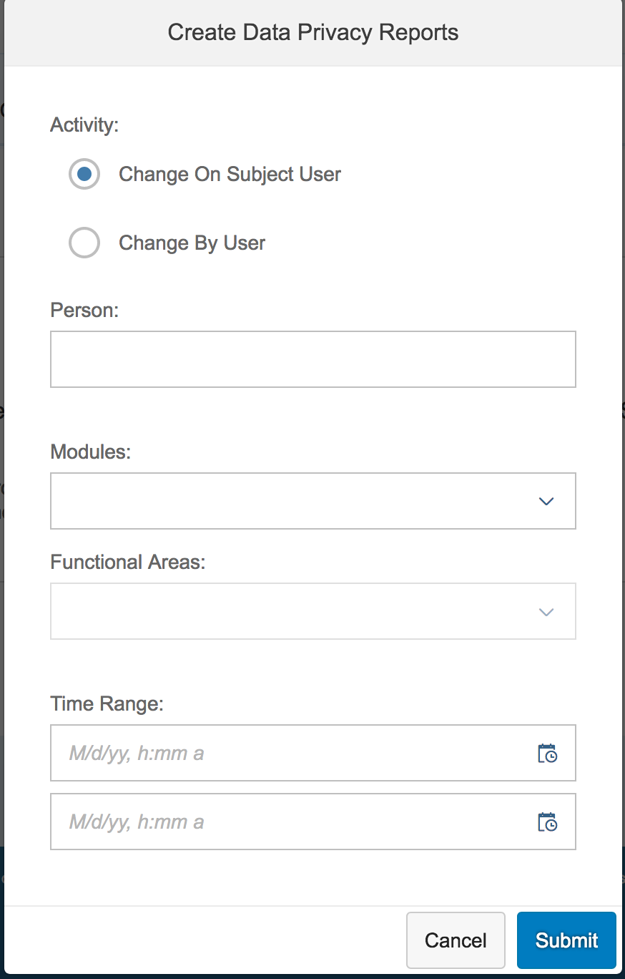
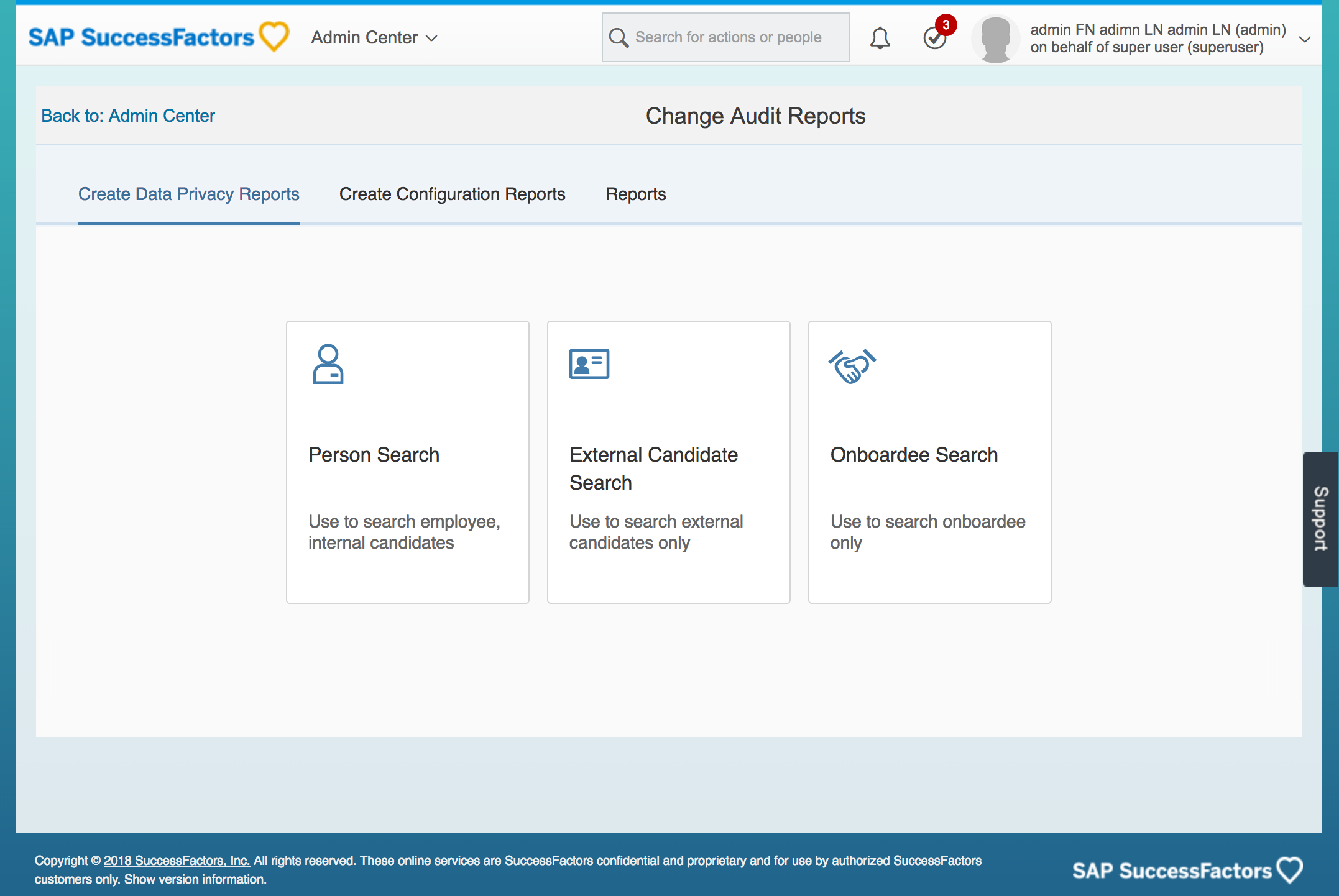
Create Change Audit Report Report on personal data changes across SuccessFactors applications
Notes:
Person search: Allows you to create either a Data Subject report showing changes made to a person’s data or report showing data changed by a user
External candidate search: Allows you to create a report showing who changed a Recruiting Candidate’s Personal Data along with additional context
Onboardee search: Allows you to create a report showing who changed an onboardee’s Personal Data along with additional context
Across the top you can see three tabs
Create Data Privacy Reports – the current tab. This is where you search for data subjects and generate change audit reports
Create Configuration Reports – This is where you can create audit reports to show changes to
Role-based permissions
Proxy user assignment
User management
Reports – this is where you go to download your finished reports.

Slide 21
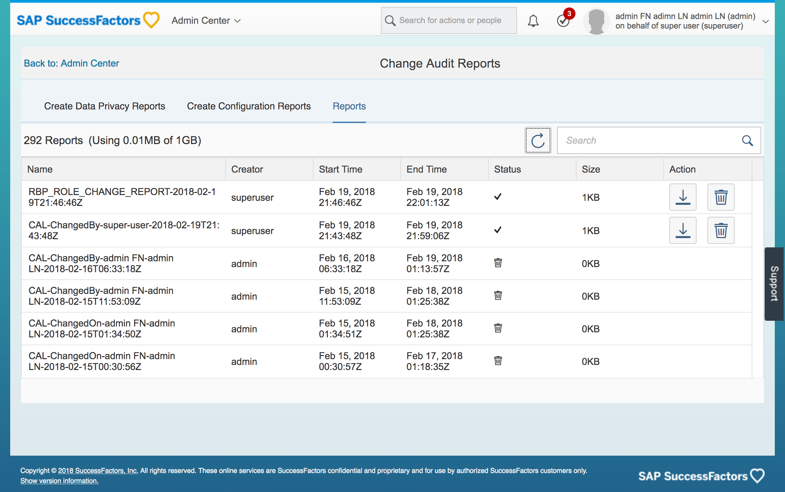
Manage and Download Change Audit Reports Check report availability and download
Notes:
Change Audit report file size can be large and take time to generate. They can be retrieved from within Admin Center -> Change Audit Reports -> Reports
The screenshot of the report may be small, but the report includes information including who changed the data – along with the proxy user if applicable – where the change was made, the type of change, date and timestamp as well as before and after values

Slide 22
Consent Management

Slide 23
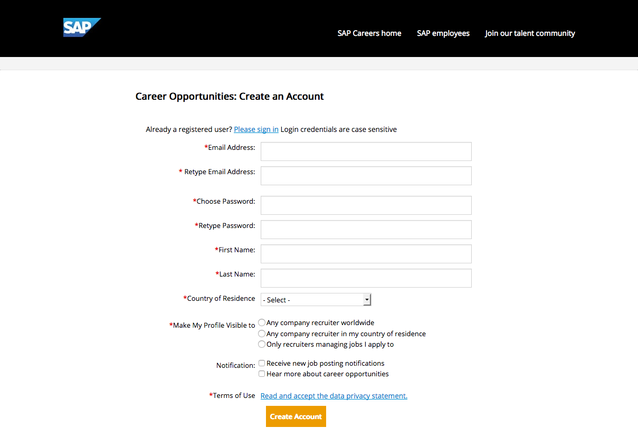
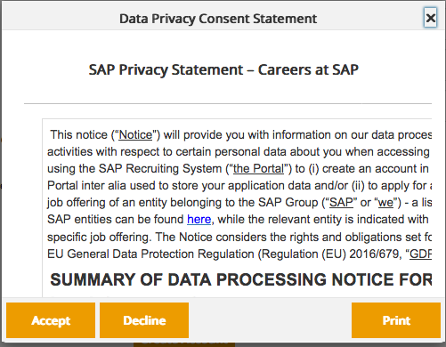
Consent Manage consent as grounds for legal processing
Notes:
Consent is one of the grounds for lawful processing called out in GDPR Article 6
Configure and manage consent statements and their acceptance

Slide 24
Data subject information report

Slide 25
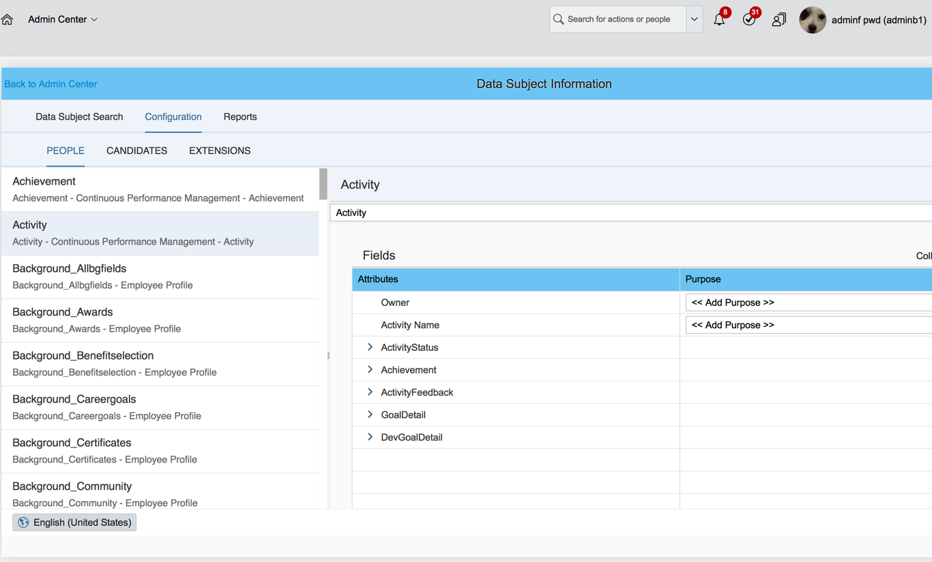
Configure Data Subject Info Report Report on a data subject’s personal data across SuccessFactors applications
One stop shop to specify which data elements you want to include in the report from each area of SAP SuccessFactors
Configure data purpose to be included for additional context in the report output

Slide 26
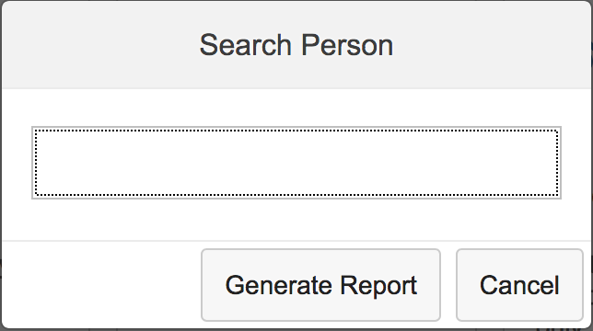
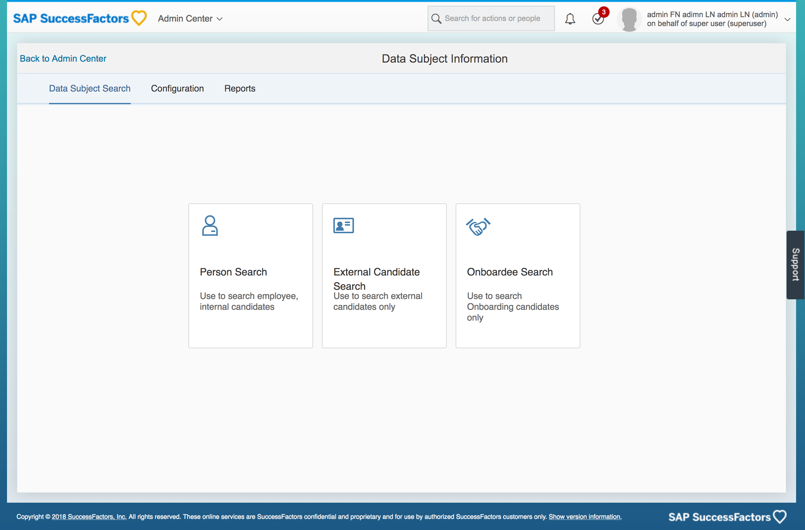
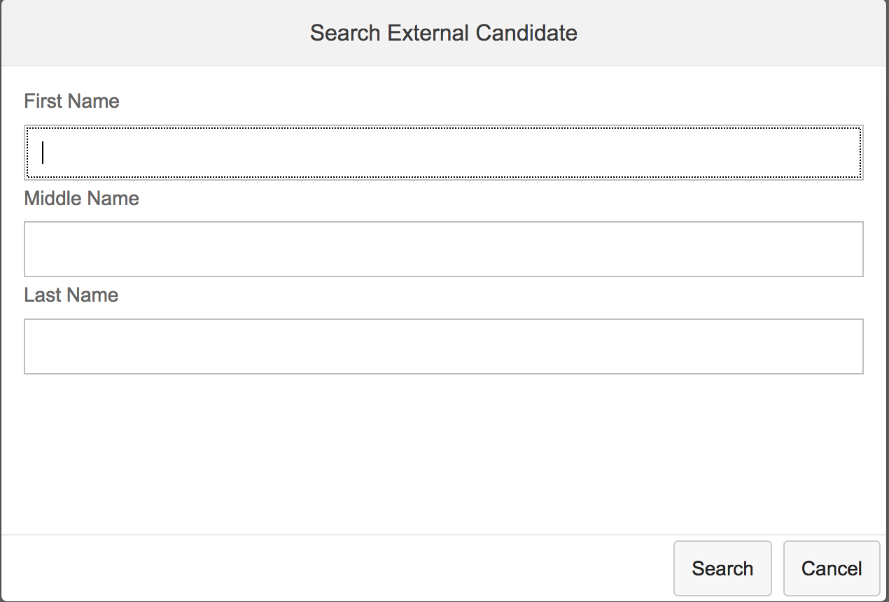
Create Data Subject Info Report Report on a data subject’s personal data across SuccessFactors applications
A single report is generated for integrated SuccessFactors instances, which pulls data from Employee Central, Recruiting Candidate Mangement, Learning, Talent, Onboarding and Workforce Analytics.

Slide 27
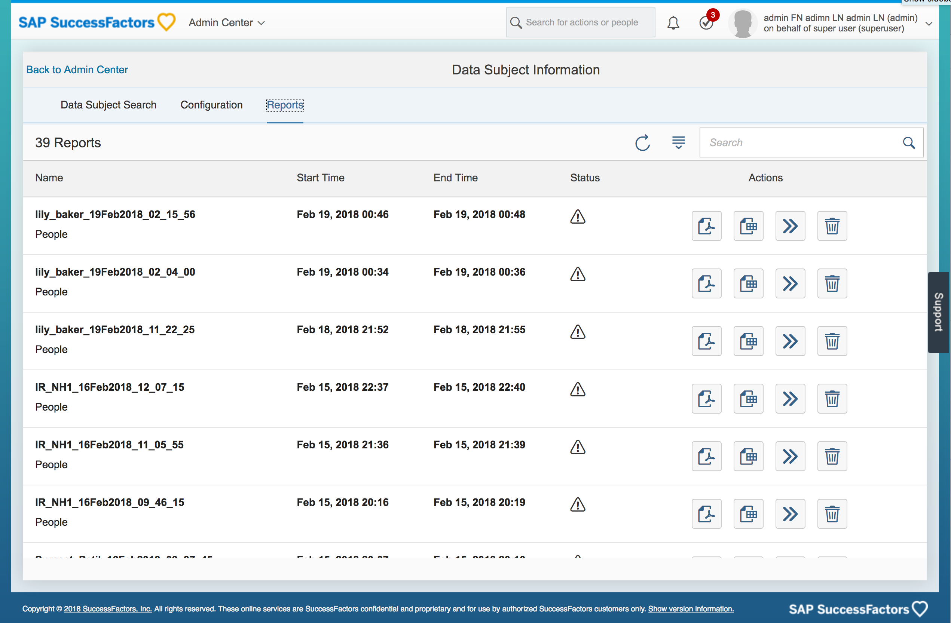
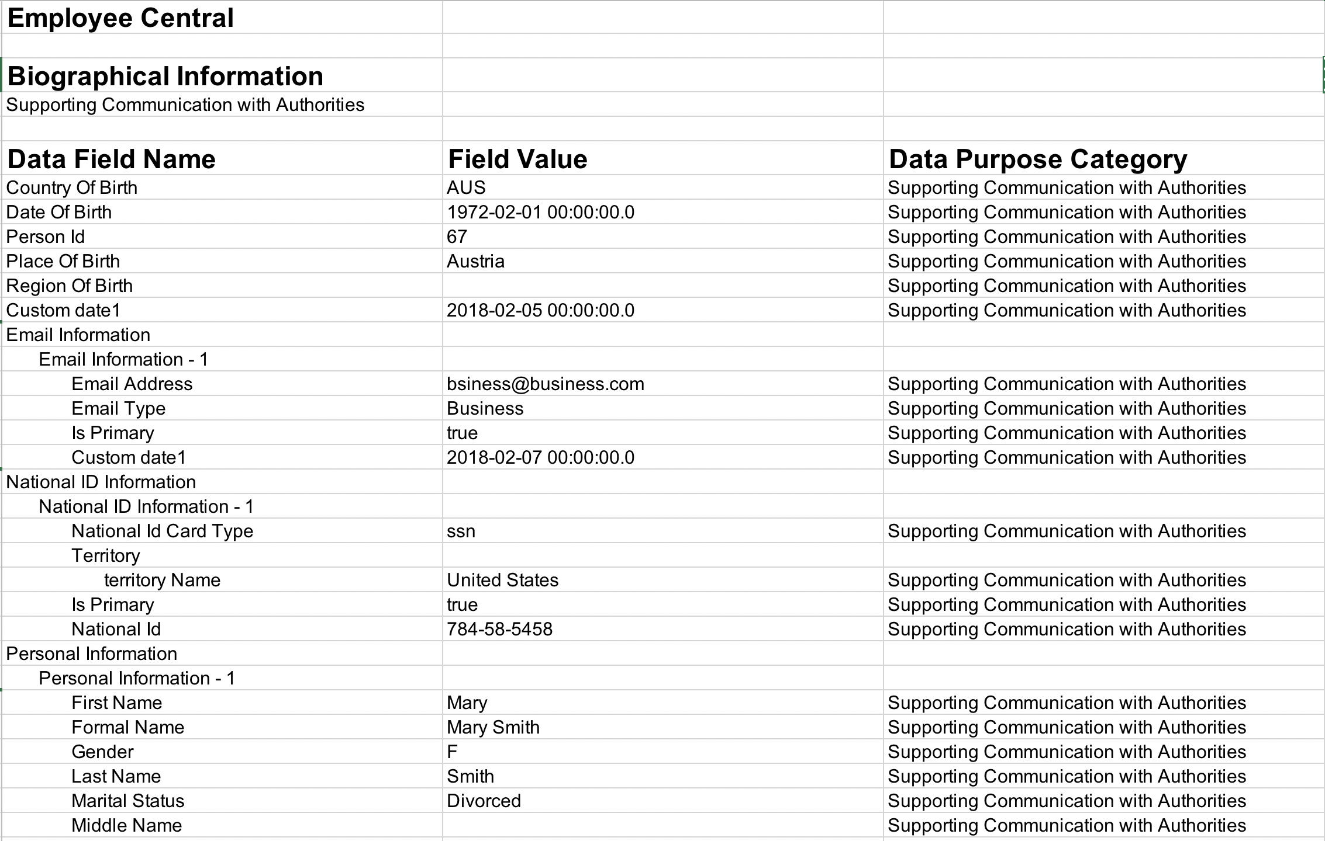
Download Data Subject Info Report Check report availability and download
Example report output
Ability to download the report in PDF or CSV format

Slide 28
SAP SuccessFactors Data Protection and Privacy Features Summary by Product Area
Feature | Talent Management | Employee Central | Employee Central Payroll | Platform | Learning | Onboarding | Recruiting Management | Recruiting Marketing | Recruiting Posting | Reporting | Workforce Analytics
Data Purge |  |  |  |  |  |  |  |  |  | N/A | N/A
Data Subject Info |  |  |  |  |  |  |  |  |  | N/A
Data Blocking | N/A |  |  | N/A | N/A | N/A | N/A | N/A | N/A |  | N/A
Consent |  | N/A | N/A | N/A |  |  |  |  |  | N/A | N/A
Change Audit |  |  |  |  |  |  |  |  |  | N/A | N/A
Read Audit |  |  |  |  | N/A |  |  |  | N/A | N/A | N/A
N/A – This feature is not needed in the application due to requirements/use case non-applicability N/A* – This feature is not supported in the application. If you have included sensitive personal data in this application, you should consider removing it from the application data model
Prerequisites: Role Based Permissions (RBP) and Metadata Framework (MDF)

Slide 29
Best Practices (Immediate) for Data Governance 1. GET RID OF PAPER DATA 2. Single Point of Contact (i.e., Data Protection Officer) 3. Form multidisciplinary team (IT, HR, DPO, Legal at a minimum) 4. Know what you have (can’t protect what you don’t know) 5. Insurance coverage – can you get it? 6. Run practice drills for report of breach (remember insurance, public relations) 7. Do what you say you are doing. 8. Anonymize everything you can.
Notes:
Get rid of paper data – OCR it if you must.
Someone has to take ownership and be equipped to handle data privacy demands
Form a team – more heads better than one to look at requests and potential breached
Audits & reviews
You may already have coverage. See what it says, particularly notice requirements
Tabletop exercises
Do what you say you are doing. This is what makes the regulators angry
Anonymize everything possible.

Slide 30
Respecting the privacy of people is good for business
SAP is ready for compliance challenges
SAP enables compliance – data protection and privacy is in our DNA
Notes:
MESSAGE 1:
Respecting the privacy of people is good for business
• We embody data protection and compliance because it’s good for business and is the right thing to do as it aligns with our values to improve people’s lives
• SAP is your partner to ensure your business is improved rather than disrupted by data protection regulations: earn and sustain customer and employee trust, increase stakeholder engagement and protect your business
• Thousands of businesses trust us - we are at the forefront of compliance (we continue to develop and invest in companies like Gigya and BigID) and dedicated to keeping our customers ahead as GDPR evolves.
MESSAGE 2:
SAP is ready for for compliance challenges
SAP is fully committed internally to complying with any relevant laws and regulations – including GDPR - to strengthen our customers’ confidence and trust
SAP has developed and implemented a Data Protection Management System to ensure that we manage the complex requirements of data protection in a centralized and structured way
Our Data Protection Officer leads the Data Protection and Privacy Office that collaborates with all business areas to ensure that SAP complies with all relevant data protection laws, in every jurisdiction where we do business.
The pillars of our internal compliance strategy are to provide the business with security and data protection recommendations, guidance and training, conduct regular compliance audits, continuously monitor our processes, and ensure employee awareness
MESSAGE 3:
SAP enables compliance - data protection and privacy is in our DNA
Data protection and privacy (DPP) are critical aspects of any digital transformation, and that’s what we do.
SAP is your trusted global partner with over 40 years of leadership in DPP and has provided best practices and guidance to enable customers to comply with regulations worldwide - long before GDPR was introduced.
SAP's products and services have data protection and privacy built in by design and default, thus helping our customers address GDPR requirements enterprise-wide
SAP offers many solutions and services that support digital transformation, end-to-end data protection, privacy, and governance operations, including our market leading GRC, EIM, and Customer preferences & consent management (Gigya) solutions. Our services experts will help customer's chart a path to drive the best outcomes for your business.

Slide 31
Thank you.
Contact information:
Barbara O’Cain
SAP SuccessFactors
Barbara.ocain@sap.com

