Slide 1
Leveraging SAP Enterprise data for Analytics Use Cases
Thomas Olivero
Senior Manager SAP Data Architects
Qlik

Slide 2
Key Outcomes/Objectives
Learn how to leverage SAP data in modern data warehouses
Overcome common limitations and challenges when working with SAP data
How to land SAP workloads in the cloud and prepare the data in an analytics ready format
Envisioning real-world Analytics use cases with SAP & non-SAP data

Slide 3
Agenda
Understanding the current use of SAP Data for Analytics in the broader analytics market
SAP Data in real-world Analytics use cases
Unique Data Integration challenges for SAP data in modern Analytics architectures
Provisioning SAP data in an Analytics ready format
Use Cases realized: Raw to ready insights in real-time

Slide 4
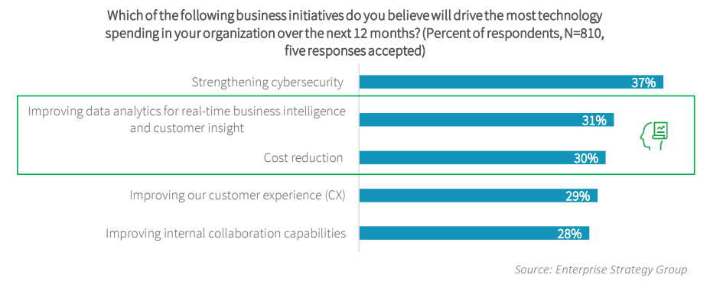
Where are SAP Customers Investing?
Real-time data and analytics pipelines are top priority

Slide 5


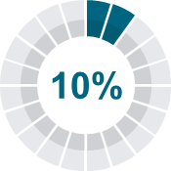




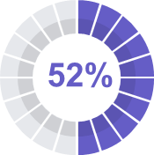




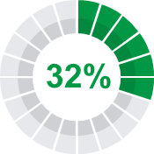




Data Challenge
Businesses have lots of data but not enough value from it
Business Data
Data-Value Gaps
Business-relevant data used for analysis
Average enterprise
has 350TB of data
Average SMB has 50TB of data
Growing at 52%
Top analytics pain point is data integration
Executives who
say they can create
value from data
Sources: IDG research; SAPinsider research from May 2020 link; IDC Worldwide Global DataSphere Forecast 2019-2023 (2019); Accenture Closing The Data-Value Gap (2019), Qlik How to Drive Data Literacy Within the Enterprise (2018)

Slide 6
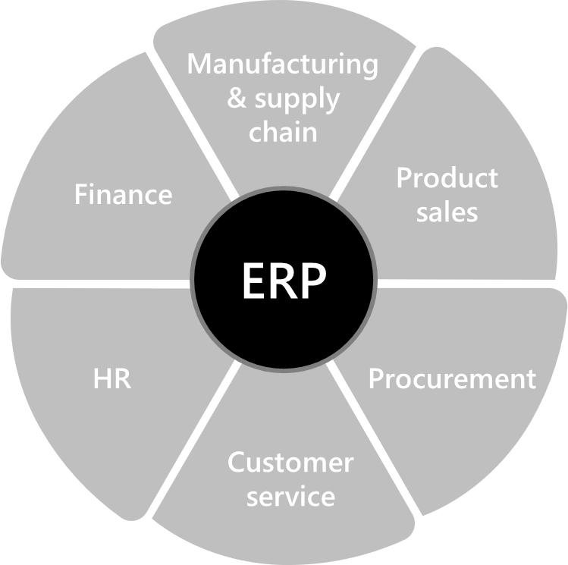

SAP
Holds valuable business data
77%
92%
80%
of world’s transaction revenue touches SAP systems
of the Forbes Global 2000 companies are SAP customers
of SAP
customers
are SME
Sources: https://www.sap.com/about/company.html; https://assets.cdn.sap.com/sapcom/docs/2017/04/4666ecdd-b67c-0010-82c7-eda71af511fa.pdf

Slide 7

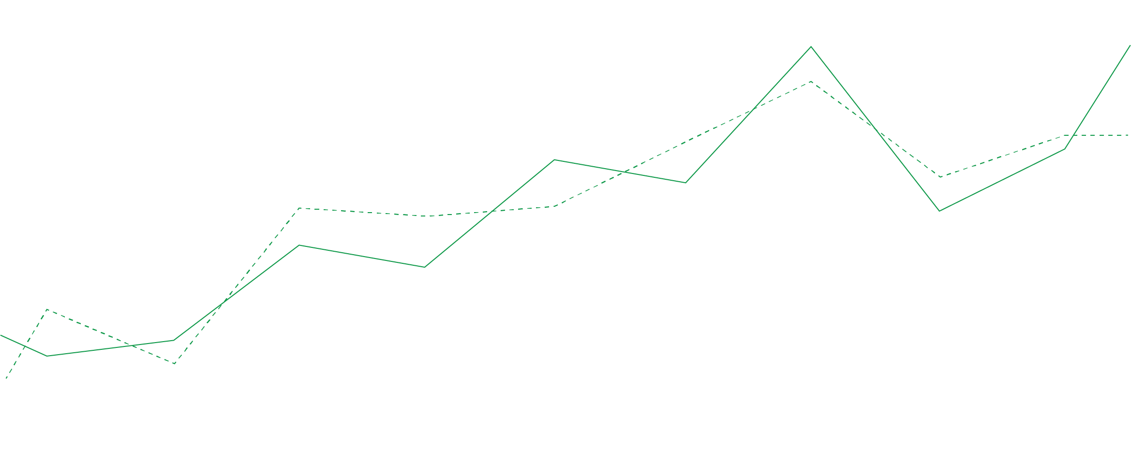

What does your SAP data do for you?
Your Business Runs on SAP
Processes Orders and Revenue
Controls and Moves Inventory
Pays Vendors and Employees
Maintains Company Financials / GL
Data is the lifeblood
of your business

Slide 8




Your SAP data can do MORE
Integrate SAP Data into modern data lakes or enterprise/cloud data warehouses
Enable Machine Learning (ML) initiatives by combining data from SAP with data from other trusted sources
Derive valuable, actionable insights by analyzing data in real-time
Your Data has
a Story to Tell

Slide 9




Use Cases
The Art of the Possible
CHANGE
BUSINESS NEEDS
Sales have
shifted online
Active intelligence on sales order trends, order fulfillment and distribution, and customer satisfaction
Supply chains are disrupted
Real-time visibility into inventory, logistics, and risks across global supply chains
Working capital is scarce
Increased speed and agility to analyze critical financials and operational data to reduce time to insights
Digitization has accelerated
Scalable, modern data architectures that automate data integration and delivery to next-gen platforms

Slide 10
Turning SAP Application Data Into Valuable Insights

Slide 11
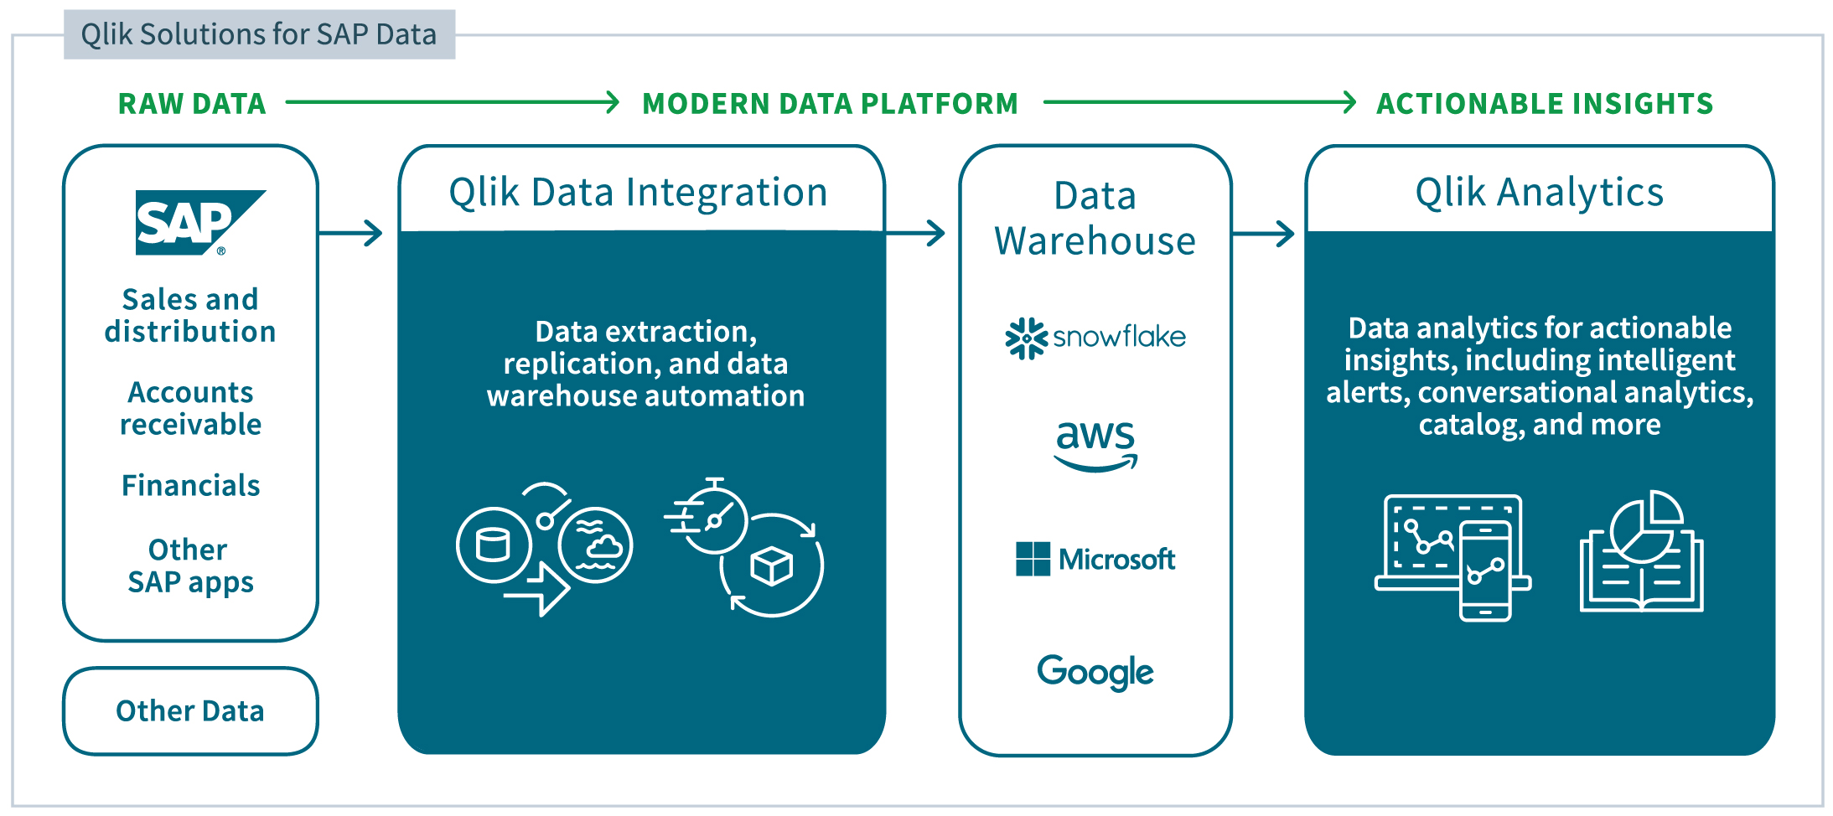
Turning Raw Data into Actionable Insights
A Modern End-to-End, Modular, and Extendable Solution

Slide 12
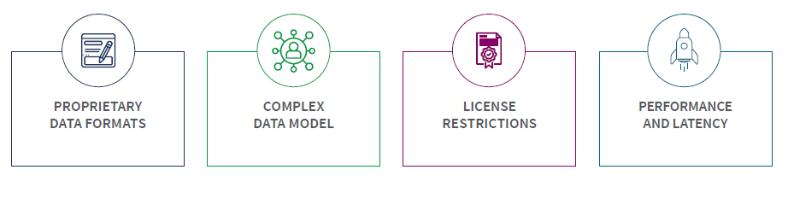
SAP Data Challenges
Leveraging and integrating SAP data is not easy
Data formats that make it incomprehensive
to most
10s of thousands of tables with intricate relationships
Complex licensing that can become time consuming and costly
Built for transactional performance not
real-time analytics

Slide 13
What Customers are Looking for…
Key Assumptions:
Customers will want to combine SAP data with data from non-SAP sources
The Consumer of the data may not be an SAP user
Data Replication of SAP Source Data (Master & Transactional)
Replicate
SAP meta-data
Combine highly structured SAP data with data from other (often unstructured) sources to enhance the data
Data Type Promotions
Field Names
(BUKRS = Company Code)
CHAR, NUMC, DATS, TIMS
Handle Pool/Cluster/INDX Tables
Values
(Company Code 1000 =
US-NorthAmerica-California)
Strings

Slide 14



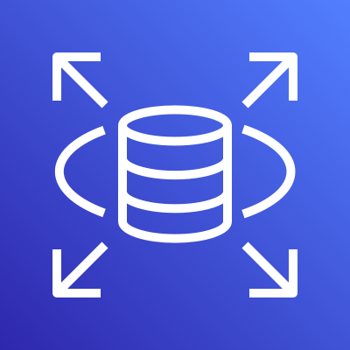









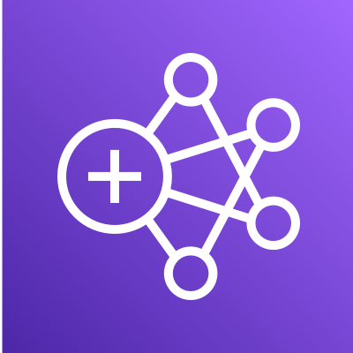





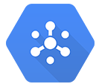

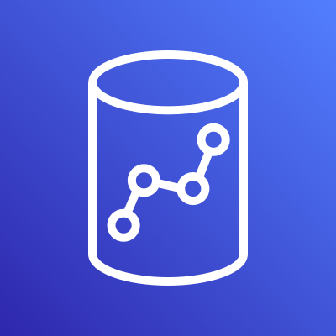

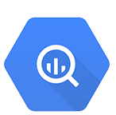





Cloud Data Integration Partner Alignment
RDS (All)
All databases
All databases
DBaaS
S3
ADLS, BLOB
Cloud Storage (GCS)
STORAGE
EMR
HDInsight
DataProc
HADOOP
STREAMING
Kinesis
Event Hubs
Kafka
Redshift
Azure Synapse
BigQuery
DWaaS
Snowflake
Snowflake
Snowflake
OTHER DWaaS
Databricks
Databricks
Data Lakes (House)
DL/DW Automation

Slide 15






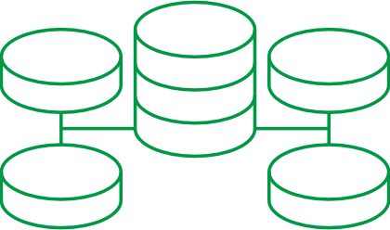

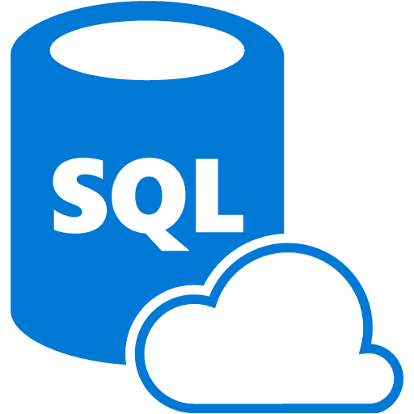


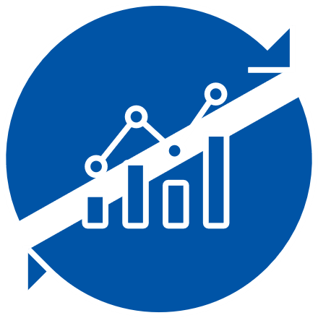





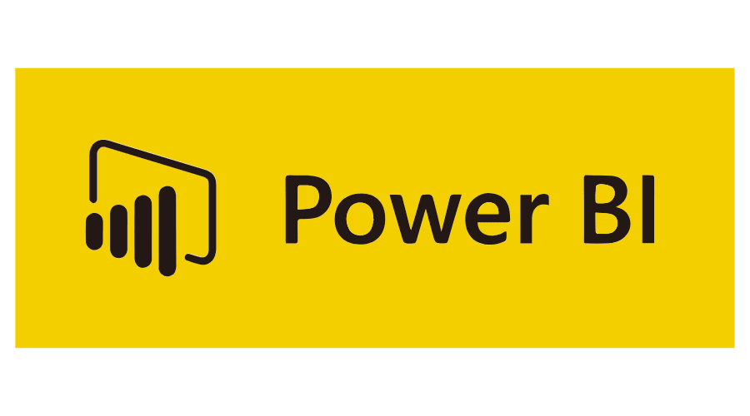











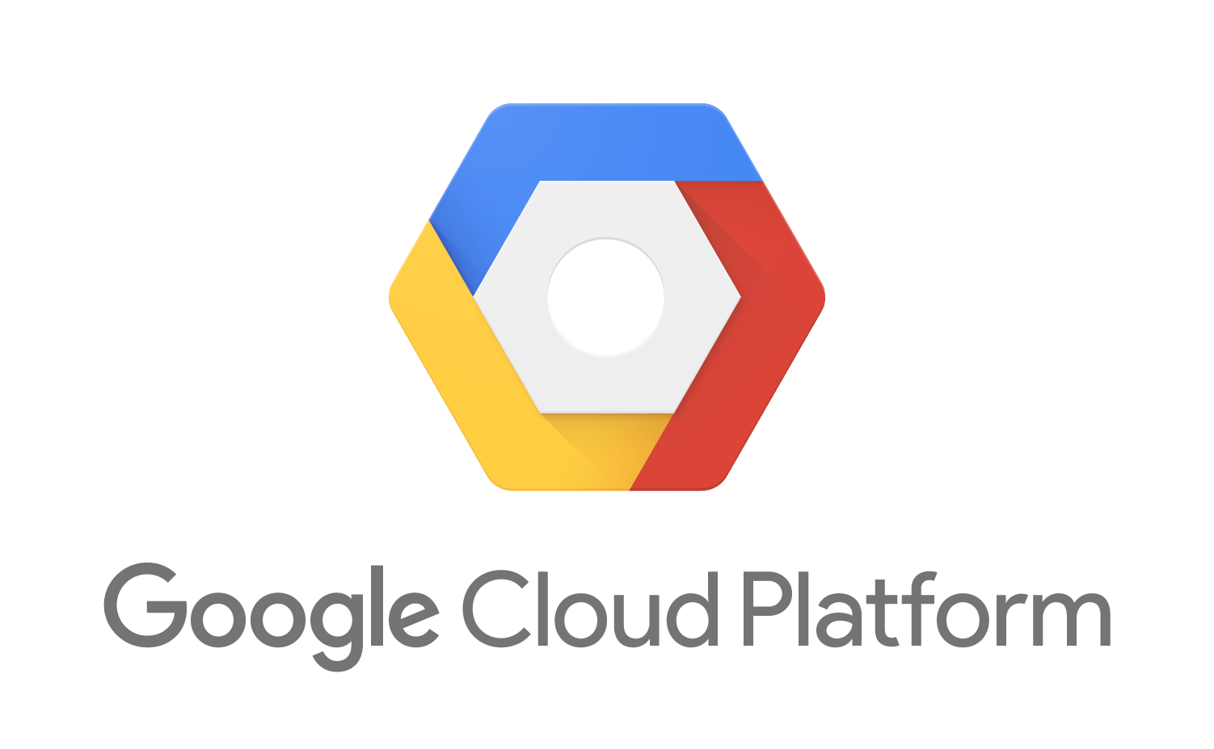




Qlik Data Integration Platform – Core Use Cases
RDBMS
CDC Streaming
Streaming Data Pipeline Automation
Data Warehouse
Commit
Amazon RDS
Azure SQL DB
Files
Data Warehouse Automation
Amazon
Redshift
Azure
SQL DW
Analytics
Mainframe
Generate
Deliver
Refine & Merge
Model
SAAS
Change Data Streams
To Clouds, Lakes…
For Analytics, AI/ML, Data Science…
Catalog
Shop, Organize & Provision
Consume
AI/ML
APPS
Managed Data Lake Creation
Design, Manage & Monitor
SAP
Conform
Data
Science
Catalog
Shop, Organize & Provision

Slide 16







Real-time SAP Data Replication
With Qlik Data Integration
Qlik Transport
Data model mapping
Qlik
Replicate
Cloud
Application/
Extractor
In-memory
Hadoop
RDBMS
Database
(Trigger)
CDC or
Batch
Kafka
Data
Warehouse
Database
(Log)
Filter
Transform
On Premises
Native SAP ABAP solution
Decodes proprietary SAP source structures
Simplifies complex SAP data model mapping
Propagates SAP metadata
Supports all core and industry-specific SAP modules
Log-based, query or application-level SAP integration
Delivers real-time data to AWS
Reassembles critical relationships in target (with Qlik Compose)

Slide 17



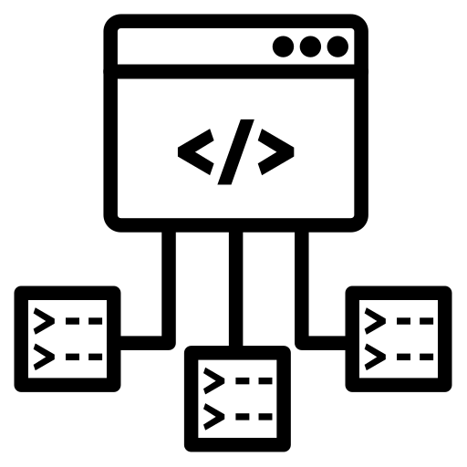





Qlik and SAP
Why SAP ODP/ODQ?
  Supports CDS/HANA Views
  (various SAP BW objects)
  Compression
  and Improved Performance
Operational Data Provisioning
/Queue framework
  (from SAP)
Greater visibility
(what's extracted and where)
  Supports Runtime Scenarios

Slide 18










Moving SAP Data with ODP
Qlik Replicate
Target schema creation
ABAP
CDS Views
SAP data type preservation
SAP BW
SAP BW/4HANA
Automated Batch
to CDC transition
SAP
HANA Views
Real-time
CDC stream
or batch
(full load)
Real-time
CDC stream
or batch
(full load)
SAP ECC
Extractors
Filtering
Transformations
Scheduling (API)
ODP BASED CDC*

Slide 19



Qlik and SAP
QLIK REPLICATE
QLIK COMPOSE
QLIK SAP ACCELERATORS
Automated, universal and real-time data integration
Data Warehouse and Data Lake automation for Analytics Ready Data.
Pre templated PS approach to accelerate customer’s time to value

Slide 20

Solution Accelerators
Pre-configured content and templates
Order-to-Cash
Optimize sales order fulfillment, billings,
and working capital
Financials
Manage and control your P&L, operating costs, and assets & liabilities
Inventory Management
Track inventory levels, movement, and costs
SAP Data Extractors
Replication
Tasks
Business Data
Models for SAP
Analytics
App Templates

Slide 21





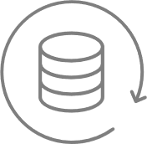

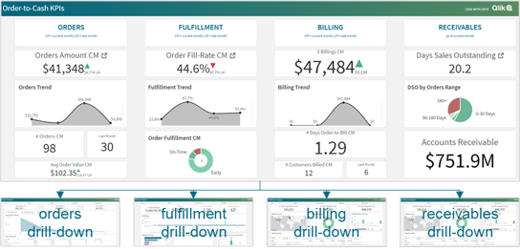


SAP – Order 2 Cash
Putting it all together
prebuilt extractors
ready to use
prebuilt replicate
tasks
prebuilt compose
models
catalog ready
data-marts
prebuilt
template apps
Extractor
Queue
Qlik
Transport
Sales Order Management
Accessible SAP Data
Prebuilt Qlik App
2LIS_11_VAITM
(Sales Item Extractor)
Replicate Tasks
Shipment & Distribution
Documented KPI catalog
Prebuilt Power BI Apps
2LIS_11_VDITM
(Billing Document)
Billing
Ready for Alerting
Sales Order Status
(2LIS_11_VASTI)
Accounts Receivables
Ready for AI/ML
Big portion of the implementation effort is repetitive across our customer base.
Qlik
accelerator package

Slide 22
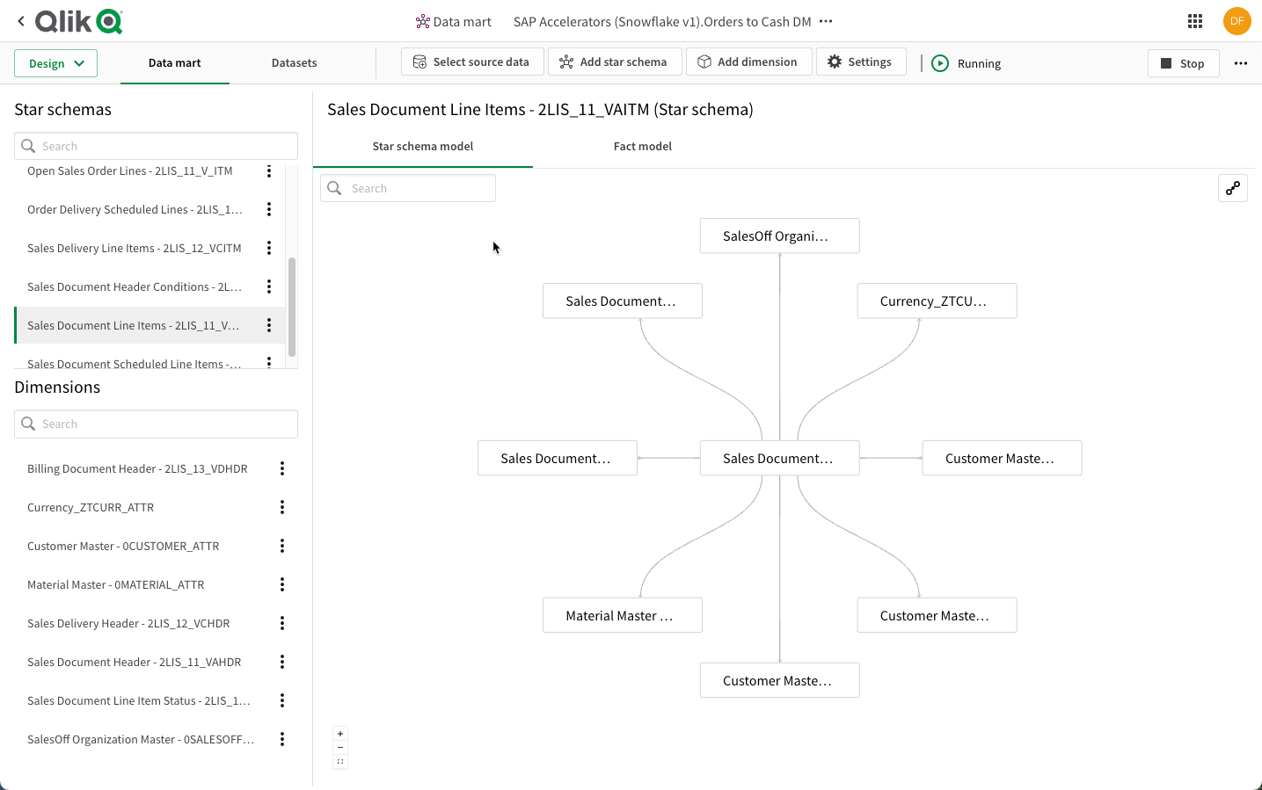


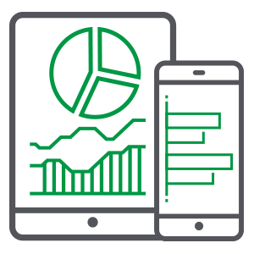







Data Pipeline & Analytics Architecture
Qlik SaaS Platform
Qlik Cloud Data Integration
Qlik Sense
Data Analytics
Leverage DW Automation
Pre-Defined SQL Transforms
Pre-defined DW model
Pre-defined ELT mappings
Pre-defined data marts
Extensible
Pre-defined Applications
Qlik Replicate
Data Ingestion
Snowpipe
Data
Loading
SAP
Extractors
CDC
Updates
AI / ML
Integration
Analytics
Applications
Cloud Data SaaS
Conversational
Analytics
Reporting
& Alerting

Slide 23
Data Pipeline & Analytics Architecture
Qlik SaaS Platform
Qlik Cloud Data Integration
Qlik Sense
Data Analytics
Leverage DW Automation
Pre-Defined SQL Transforms
Pre-defined DW model
Pre-defined ELT mappings
Pre-defined data marts
Extensible
Pre-defined Applications
Qlik Replicate
Data Ingestion
Snowpipe
Data
Loading
SAP
Extractors
CDC
Updates
AI / ML
Integration
Analytics
Applications
Cloud Data SaaS
Conversational
Analytics
Reporting
& Alerting

Slide 24
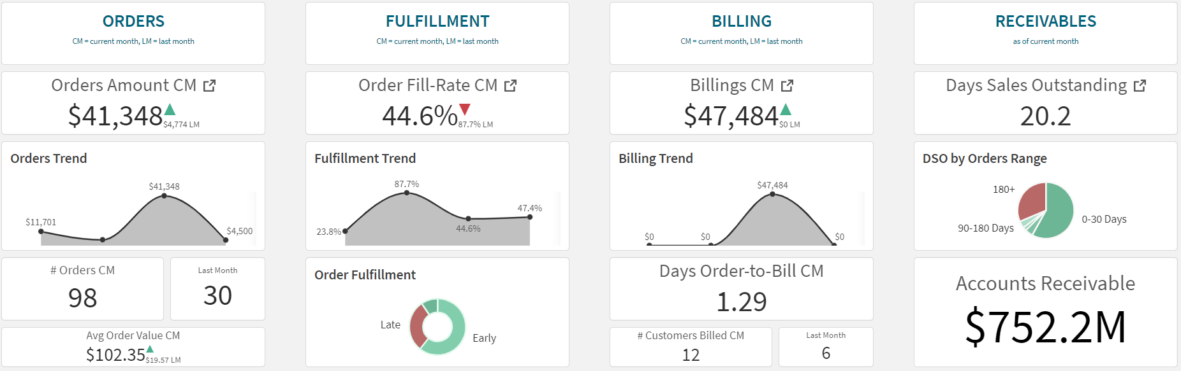
Optimize Working Capital and DSO*
* days sales outstanding = cycle time between order booking and customer payment; lower DSO = more cash, better liquidity
Gain actionable insights into sales orders and trends
Take proactive decisions on order fulfilment and delays
Analyze billings, discounts, and taxes with visibility down to billing documents
Improve working capital & DSO by accelerating customer payments

Slide 25
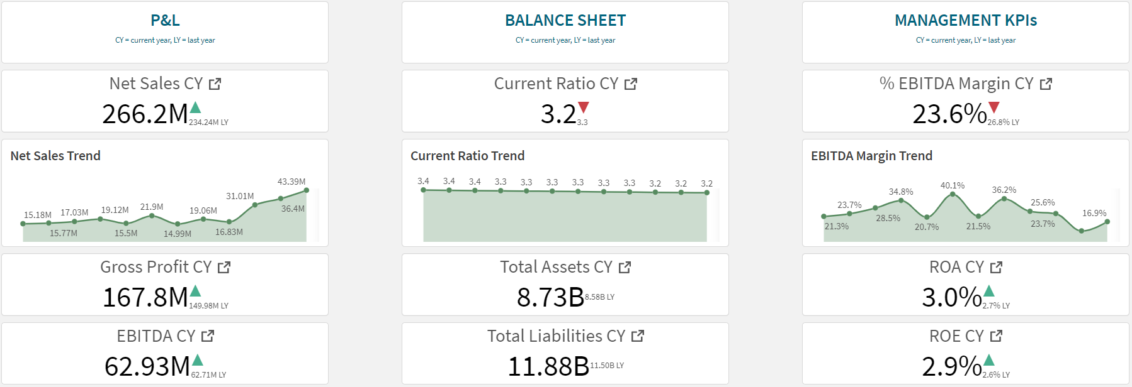
Improve Financial Profitability and Resilience
Drive growth & profitability with near real-time P&L and expenditure insights
Improve financial resilience with balance sheet analytics
Collaborate with business units on key management KPIs

Slide 26
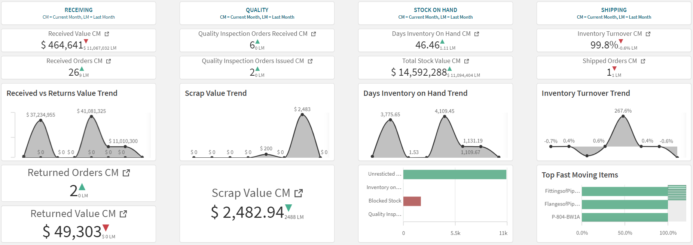
Decrease Inventory Inefficiencies and Costs
Gain actionable insights into materials receiving & returns
Manage stock quality, inspections, and scrap
Identify inventory bottlenecks in locations and movements
Improve inventory turnover by identifying slow moving items

Slide 27




The Vision
Acceleration through business content
=
technological advantage
prebuilt
business content
accelerated success

Slide 28
For questions after this session, contact us at thomas.olivero@qlik.com.

Slide 29

Stay connected. Share your SAP experiences anytime, anywhere.
Join the ASUG conversation on social media: @ASUG365 #ASUG

