Slide 1
Leveraging SAP Enterprise data for Analytics Use Cases
Matthew Hayes
VP of SAP Business
Qlik

Slide 2
Key Outcomes/Objectives
Learn how to leverage SAP data in modern data warehouses
Overcome common limitations and challenges when working with SAP data
How to land SAP workloads in the cloud and prepare the data in an analytics ready format
Envisioning real-world Analytics use cases with SAP & non-SAP data

Slide 3
Agenda
Understanding the current use of SAP Data for Analytics in the broader analytics market
SAP Data in real-world Analytics use cases
Unique Data Integration challenges for SAP data in modern Analytics architectures
Provisioning SAP data in an Analytics ready format
Use Cases realized: Raw to ready insights in real-time
Notes:
Walking through the agenda, we’re going to discuss the numbers. What are the market needs and where are SAP customers making investments? How efficient are SAP customers at leveraging their data and what are the current challenges? We will talk about the Qlik solution and how we are uniquely positioned to handle the most complex data challenges. Helping you gain valuable insights from the SAP data. Going from Raw application data to analytics ready data marts that can help lower time to value for analytics projects and speed decision making. We will then provide a demonstration that shows 2 methods for getting SAP data into the data warehouse.

Slide 4
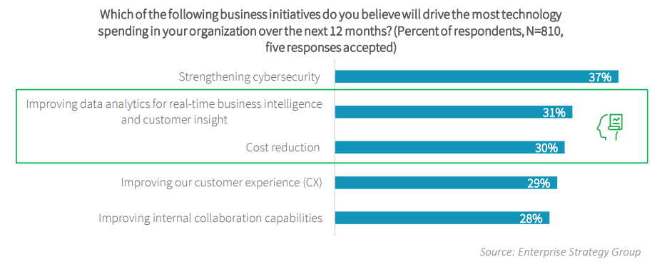
Where are SAP Customers Investing?
Real-time data and analytics pipelines are top priority
Notes:
And this metric shows that SAP customers are pivoting their investments to meet the challenges. This research shows the top 5 areas where SAP customers are investing their resources. Cybersecurity is understandably at the top of the list, but right behind it are two topics that Qlik can address. Improving data analytics to gain real-time insights and reducing cost go hand-in-hand. Often, the primary drivers for analytics projects is cost reduction, increasing revenue or creating a competitive advantage. The most tangible of these is cost reduction because it can be targeted. When combining these priorities, it means that nearly two-thirds of SAP customers are focused on making the business more efficient through data.

Slide 5


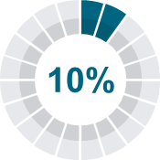




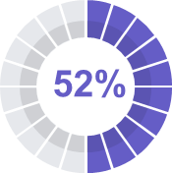




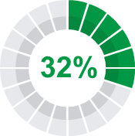




Data Challenge
Businesses have lots of data but not enough value from it
Business Data
Data-Value Gaps
Business-relevant data used for analysis
Average enterprise
has 350TB of data
Average SMB has 50TB of data
Growing at 52%
Top analytics pain point is data integration
Executives who
say they can create
value from data
Sources: IDG research; SAPinsider research from May 2020 link; IDC Worldwide Global DataSphere Forecast 2019-2023 (2019); Accenture Closing The Data-Value Gap (2019), Qlik How to Drive Data Literacy Within the Enterprise (2018)

Slide 6
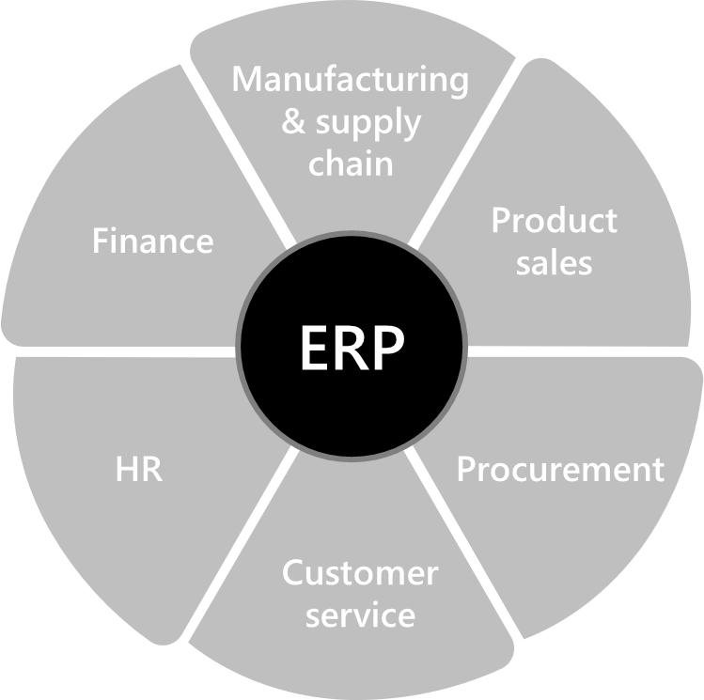

SAP
Holds valuable business data
77%
92%
80%
of world’s transaction revenue touches SAP systems
of the Forbes Global 2000 companies are SAP customers
of SAP
customers
are SME
Sources: https://www.sap.com/about/company.html; https://assets.cdn.sap.com/sapcom/docs/2017/04/4666ecdd-b67c-0010-82c7-eda71af511fa.pdf

Slide 7

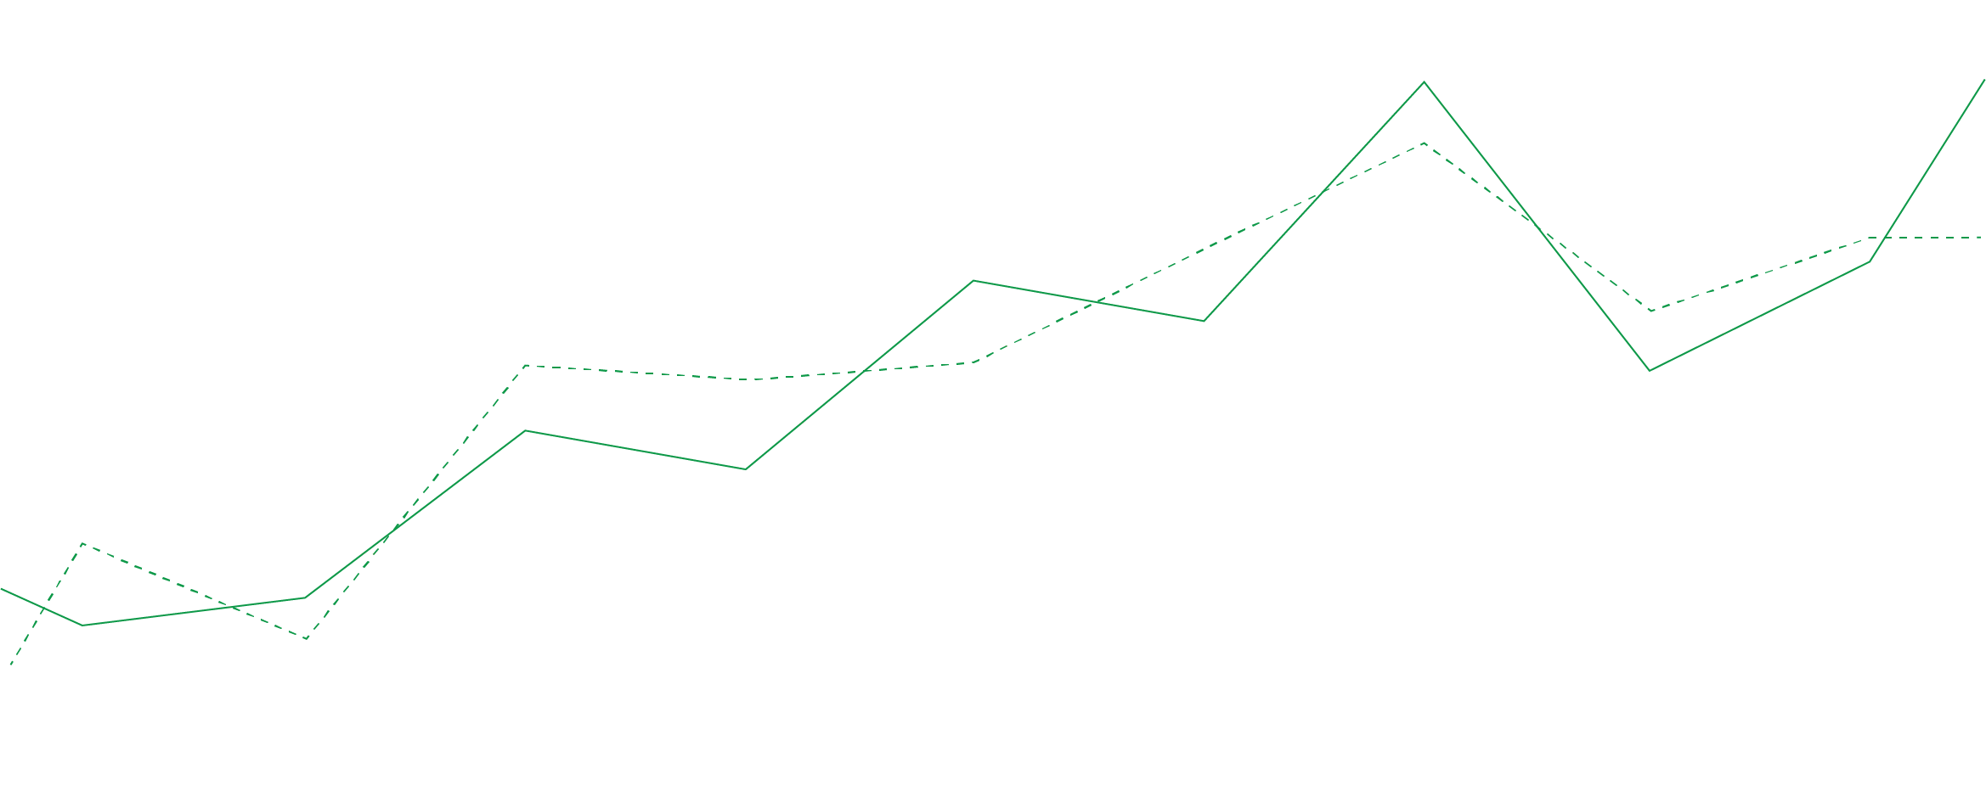

What does your SAP data do for you?
Your Business Runs on SAP
Processes Orders and Revenue
Controls and Moves Inventory
Pays Vendors and Employees
Maintains Company Financials / GL
Data is the lifeblood
of your business
Notes:
So, let’s break it down. Everyday, your business runs on SAP. Revenue is processed, Inventory is allocated and moved, Vendors and employees are paid, and many companies issue their financials using SAP applications. SAP data truly is the lifeblood of the business.

Slide 8
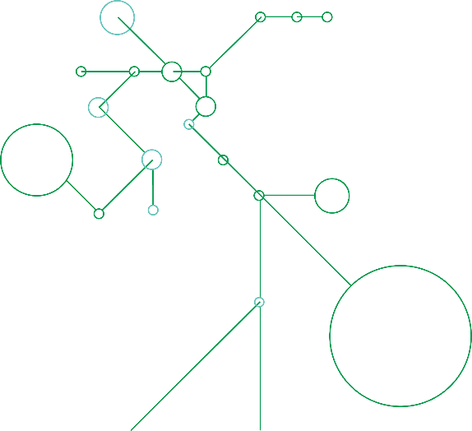

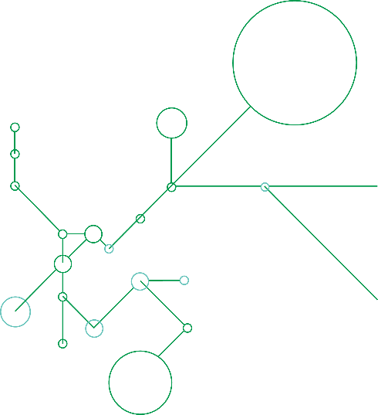

Your SAP data can do MORE
Integrate SAP Data into modern data lakes or enterprise/cloud data warehouses
Enable Machine Learning (ML) initiatives by combining data from SAP with data from other trusted sources
Derive valuable, actionable insights by analyzing data in real-time
Your Data has
a Story to Tell
Notes:
But what’s happening in that ocean of data? Well, the data is always telling a story. It’s telling the story of your business. Where it’s performing, how efficiently and where there are inefficiencies. Drill down dashboards and reports can be very insightful, but what else is happening? Are there underlying KPI’s that aren’t being monitored? Can Machine Learning models be trained to mine for micro-efficiencies? Or can the data be even more valuable when combined with data from other sources? There is more value in your SAP data and as has been identified in the research, companies know it’s there.

Slide 9




Use Cases
The Art of the Possible
CHANGE
BUSINESS NEEDS
Sales have
shifted online
Active intelligence on sales order trends, order fulfillment and distribution, and customer satisfaction
Supply chains are disrupted
Real-time visibility into inventory, logistics, and risks across global supply chains
Working capital is scarce
Increased speed and agility to analyze critical financials and operational data to reduce time to insights
Digitization has accelerated
Scalable, modern data architectures that automate data integration and delivery to next-gen platforms

Slide 10
Turning SAP Application Data Into Valuable Insights

Slide 11
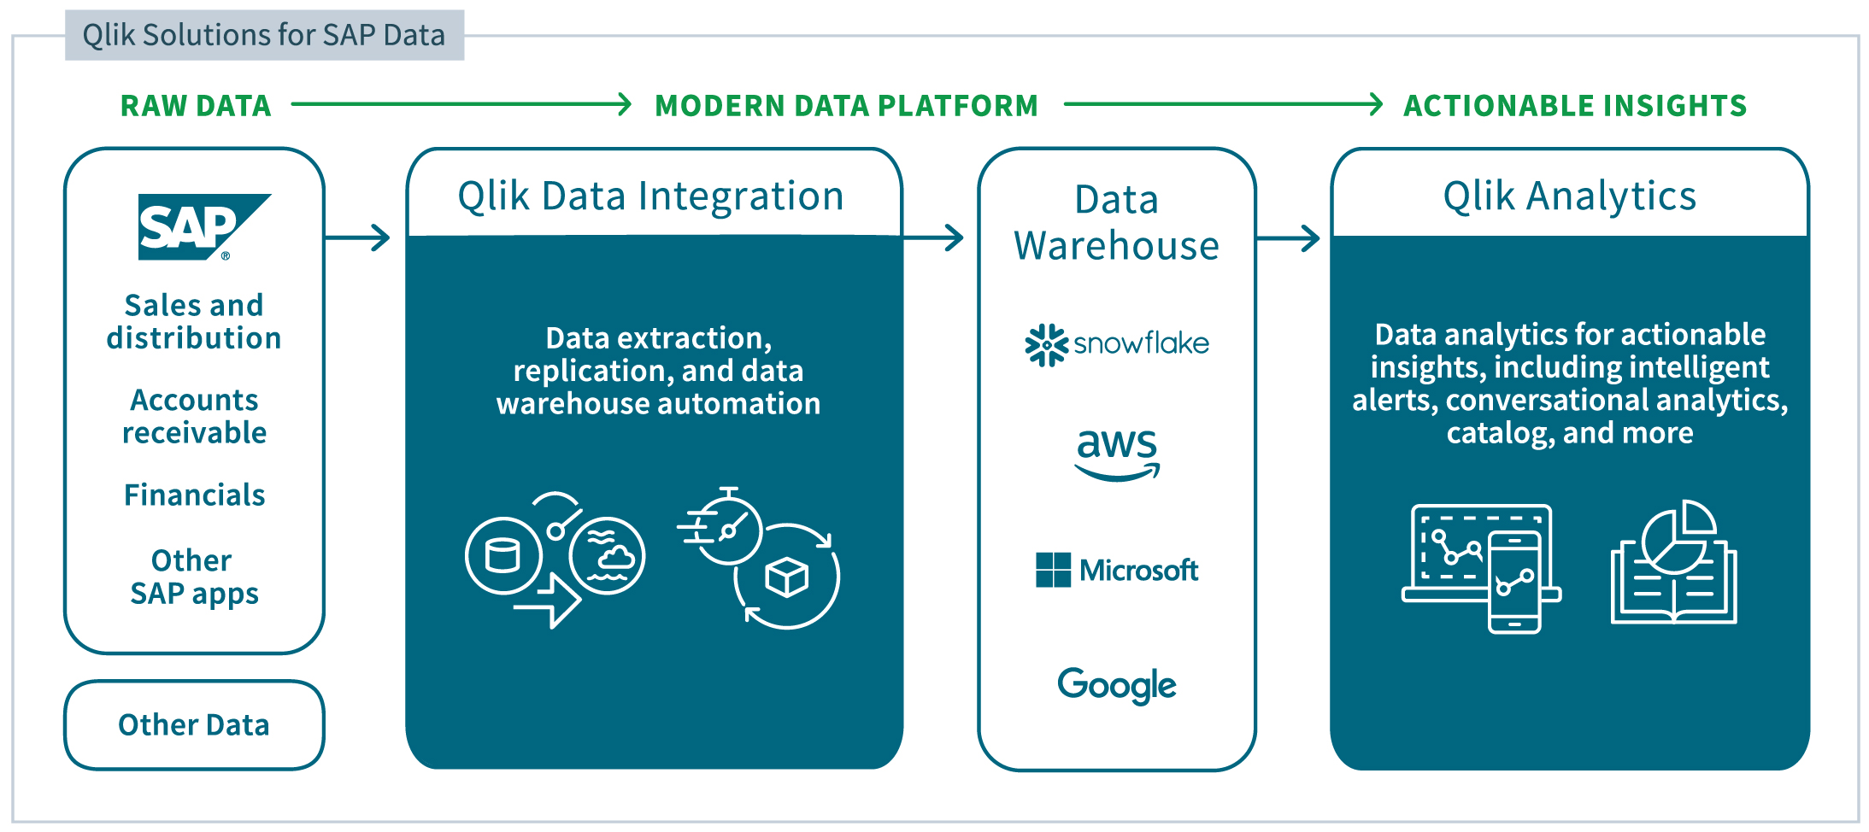
Turning Raw Data into Actionable Insights
A Modern End-to-End, Modular, and Extendable Solution
Notes:
Let’s start by understanding the flow of data and how Qlik is organized to support the Data Integration, as well as the Analytics. The data integration products and functionality at Qlik fall under Qlik Data integration. This involves extracting data from source systems, databases and applications. In this case, SAP application data from both HANA and non-HANA databases. Processing and landing of the data into our customers desired target data lake or data warehouse. Once the data lands in the target, Qlik’s data warehouse automation can apply a model against the data, create the schema, generate the ETL code and create the analytics ready data mart. Data can then be published and subscribed to using the features of Qlik Catalog.

Slide 12
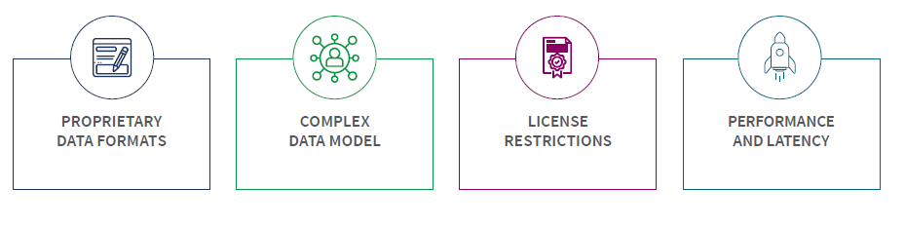
SAP Data Challenges
Leveraging and integrating SAP data is not easy
Data formats that make it incomprehensive
to most
10s of thousands of tables with intricate relationships
Complex licensing that can become time consuming and costly
Built for transactional performance not
real-time analytics

Slide 13
What Customers are Looking for…
Key Assumptions:
Customers will want to combine SAP data with data from non-SAP sources
The Consumer of the data may not be an SAP user
Data Replication of SAP Source Data (Master & Transactional)
Replicate
SAP meta-data
Combine highly structured SAP data with data from other (often unstructured) sources to enhance the data
Data Type Promotions
Field Names
(BUKRS = Company Code)
CHAR, NUMC, DATS, TIMS
Handle Pool/Cluster/INDX Tables
Values
(Company Code 1000 =
US-NorthAmerica-California)
Strings
Notes:
It’s not just variety of endpoints that’s important. It’s also care in processing the data. For SAP customers, everything starts with our approach to innovation and that begins with two key assumptions. First, we expect that our SAP customers want to merge the SAP application data with data from non-SAP sources. We hear this desire from customers all the time. Second, we assume that the end user may not actually be an SAP user. This is a humbling assumption in that it means we need to normalize the SAP data as much as possible so that analytics teams that don’t speak SAPanese can easily work with the data. From a technical standpoint, that means that we need to normalize complex data objects, like pool and cluster tables. We also bring over SAP metadata, meaning that we bring over textual elements of the SAP data dictionary and configuration. When creating tables in the target data warehouse, this means customer can use the English (or any language) text instead of the cryptic SAP column names. By bringing configuration text, customers can also choose to use the text of the stored data, meaning instead of a dashboard displaying company codes by their numeric values, they can be displayed using the text description. And finally, we make sure that the target table reflects the structure and data types of the SAP data dictionary object as we promote the generic strings data types of varchar and nvarchar to their actual types; such as, CHAR, NUMC, DATS, Currency, etc. All of this serves the customer needs better as both SAP and non-SAP users can make sense of the data. Making it easier to blend the SAP data with data from other sources.

Slide 14



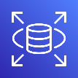

























Cloud Data Integration Partner Alignment
RDS (All)
All databases
All databases
DBaaS
S3
ADLS, BLOB
Cloud Storage (GCS)
STORAGE
EMR
HDInsight
DataProc
HADOOP
STREAMING
Kinesis
Event Hubs
Kafka
Redshift
Azure Synapse
BigQuery
DWaaS
Snowflake
Snowflake
Snowflake
OTHER DWaaS
Databricks
Databricks
Data Lakes (House)
DL/DW Automation

Slide 15
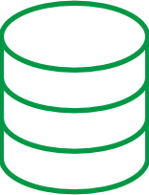





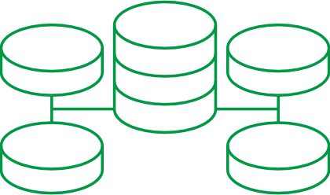

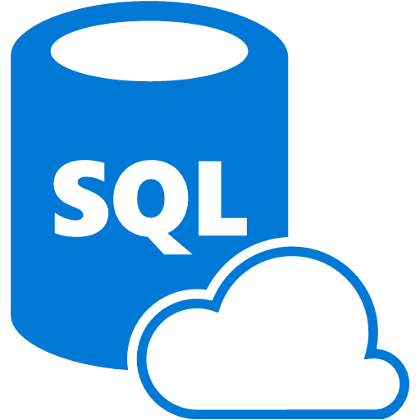




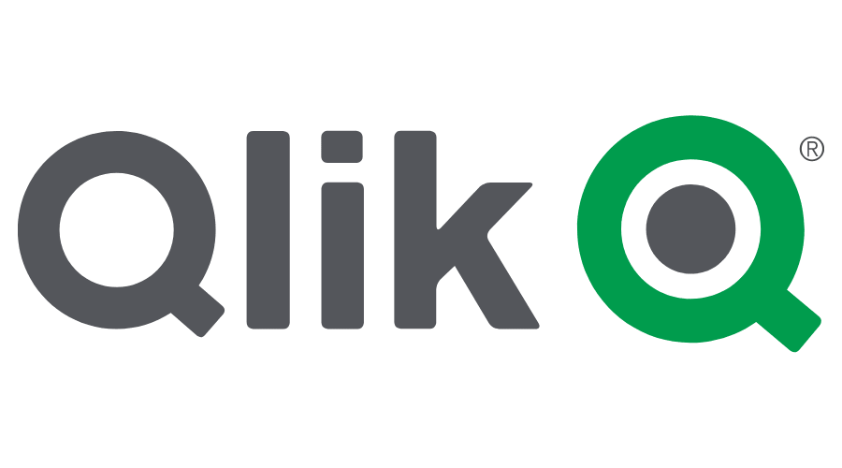


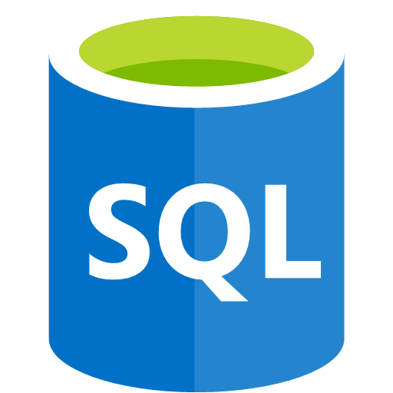
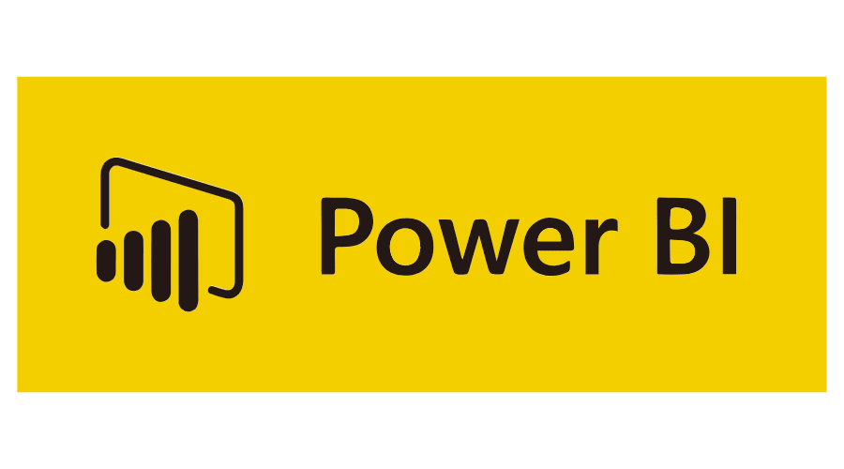

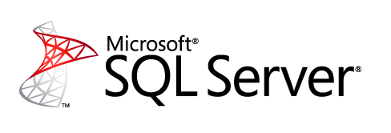









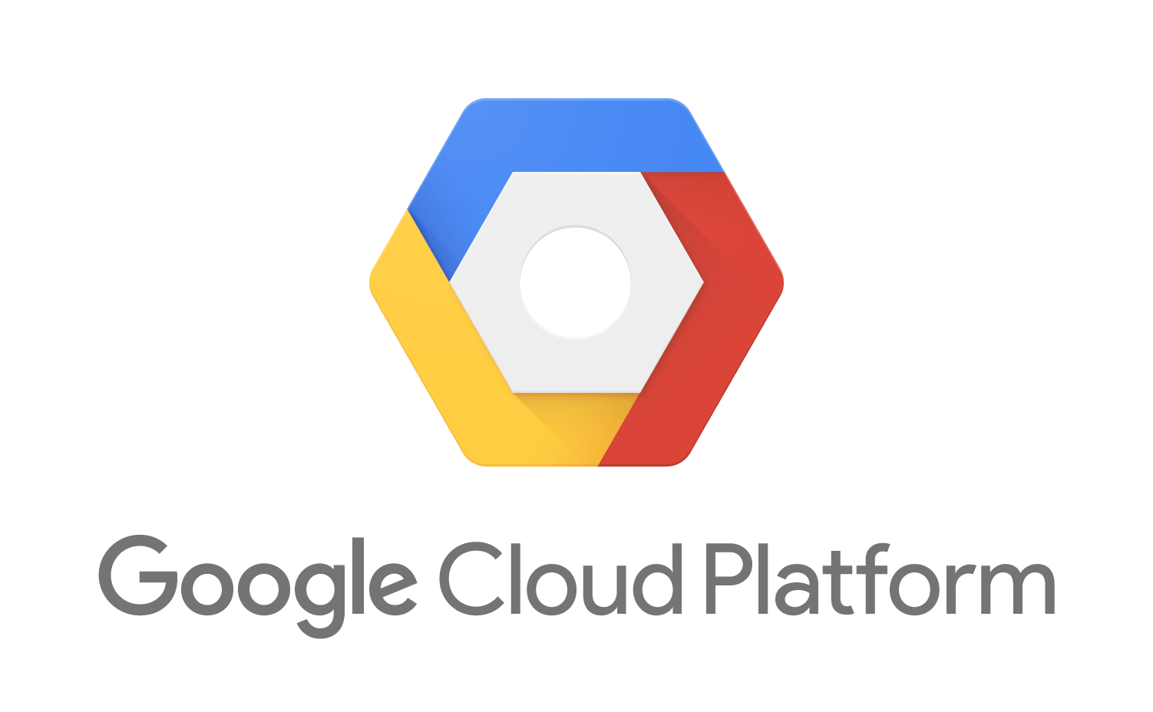




Qlik Data Integration Platform – Core Use Cases
RDBMS
CDC Streaming
Streaming Data Pipeline Automation
Data Warehouse
Commit
Amazon RDS
Azure SQL DB
Files
Data Warehouse Automation
Amazon
Redshift
Azure
SQL DW
Analytics
Mainframe
Generate
Deliver
Refine & Merge
Model
SAAS
Change Data Streams
To Clouds, Lakes…
For Analytics, AI/ML, Data Science…
Catalog
Shop, Organize & Provision
Consume
AI/ML
APPS
Managed Data Lake Creation
Design, Manage & Monitor
SAP
Conform
Data
Science
Catalog
Shop, Organize & Provision
Notes:
Going deeper into the data integration architecture illustrates this process and demonstrates the benefits of Qlik being an agnostic solution. Many SAP customers ask how Qlik’s solutions compare to SAP’s own data integration offerings. Our primary goal is not to compete with the SAP stack tools, but rather to meet the needs of our customers. And of course, our customers have tons of SAP and non-SAP data. Ensuring that we can handle the SAP data and non-SAP seamlessly, while also supporting any number of on-perm or cloud-based targets benefits the customer. Yes, this means there will be natural overlap with SAP’s tools, but we design Qlik’s solution to offer benefits and advantages for our customers. The biggest benefit is that we create a technological advantage by expertly handling the SAP data on the source side and delivering it to the target on one hop. If you have multiple targets or your architecture pivots, Qlik can pivot with you. Even on the analytics side, you can see we remain agnostic to solutions and methods for consuming the data.

Slide 16







Real-time SAP Data Replication
With Qlik Data Integration
Qlik Transport
Data model mapping
Qlik
Replicate
Cloud
Application/
Extractor
In-memory
Hadoop
RDBMS
Database
(Trigger)
CDC or
Batch
Kafka
Data
Warehouse
Database
(Log)
Filter
Transform
On Premises
Native SAP ABAP solution
Decodes proprietary SAP source structures
Simplifies complex SAP data model mapping
Propagates SAP metadata
Supports all core and industry-specific SAP modules
Log-based, query or application-level SAP integration
Delivers real-time data to AWS
Reassembles critical relationships in target (with Qlik Compose)
Notes:
If I tell you that we can handle the SAP data in an expert fashion, we better be able to back it up. SAP customers are notorious for being technically skeptical and rightly so. Every SAP configuration is unique and filled with customization and even industry specific solutions. Technical and performance requirements are high priority, but SAP customers also have to navigate licensing restrictions and requirements and also manage their risk with SAP. Taking all this into consideration means we need to give customers options when sourcing data from SAP applications. Direct database connection with log-based Change Data Capture is always preferred and will always provide the fastest performance, but it’s not always that straight forward. Customers running HANA may realize benefits from a trigger-based change data capture and customers with a runtime license restriction will be limited to sourcing the data from the application level. To meet every customer requirement, we provide 3 distinct endpoints. For customers on non-HANA databases, they can typically source from the database with log-based CDC. For customers on HANA, they can choose a database connection with either trigger or log-based CDC. And for customers pulling from the application layer, Qlik can use the SAP extractors, which are typically used to populate BW systems. The full load, complimented with subsequent delta loads from the extractors functions as a micro-batch in delivering changes to the target. Latency will be higher with this endpoint, but customers can avoid the database connection and take advantage of customization they have already invested in their extractors. While there are pros and cons to each endpoint, deciding which endpoint to use is more of a mix and match against the customers requirements.

Slide 17

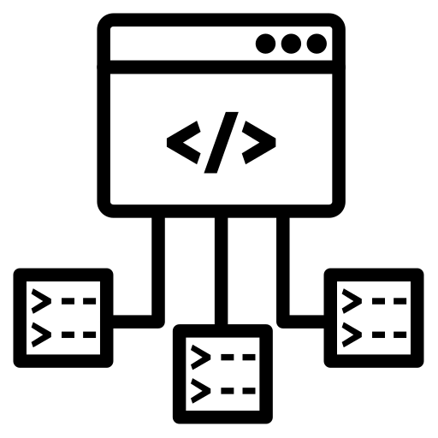



Qlik and SAP
Why SAP ODP/ODQ?
  Supports CDS/HANA Views
  (various SAP BW objects)
  Compression and Improved Performance
Operational Data Provisioning
/Queue framework
  (from SAP)
Greater visibility
(what's extracted and where)
  Supports Runtime Scenarios
Notes:
Enables common platform for replication of CDS/ HANA Views and various SAP BW objects
Compression of data which significantly increases extract speed
Gives visibility to what data is being extracted and where it is going to
Controlled entirely via the application layer to support runtime scenarios

Slide 18












Moving SAP Data with ODP
Qlik Replicate
Target schema creation
ABAP
CDS Views
SAP data type preservation
SAP BW
SAP BW/4HANA
Automated Batch
to CDC transition
SAP
HANA Views
Real-time
CDC stream
or batch
(full load)
Real-time
CDC stream
or batch
(full load)
SAP ECC
Extractors
Filtering
Transformations
Scheduling (API)
ODP BASED CDC*
Notes:
Sources: SAP Application, SAP Application (DB), SAP Extractor, SAP HANA, SAP Sybase ASE, SAP ODP
Unique to ODP : CDS View / BW / Hana Views !!!
(Delta enabled depending on source)
Other ways to handle extractors
What targets do we want to call out? Hyperscalers, Snowflake Databricks Streaming , SDAP Hana logo
Note This solution can be deployed as a Client Managed option as described, if Streaming data is required
Or we can now also deploy as a Cloud Native solution using Qlik Cloud Data Integration services direct to Google BigQuery (from Oct 2022)
Lets zoom into the CDC Streaming part of Qlik Data Integration and the data replication architecture, typically a middle tier server or data gateway
Data sources on the left side can be on-prem and cloud - wide range of endpoints from legacy systems like mainframe, relational databases data warehouse and lakes and flat files
We allow you to capture data from those sources and automatically apply light weight transformations and filtering in flight before propagating the data to a wide range of targets depicted on the right side which again can be on-prem and in the cloud including streaming messaging platforms
With Qlik Replicate you seamlessly replicate data from full load (batch) and automatically capture and replicate just the changes in the data as and when it occurs at source using log-based change data capture.
We apply the transformation as much as we can in-memory and provide filter capabilities on the data. E.g. filter from 10 years to a single year for most recent transactions or regions, etc.
This can improve speed and security by filtering our or obfuscating sensitive data such as PII during transformations.
Additional transformations can be applied by utilizing the rest of the Qlik Data integration platform further upstream such as automatic creation of data marts, warehousing and lakes by taking advantage of other products called Qlik Compose and Qlik Catalog.
There is a lot of flexibility in the data flows that can be configured such as replicating data from one source to many targets or visa versa or migrating data from multiple disparate systems in to the cloud
You may notice the persistent store and a key point to make here is that we don’t use this to store the data being replicated here. The persistent store is used to store configuration and state
For each replication source and target is configured as a single task, and is this configuration that is stored, e.g. What the type of meta data, fields and tables are selected and the transformations required. And the state of the last replicate task is stored so we can pick up where we left off in case of interruptions, errors or pauses in the replication tasks. Think bookmarks
And all of this can be done at scale, we have many customers with hundreds of tasks running in their production systems.

Slide 19



Qlik and SAP
QLIK REPLICATE
QLIK COMPOSE
QLIK SAP ACCELERATORS
Automated, universal and real-time data integration
Data Warehouse and Data Lake automation for Analytics Ready Data.
Pre templated PS approach to accelerate customer’s time to value
Notes:
Qlik Replicate - (we can offer a wider range of connectivity options than any other - log-based, trigger based, Extractors and now also ODP)
Qlik Compose – Can wider the gamut and transform SAP data for analytics ready consumption in DWA / DL
Qlik SAP Accelerators – Pre templated PS approach to accelerate customers time to value utilizing full end-to-end portfolio(Orders-to-cash, etc)

Slide 20

Solution Accelerators
Pre-configured content and templates
Order-to-Cash
Optimize sales order fulfillment, billings,
and working capital
Financials
Manage and control your P&L, operating costs, and assets & liabilities
Inventory Management
Track inventory levels, movement, and costs
SAP Data Extractors
Replication
Tasks
Business Data
Models for SAP
Analytics
App Templates

Slide 21



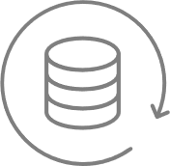

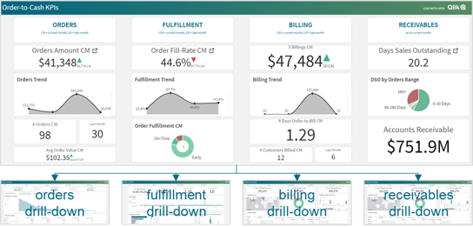


SAP – Order 2 Cash
Putting it all together
prebuilt extractors
ready to use
prebuilt replicate
tasks
prebuilt compose
models
catalog ready
data-marts
prebuilt
template apps
Extractor
Queue
Qlik
Transport
Sales Order Management
Accessible SAP Data
Prebuilt Qlik App
2LIS_11_VAITM
(Sales Item Extractor)
Replicate Tasks
Shipment & Distribution
Documented KPI catalog
Prebuilt Power BI Apps
2LIS_11_VDITM
(Billing Document)
Billing
Ready for Alerting
Sales Order Status
(2LIS_11_VASTI)
Accounts Receivables
Ready for AI/ML
Big portion of the implementation effort is repetitive across our customer base.
Qlik
accelerator package
Notes:
We don’t have to call out/explain each Qlik product

Slide 22
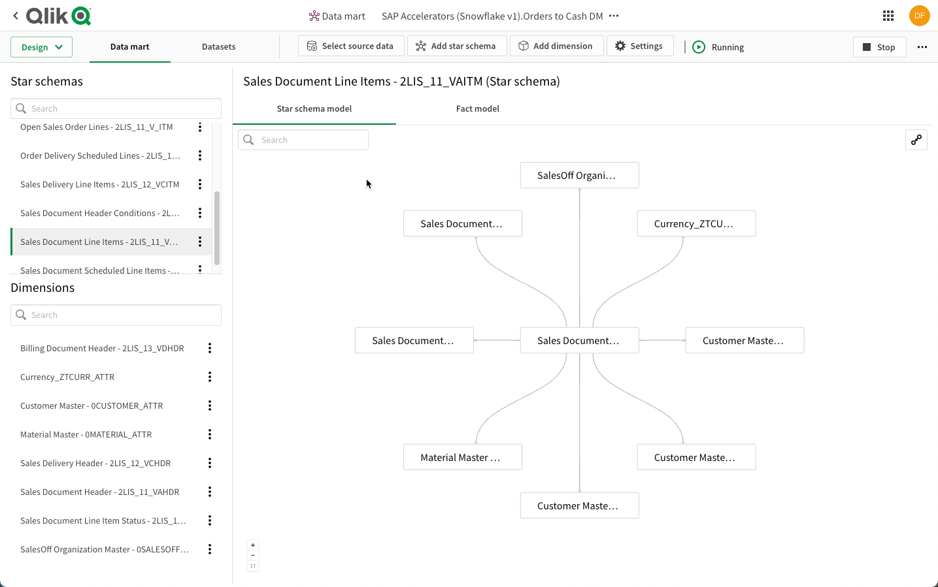









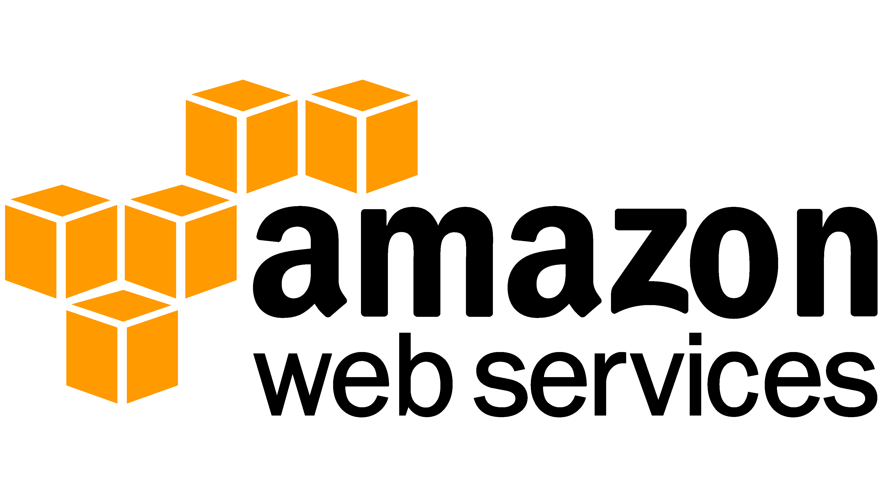
Data Pipeline & Analytics Architecture
Qlik SaaS Platform
Qlik Cloud Data Integration
Qlik Sense
Data Analytics
Leverage DW Automation
Pre-Defined SQL Transforms
Pre-defined DW model
Pre-defined ELT mappings
Pre-defined data marts
Extensible
Pre-defined Applications
Qlik Replicate
Data Ingestion
Snowpipe
Data
Loading
SAP
Extractors
CDC
Updates
AI / ML
Integration
Analytics
Applications
Cloud Data SaaS
Conversational
Analytics
Reporting
& Alerting

Slide 23
Data Pipeline & Analytics Architecture
Qlik SaaS Platform
Qlik Cloud Data Integration
Qlik Sense
Data Analytics
Leverage DW Automation
Pre-Defined SQL Transforms
Pre-defined DW model
Pre-defined ELT mappings
Pre-defined data marts
Extensible
Pre-defined Applications
Qlik Replicate
Data Ingestion
Snowpipe
Data
Loading
SAP
Extractors
CDC
Updates
AI / ML
Integration
Analytics
Applications
Cloud Data SaaS
Conversational
Analytics
Reporting
& Alerting

Slide 24
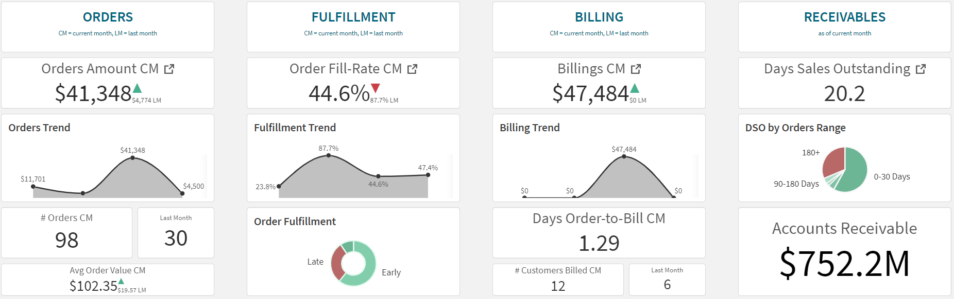
Optimize Working Capital and DSO*
* days sales outstanding = cycle time between order booking and customer payment; lower DSO = more cash, better liquidity
Gain actionable insights into sales orders and trends
Take proactive decisions on order fulfilment and delays
Analyze billings, discounts, and taxes with visibility down to billing documents
Improve working capital & DSO by accelerating customer payments

Slide 25
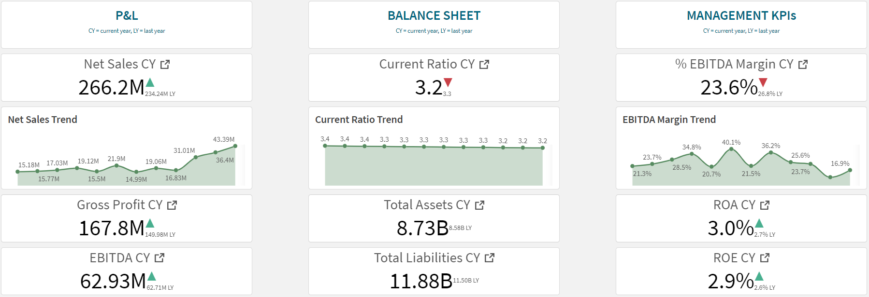
Improve Financial Profitability and Resilience
Drive growth & profitability with near real-time P&L and expenditure insights
Improve financial resilience with balance sheet analytics
Collaborate with business units on key management KPIs

Slide 26
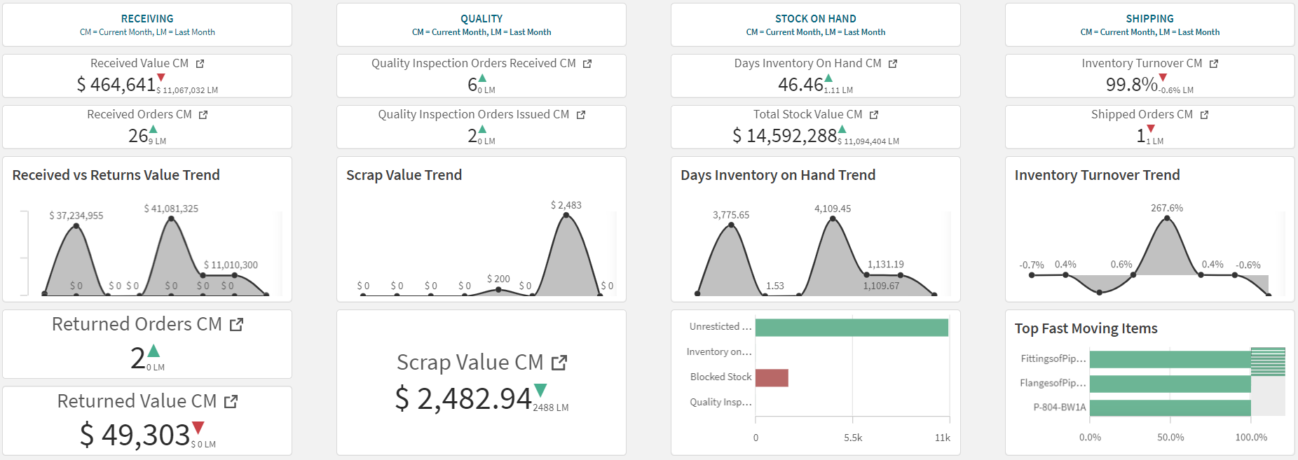
Decrease Inventory Inefficiencies and Costs
Gain actionable insights into materials receiving & returns
Manage stock quality, inspections, and scrap
Identify inventory bottlenecks in locations and movements
Improve inventory turnover by identifying slow moving items

Slide 27




The Vision
Acceleration through business content
=
technological advantage
prebuilt
business content
accelerated success
Notes:
All of this creates a vision for our innovation and a vision for our customers success. The goal is to create a technical advantage with superior solutions, combines with deep SAP domain expertise and content to deliver success for our customers. Of course, if the you the customer is successful, then we are as well.

Slide 28
For questions after this session, contact us at matt.hayes@qlik.com.

Slide 29

Stay connected. Share your SAP experiences anytime, anywhere.
Join the ASUG conversation on social media: @ASUG365 #ASUG

