Slide 1

SAP Archiving: What’s Old is New Again!
February 29, 2024
Notes:
Hello and Welcome!!

Slide 2

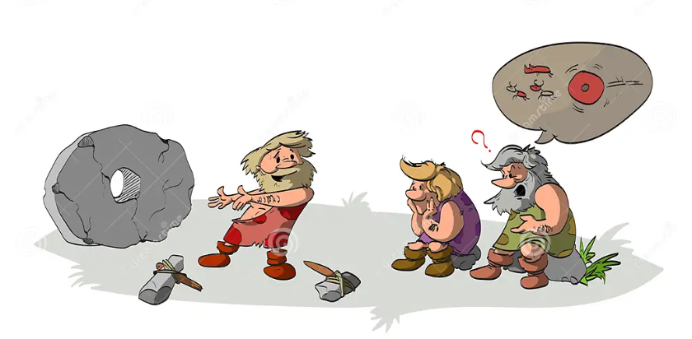
I’ve seen this before!
It does look familiar, but this one is powered by AI!

Slide 3
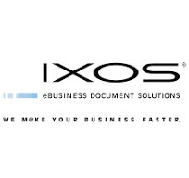





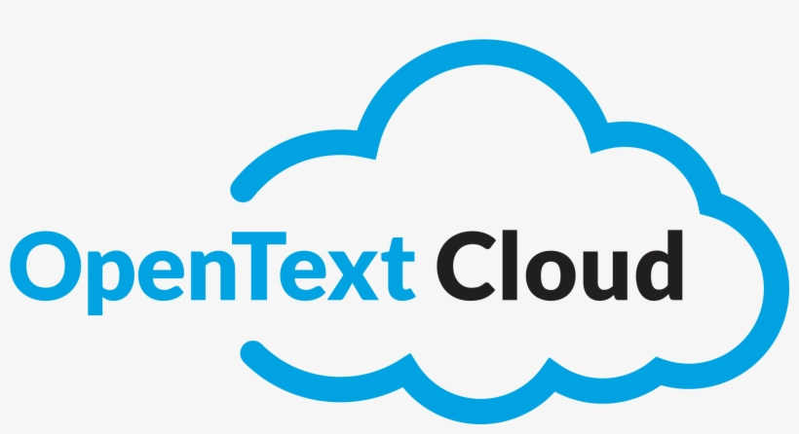
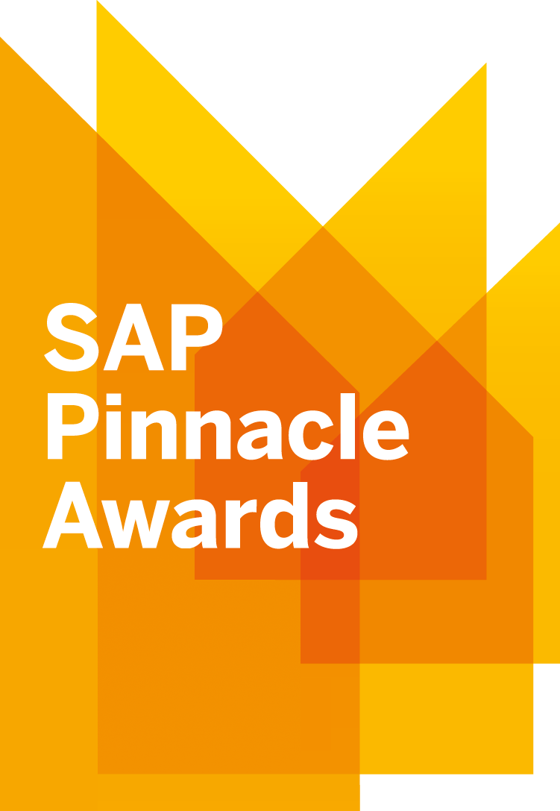
How many are familiar with OpenText Archiving Solutions for SAP?
18-time
SAP Pinnacle Award Winner
Notes:
SAP Solution Extension for over thirty years!
Move data and documents from your production SAP instance to free up space and improve performance, while data is still available from you SAP system
OpenText has many more archiving solutions for SAP including SasS solutions
Regardless of where SAP customers are in their S/4HANA journey, establishing an effective archiving strategy can save significant time, effort and costs:
Pre S/4HANA: Reduce migration cost, time and risk.
Post S/4HANA: Reduce operating costs and ensure optimal performance from the in-memory database.
Additional benefit: get information on an appropriate retention schedule.
Decommission legacy SAP ECC systems and eliminate costs

Slide 4
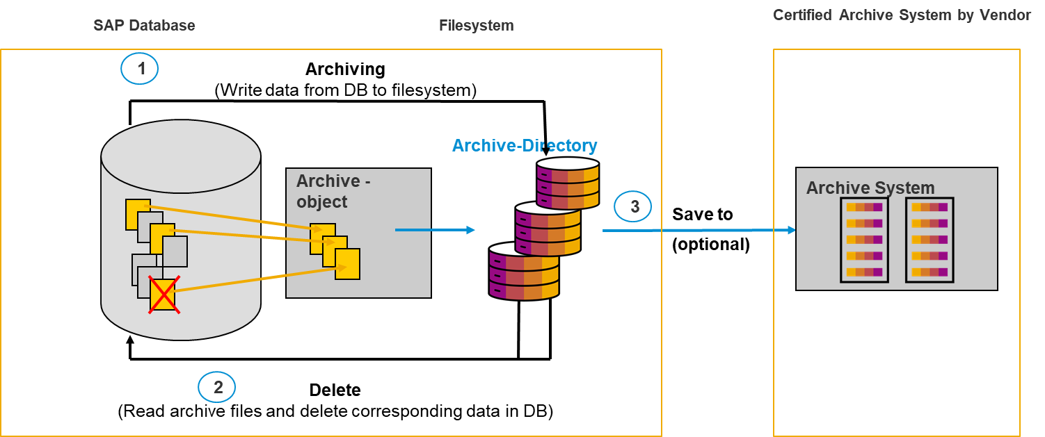
Classic SAP Archiving Process

Slide 5
SAP ECC and S/4 HANA Archiving Strategies are ‘Top of Mind’ again
Regardless of where SAP customers are in their S/4HANA journey, establishing an effective archiving strategy can save significant time, effort and costs
Notes:
Pre S/4HANA: Reducing the amount of data migrated into S/4HANA can significantly reduce the cost of migration, project timeline and overall risk.
Post S/4HANA: Reducing the amount of data in S/4HANA can significantly reduce operating costs and ensure optimal performance from the in-memory database. There are additional benefits as well, including an opportunity to finally get information on an appropriate retention schedule. Older, legacy SAP ECC systems can be completely archived and decommissioned while still providing historical access to auditors and business users.
OpenText and SAP have closely partnered to provide data archiving solutions for nearly 30 years. Hear how these solutions can allow you to migrate/maintain the absolute minimum amount of data required in your S/4HANA environment while still providing consistent SAP-based access to archived data for the business users. Learn how customers have utilized various archiving strategies to significantly reduce their cost of migration, to maximize S/4 HANA performance and to retire legacy SAP systems.

Slide 6
Important Implications/Considerations for S/4HANA
Cost implications for SAP’s cloud customers
  In-memory storage is very expensive
  SAP memory extensions, tiers, etc.
Performance implications for an in-memory database
  In-memory databases store data in main (internal) memory….as opposed to retrieving from disk drives
  Optimized for high performance (i.e. faster)
  If database grows too large:
    Performance will be negatively impacted
    Upgrades/updates become more time-consuming
Complex Landscape consolidation considerations
  How do we consolidate and retain all the historical data?

Slide 7
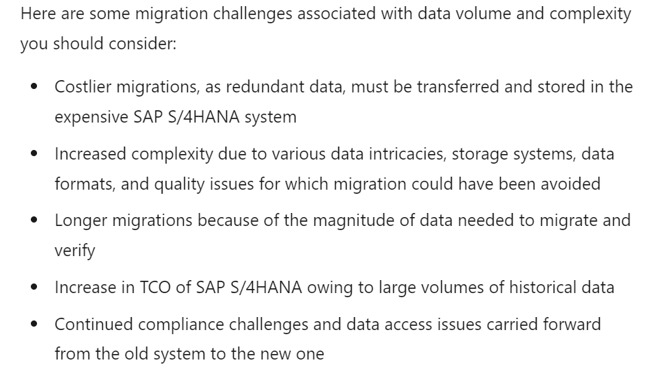
Pre S4/HANA Archiving Example:
The less data you have, the less time, effort and cost required to migrate to S4/HANA
Notes:
Great Lakes Examples:
Victoria’s Secret
Mine Safety Appliance

Slide 8

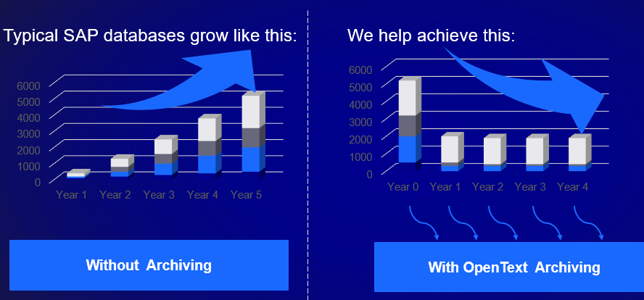
Archiving after ‘RISE with SAP’:
Signet Jewelers
On S/4 HANA for several years and have now executed the move to RISE
Storing documents / attachments in OpenText for Finance and AR Groups
Noticed high data volume growth in S/4 – planning to start Data Archiving into the same system

Slide 9
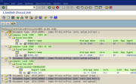
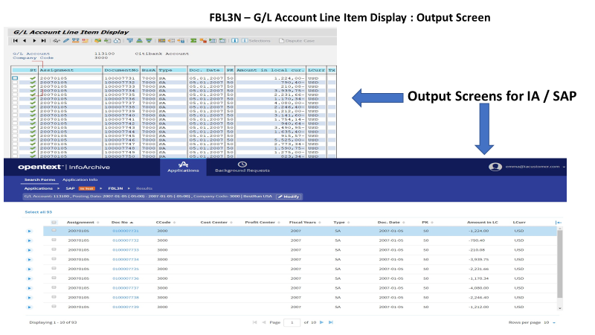
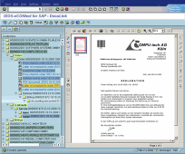
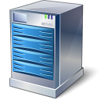


Live Archiving and System Decom. Factory
Access to Decommissioned and Archived Data for Audit, Compliance and Litigation Needs
Unified Access to Active & Archived Data for SAP Users
T-code lookup
Active SAP Systems
Legacy Systems / Read Only / Business Complete
S/4 HANA
INFOR
Eclipse
OLD SAP ECC
Structured
data
Unstructured
data
Transaction
data
ADK Files
Documents
Archive > 24 Months
SAP Cloud Archive by OpenText
User Access
Retention and Decommissioning Rules
Deep Archive > 60 Months [optionally]
OpenText InfoArchive
Enterprise Decommissioning and Archiving
Notes:
Set up the app decommissioning factory. Decommission legacy SAP systems, QAD systems, etc. and reclaim associated cost and IT budget for more transformation investments in IT. Also consolidate the data from these legacy systems, simplifying and accelerating access to data for audit and compliance purposes.

Slide 10

Client Profile: Westinghouse Electric Company
Global Designer/Builder of Nuclear Power Plants, headquartered in Cranberry Township, PA
Offices and many reactor sites around the globe
Implement an SAP ERP and a Documentum system for each reactor site
When construction is completed and the site is handed over, the SAP and Documentum systems become redundant
Must comply with stringent Nuclear Energy Regulatory Commission (NERC) regulations
Keep all data forever
Has decommissioned two SAP/Documentum combos to date, with another two planned this year.

Slide 11
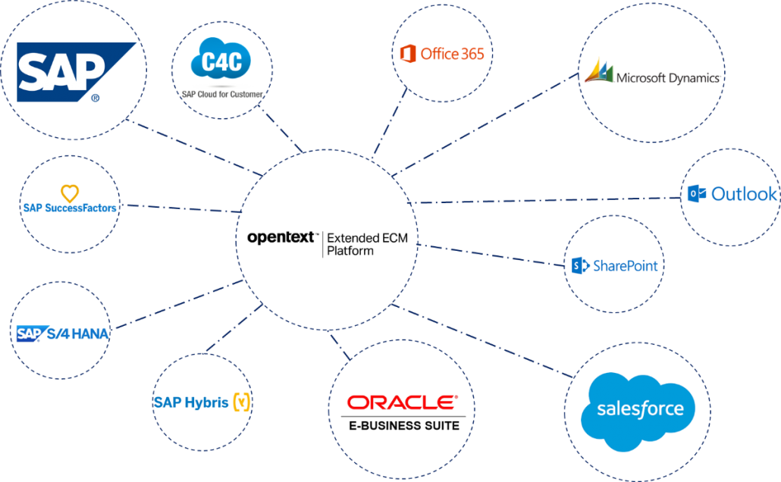
Leveraging SAP Content Beyond SAP
RISE transformations provide opportunities to knock down traditional information silos so that SAP content can be shared across the organization to provide more value, etc.
Notes:
Great Lakes Examples:
NiSource
Marathon Petroleum

Slide 12
Archiving Benefits by the Numbers

Slide 13
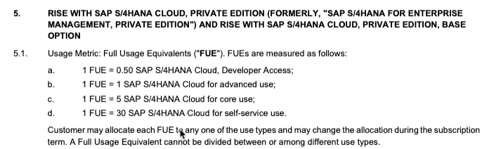

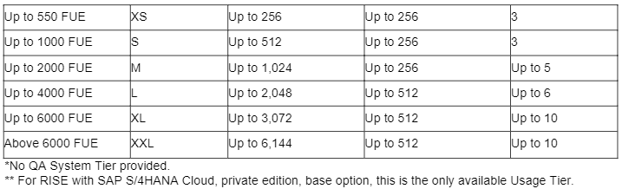
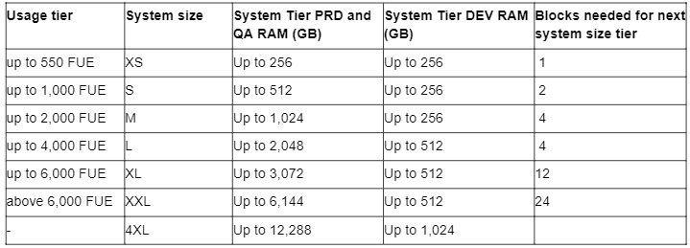
RISE with S/4HANA Sizing Metrics
  FUE = Full Use Equivalent define a standard HANA (in-memory) > system size & no of App Servers
> Add HANA System capacity with “In-Memory Extension” SKUs

Slide 14

All SAP Data does not require being in the database, and documents even less
DB
size
y1
y2
y3
y4
y5
y5
FUE
time
Archive
size
Notes:
And when implemented effectively, our platform not only accelerates your digital transformation programs and projects, it gives you the ability to transform something even more important – the relationships that drive your business.
By fueling every process, transaction and interaction with vital, related information, insight, and personalization, digital agility delivers new levels of success and vastly improved outcomes across these four vital communities.
Deliver captivating customer experiences that impact satisfaction and loyalty, increasing your ability to maximize customer lifetime value and upsell and cross-sell revenue.
Digitize your supply chain to streamline supplier selection and onboarding, enrich relationships and collaboration, and improve tracking and performance.
Empower employees the right information at the right time in the right system or process to accelerate innovation and improve engagement, satisfaction and retention.
And finally, improve partner collaboration, communication, and information sharing to speed outcomes, improve results, and uncover new, joint opportunities.
If you think about it, these relationships are far more important than the back-office enterprise applications we spend the majority of our time attempting to transform.
Digital agility allows your organization to bring these relationships back into clear focus, strengthening bonds that drive satisfaction, loyalty, interdependency, and ultimately, success.

Slide 15
Archiving allow you to manage database growth and overall expense
HANA DB
size
HANA DB
size
y1
y2
y3
y4
y5
y1
y2
y3
y4
y5
Archive
size

Slide 16
As your DB Memory needs grow over the years In-Memory Extension blocks must be purchased ahead of your needs
DB
size
DB
size
y1
y2
y3
y4
y5
y1
y2
y3
y4
y5
Not used
FUE
Not used
FUE
time
The SAP RISE service subscription is based on a main metric: the Full Use Equivalent (FUE)
It provides a standard in-memory size of your tenants. Additional needs can be complemented with In-Memory Extension blocks.
time
The HANA In-Memory Extension blocks are not linear with your In-Memory need, so you must subscribe to and pay for a larger capacity than required
Notes:
And when implemented effectively, our platform not only accelerates your digital transformation programs and projects, it gives you the ability to transform something even more important – the relationships that drive your business.
By fueling every process, transaction and interaction with vital, related information, insight, and personalization, digital agility delivers new levels of success and vastly improved outcomes across these four vital communities.
Deliver captivating customer experiences that impact satisfaction and loyalty, increasing your ability to maximize customer lifetime value and upsell and cross-sell revenue.
Digitize your supply chain to streamline supplier selection and onboarding, enrich relationships and collaboration, and improve tracking and performance.
Empower employees the right information at the right time in the right system or process to accelerate innovation and improve engagement, satisfaction and retention.
And finally, improve partner collaboration, communication, and information sharing to speed outcomes, improve results, and uncover new, joint opportunities.
If you think about it, these relationships are far more important than the back-office enterprise applications we spend the majority of our time attempting to transform.
Digital agility allows your organization to bring these relationships back into clear focus, strengthening bonds that drive satisfaction, loyalty, interdependency, and ultimately, success.

Slide 17
OpenText Can Help
Q & A
Thank you!

Slide 18

Why do something?
Typical SAP databases grow like this:
We help achieve this:
Benefits:
-Reduce monthly/annual charges for SAP RISE
- Avoid surprises with S/4 RISE = Predictable In Memory Extension growth and costs
-Optimize/Improve SAP performance
-Mitigate migration risks and reduce move costs
Without Archiving
With OpenText Archiving

Slide 19
How can you get started?

Slide 20
Data Archiving Methodology with OpenText Core Archive
Analysis
Design
Build
Accept
Deploy
Close
Meeting
Introduction to Archiving
Demo OT Core Archive
Customer Requirement
Talk about DVMS
Discuss Residence
Discuss Retention
Obtain/gather
Country/Region of system
System go-live date
Actual System Size
Monthly Growth
Largest table by size
DVMS
Identify Archive Object
Perform mapping
Optimize Sequence
Eval: Migrate/store/purge
Review Access
Establish potential
Design Global Strategy
Breakdown by group
Evaluate effort
Design archiving scenario
Meeting
Kick off Meeting
Confirm Residence
Confirm Retention
Confirm Scenario
Activities
Getting necessary access
Archive object list
Define Repository
Connectivity to OTCA
Certificate
Test Repository
Disk space
Directory Structure
Logical File/Path
Identify OSS note
Arch Admin Role
SBX
TAANA per type
Test Arch.Admin Role
Tech + Func Setting
Basic Archiving
OpenText ADA Transport
DEV
Object Documentation
Instance Parameter
  DIR_TMP
  DIR_SORTTMP
Technical setting
  Logical file/path
  Delete job
  Commit
  # Object
  Post process
  Storage to OTCA
  InfoStr Choice
  InfoStr Activate
Functional setting
  Doc. Type
  Residence
TAANA
  Virtual fields
  Virtual variant
Execute
  QA/unit testing
Transport
  QAS
QAS
Questionnaire
TAANA before
Define Variant
Execute archiving variant
  Pre-processing
  Write
  Delete
  Post Processing
  Store
Load Info Structure
Store to OTCA
TAANA after
Cleansing
Results report
Plan vs Reel
QA/Integration Testing
QA/UAT
Acceptance document
Prepare archiving plan
Transport
  STG+PRD
STG (if require)
TAANA before
Execute archiving variant
Load Info Structure
Store to OTCA
TAANA after
Cleansing
Measure results
PRD
TAANA before
Execute archiving variant
  Pre-processing
  Write
  Delete
  Post Processing
  Store
Load Info Structure
Store to OTCA
TAANA After
Cleansing
Measure results
PRD
Spool analysis
Session's statistics
Report by system
Table Statistics
Table reorganization
Compression
Compile results
Lessons learned
Project overall results
Deliverables
Present DVMS results
Choose scenario
SOW
Deliverables
OT Solution Architecture
Connectivity test result
Deliverables
Technical Doc. per object
Build Book OT Config
Deliverables
Acceptance Document
Archiving Plan w/variant
Deliverables
Weekly Status
Results report
Deliverables
Project overall results
Next Phase

Slide 21
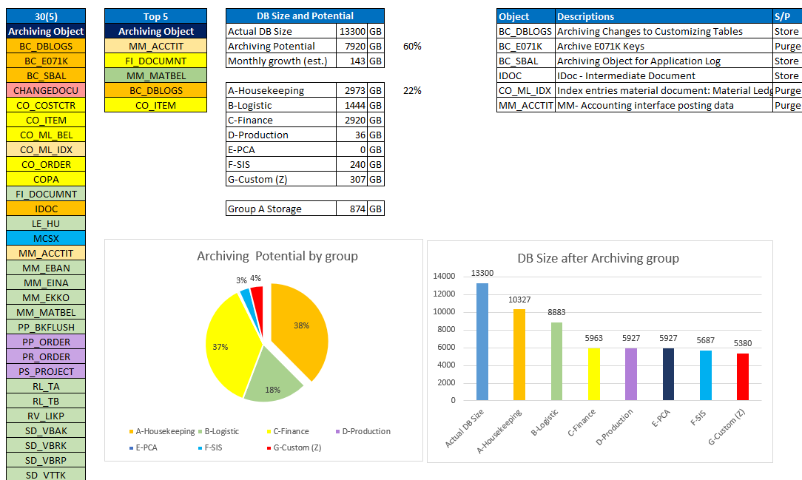
Results of Quick DB Analysis of SAMPLE SAP ECC*

Slide 22
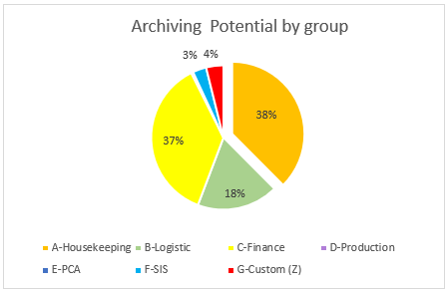


Value and Benefits of the Archiving Project to your Business and IT
Reduce cost of storage and future S/4 HANA costs
Reduce internal costs, resources, risk, by using a fully hosted and SAP Certified SaaS Archive
Reduce Infrastructure cost of SAP storage, DB, back-up, refresh
Improve performance of the SAP systems, once large amounts of data are archived/purged

Slide 24
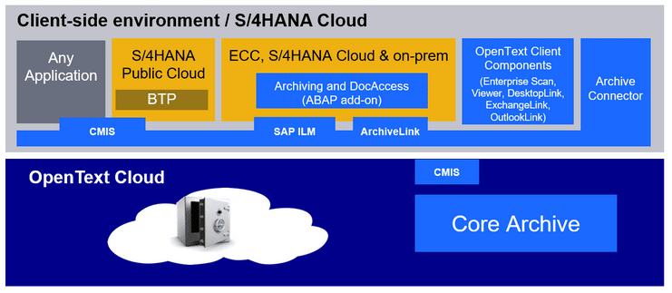
Cloud Archive Architecture

Slide 25
SAP + OpenText
Embed content directly into your business processes to build a digital foundation for the cloud
18-time
SAP Pinnacle Award Winner
1992
SAP + OpenText
2023
The Awards showcase
top-performing partners
who have excelled in
helping customers become best-run businesses
Winners are chosen
based on their commitment
to customer value creation, exponential growth,
and simplification
Winners demonstrate their ability to understand SAP customers’ business needs, deliver unmatched value, offer solutions that reduce complexity, and help
every customer become
a best-run business
10K
Customers
30
Years
Flexible
Architecture
Use an SAP
OpenText
Solution
Of partnership
and innovation
Deploy on
premise or in
the cloud
Nearly
4M
Roadmap Integration
Integrated across
the SAP
Portfolio
SAP users
subscribed
Notes:
For more than three decades, SAP and OpenText have enjoyed a very successful partnership, with over two million users and 10,000 SAP customers utilizing OpenText’s market-leading Enterprise Content Management (ECM) solutions. OpenText has consistently been a top-performing partner, being awarded the SAP’s premier global partner recognition program, Pinnacle Awards, a total of 17 times. Customers who work with the winners of the Pinnacle Award are guaranteed to be working with the best. OpenText portfolio is available on the SAP pricelist as solution extensions that allow SAP customers to utilize comprehensive, integrated ECM solutions to create simpler, secure, compliant, and intelligent business processes. These solutions are ideal for customers who are implementing RISE with SAP as well as those looking to digitally transform their business and build an intelligent enterprise based on content-enriched business processes. A recent IDC study showed that SAP customers who utilize these solutions achieved 288% return on investment, recouping their investments within ten months. These customers also generated more than $7M in additional revenue and reduced costs by $1.5M.

