Slide 1



How Splunk Runs SAP (& Splunk)
To Drive Digital Resilience
Thursday, September 21st, 2023
Keith Hontz
Global Head of SAP Alliance
Splunk Inc. | www.splunk.com/sap
+1 (484) 431-0104 | khontz@splunk.com
PHILADELPHIA | AMER | APAC | EMEA
Brandon Kurtz
Regional Sales Manager
Splunk Inc. | www.splunk.com/sap
1 (215) 410-9740 | bkurtz@splunk.com
PHILADELPHIA | AMER | APAC | EMEA

Slide 2
Agenda
Welcome & Introductions
Splunk at a Glance
Splunk Solutions for SAP
How Splunk Runs SAP
Q&A

Slide 3








































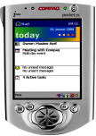









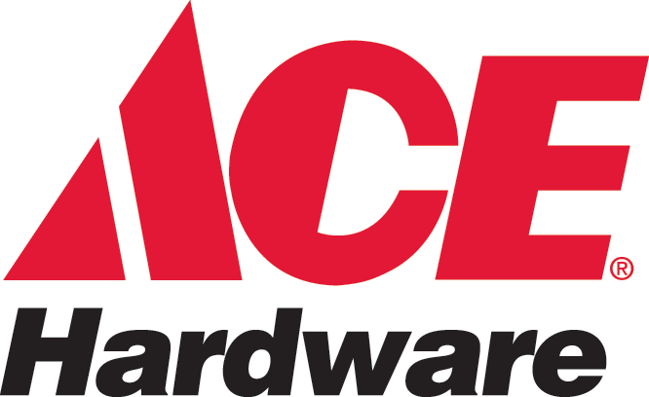



30+ Years Of SAP Experience
MANUFACTURING
SERVICE
FINANCIAL & PUBLIC SERVICES
CONSUMER & RETAIL
1990 1995 2000 2005 2010 2015 2020

Slide 4

Splunk – Our Mission

Slide 5





Splunk At A Glance
Corporate Overview
Splunk was founded in 2003 to solve problems in complex digital infrastructures
Headquartered in San Francisco, CA
$4B in revenue, 40% YoY growth, over 8,000 Splunk employees globally
Strategic Partnership with SAP formalized in 2019
SAP Store Listings
  - Splunk Security for SAP® solutions
  - Splunk Service Intelligence for SAP® solutions
SAP is one of Splunk’s largest customers
3,400+ joint SAP Splunk Enterprise Customers
Over 1,100 patents and a culture of innovation
Over 90% of Fortune 100 companies run Splunk
2022 Best Workplaces for Women by Fortune
Splunk named a “Leader” in Gartner’s 2022 Magic Quadrant (MQ) for Security Information and Event Management (SIEM) 9th straight year
    “Attacks have been changing dynamically — and Splunk has helped us quickly react and tune our preventive controls.”
Justin Falciola
CTO

Slide 6
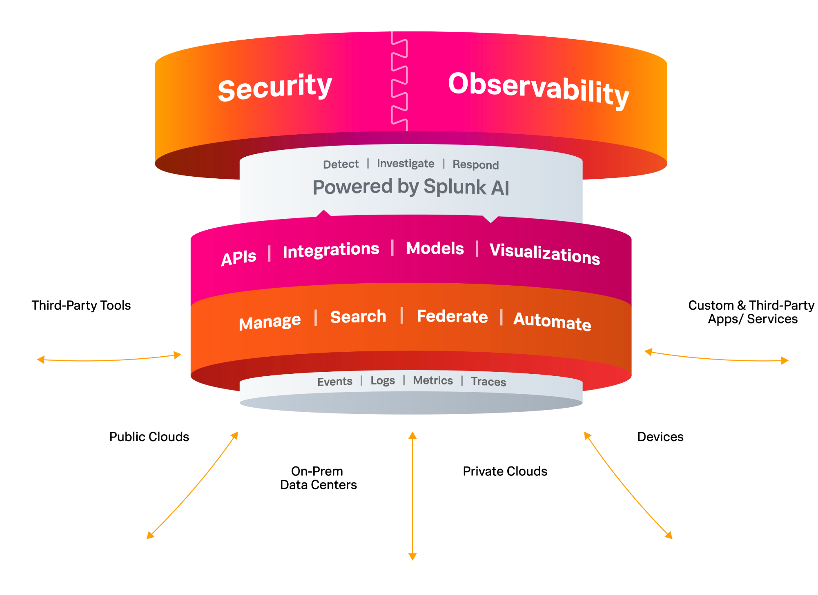
The Unified Security and Observability Platform

Slide 7














































































Education
Energy and Utilities
Cloud/Online Services
Financial
Services and
Insurance
Healthcare
Manufacturing
We Help Make
the World’s Leading Organizations More Resilient
Government
Nonprofit
Technology
Travel and Leisure
Wholesale, Consumer & Retail
Telecoms

Slide 8

Splunk is the only vendor recognized as a leader in the latest Magic Quadrant™ Reports for SIEM and APM and Observability
A Leader
A Leader
Gartner® Magic Quadrant™
for SIEM
Gartner® Magic Quadrant™
for APM and Observability
2022 Gartner Magic Quadrant for Security Information and Event Management | 2023 Magic Quadrant for Application Performance Monitoring and Observability | Gartner does not endorse any vendor, product or service depicted in its research publications and does not advise technology users to select only those vendors with the highest ratings or other designation. Gartner research publications consist of the opinions of Gartner’s Research & Advisory organization and should not be construed as statements of fact. Gartner disclaims all warranties, expressed or implied, with respect to this research, including any warranties of merchantability or fitness for a particular purpose. GARTNER is a registered trademark and service mark of Gartner, Inc. and/or its affiliates in the U.S. and internationally, and MAGIC QUADRANT is a registered trademark of Gartner, Inc. and/or its affiliates and are used herein with permission. All rights reserved.
GARTNER is a registered trademark and service mark of Gartner, Inc. and/or its affiliates in the U.S. and internationally and is used herein with permission. All rights reserved. Gartner does not endorse any vendor, product or service depicted in its research publications, and does not advise technology users to select only those vendors with the highest ratings or other designation. Gartner research publications consist of the opinions of Gartner’s research organization and should not be construed as statements of fact. Gartner disclaims all warranties, expressed or implied, with respect to this research, including any warranties of merchantability or fitness for a particular purpose.

Slide 9




Splunk is a recognized leader in
security and observability
Ranked #1
A Leader
A Leader
in SIEM Market Share
in ITOps and Analytics Market Share
in Forrester Wave™ Security Analytics Platforms
in Cloud Observability, APM, AIOps and Incident and
Task Management
in Observability and
AIOps Markets
IDC, Worldwide Security Information and Event Management Market Shares, 2021: The Cardinal SIEMs, doc #US48506522 (July 2022) | IDC, Worldwide IT Operations Management Software Market Shares, 2021: Market Growth Moderates, doc #US49609921 (September 2022) | Forrester, The Forrester WaveTM: Security Analytics Platforms, Q4 2022 (December 2022) | GigaOm, Radar for Cloud Observability Solutions (March 2022) | Research in Action, VSM Observability and AIOps (May 2022)

Slide 10


Business Challenges in Managing SAP
Lack of visibility and insight into SAP services
Increasingly Complex Systems
Lack of Correlated Business Analysis
Separately Managed
No automated alerts or action. Manual health checks are slow and error-prone
Difficult to extract SAP data, no easy way to gather insights, silos
Misaligned, siloed teams lack cohesive visibility and KPI management
Notes:
(To set the stage, SAP is a pervasive and powerful Business Solution, but) what we hear from customers, is that understanding SAP health is not easy. There’s a lack of visibility and insight into end-to-end services, and… to the organisations running and utilizing SAP today, it’s often viewed as an impenetrable Black Box within their organization.
Customer Challenges are presented in three main areas.
Increasingly complex systems, are integrated across a broad shared technology and infrastructure landscape. This includes: Shared integrations, load balancers, firewalls, message queue services, web services, archive systems and many other applications.
There are limited alerts and actions and manual health checks are prevalent, they’re slow and error-prone.
Secondly, Massive amounts of mission-critical data spanning business, operations, security and telematics are locked in SAP.
The opportunity to correlate this large and very valuable data silo, with other parts of the business is enormous.
And thirdly, SAP’s native tools are designed to be inward-looking with limited visibility into the non-SAP platforms that make up end-to-end services.
What are the specific challenges customers customers share with us?

Slide 11
Splunk’s SAP Use Cases
Where we’ve focused on our efforts
SAP Observability
Performance
& User Experience
Migrations & Upgrades
Security &
Compliance
E2E Process Monitoring
Cross-System Data Validation
Business Process Monitoring
Root Cause Analysis
End-User Experience
Correlation to infrastructure
Baseline All Metics
Comparative monitoring, before, during, and after migrations or upgrades
User Behaviour Analytics
Automated Audit Reporting
Access Monitoring
Threat Correlation

Slide 12

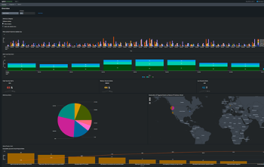
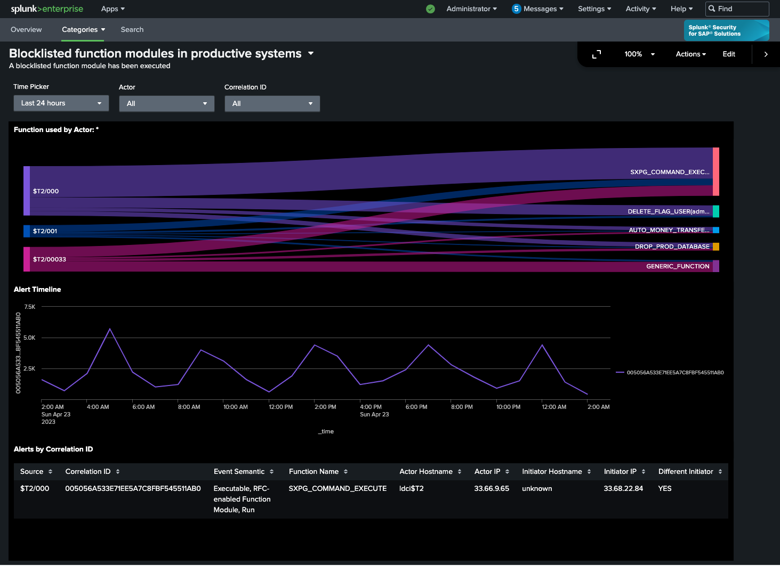
Splunk Security for SAP® Solutions
What It Is
SAP specific security solution built & powered by Splunk, delivering immediate value for security teams and SAP practitioners by providing:
            Predefined security dashboards, KPIs and correlation searches
            Risk-based alerting leveraging the Power of Splunk ES
            Additional capabilities for analyzing alerts & streamlining investigations
            Correlation of SAP data with other security relevant data sources
Value It Provides
            Fully Integrated with SAP ETD (Enterprise Threat Detection)
            Risk Reduction with real-time correlated views; Apps, Infra & Cloud
            Threat Neutralization with proactive alerting & identification of threats
            Protection for Business Operations with OOTB SAP security content
            Increased Visibility into the SAP application & technology ecosystem
            Faster detection and resolution of incidents (MTTD and MTTR)

Slide 13

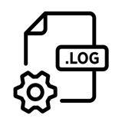



Protect SAP with the Power of Splunk Security
Removing data silos with real-time, application level, security monitoring
Systems, Applications & Products
Additional Security Data Sources
ECC
BW
SRM
CRM
Hana
Oracle
SQL
MaxDB
DB2
SAP Enterprise Threat Detection
Security Events, Threat Patterns,
& Alerts

Slide 14
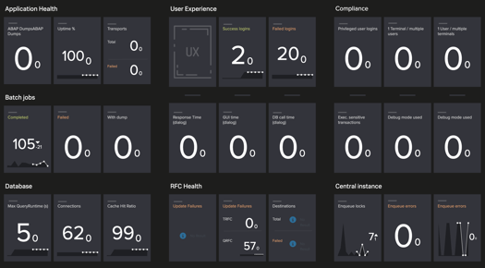

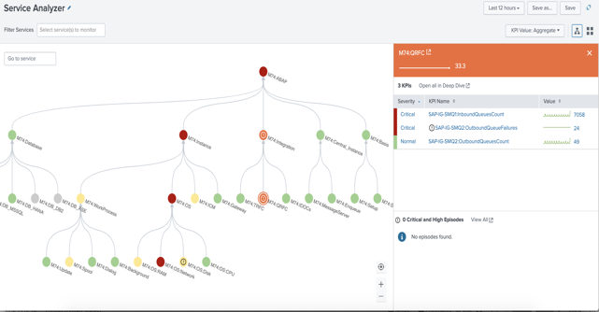
Splunk Service Intelligence for SAP® solutions
What It Is
Out-of-the-box ITSI content pack for SAP application and infrastructure monitoring
Service Analyzer Tree for SAP
Service Health Dashboard with 100s of SAP metrics & KPIs
ITSI AI/ML predictive analytics for SAP
Correlation of SAP and infrastructure data for advanced troubleshooting
Glass Tables for SAP health data
Why It Matters
SAP is mission critical for business. SAP environments are very large, complex with many integrations. Suffer frequent outages, long MTTR and MTTI due to siloed monitoring tools.
SI for SAP addresses these issues:
Reduces MTTR & MTTI with real-time correlated view of - SAP Applications, infrastructure / Cloud
Prevents outages with proactive alerting
Reduce time to value with OOTB SAP content

Slide 15
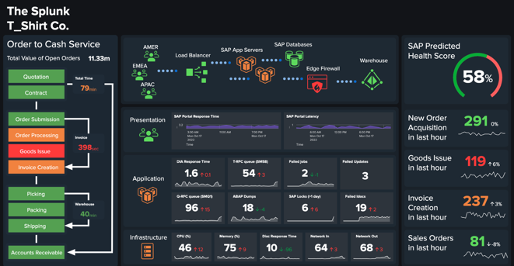
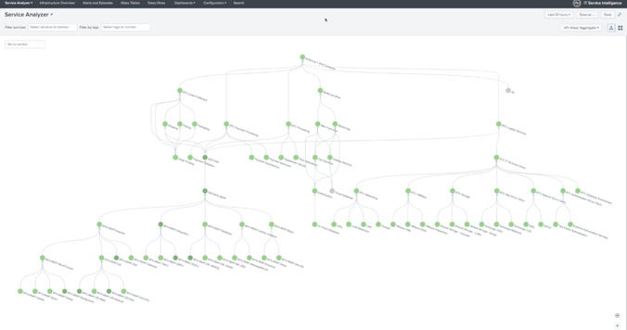
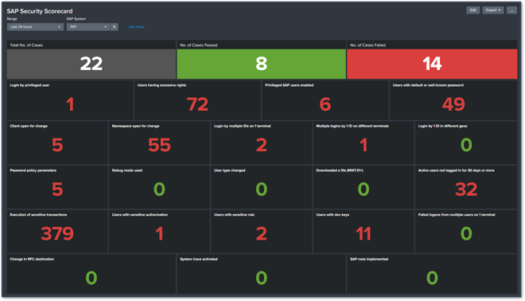

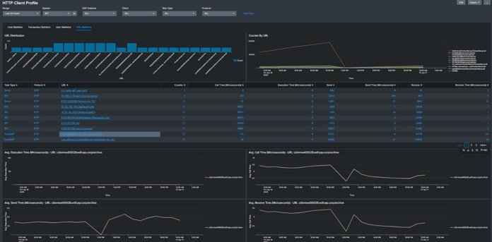
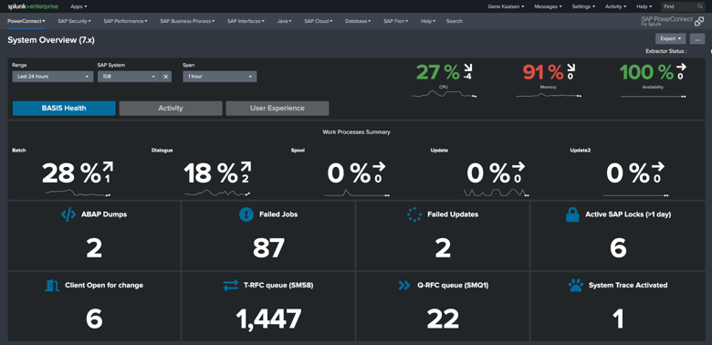
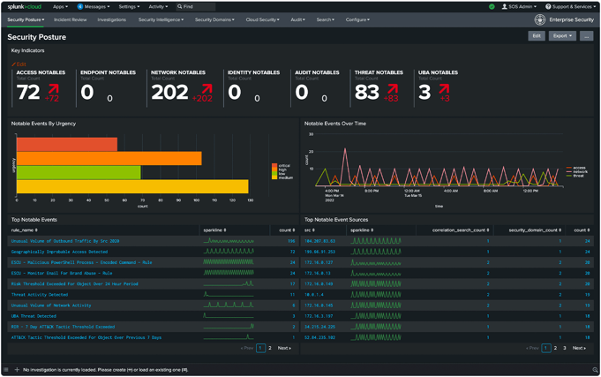







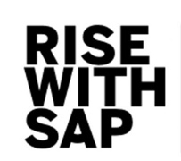


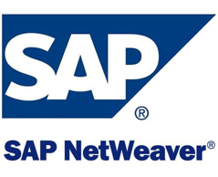



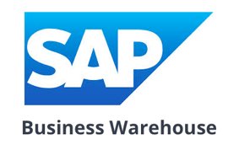
Unlock 1,600+ Out of the box SAP Use Cases With Splunk
546 ootb SAP Adaptive Threshold KPIs
Splunk ITSI
+ Splunk Service Intelligence for SAP
Splunk Enterprise Security
23 ootb SAP Notable Event Correlation Searches
1,037 ootb SAP Use Cases
SAP ABAP
SAP Java
SAP Cloud SaaS & PaaS
Employee Portal
Analytics Cloud
Cloud Platform
BW/HANA
SAP Concur
Business Technology Platform
Data Services
SAP Ariba
API Management

Slide 16
Splunk Service Intelligence for SAP
SAP Monitoring Maturity
Splunk Service Intelligence for SAP®
Delivers predictive and real-time insights across diverse business services
(SAP and Non-SAP)
SAP® PowerConnect for Splunk
Enables deep correlation to business metrics, services, security and infrastructure out of the box. (SAP and Non SAP)
SAP® Focused Run
Builds more proactive alerting but lacks correlation to environment or business context. (SAP Only)
SAP® Solution Manager
Provides basic monitoring for SAP-specific data sets with limited correlation and context. (SAP Only)
STAGE 4
STAGE 3
STAGE 2
STAGE 1
Baseline
Proactive
Prescriptive
Predictive

Slide 17




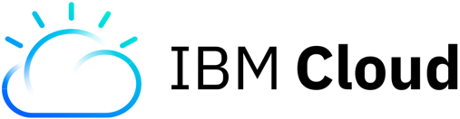
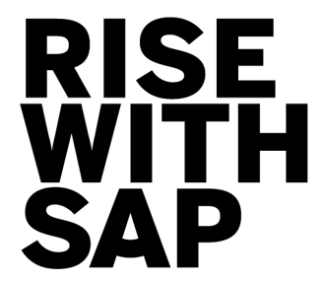
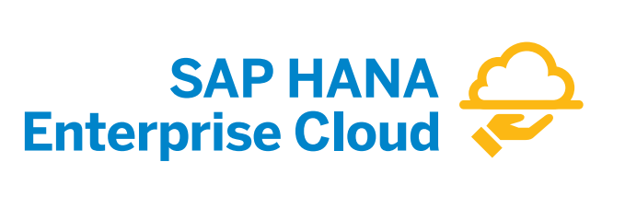





SAP Cloud Migrations and Upgrades
Baseline every SAP KPI and metric - Fast Time to Value - Days to implement
During Migration
Before Migration
After Migration
Compare historical on-prem to destination environments
Ensure migration of dependent services
Continually monitor SAP system health
Ensure uptime of business critical services
Monitor performance improvements and provide data analytics
Visibility to
SAP and all dependent components
Establish business process benchmarks, KPIs, and metrics
Map all SAP services from end to end
Compare
before and
after
migration
KPIs
Enhanced
security posture and reduce vulnerabilities
Provide continual 360 degree view
to SAP business services

Slide 18








Splunk Runs SAP Globally
Sourcing and Procurement
Facts & Figures
SAP
SAP S/4HANA on GCP (300 Users) Go Live <1yr
SAP Ariba (1,500 Users)
SAP Concur (8,000 users)
SAP BRIM/Convergent Invoicing
SAP GRC
SAP Fiori
Non-SAP
Salesforce.com
Workday
Splunk
SAP Ariba
Finance
Manufacturing
R&D and Engineering
Asset Management
GRC
Human Resources
Sales
SAP Concur
BRIM/Convergent Charging
Supply Chain
Business Technology Platform

Slide 19
Splunk & SAP Architecture Overview

Slide 20
Splunk & SAP Architecture Overview

Slide 21
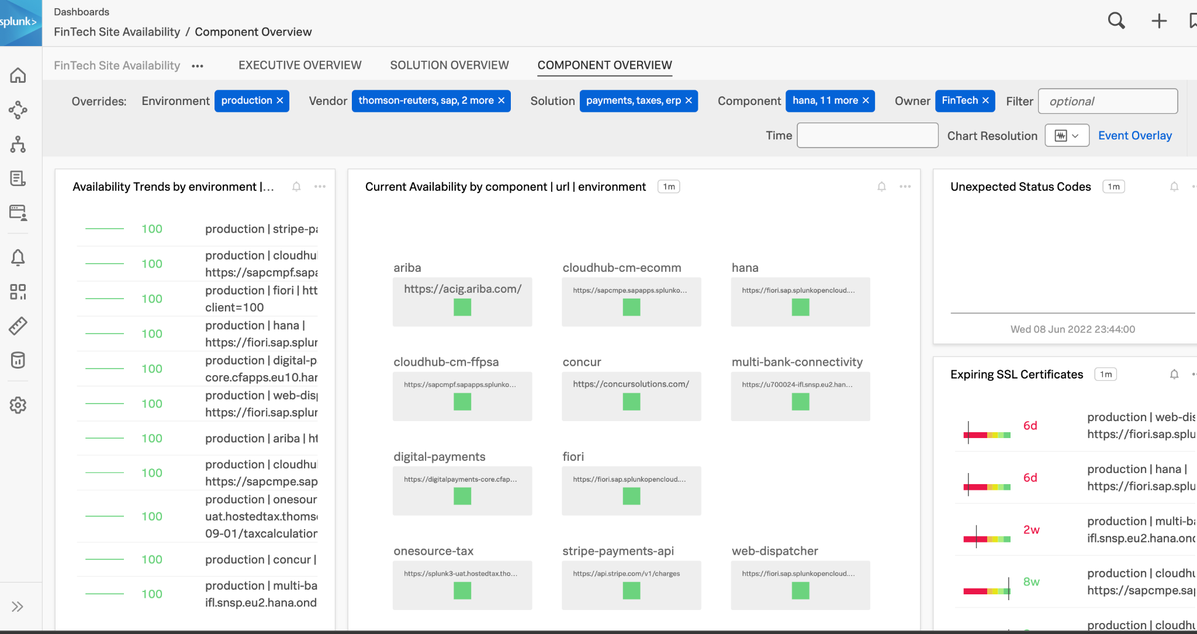
Splunk Infrastructure Monitoring

Slide 22
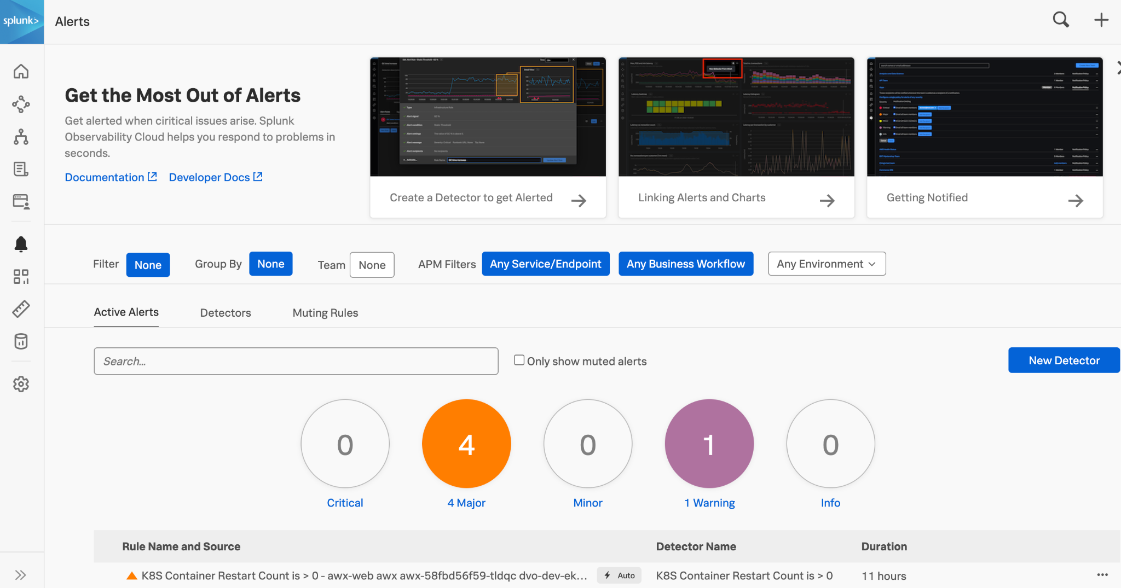
Splunk Infrastructure Monitoring

Slide 23
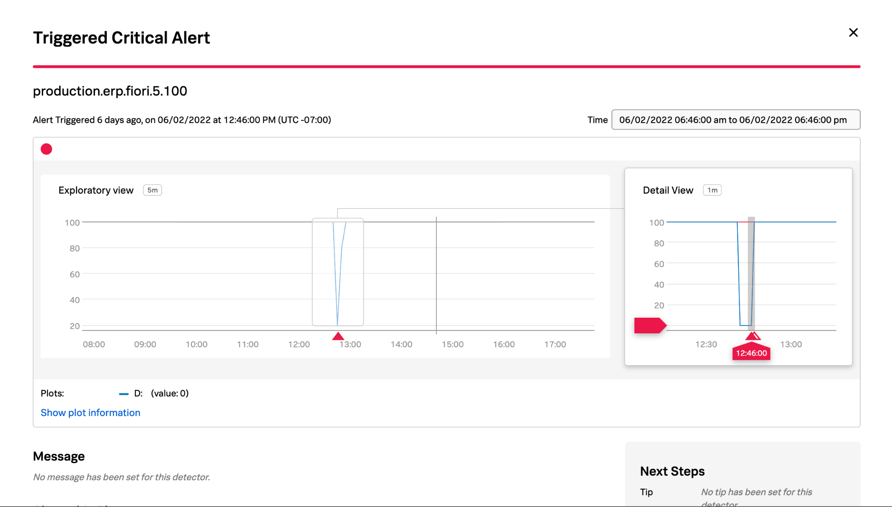
Splunk Infrastructure Monitoring

Slide 24
SAP PowerConnect For Splunk
Provide Security & Compliance Reports
  SAP Security Essentials
  Out of the box audit reports.
  Track user authentication activity with location.
  System logs.
Support SAP Process Monitoring
  Batch job execution.
  IDoc & Change documents processing.
  PI/PO message – payload, logs.

Slide 25
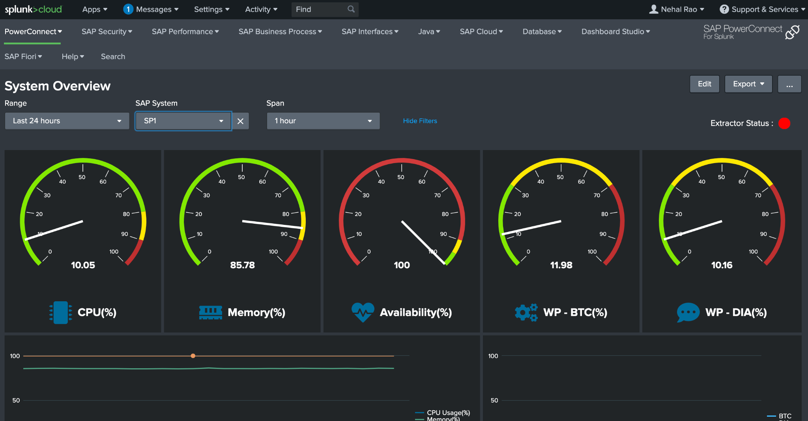
SAP PowerConnect For Splunk

Slide 26
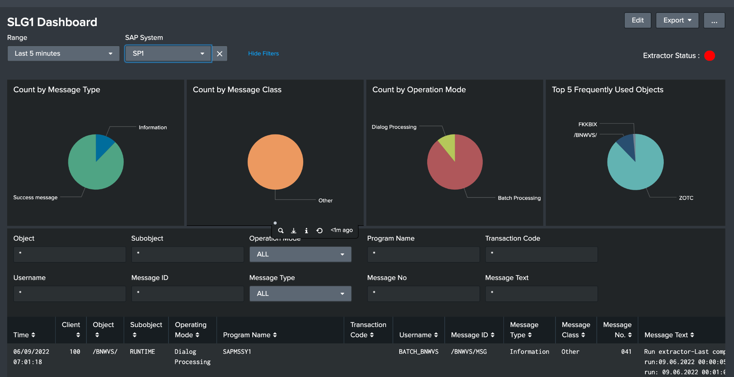
SAP PowerConnect For Splunk

Slide 27
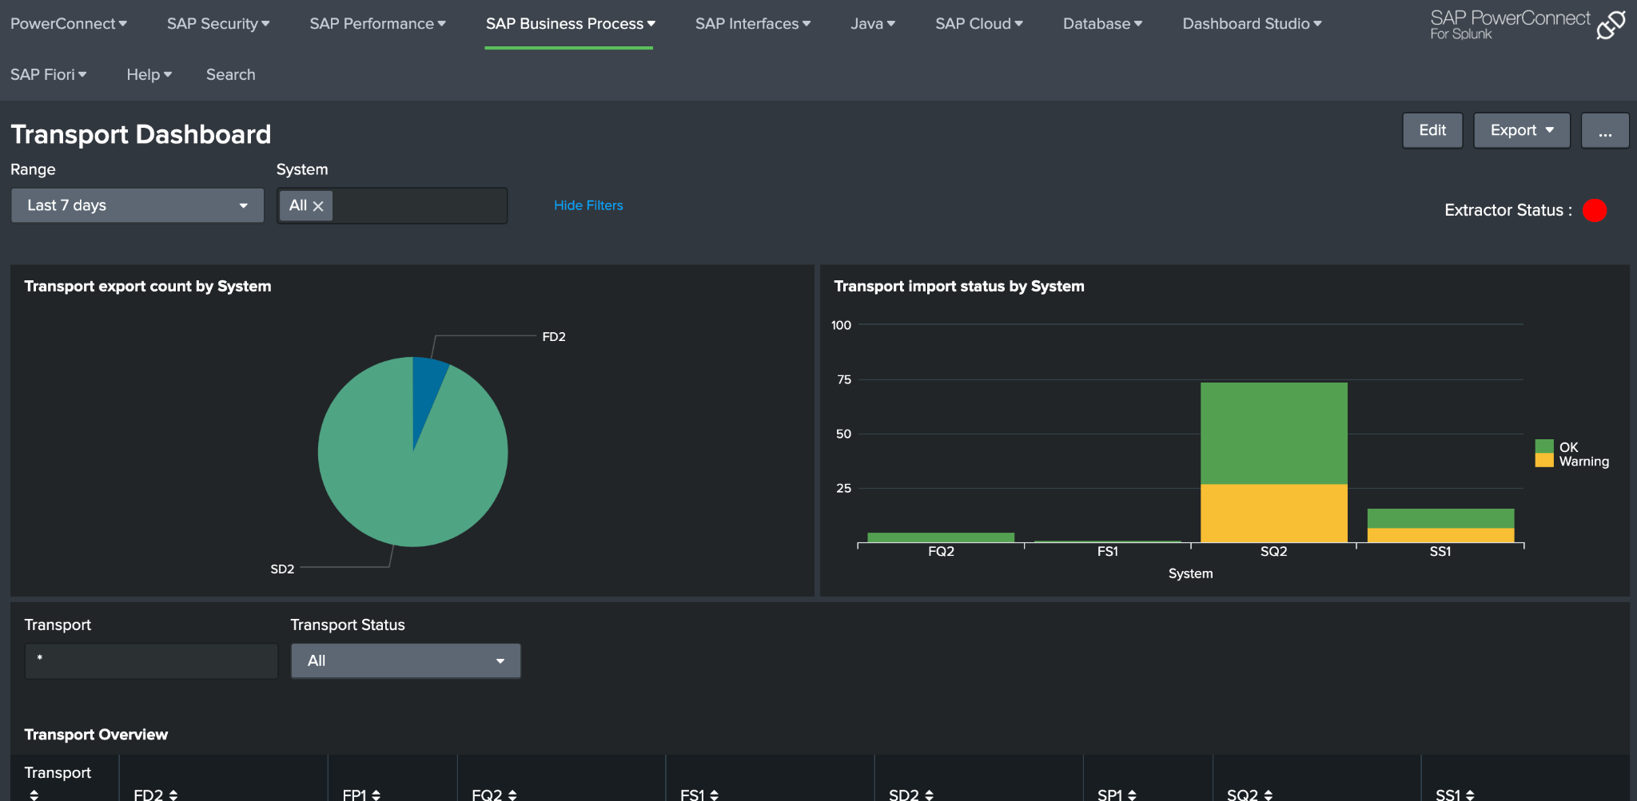
SAP PowerConnect For Splunk

Slide 28


Upcoming Events At A Glance
Regional ASUG Chapter Events – Q3/Q4
Joint SAP Splunk Webinars (9/12, 9/24)
SAP S/4HANA & Enterprise Architecture Summit (Dallas) – 10/10-11
SAP Tech Connect (New Orleans) – 11/7-9
AWS re:Invent (Vegas) – 11/27-29

Slide 29
For questions after this session, contact us at khontz@splunk.com

Slide 30
Thank You!
Notes:
Goal:
Wrap up
Takeaways:
Thank you.
Sample talk track:
Thank you!

