Slide 1
Accelerate your business transformation with S/4HANA Cloud, public edition Anurag Barua Digital Transformation Leader
SAP America

Slide 2
Speaker introduction
24 years of SAP experience in a career of 29 years in a variety of roles including SAP product development, delivery/advisory/consulting, pre-sales, & sales; currently work for the SAP S/4HANA Center of Excellence, North America
Served nearly 100 clients globally & across multiple industry verticals including Public Sector, Utilities, Media, Manufacturing, Pharmaceuticals, Oil & Gas, & Hi-tech among others
Areas of expertise include SAP Financials, Logistics/Supply Chain, Reporting & Analytics, Data Management & Governance, Cloud technologies, User Experience, & Project/Program Management
Prolific thought leader: Published over 100 articles & white papers for SAP publications; written 5 SAP books; spoken at nearly 60 SAP conferences globally
Nearly 25 years of SAP experience in a career of 30 years in a variety of roles including SAP product development, delivery/advisory/consulting, pre-sales, & sales; currently work for the SAP S/4HANA Center of Excellence, North America
Served clients globally & across multiple industry verticals including Public Sector, Utilities, Media, Manufacturing, Pharmaceuticals, Oil & Gas, & Hi-tech among others
Areas of expertise include SAP Financials, Logistics/Supply Chain, Reporting & Analytics, Data Management & Governance, Cloud technologies, User Experience, & Project/Program Management
Prolific thought leader: Published over 100 articles & white papers for SAP publications; written 5 SAP books; spoken at over 150 SAP conferences & events globally books; spoken at nearly 60 SAP conferences globally

Slide 3
Agenda
Overview & benefits of S/4HANA Cloud, Public Edition
Capabilities & key features
Deployment model

Slide 4
S/4HANA Cloud, public edition – fast facts
100% Software-as-a-Service (SaaS) application
(Annual) subscription-based license model
Enterprise Resource Planning (ERP) in the cloud
Entirely organic & relatively new SAP application that’s been in the market for nearly 7 years
All innovations will be delivered in the Public Cloud first
Runs on the HANA database and leverages HANA capabilities
Solution needs to be ‘deployed’ or ‘rolled-out’ and not ‘implemented’
100% mobility-enabled
SAP Fiori is the only UI
Also referred to as S/4HANA Public Cloud, Multi-tenant Edition (MTE), & Essentials Edition

Slide 5
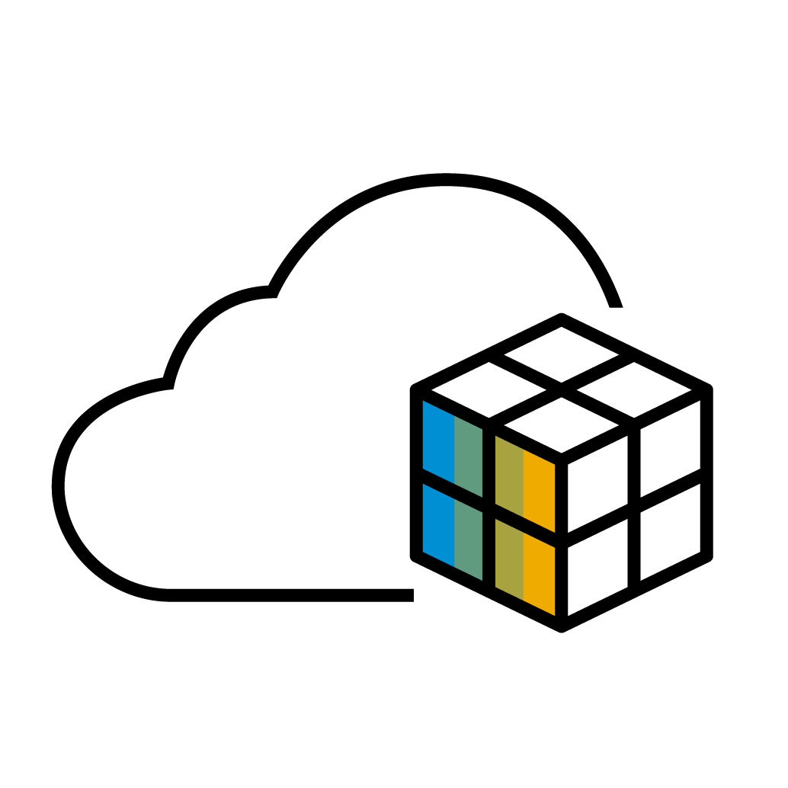
S/4HANA Cloud, public edition: Key differentiating qualities
S/4HANA Cloud, public edition – benefits
Agile
Innovative
Fast implementation
Industry best practices built in
Self service business configuration
Localized in 51 countries and extensible to others
Automated testing tools included
Cloud first innovation
Intuitive & simple UX, on any device
Intelligence built in (Process Automation, ML) Embedded Analytics (SAC and Datawarehouse Cloud)
Automatic and continuous upgrades
SAP S/4HANA Cloud, public edition
Flexible
Resilient
Modular extensibility
Easy in-app extensibility
Side-by-side extensibility
Out of the box integrations
Open architecture
Best in class uptimes
Mission critical response times, dynamic scalability
Cloud security and compliance
Backup and disaster coverage
Data protection

Slide 6
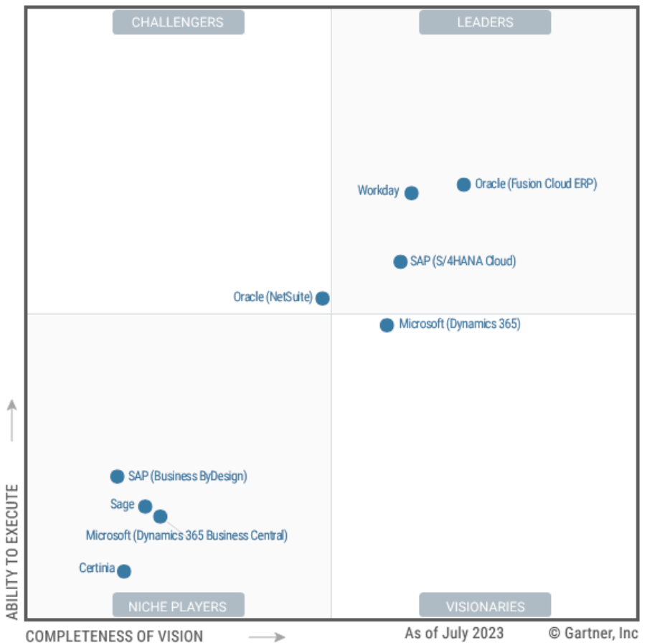
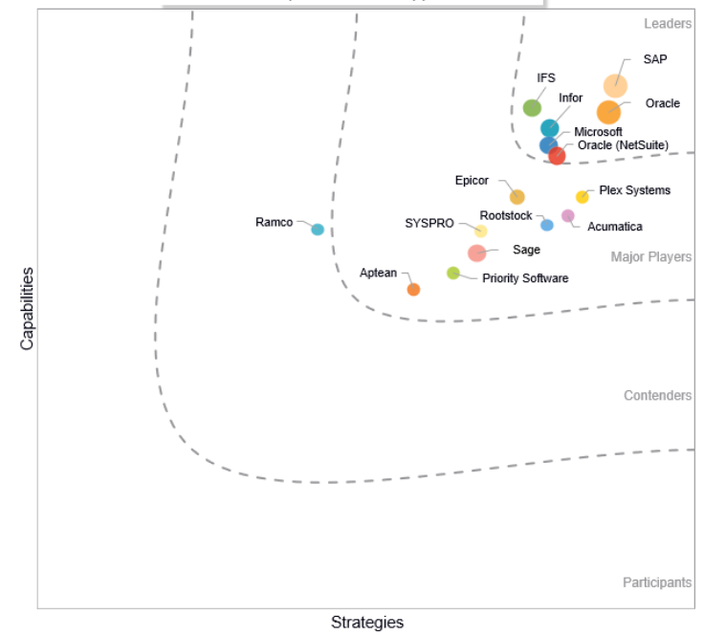
Leader in Finance and Service-Centric Domains
SAP S/4HANA Cloud is a Strong Leader in the 2022 Gartner Magic Quadrant™ for Service-Centric Cloud ERP
Gartner notes that SAP S/4HANA Cloud is a “100% managed SaaS cloud solution with a comprehensive breadth of features. Strengths included strong financial management product vision and breadth, including core management, treasury, analytics, and planning.”
Gartner Magic Quadrant for Cloud ERP for Service-centric
IDC Marketscape SaaS & Cloud-enabled operational ERP (2022)
SAP S/4HANA Cloud is a Leader in the 2021 Gartner Magic Quadrant™ for Cloud Core Financial Management Suites for Midsize, Large and Global Enterprises
Strong Leader in the 2020 IDC MarketScape™ for Cloud-Enabled PSA ERP Applications Vendor Assessment
Strong Leader in the 2020 IDC Worldwide SaaS and Cloud-Enabled Enterprise Finance and Accounting Applications Vendor Assessment

Slide 7
Agenda
Overview & benefits of S/4HANA Cloud, Public Edition
Capabilities & key features
Deployment model

Slide 8
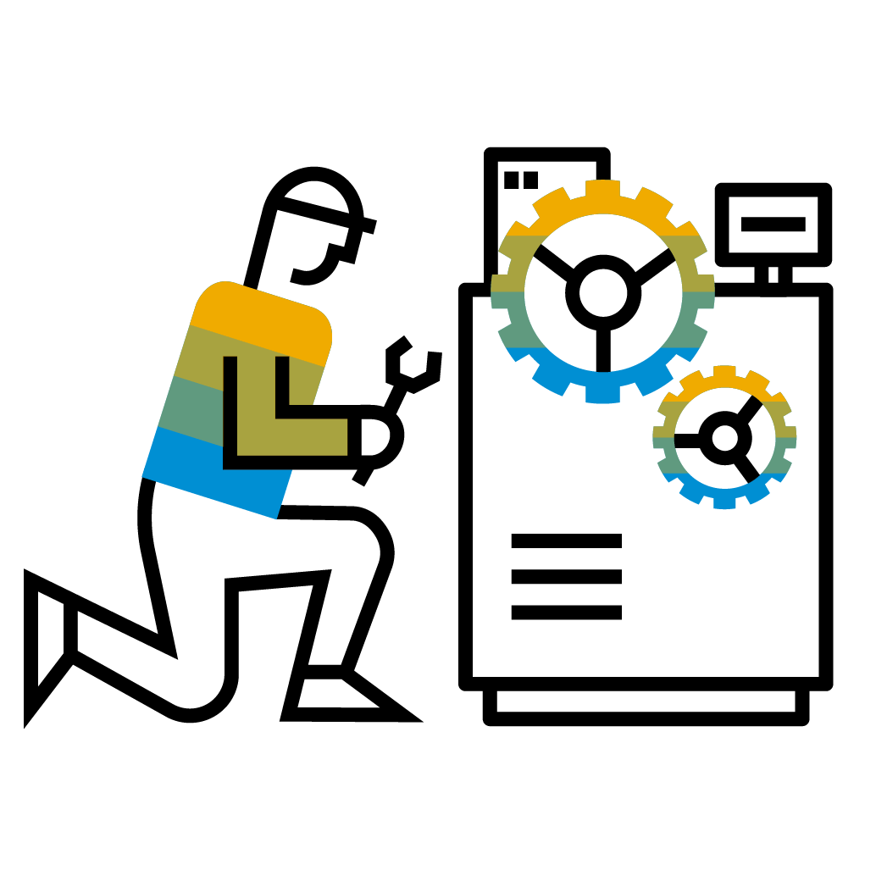
Packaged capabilities based on Best Practices
Finance
Accounting and financial close
Receivables and Payables mgmt.
Cost mgmt. & profitability analysis
Treasury & working capital mgmt.
Governance Risk and Compliance
Procurement
Direct material procurement
Service procurement
Supplier management
Central procurement
Sales
Sell Products, Projects and Contract-based Services separately or as a full solution
Convergent & External Billing
Service
After-sales service and support with contracts, service deliveries, and billing
Combine sales & services as packaged solution offerings
Service-Centric Industries
Professional services
Public sector
Higher education
Media
Financial services
Predictive Contracts
SAP S/4HANA Cloud, public edition
Manufacturing
Material requirements planning with demand driven and/or predictive MRP
Make to stock and make to order
Quality management
Environment, Health and Safety
R&D
Product compliance
Enterprise portfolio and project management
Advanced Variant configuration
Asset management
Reactive and proactive maintenance
Resource scheduling for maintenance planner
Enhanced collaboration + review
Supply chain
Warehouse Outbound & Inbound Processing
Core Inventory Management
(Advanced) ATP Processing
Basic Transportation Mgmt.
Product-Centric Industries
Component manufacturing
Hi-tech
Automotive
Mining services

Slide 9
Accelerate business growth
in All Industries with a finance-led, administrative (backoffice) ERP
Finance-Led
Industries:
All Industries*
Order to Cash | Procure to Pay | Record to Report | Financial Planning & Analytics
Scenarios:
Differentiation:
Modern SaaS Cloud ERP at Any Scale and Scope | Uniquely simple financials Tightly integrated O2C, P2P, R2R | Modularity to include SAP LOB, Industry Cloud and customer scope now or in future
Source to Pay
Order to Cash
Record to Report
Administrative ERP Value Chain:
Sourcing
Process
accounts payable
Financial accounting
Confirm customer order
Create
purchase order
Create
supplier invoice
Receive customer order
Collect billing + usage data
Execute invoicing
Perform financial close
Demand planning
Manage payable
financing
Deliver goods & post costs
Record
Buy & Receive
Invoice & Pay
Order & Fulfill
Bill & Collect
Record to Report, FP&A
Manage working
capital
Process payments
Handle returns and claims
Confirm services & post costs
Monitor profitability
Post revenue
Financial Planning, Budgeting + Forecasting
Management Reporting
Goods
receipt
Confirm Order
Bank commun-ication
Monitor order execution
Collect open payments
Financial reporting
*except highly regulated industries such as Healthcare
Notes:
Functional differentiation is delivered the business process and industry-specific levels.
Finance-Led ERP, also called Administrative ERP, is the core backoffice ERP solution that can be run in virtually any industries (with a few highly regulated industries like Healthcare being the exception). This solution plugs into a customers middle-office and front-office solutions.

Slide 10
Accelerate business growth
in Service-Centric Industries with end-to-end operational processes
Service-Centric Industries
Professional Services
EC&O + Real Estate
Public Sector
Higher Education
Travel + Transportation
Industries:
Media
Banking
Insurance
Customer Projects | Contract-Based | Solution Business
Commercial Real Estate | Govt + University Budget Mgmt | Regulated Financials | Asset Management
Scenarios:
Differentiation:
Real Time Revenue Recognition Project profitability at any time | Project Billing Solution Management / Bundling | XaaS / Subscription Management Commercial Real Estate Management
Sell & Plan
Setup & Staff
Delivery & Recognize
Bill & Manage
Example – Customer Project Value Chain:
Time Recording
Accounts Receivable
Lead Management
Opportunity Management
Engagement Setup
Search for Qualified Resources
Services Procurement
Travel & Expense
Engagement Billing
Credit + Collections
Sell & Plan
Setup & Staff
Deliver & Recognize
Bill & Manage
Closing + Contracts
Bid Creation
Utilization Reporting
Assign Resources
Manage Margin
Revenue Recognition
Engagement Analytics
Engagement Close
Manage WIP
Notes:
Functional differentiation is delivered the business process and industry-specific levels.
Service-Centric Industries are supported by all the Finance-Led ERP capabilities, PLUS they add on key operational capabilities such as the customer project lifecycle, contract-based services, subscription management (via an integrated SAP cloud “Subscription Billing” solution), Solution Order Management, Funds Management for public-sector and Higher Education segments, Banking-specific financials for insurance and banking segments.

Slide 11
Accelerate business growth
in Product-Centric Industries with end-to-end operational processes
Product-Centric Industries
Automotive
High Tech
IM&C
Mining
Mill Products
Retail
Industries:
Wholesale Distribution
Utilities
Oil & Gas
Chemicals
Aerospace & Defense
Produce & Sell Standard Products / MTS | Lot Size One / MTO | Engineer Products and Systems / ETO
Scenarios:
Early Product Designer Just in Time, Just in Sequence Delivery Scheduling |  | Demand Driven Replenishment Advanced Available to Promise Predictive MRP | Advanced Variant Configuration Project Controlling 8D Quality Management
Differentiation:
Idea to Market
Source to Pay
Plan to Fulfill
Order to Cash
Example - Make-to-Stock Scenario Value Chain:
Handover to manufacturing
Run production of subassemblies
Create sales order
Create and capture design
Run demand forecasting
Schedule production
Confirm and receive subassemblies
Create quotation and receive order
Plan transport and run outbound delivery
Plan
Produce
Deliver
Receive components
Run MRP
Receive finished products into warehouse
Pick components and run final assembly
Create service order and run service
Run and track outbound transport
Procure components
Confirm final assembly
Monitor warranty and react to claims
Notes:
Functional differentiation is delivered the business process and industry-specific levels.
Product-Centric industries are supported by manufacturing processes supporting Make-to-Stock, Assemble-to-Order, and Engineer-to-Order applicable for Automotive Suppliers, Industrial Machinery, Mill Disrete and High Tech suppliers.

Slide 12
Flexibility/extensibility
Key User Extensibility (Key User – In App)
Developer Extensibility (ABAP Developer, EA only)
Side-by-Side Extensibility (Developer)
Scenario
Smaller low-/no-code extensions of SAP solutions
Tightly-coupled and more complex extensions and apps
Loosely-coupled extensions and applications, such as partner solutions or custom applications targeting a different end user group
Use Cases
UI field layout, custom forms and templates
Custom analytics via CDS views
Custom SAP® BusinessObjects™
Custom business logic using cloud BADIs
Customer Implemented Localization
ABAP based:
custom app development
extensions of SAP S/4HANA Cloud solutions
partner extensions
Customer Implemented Localization
Custom or multitenant applications
ABAP and non-ABAP (Java, Node.js,) development
SaaS solutions developed by partners
Apps for separate target groups
Customer Implemented Localization
Persona
Key user
ABAP developer
Developer
Benefit
Fully managed and integrated in SAP S/4HANA Cloud
No or very basic development skills required
Development of extensions inside the SAP S/4HANA Cloud system
No remote access or data replication
Use and extend released SAP S/4HANA Cloud objects
Decoupled extensions independent of SAP S/4HANA Cloud operation and lifecycle management
Extensibility Integrated in SAP S/4HANA Cloud
Side-by-Side Extensibility

Slide 13
Release and Update Cycle*
Current release as of Aug 2023
Systems “continuously upgraded” and always on latest and greatest, eliminating major upgrade projects and allowing fast and cost effective adoption of new innovations.
Release
Release
Release
Release
SAP S/4HANA Cloud 2202
SAP S/4HANA Cloud 2208
SAP S/4HANA Cloud 2302
SAP S/4HANA Cloud 2308
Feb 2022
Aug 2022
Feb 2023
Aug 2023
2202.1
2208.1
2302.1
2202.2
2208.2
2302.2
2202.3
2208.3
2302.3
2202.4
2208.4
2302.4
Continuous innovation updates
*This is the current state of planning and may be changed by SAP at any time without notice
PUBLIC
13

Slide 14
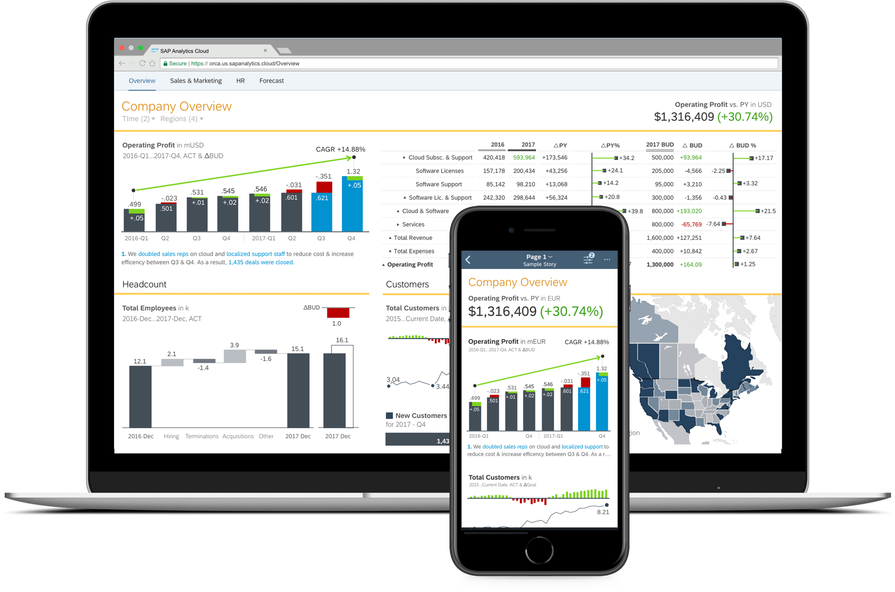
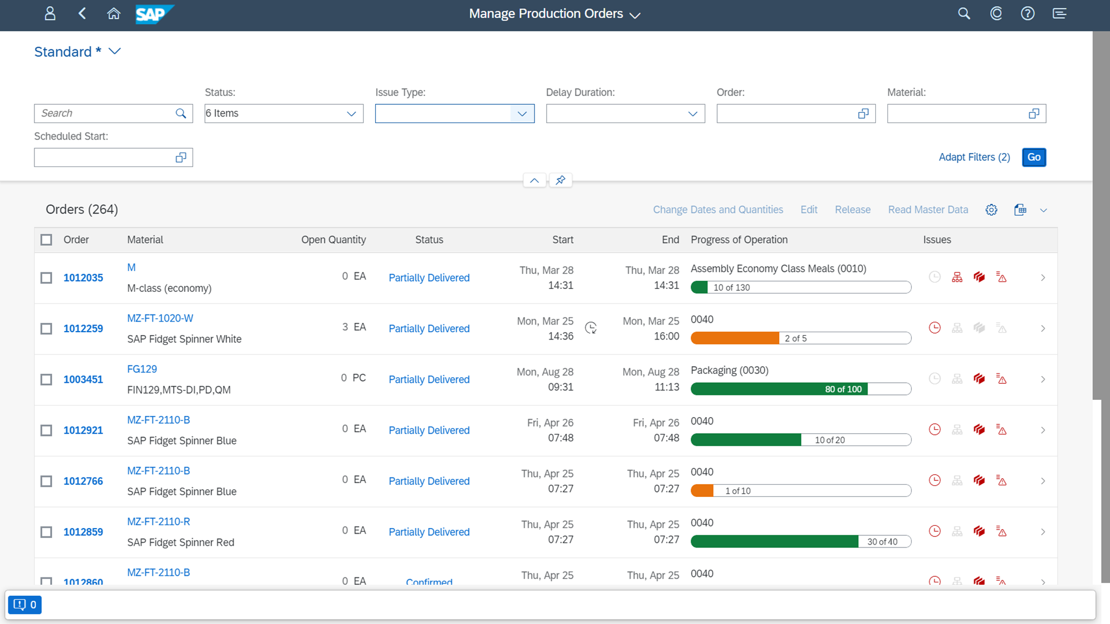
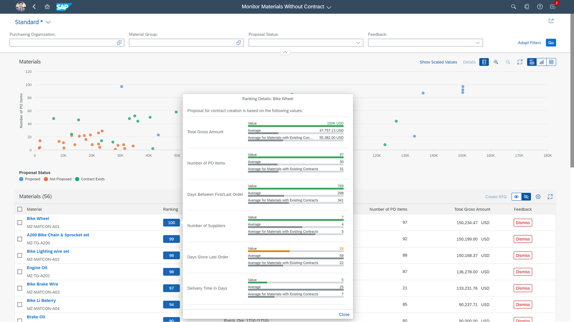
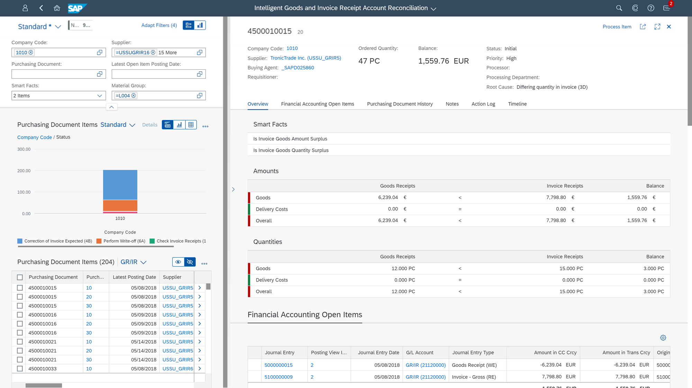
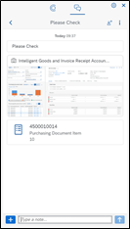
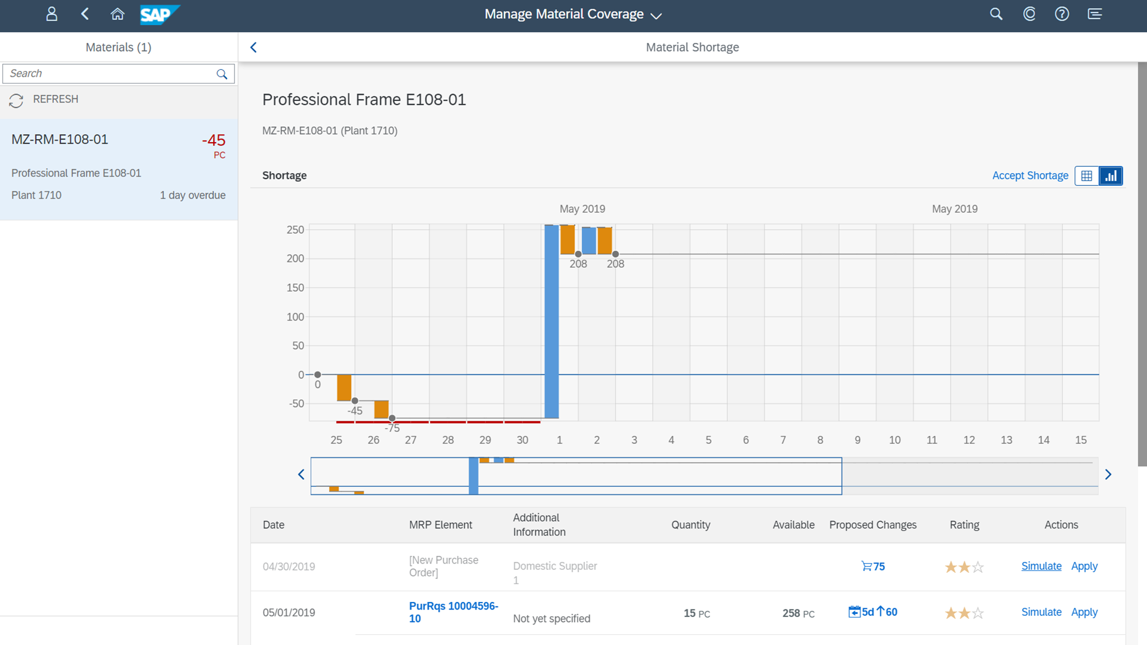
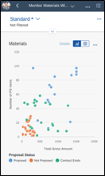
World-class UX with SAP Fiori
On any device, use role based cockpits with digital assistant
Embedded analytics for simulation, prediction & insight-to-action
Machine learning for automated processing & decision support
Monitor GR/IR account with 360° cockpit

Slide 15
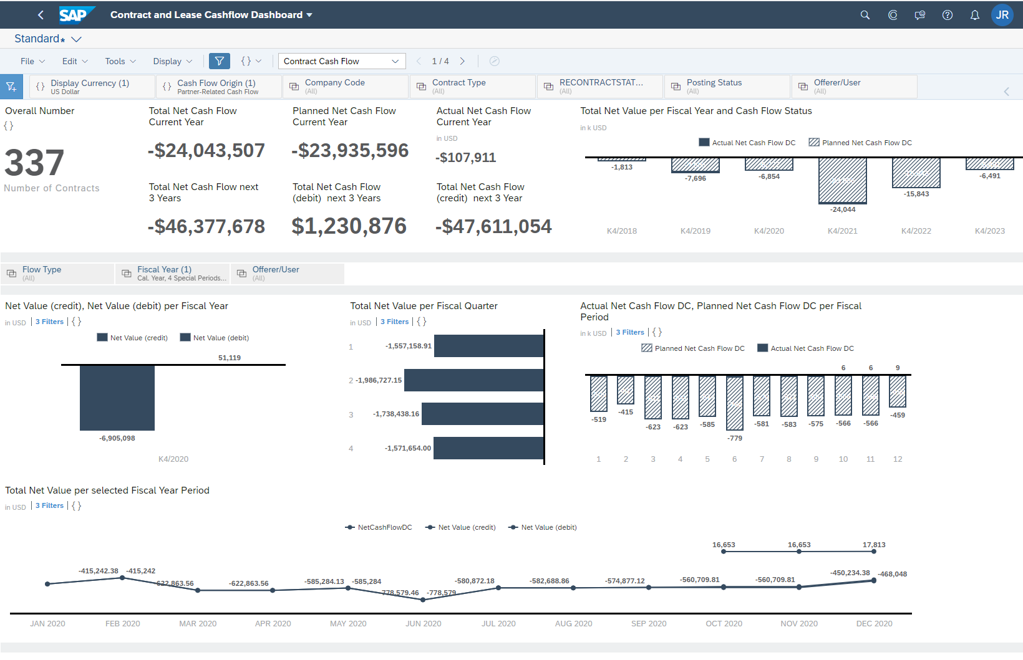
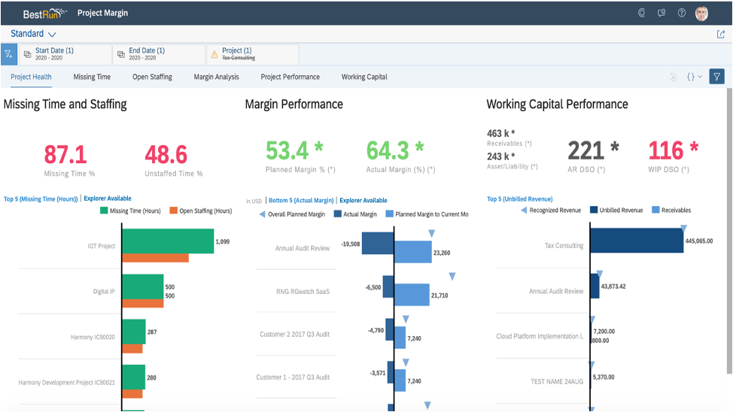
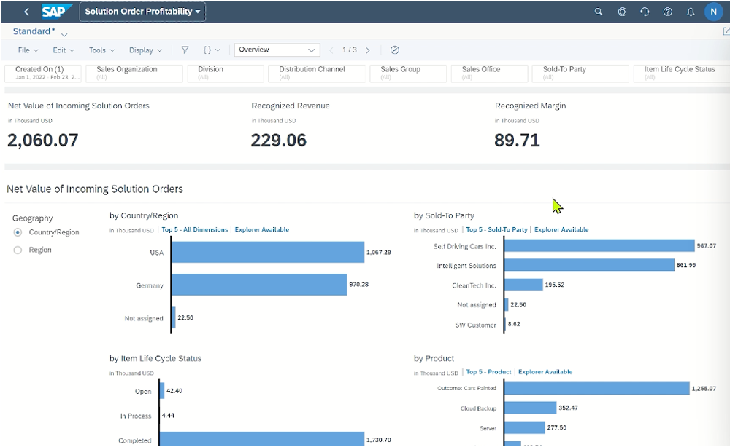
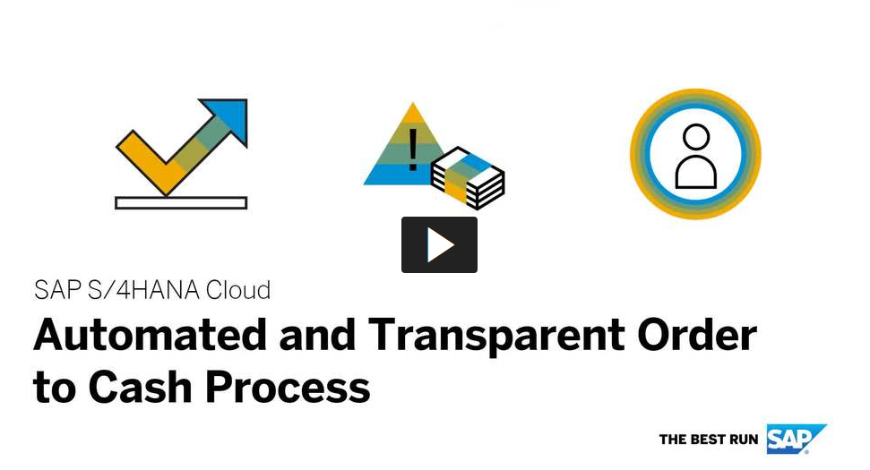
Embedded intelligence helps unlock efficiencies
Discover embedded insights
React with situation handling
Automate SAP Process Automation
Data-driven decisions for measurable outcomes
Exception-based notifications for insight to action
Multiple bot workflows for execution (attended + unattended)
7 Times increase in order processing capacity
Streamlining Order-to-Cash processes increases capacity for seasonal sales peaks
42% of sales orders automated Integrating Solutions for a real-time overview of the entire go-to- market channel
Notes:
So we have seen how we can deliver new business models to drive revenues but it is also critical to control the bottom line with increased insight and efficiency
We have a rich source of data running through the end to end processes and we see it as critical to maximize the insight this can provide
By embedding flexible insights that can provide context for making the right decisions which could be
people related such as hiring decisions, ensuring compensation plans are on target, and successors are correctly identified
or Real estate portfolio related to ensure that key assets are being optimized
Or Service related to ensure maximum utilization and on target margins
This allows our customers to get instant insight and take action without navigating away from where you are working … And of course what is displayed is configurable to meet your specific requirements.
We extend this further with exception-based through the collection of comprehensive analytical data on business situations to monitor and continuously improve business processes.
Siutation handling which provides intelligent role based notifications for example the need to raise a bill based upon WIP levels or take action due to late delivery of a service. These are proactively pushed to the user in context to all
This can then be taken a step further where the exception automatically intelligently triggers an action via RAP and increasingly takes us towards the realisation of autonomous solutions.

Slide 16
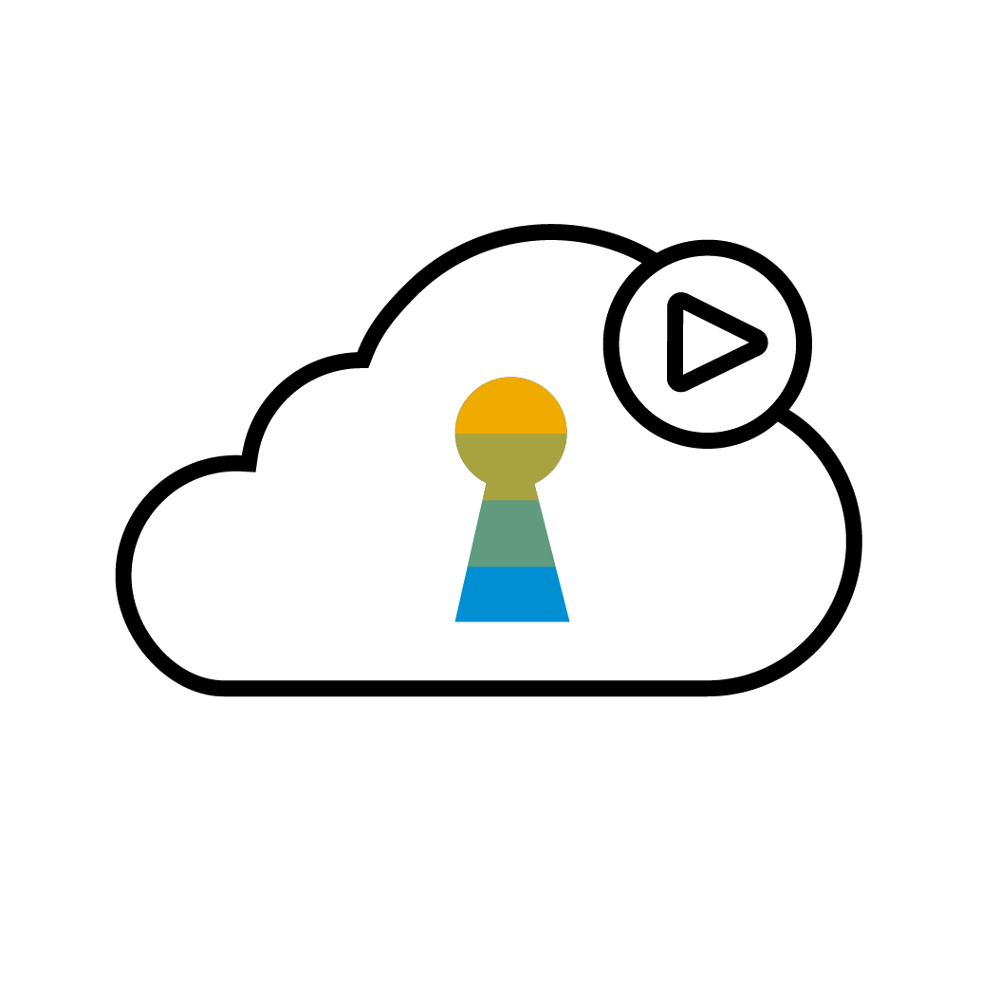
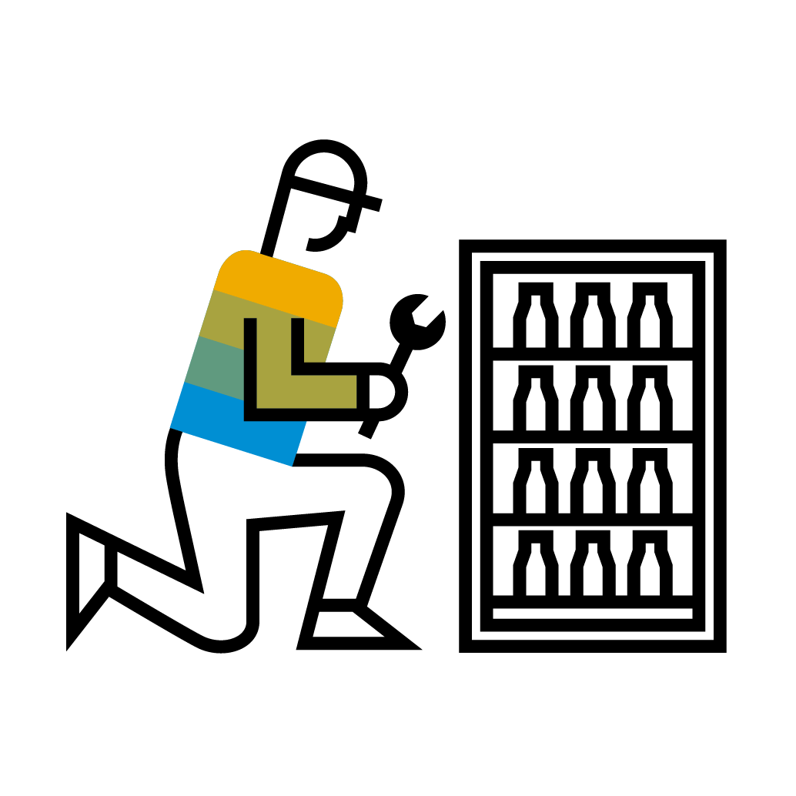
2-tier ERP Overview – for large enterprises (on SAP ECC or S/4HANA)
What is a two-tier scenario?
A composable ERP strategy with different ERP systems at two different layers of the organization.​
One system serves a given function (e.g. HQ) as a stable backbone while the 2nd layer run on independent (often integrated) ERP system/s
HQ
TIER 1
Stable Core
TIER 2
Five distinct profiles
Acquisitions
Subsidiaries
Divestitures
Incubations
Autonomous
Divisions
Notes:
Present this slide as conceptual presentation of use-cases regardless of ERP vendor.
What is Two-Tier ERP?
A composable ERP strategy with different ERP systems at two different layers of the organization.​
One system serves a given function (e.g. HQ) as a stable backbone while the 2nd layer run on independent (often integrated) ERP system/s
It’s usually a hybrid strategy but I prefer not to get them confused. Hybrid refers to different IT deployments, like Onprem ECC with SaaS salesforce.com. Here we are talking about specifically ERP to ERP use cases.
Acquisitions.- Companies who are expanding their product/service portfolio or geographic reach by acquiring other companies. These are typically high growth companies or larger companies in industries with M&A activity. Their challenge is to quickly onboard the company post-acquisition without destabilizing
Subsidiaries - Corporations that have a portfolio of established subsidiaries, often running a disparate set of ERP solutions. (focus for Netsuite and Dynamics) . Their challenge is to reduce the cost of managing multiple disparate ERP solutions, while gaining better visibility into their performance.
Divestiture - Corporations may need to rationalize their company portfolio either due to cost cutting measures or increased focus on the core business. They do this by selling off non-strategic divisions .
Their challenge is to quickly carve out the divestiture without jeopardizing the stability and creating an attractive acquisitions target for prospective buyers, while minimizing the investment.
Incubations - Companies that are entering a new business may setup a new entity separate from their own to allow them to be more nimble.
The ownership structure may be a JV, and long-term ownership may not be determined.
Their challenge is to create an environment where the incubated entity can experiment and govern itself.
Autonomous divisions - Divisions of a company which manage a different business process or business model. This may be a shared service like a field service or finance division which is not necessarily a separate legal entity.
Their challenge is to provide an environment where the entity has the flexibility to define new processes, which can be integrated to corporate but not governed by corporate.
Laggards: Fallen behind. Maybe smaller, May be dormant. Move to provide cloud may be a big step. Looking at greenfield. Why not go public clould – move from laggard to leader.
Innovators: Pushing us. Looking at true SaaS. We are competing with Workday, maybe oracle. Only accept SaaS.
CIO knows exactly what they want.

Slide 17
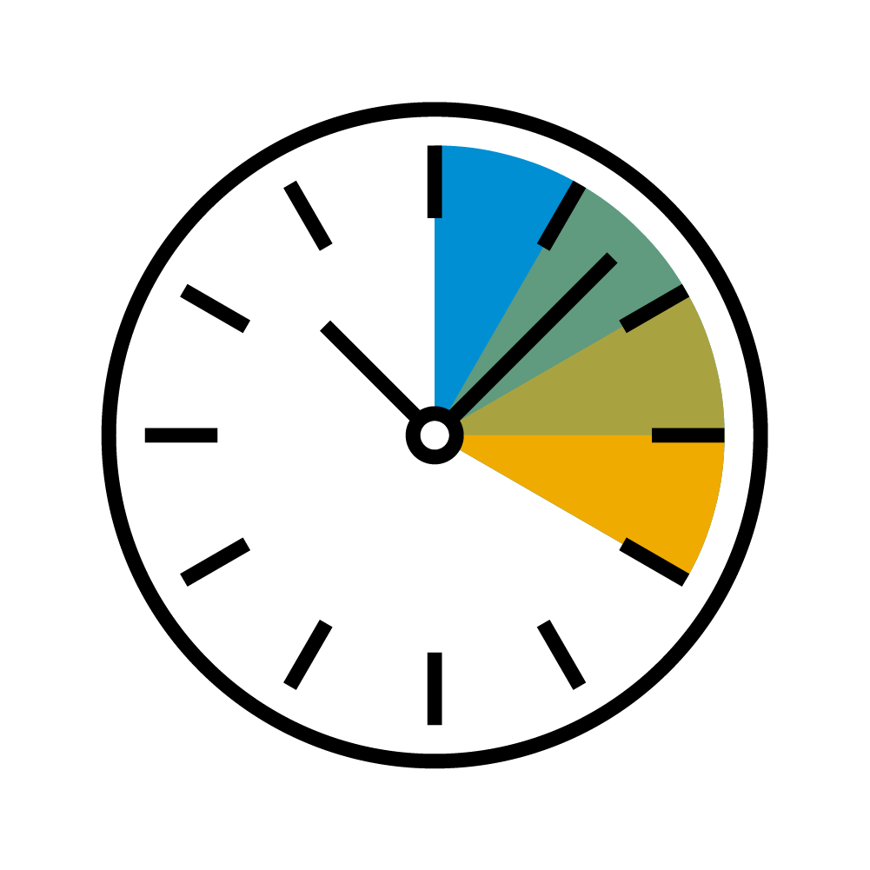
Benefits from a 2-tier ERP model
Agility | Flexibility | Autonomy | Compliance
Faster Onboarding to reduce time to value Automated updates and patching Absorb Innovations at a faster rate | Innovate with new business processes/models utilizing modern cloud technologies Flexible commercial models without large upfront investment | Increased independence for the two-tier entity Evolve, change and adapt at own pace Lower risks and disruptions to global/HQ landscape | ISO Certified Security Address local legal requirements and changes Independent legal structure supporting JVs Carve out independent installations for divestitures
Notes:
Present this slide as conceptual presentation of use-cases regardless of ERP vendor.
What is Two-Tier ERP?
A composable ERP strategy with different ERP systems at two different layers of the organization.​
One system serves a given function (e.g. HQ) as a stable backbone while the 2nd layer run on independent (often integrated) ERP system/s
It’s usually a hybrid strategy but I prefer not to get them confused. Hybrid refers to different IT deployments, like Onprem ECC with SaaS salesforce.com. Here we are talking about specifically ERP to ERP use cases.
Acquisitions.- Companies who are expanding their product/service portfolio or geographic reach by acquiring other companies. These are typically high growth companies or larger companies in industries with M&A activity. Their challenge is to quickly onboard the company post-acquisition without destabilizing
Subsidiaries - Corporations that have a portfolio of established subsidiaries, often running a disparate set of ERP solutions. (focus for Netsuite and Dynamics) . Their challenge is to reduce the cost of managing multiple disparate ERP solutions, while gaining better visibility into their performance.
Divestiture - Corporations may need to rationalize their company portfolio either due to cost cutting measures or increased focus on the core business. They do this by selling off non-strategic divisions .
Their challenge is to quickly carve out the divestiture without jeopardizing the stability and creating an attractive acquisitions target for prospective buyers, while minimizing the investment.
Incubations - Companies that are entering a new business may setup a new entity separate from their own to allow them to be more nimble.
The ownership structure may be a JV, and long-term ownership may not be determined.
Their challenge is to create an environment where the incubated entity can experiment and govern itself.
Autonomous divisions - Divisions of a company which manage a different business process or business model. This may be a shared service like a field service or finance division which is not necessarily a separate legal entity.
Their challenge is to provide an environment where the entity has the flexibility to define new processes, which can be integrated to corporate but not governed by corporate.
Laggards: Fallen behind. Maybe smaller, May be dormant. Move to provide cloud may be a big step. Looking at greenfield. Why not go public clould – move from laggard to leader.
Innovators: Pushing us. Looking at true SaaS. We are competing with Workday, maybe oracle. Only accept SaaS.
CIO knows exactly what they want.

Slide 18
Agenda
Overview & benefits of S/4HANA Cloud, Public Edition
Capabilities & key features
Deployment model

Slide 19
SAP Activate – Deployment methodology
Customers achieve fast and cost efficient deployment of SAP innovations with ONE simple, modular and agile methodology
Drive delivery of customer and time to value
Full support for initial implementation and on-going business innovation
Broad coverage of SAP solutions
SAP ACTIVATE Methodology
Enabled for cloud, on-premise, and hybrid deployments
Flexible to accommodate today and future delivery approaches, including SAP partners
Enables co-innovation with customers

Slide 20
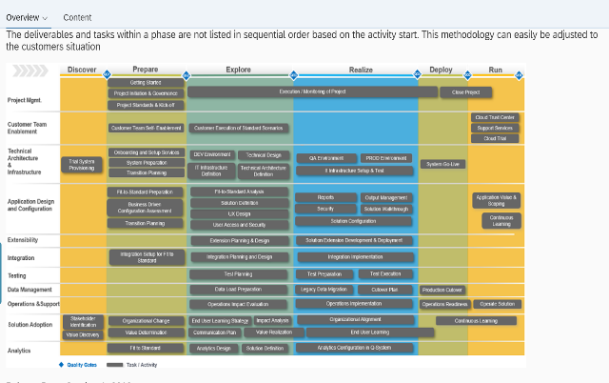
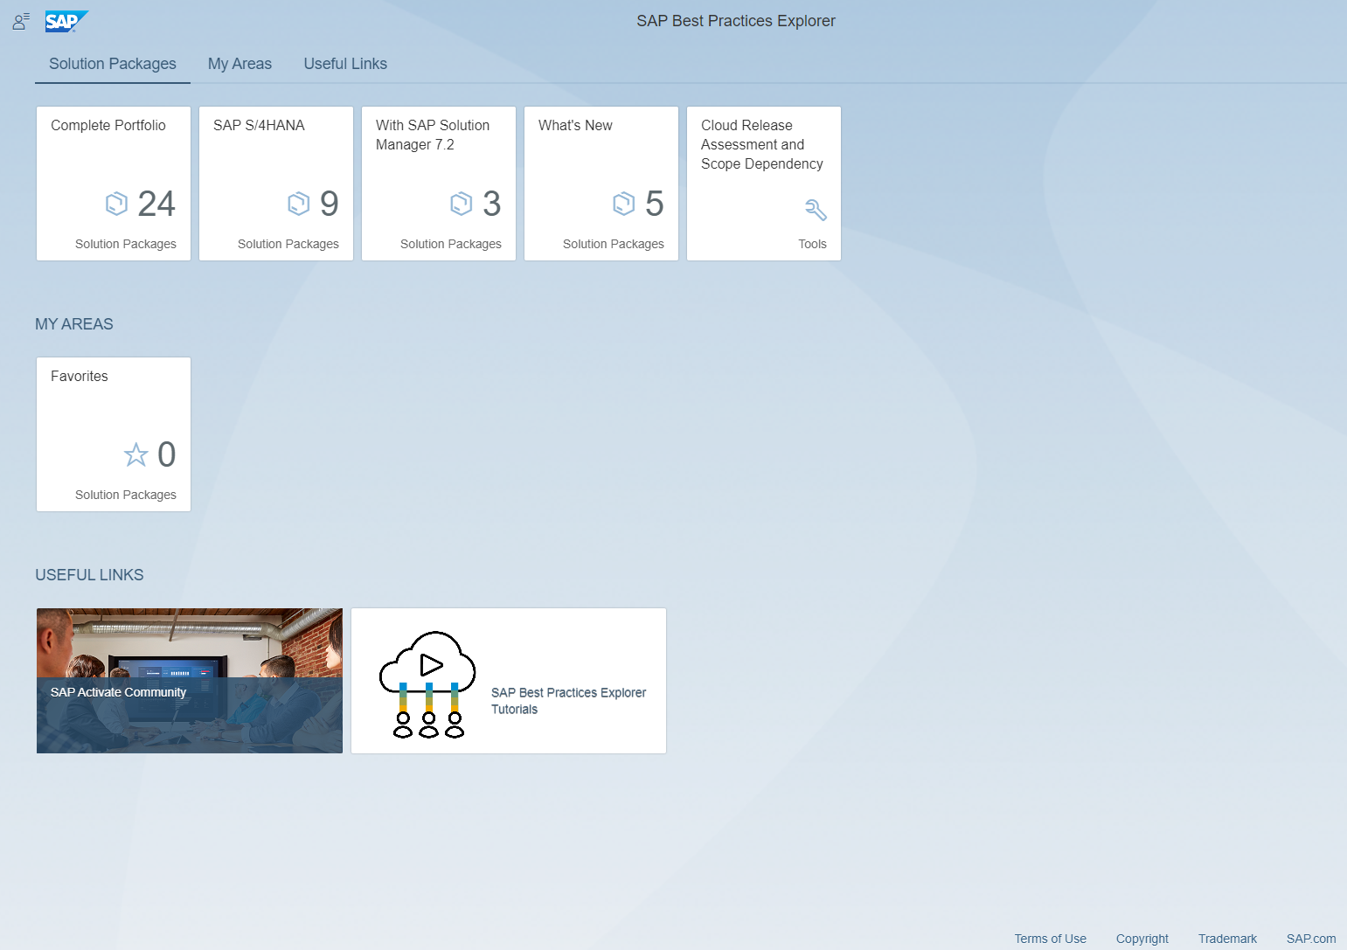
Enablers for SAP Activate
SAP Roadmap Viewer & Activate
Access implementation guidance for your digital transformation
View and download SAP Activate methodology assets and accelerators
Provide feedback to the Activate team
https://go.support.sap.com/roadmapviewer/#
SAP Best Practices Explorer
Access and download SAP Best Practices content
Power your project with ready-to-run business processes
https://rapid.sap.com/bp/
SAP Activate Community
Engage SAP Activate experts
Ask questions and collaborate
Stay up to date
Follow the community at https://community.sap.com/topics/activate
To be replaced starting June 30, 2023 by “Process Navigator by SAP”

Slide 21
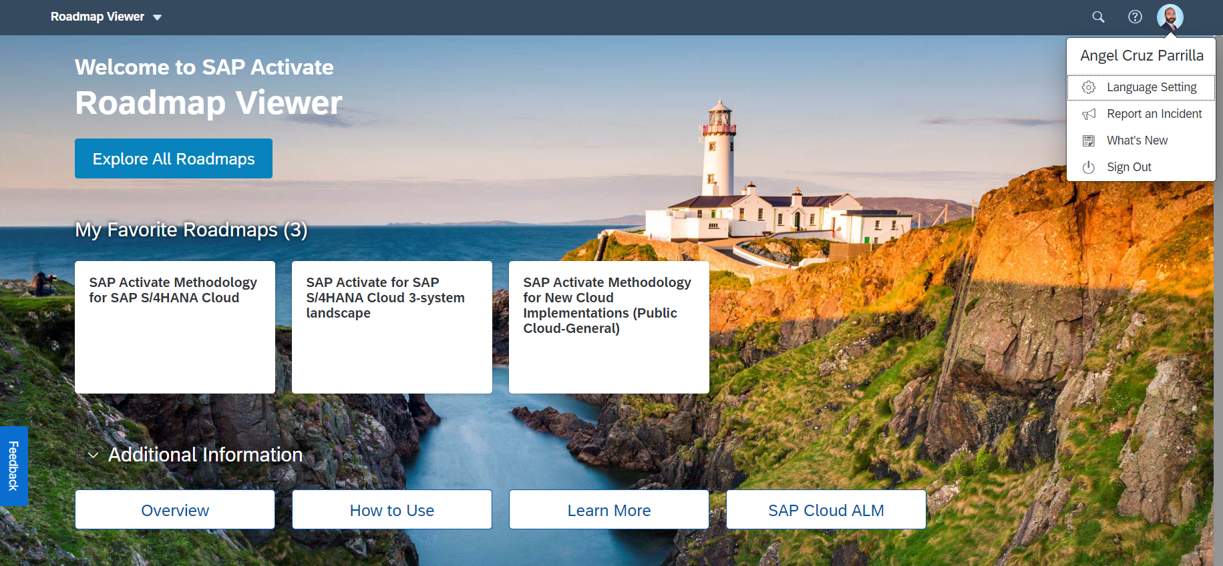
SAP Activate Roadmap Viewer
SAP Activate Roadmap Viewer
Access:
Benefits:
https://go.support.sap.com/roadmapviewer/
• SAP Fiori application to help you to guide your
SAP S/4HANA implementation project
Getting Started with the SAP Activate Roadmap Viewer
• Contains time-phased instructions to help execute
tasks throughout the implementation journey
• Offers you a large number of accelerators to help
you run your project as efficient as possible
• Content continuously updated to provide current
and accurate instruction
• Guides you through the whole SAP S/4HANA solution lifecycle

Slide 22
SAP Activate phases
Qualification
Journey and Key Milestones
Discovery Assessment
Finalized scope and backlog with delta requirements
Buy
Cloud ALM & Central Business Configuration
Go-Live Readiness Assessment
Update & Upgrade
OCM Delivery & Monitoring
Onboard Project Team
Activate new scope / add countries
Go-Live
Discover
Prepare
Explore
Realize
Deploy
Run
Continuous Innovation
Discovery Assessment (Scope)
Setup and Enablement
Fit-to-Standard Analysis
Configure, Play back
Migrate, Integrate, Test
Extend
Onboard Users and Deploy
Innovate, Operate, Support
Starter System
System Landscape
4
Development System
5
Test System
SAP for Me
6
Production System
7
1
Initial Transport
Ongoing Transports
SAP Central Business Configuration
x
3
Sequence of provisioning
2
SAP Cloud ALM

Slide 23
Cloud Mindset – key ingredient for success
A fundamental new way of thinking in the cloud era. It requires the ability to rapidly adopt standard best practices and leverage cloud technology to engage in continuous innovation
The adoption of a cloud mindset enables an organization to achieve higher agility, flexibility and collaboration thereby optimize the use of business and technological innovations that the cloud offers.
Customer committed to cloud mindset embrace:
Adopting standard processes
Running the solution in a SAP selected Data Center
Accepting innovation and update cycles

Slide 24
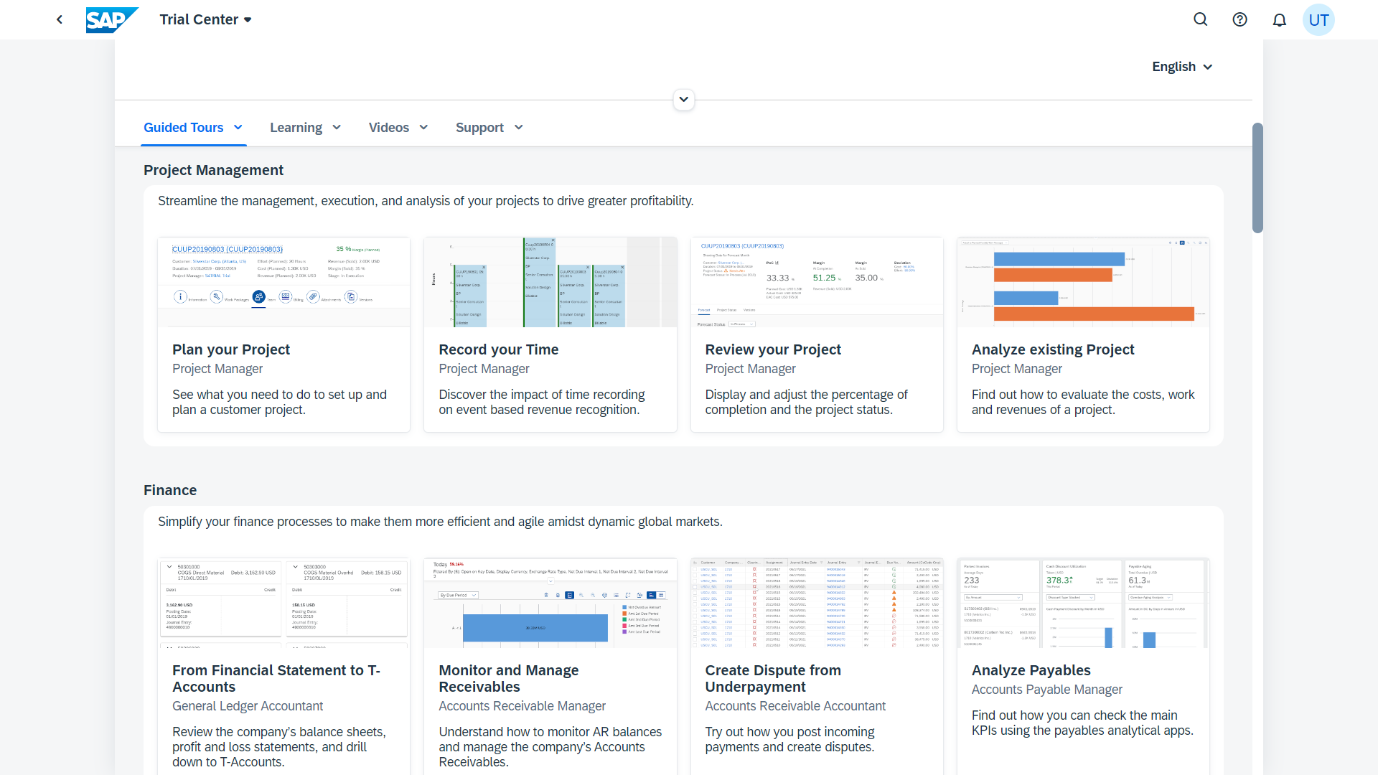
Get started now with free trial version
SAP S/4HANA Cloud, public edition Trial
Free of Charge Test a real SAP S/4HANA Cloud system 14 days for free.
Guided Tours Explore the solution highlights along expert-curated scenarios.
Comprehensive Scope Run a broad range of processes across Finance and Logistics.
Complementary Content Consume complementary content linked in the trial.
Get started now!

Slide 25
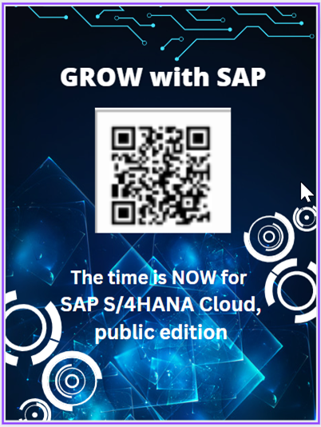
Customer Flipping Book
Ready-To-Run Customer Flipping Book
Learn about GROW with SAP at https://www.sap.com/products/erp/grow.html

Slide 26
For questions after this session, contact me at Anurag.barua@sap.com

Slide 27
For questions after this session, contact me at Anurag.barua@sap.com

