Slide 1
Removing Roadblocks on Your Road to S/4HANA
Rob Jackson, Serrala
Vishal Awasthi, Neev

Slide 2
Agenda
What Roadblocks Exist on the Road to S/4HANA?
Archive Data Before You Start the Move
Greenfield Considerations
Insurance Company
Brownfield Considerations
Dr Pepper Snapple Group
Start Finance Digital Transformation Now
Greenfield and Brownfield Considerations
Transform Before – Zoetis Case Study
Transform During or After – Zurich North America
Wrap Up

Slide 3
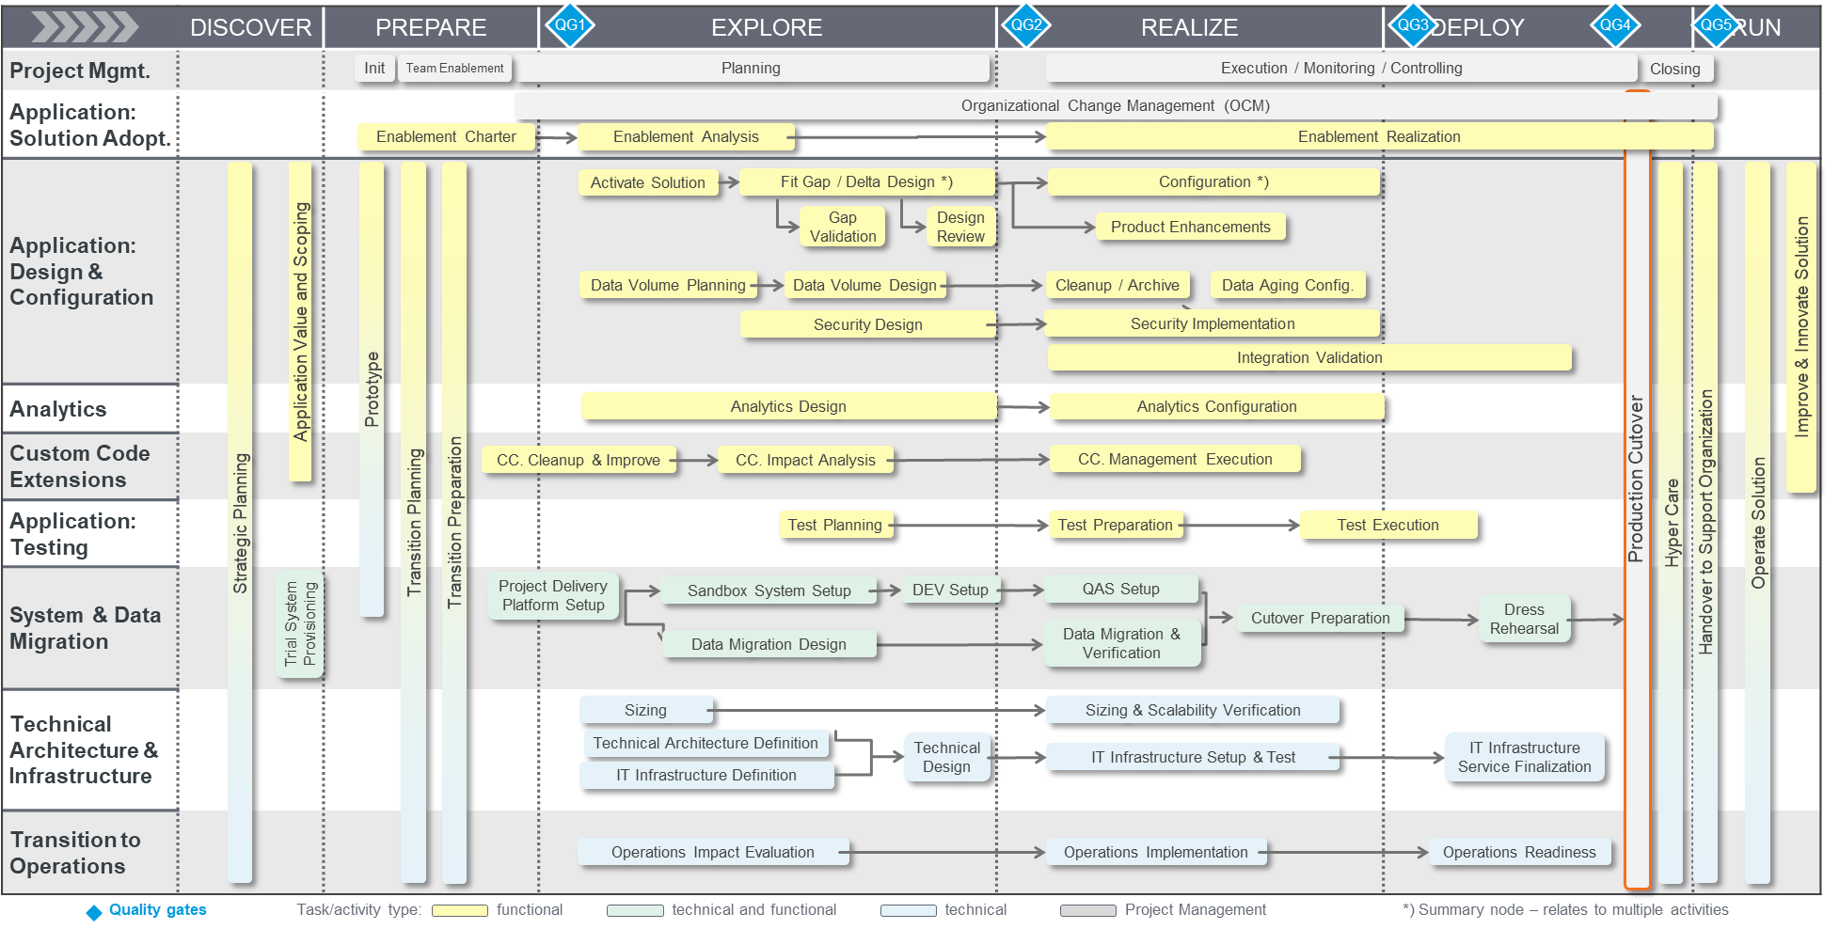
Typical S/4HANA Transition Plan

Slide 4
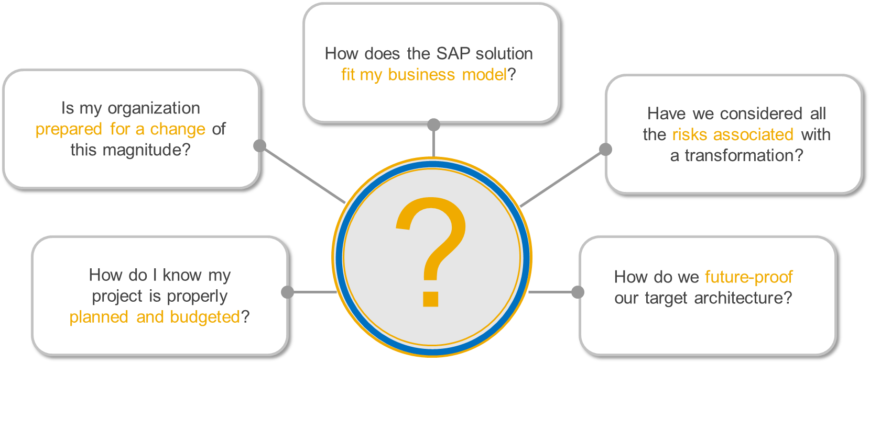
Common Concerns and Complications When Beginning Transformation

Slide 5
Removing Roadblocks on your Road to S/4HANA
Archive Data Before Moving to S/4HANA
Start Finance Digital Transformation
Reduce the time and effort required to move to S/4HANA:
Archive data in SAP ECC to reduce the volume of information you need to move.
Retain data and documents in a cost-effective archive repository for audit and reporting purposes
Begin digital transformation in finance to prepare for S/4HANA:
Identify and eliminate customizations
Standardize, digitize, and extend processes as needed for S/4HANA
Determine transformation roadmap and resources
Prepare IT and Finance for the Move to S/4HANA Now to Maximize Your Return on Investment

Slide 6
Archive Data Before Moving to S/4HANA
6

Slide 7
Transition Approach for SAP S/4HANA
Business Objectives
Transition Path
Destination Options
Business Model Innovation
New Implementation “Greenfield”
SAP S/4HANA® Cloud
Business Process Optimization
Selective Data Transition “Brownfield”
SAP S/4HANA Private Cloud
SAP S/4HANA including SAP HANA ® Enterprise Cloud and information as a service
ERP Rapid Modernization
System Conversion
OI Transition

Slide 8
SAP Data Archiving - The First Step on the Path to S/4HANA
Without Archiving
With Archiving
Archive
Online
Online
Y1
Y2
Y3
Y4
Y5
Y6
Y7
Y8
Y9
Y10
Y1
Y2
Y3
Y4
Y5
Y6
Y7
Y8
Y9
Y10
Time
Time
Slim That Database Down to Size!
8
Notes:
Typical situation: data growth by time.
Archiving: Transfer growth to archive achieving several benefits:
Compressed storage in flat files => less resources, costs
Compliant storage of archive files; not changable.
Ideal situation: 0-growth in DB; archive as much as new data is created/stored.

Slide 9
Greenfield - Start with a brand-new S/4HANA installation
New S/4HANA
S/4HANA
ERP
Non SAP
Open Items
?
How to deal with closed business transactions
Retention of mature data for audits
Continue using the exiting environment as “read only” system
System decommissioning – keep data in “SAP format”
System decommissioning – keep data in an open format (SAP independent)
9
Notes:
2. ADK format and give access to files through DNO
3. Corsestone Cloud DNO – Smith and Nephew, 77Energy

Slide 10
Transfer open items and decommission the legacy system
System Decommissioning
Legacy system (SAP ECC)
SAP S/4HANA
Legacy data
Document Navigator
OI
HANA
Archive Service
Doc Archive
Doc Archive
Archive remaining documents
Technical Archive Migration
Archive all remaining data
Cloud on-prem
Serrala Archive Accelerator
ADK Archive
ADK Archive
2000 - 2018
from 2019
10

Slide 11
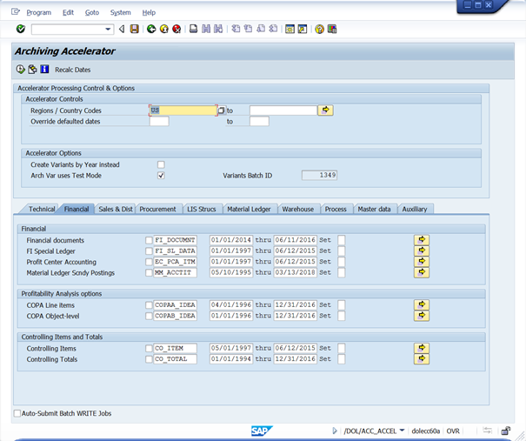
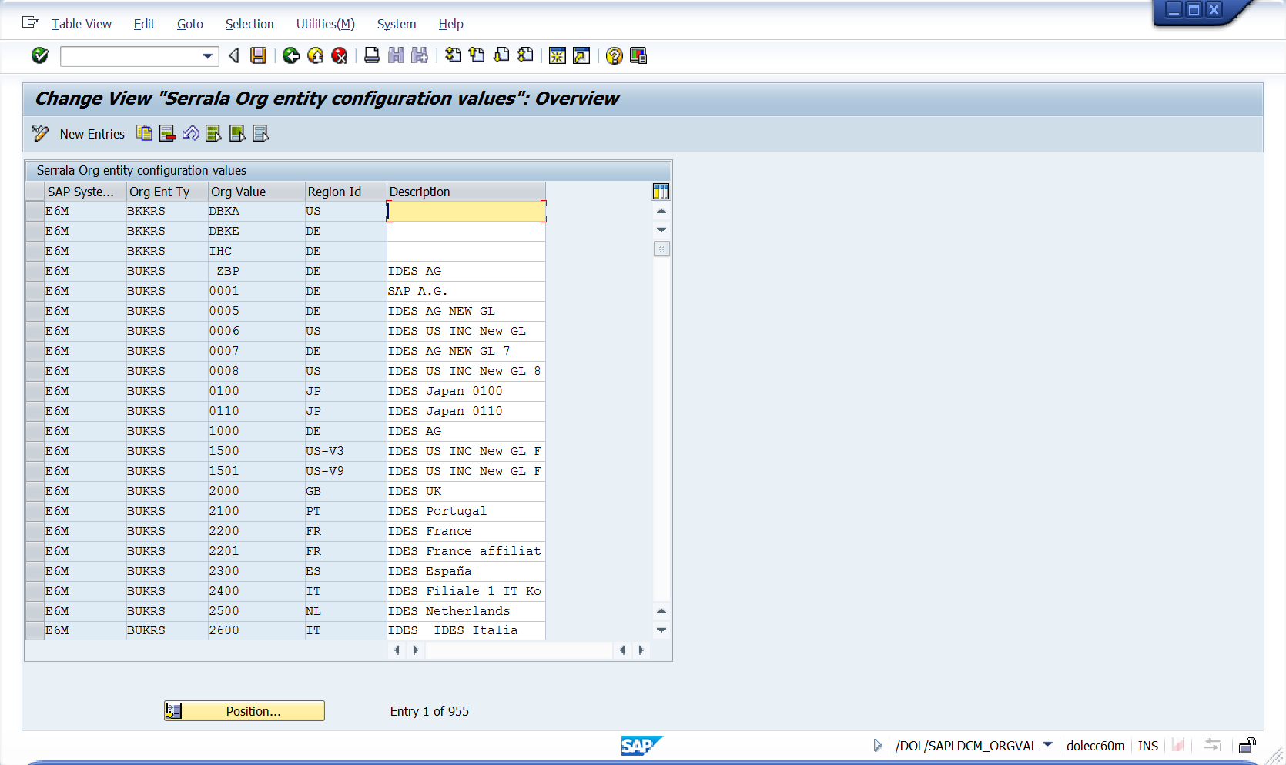
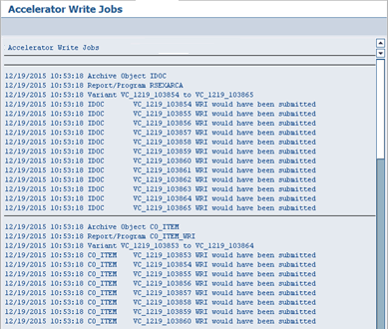
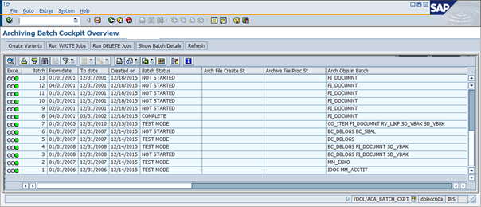
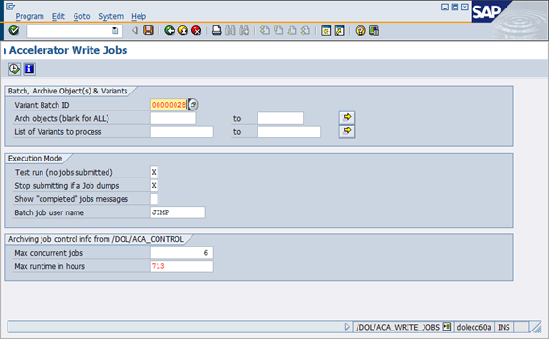
Automated Archiving
Automatically Create Variants
Configure Archive Requirements
Schedule Archive Jobs
Review Archive Results
Notes:
Carving out mass amounts of data manually using standard archiving process traditionally required months and even years to complete. The Dolphin ACA is a software solution that completely automates this process, ensuring there’s a predictable, constant and auditable process and replaces the labor-intensive, error-prone processes providing fast cost saving with reliable results.
The Dolphin ACA Solution will:
Accelerate the removal of targeted data from lowest-level Transactional data, all the way up through the Business Process and including all Segments of Master data.
Provide a simple configurable cockpit designed to accommodate your specific carve out criteria.
Assures that all targeted data across tables and functional areas will be identified and removed.
Flexible selection criteria for archiving and removing data can be based on any field in any table.
Project timeline reduced from years to weeks!

Slide 12
Serverless Content Archive Service
SAP Document Viewer/Browser
ECC, S/4HANA, CRM, SRM
SAP Database
Data & Documents
Storage API
HTTP/HTTPS
Archive Platform
Archive
Documents
Capture/
Recognition
On Premise
Neev Content Archive for SAP is a lean ABAP interface solution that enables any application in your SAP system to use an SAP ArchiveLink connected archive repository for long term storage of structured and unstructured content.

Slide 13
DNO View Options: Functional Single Doc Display
Display generated from a call to the archive PLUS a join to the legacy master data tables
Notes:
#2

Slide 14
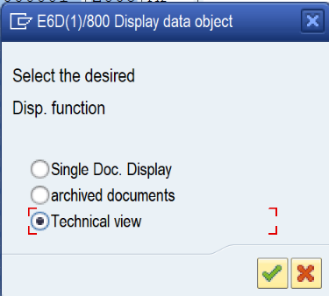
DNO View Options: Technical Single Doc Display
Notes:
#2

Slide 15
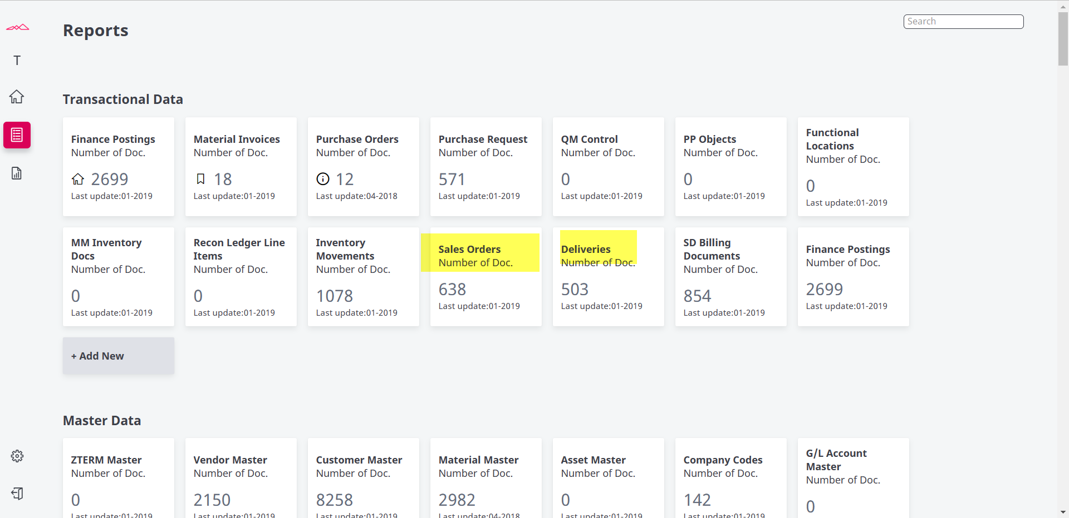
Web-Frontend for Legacy Data Access – non-SAP Look and Feel
Notes:
#3

Slide 16
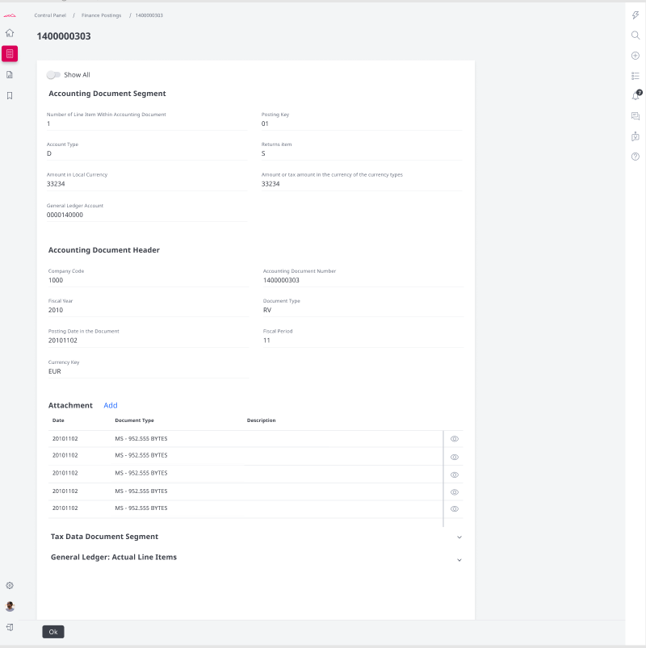
Web-Frontend for Legacy Data Access
Notes:
#3– non-SAP Look and Feel

Slide 17
Architecture Serrala Corestone for SAP – Partial BTP
Firewall
Firewall
User
Application clients
User
SAP Business Technology Platform
SAP® S/4HANA
Customer Subaccount / Tenant
SAP
Identity
API
Corestone Content
Archive
Corestone Content
Search
On-premise
OData
UI5 Applications
https - RFC
SAP Cloud Portal
REST
Secure
Cloud
Connector
Users SAP GUI
Cloud private edition
Corestone Content
Archive Backend
Corestone Content
Search Backend
https
Leading Cloud Object Stores

Slide 18
Insurance Company Moves to New Implementation of SAP S/4HANA
Challenges for the Transition to S/4HANA
SAP ECC system live since 2000
2 TB database with no previous data archiving / DVM
Greenfield SAP S/4HANA implementation ➔ Transfer only open items
Legacy information required for reporting and audits
Data/Document Transition Approach
Transfer open items to SAP S/4HANA
SAP office documents ➔ Archive
All mature “legacy” data ➔ Archive
Store content in lean archive repository
Access legacy data from S/4HANA system
A leading multi-line insurer that serves its customers in global and local markets
Solutions and Services
Extract legacy data and documents
Lean SAP ArchiveLink-compliant archive platform
Flexible user access to legacy data
18

Slide 19
Brownfield : Migrate Your System and Retain Existing Data Structures
System Migration
S/4HANA
ERP
Data volume,
data growth
SAP DB
Migration time window to move to S/4HANA
SAP DB
+
Data access, retention,
data privacy
ADK
ADK
ADK
Extensive costs
(HANA appliance)
Archive
19

Slide 20
Case Study: Dr Pepper Snapple Group Migrates from SAP ECC to HANA (SoH)
Projected HANA Migration Time Was Too Long
System shutdown 3 h
EHP upgrade 18 h
Database migration 48 h
Post migration jobs 12 h
Validation 5 h
1 TB
86 h
24+ TB
11 TB
SAP ECC SAP HANA
Needed to archive 40% of data to reduce migration time and
Increase the space available for secure and fast HANA operation
Run other S/4HANA instances on the same HANA appliance
Objective: Archive data and optimize HANA migration time
< 72 h !
20

Slide 21
Dr Pepper Snapple Group: Successful Migration to HANA Results
24+ TB
40% of data archived
24+ TB
1 TB
8 TB
11 TB
Reduces Volume of Data Migrated
4 TB
8 TB
SAP ECC
SAP HANA
SAP ECC
HANA + Archive
Faster Time to Migration
<48
25
Data Archiving Accelerates Migration to S/4HANA
21

Slide 22
Begin Digital Transformation of Finance
22

Slide 23
Transition Path: How Will Finance Be Impacted by the Move to S/4HANA?
Simplified Data Model
Improved User Experience
New Capabilities & Better Performance
BROWNFIELD
GREENFIELD
NEW Business Partner Concept
How much downtime during transition?
What information should I archive or purge to minimize legal risk when I move?
Change management
NEW Business Partner Concept
CHANGE Legal Entity Structure
CHANGE Chart of Accounts
Which data & documents do I move to support audits and other requests?
When should I move my data?
Change management
Notes:
ROB
SAP has made considerable technical and structural improvements in S/4HANA (the Digital Core) over prior systems. Not only does HANA’s in-memory architecture deliver instantaneous responsiveness, but it has also enabled SAP to restructure the ERP solution from the ground up. S/4HANA’s simplified data structures reduce duplication and redundant tables, and create a “single source of truth” for reporting that reduces the likelihood of errors.
Moving to S/4HANA is a complex process that will be led by the IT department. Greenfield and Brownfield are the most common strategies use to move. Each strategy has a different impact on Finance.
https://blogs.sap.com/2018/12/18/conversion-to-sap-s4hana-insights-into-finance-data-migration/
Several flavors in between greenfield and brownfield such as bluefield, selective brownfield …
Smaller companies are moving brownfield now, but it's still about 50:50. Age of the SAP system influences your decision, a lot of companies who do greenfield, their needs have changed as far as enterprise structure... Second chace
Updating it in place to new hardware – an upgrade vs. Reimplementation.
SI – 70% were still on ECC – there's a tsunami of companies that haven't made the switch. They're still in the planning stages.
Greenfield
PROS
Get the benefit of all S/4 has to offer​ Big Data, Simplified process, and Mobile integration​
Wipe the slate clean​ aim for best practice​
CONS
Time-consuming​
Requires significant buy-in from both business sponsors and end-users​
Existing regression test assets no longer applicable rebuilt from scratch​
Brownfield
PROS
Protects investments made in existing system​ includes all config and custom development​
End-users see little to no disruption​
Step-by-step approach toward S/4 allows to proceed at own pace​
CONS
Upgrade to at least EhP 7​
Convert to Unicode​
If data quality is poor this approach will be more time-consuming​

Slide 24
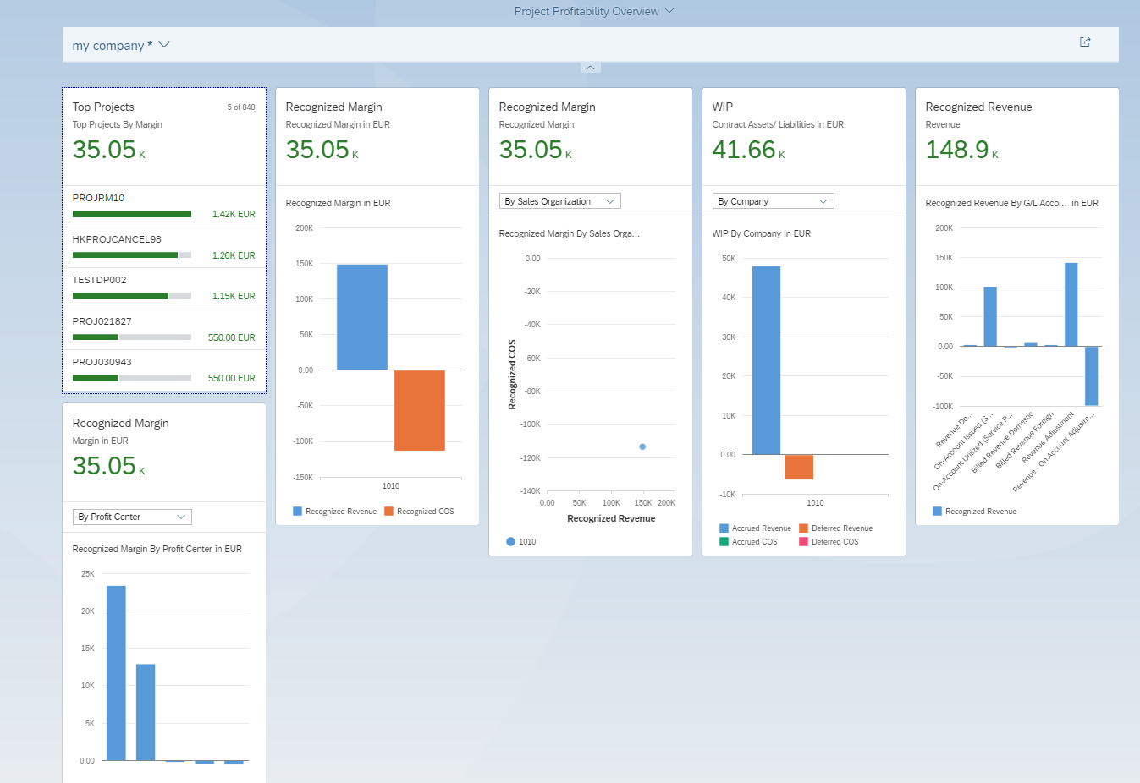
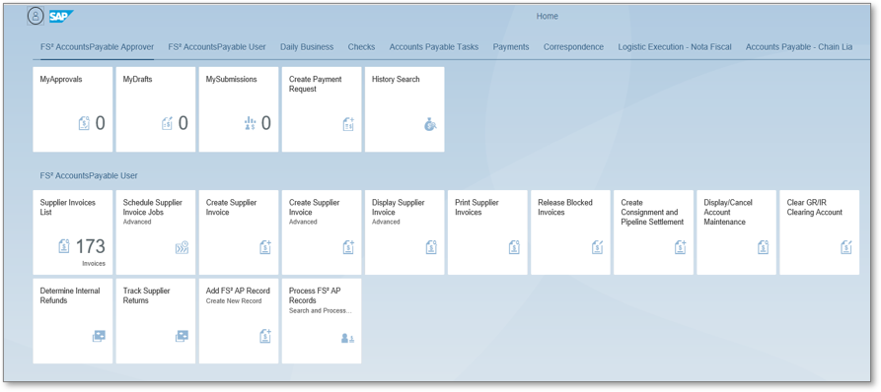
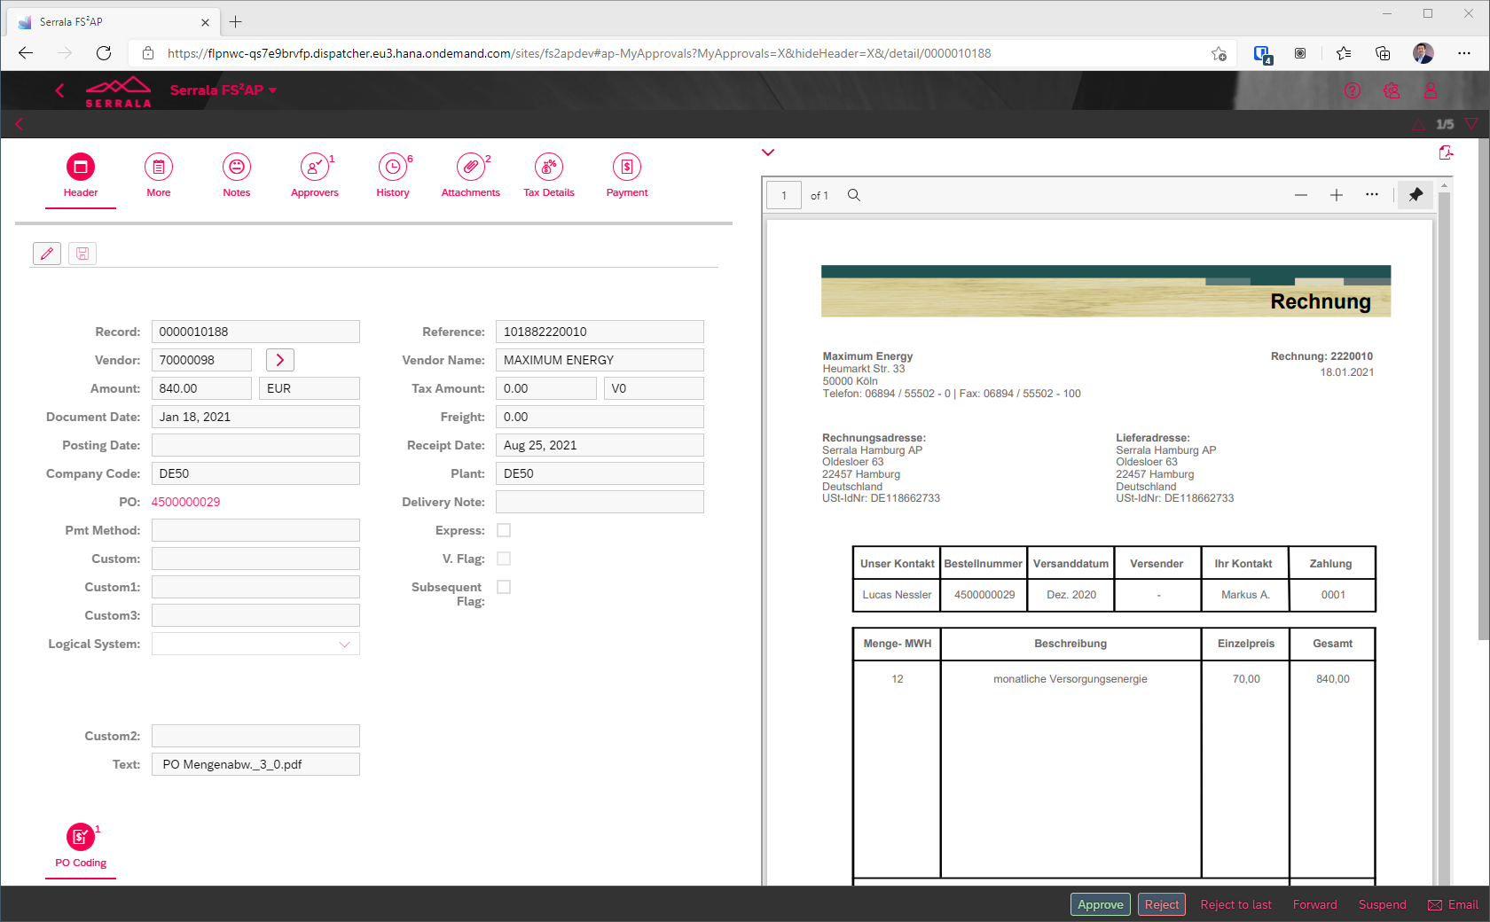
Capabilities: What New Features and Functionality are Available in S/4HANA?
Simplified Data Model
Improved User Experience
New Capabilities & Better Performance
FIORI tiles
Web/Mobile
Analytics
Cloud Apps
Notes:
Rob
Fiori tiles/User Experience
Web/Mobile enabled applications
Advanced Analytics
Cloud components (BTP)
Simplified Data Model
Universal Ledger
Business Partners

Slide 25
Digital Transformation: What Opportunities Exist for Finance in S/4HANA?
Eliminate Legacy Customizations
Standardize Processes
Automate Routine Taks
Standardize Integrations
New Cloud Services
Web & Mobile Ready
Generative AI & Machine Learning
Advanced Analytics
Notes:
Michael
SAC SAP analytics cloud – those capabilities only available with S/4 we could use the SAC cloud for reporting
Standardize processes globally
Modernize
Eliminate legacy customizations
Increase automation (AI /ML)
Improve third-party integrations (Procurement, Banks, Credit Rating Agencies)
Add new cloud services / capabilities
Improve user experience with Web/Mobile-enabled processes (e.g., Fiori)
Gain better insights with reporting & analytics

Slide 26
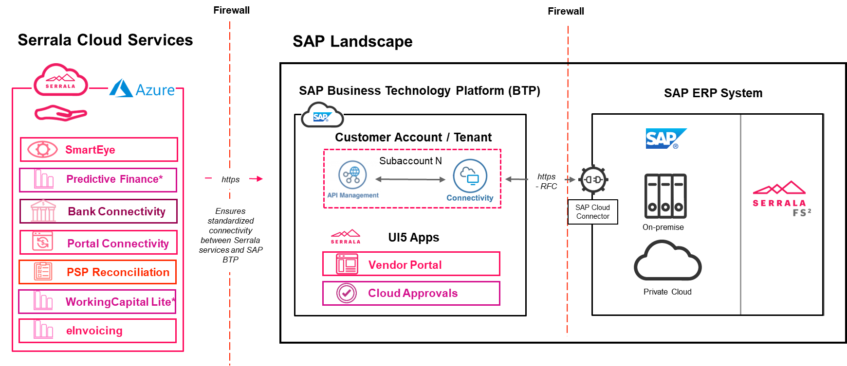
Extend SAP S/4HANA with BTP Enabled Apps & Services
SAP
SAP ECC or S/4HANA
Notes:
The Advanced Approvals app is available in the SAP BTP and works seamlessly with existing on-premise SAP ECC and S/4HANA systems
Delivers new capabilities and connectivity to users in days, not weeks
Agility in design affords choice for user
Cost effective process improvement
More info on connectivity is at: Serrala_Cloud_Add_Ons_SAP_Integration_Scenarios.pptx
AFS2 Platform on Azure is:
SOC certified
SSAE 16 / ISAE 3402
ISO 27001, 27017/27018, PCI-DSS, SOC 1-3.
This scenario is for clients that would only need to use Serrala hosted BTP service to for middleware purposes (Only SmartEye)
Serrala US has an BTP account specifically for clients that use only connectivity
Pricing is covered by ‚SAP Business Technology Platform – SmartEye Connectivity Only‘ – no other price book items needed

Slide 27
Timing: When Should Finance Look at Implementing Improvements for S/4HANA?
BEFORE you Move
WHILE or AFTER you Move
Improve process efficiencies and realize savings right now
Free up your internal resources to focus fully on the conversion project
Benefit from optimized processes from day one on SAP S/4HANA
Need to modernize your existing add in or bolt on, solutions in order to make the move
Easy to align with other business units on joint process improvements
Document your process improvements only once
Notes:
Michael
Finance cannot stop and data is always changing so you’ll need a solid migration strategy
Work with a partner who understands the complexity of SAP S/4HANA and your business processes
Serrala Recommends:
set up and test application first, then move the data (greenfield), if you're doing a brownfield you're migrating your data to a new HANA db. Suite on HANA = ECC running on a HANA db. That makes it easier because you don't have to migrate.
Consider archiving to make move easier. BONUS – archiving also reduces risk and improves compliance!
SETUP Setting up server, doing some smoke testing of application,
MOVING Data – which continues to move the data – goes faster because you have less to move – more compliant, reduces the cost of the appliance you need to install. The size of your cloud solution. Cost of HANA was much higher than ECC, but now the cost is reducing. Compliance is the argument for archiving, vs
BEFORE MOVE
ZOETIS
...
AFTER MOVING TO S/4HANA
Burberry
City of Edmonton

Slide 28
Zoetis Automates AR Processing BEFORE Moving to S/4HANA
Needs
Results
Transform order-to-cash process to support a new direct to consumer model
Standardize processing across different markets
Increase flexibility to establish shared services centers
Ensure processes are ready for SAP S/4HANA
+90% automated cash application in only 3 months
Additional 20% revenue auto-applied
Business defines rules to improve automation without IT support
Simplified processing of large remittances with thousands of lines
Staff has time to handle new business
Notes:
Michael

Slide 29
Zurich North America Digitizes Claims WHILE Moving to S/4HANA
Needs
Results
Automate processing of Non-PO invoices and expenses
Enable touchless payment processing for seven unique processes
Enable field claims agents to approve invoices or send for additional processing
Enable visibility into invoices across shared services locations
Reduced cost of processing invoices
Increased accuracy of financial reporting and reconciliations
Almost eliminated out-of-balance errors saving time and effort re-processing
Added ACH payments to the claims process in only 6 weeks
Easy to train field agents
Notes:
ROB
Zurich North America – FS2 AccountsPayable
CFO Playbook and US User Summit 2020
Business Need
Move off of existing P2P solution to automate processing of Non-PO invoices and expenses
Enable touchless payment processing for seven unique processes
Make it easy for field claims agents to approve invoices or send for additional processing
Enable visibility into invoices across shared services locations in the US, India, and Eastern Europe
Results
Reduced costs due to less time spend processing invoices and less paper
Accuracy of financial reporting and reconciliations has increased
Almost eliminated out of balance errors between SAP and EZAccess, saving hours investigating, correcting and re-processing
Easy to use solution was rolled out during coronavirus crisis in Spring 2020. It was easy to train and bring agents up to speed remotely.

Slide 30
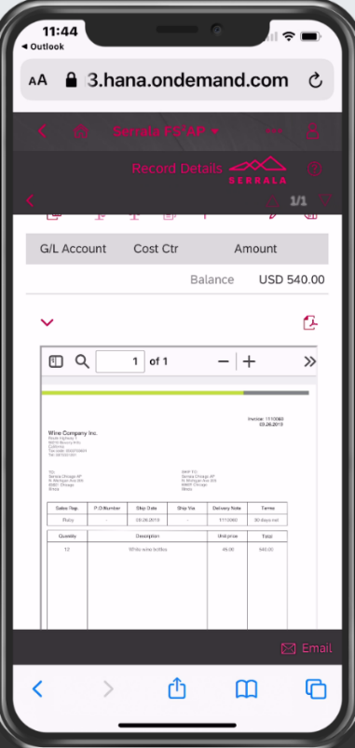
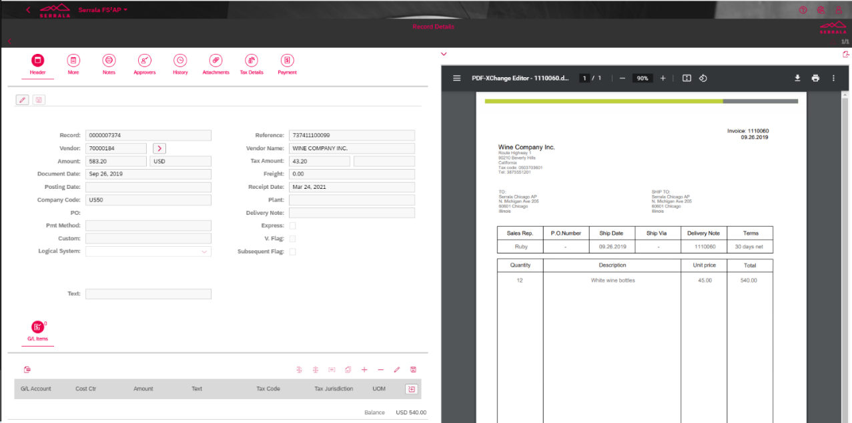
Search for Invoice/Claims Payment by Status Code and Drill to View Details
Multiple Search Filters
Mobile Access
Drill to Details and View Attached/ Archived Documents
Notes:
DAN
Switch to new procurement solution provided new capabilities, but created processing gaps for Payment Requests, which were filled using the SAP-embedded solution from Serrala, FS2 Accounts Payable. It allowed us to have more flexible approvals, based on the authorizations levels that were already defined in SAP.
Manager Approvals based on existing hierarchy or ad hoc approvals
Standard authorization based on job reward level for hierarchy
Ad hoc approval hierarchy based on authorization to Ledger accounts

Slide 31
Wrap Up
31

Slide 32
How to Remove Roadblocks on Road to S/4HANA and Maximize Value
Clean-up, archive data that will not be loaded into the new systems
Understand your path to HANA to determine data migration and storage needs
Eliminate customizations and standardize finance processes globally
Increase automation with SAP-certified add-on solutions that can be managed by the business without IT assistance
Ensure a clean core by extending S/4HANA with standardize connectivity though SAP BTP
Work with knowledgeable solution partners – S/4HANA is more than an IT project, it will impact your business processes too!
Notes:
Michael

Slide 33
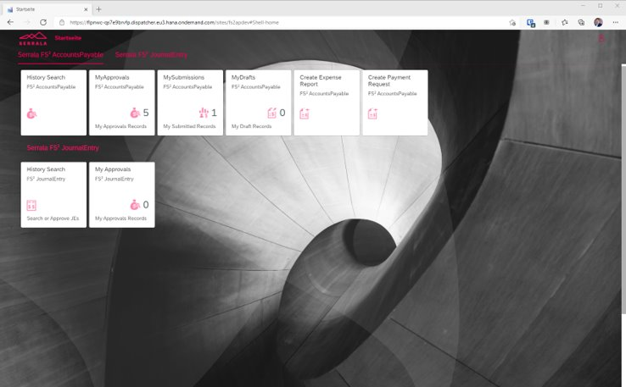
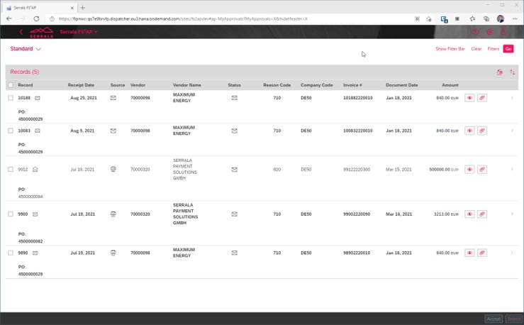
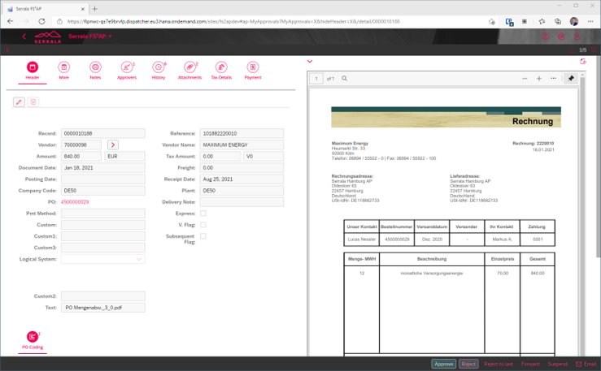
Why S/4HANA & Serrala
Business Needs
Serrala focuses on optimizing SAP
Serrala provides real global and scalable business applications
ERP & Process Standardization
S/4HANA move is fully supported
Serrala applications support global standardization
Transition to Cloud
Multiple cloud services can seamlessly be integrated
Hybrid approach is supported to accommodate customer needs
Digitization & Innovation
Serrala provides innovative solutions
Benchmarking with the best
33

Slide 34
Questions?
Rob Jackson
Principal Solution Architect Serrala
Rob.jackson@serrala.com
https://www.linkedin.com/in/jacksor2/
Vishal Awasthi
CEO and Founder, Neev Data
vishal@neevdata.com
https://www.linkedin.com/in/vishala/
www.serrala.com
www.neevdata.com

