Slide 1
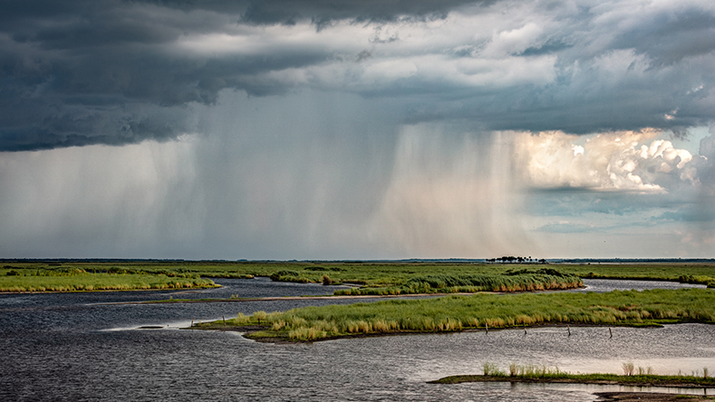
Is Recession Coming?
Presented by
Dr. John Min Chief Economist, Monex USA
August 10, 2023

Slide 2
Introduction
Your Partner for Global Payments
& Risk Management
2023

Slide 3
Key Global Group Figures
Numbers Stacked in Your Favor
38+
YEARS
$11.1
BILLION
$303
BILLION
7.6
MILLION
2.8+
THOUSAND
38+ Years of Collective Expertise
$11.1B in Total Global Assets
$303 Billion FX Turnover
7.6M FX Transactions
2,800+ FX Experts
Monex USA is headquartered in Washington, DC, since 1999; The global Monex financial group was founded in 1985
Sound financial foundation to support all your global operations.
Global market buying power leveraged to provide leading competitive exchange rates group-wide.
Efficient, secure, and intuitive payment processing around the world.
Personalized, dedicated service across a broad range of industries, global reach with local expertise.

Slide 4
Global Presence, Local Expertise
Cross-Border Solutions Made Simple
North-America
Europe
Asia
Local presence in Canada, Mexico, and United States; Washington, DC, NY & LA
Local presence in the UK, Spain, Luxembourg, and the Netherlands
Local presence in Singapore

Slide 5
Trusted Around the World
Keeping Your Funds, Beneficiaries, and Business Safe
Licensed Nationwide
All your transactions are securely and seamlessly sent from one of the first Money Service Businesses (MSB) to be completely registered, licensed, and bonded in every U.S. state. We are committed to strict adherence with all applicable regulations and codes.
Bonded & Insured
Your funds are fully protected under our extensive insurance and surety bond coverage through Liberty Mutual and The Hartford. We are Registered with Dun and Bradstreet:
D-U-N-S #09-524-0136
Dedicated Compliance
In addition to your internal safeguards, you receive an added layer of protection with our team of Anti-Money Laundering (AML) compliance and legal professionals, dedicated to keeping your business and money safe.

Slide 6
Trusted by Leading Financial Media
Most Quoted Global Payments Company

Slide 7
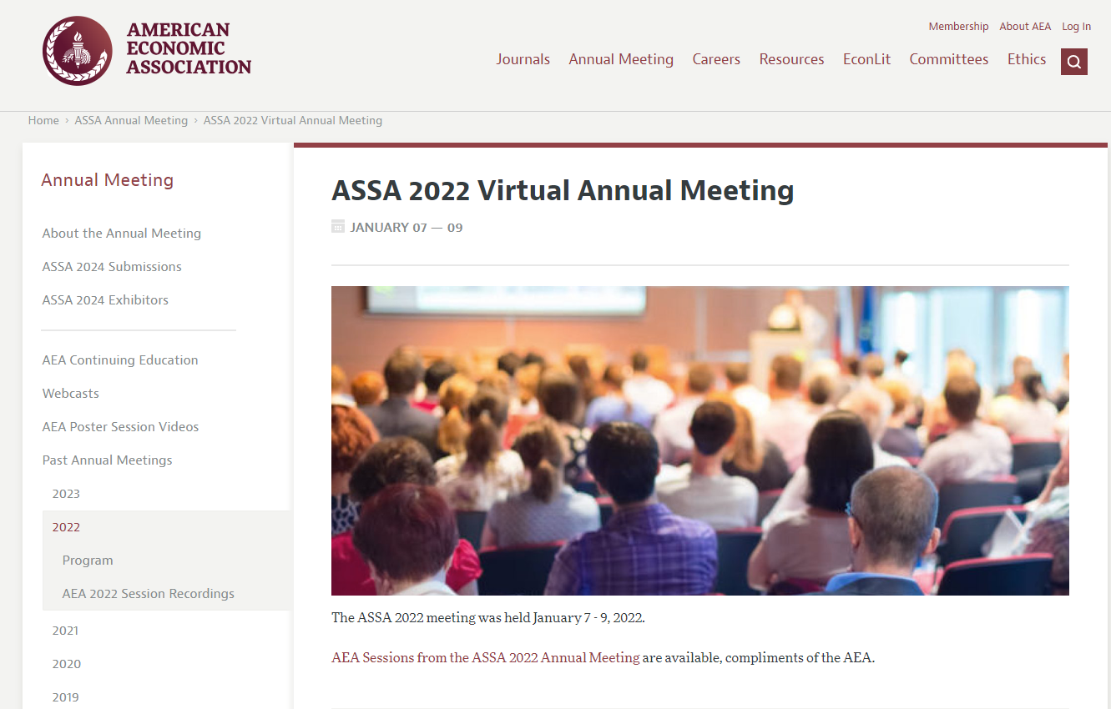
Market Wizards

Slide 8
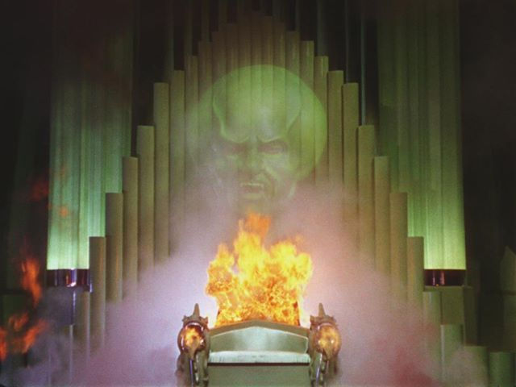
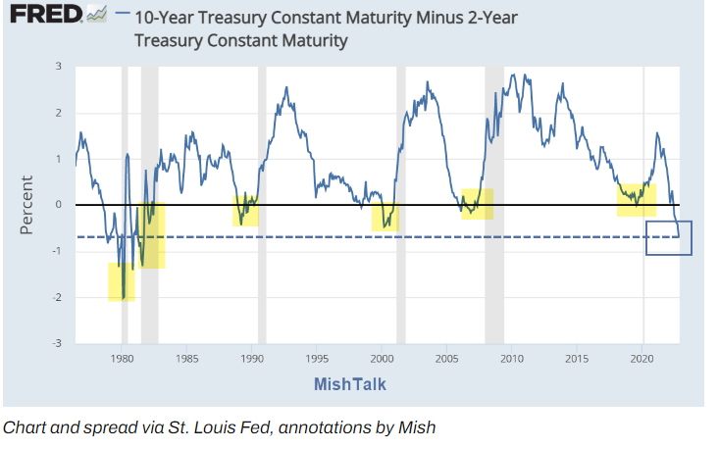
Recession!

Slide 9
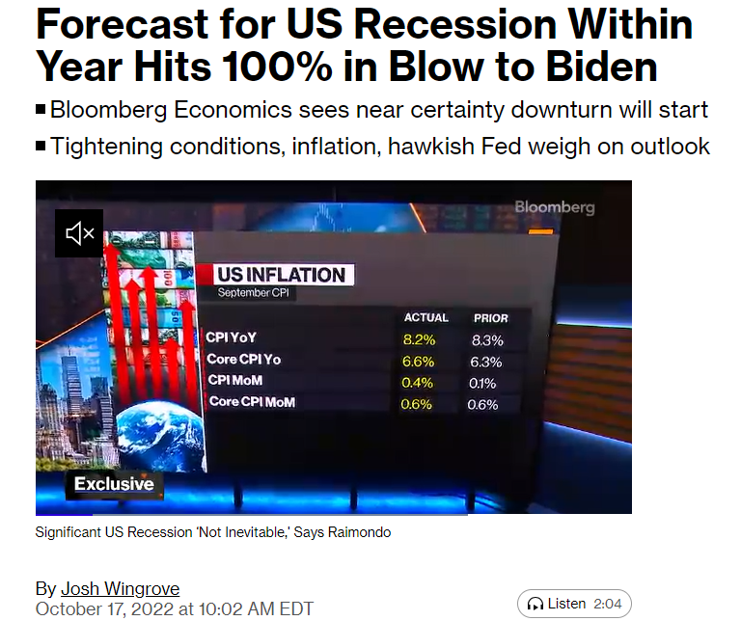
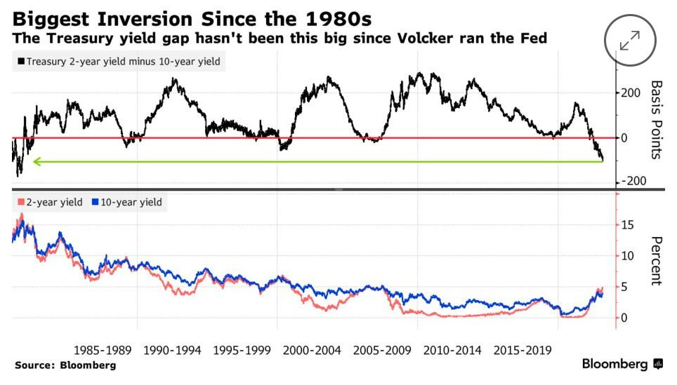
Recession!

Slide 10
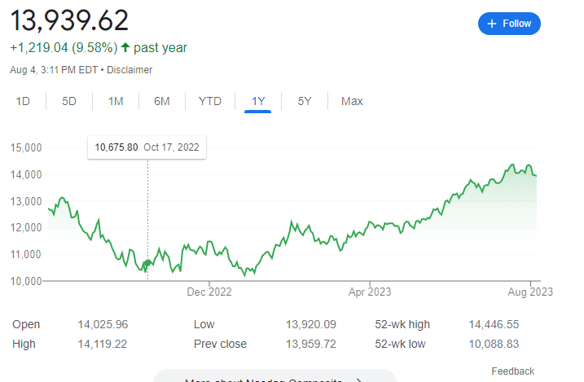
Not Prescient

Slide 11
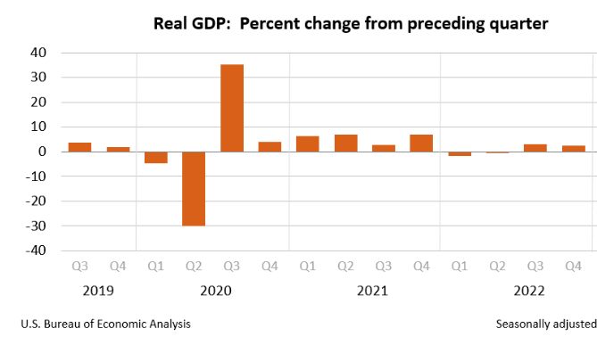
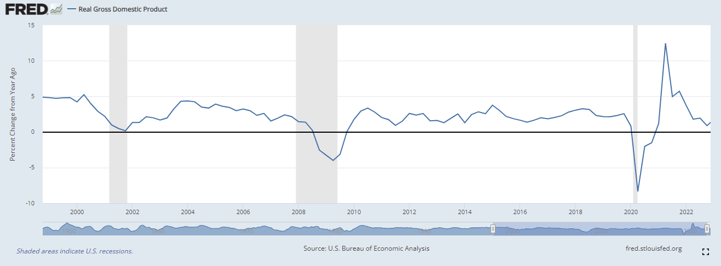
What Recession?

Slide 12
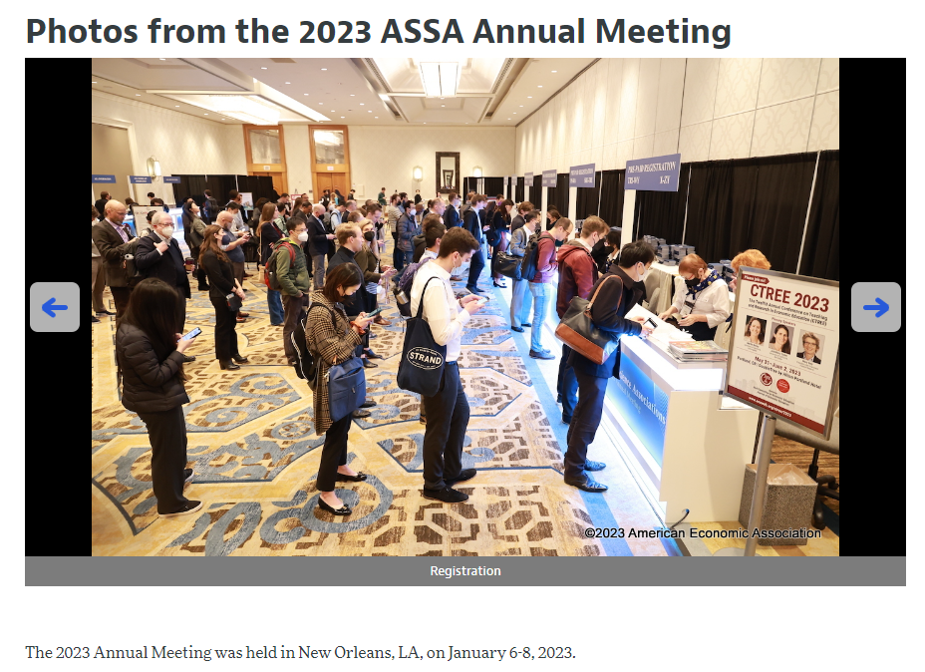
Hogwarts

Slide 13
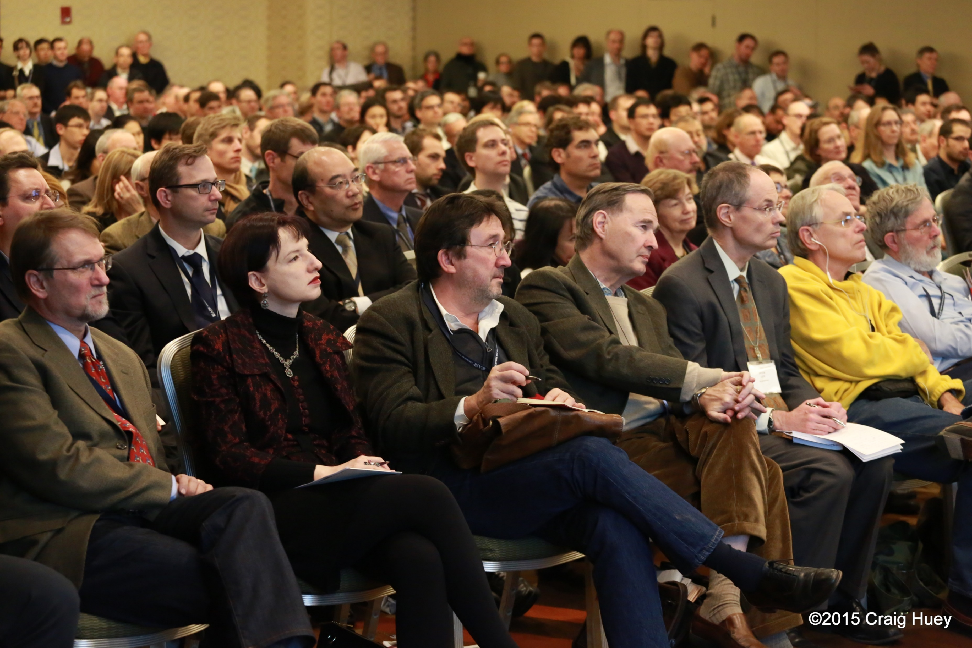
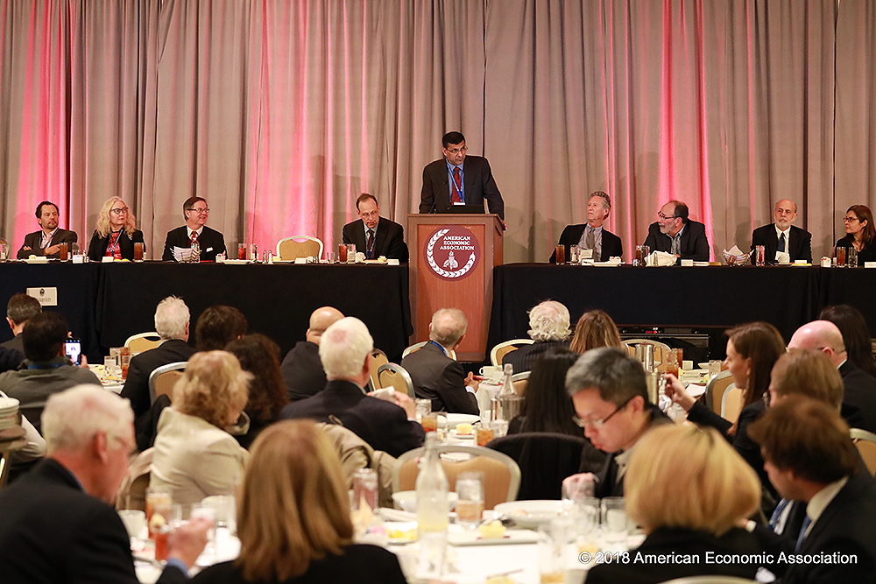
Postmortem

Slide 14
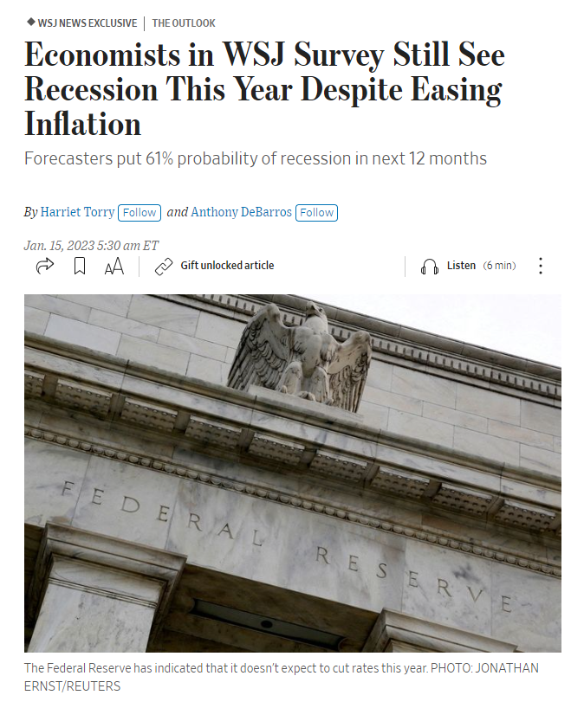
Market Wizards

Slide 15
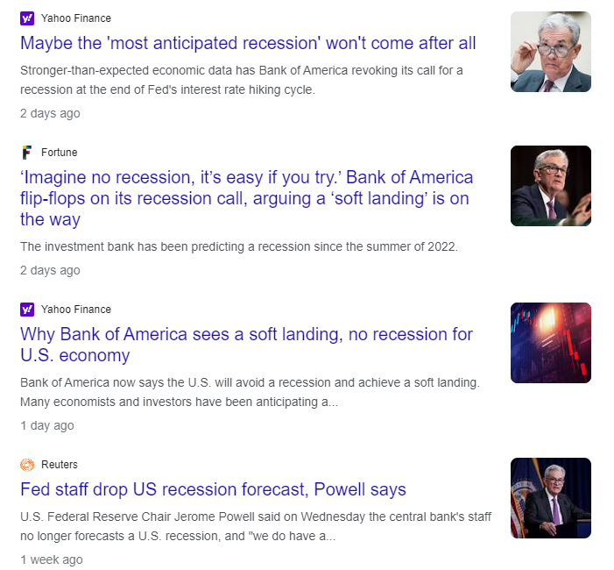
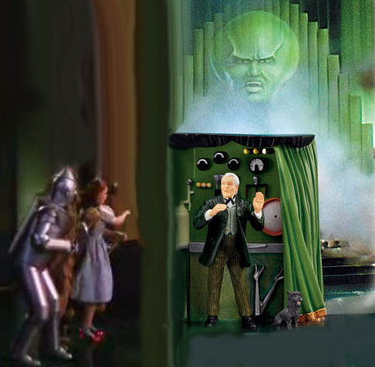
Did It Again!

Slide 17
No Free-Lunch

Slide 18
Fuel

Slide 19
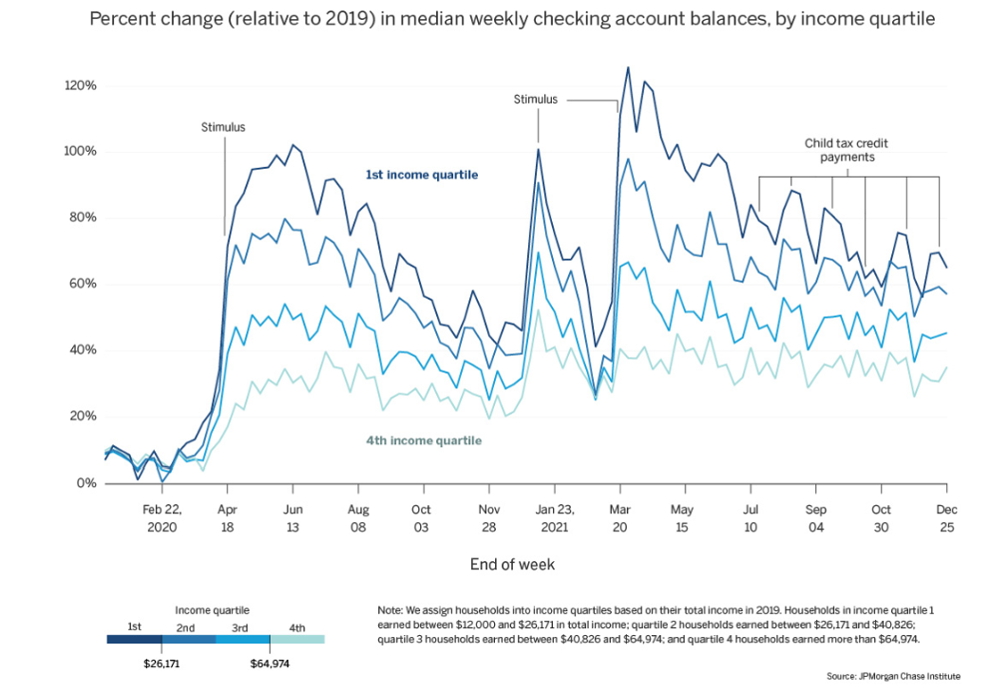
Balances

Slide 20
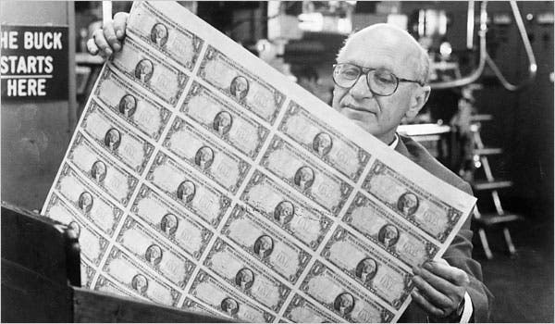
Money Supply

Slide 21
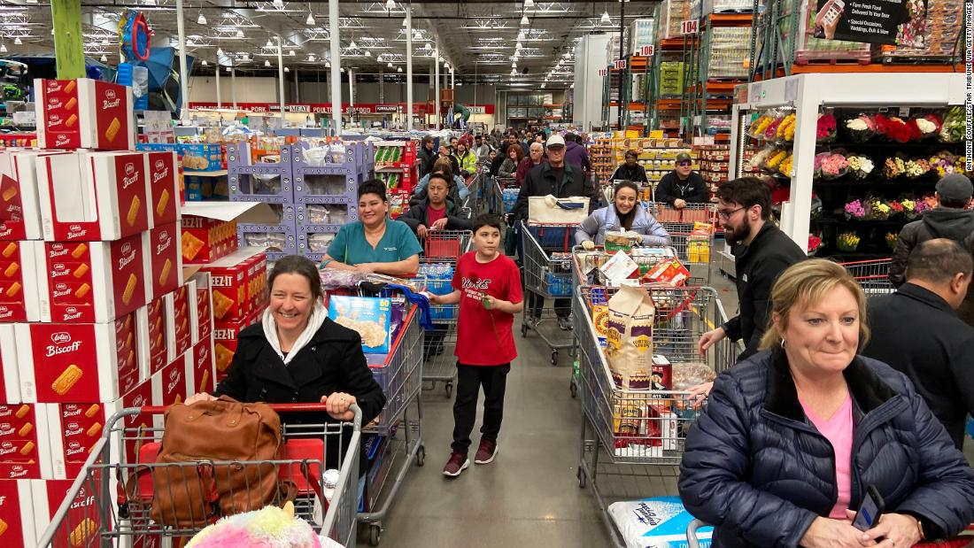
Shock

Slide 22
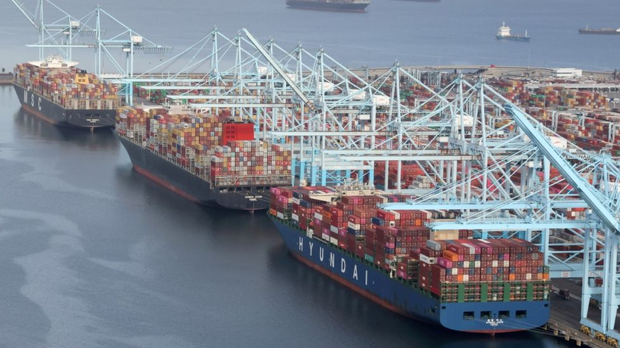
Stress

Slide 23
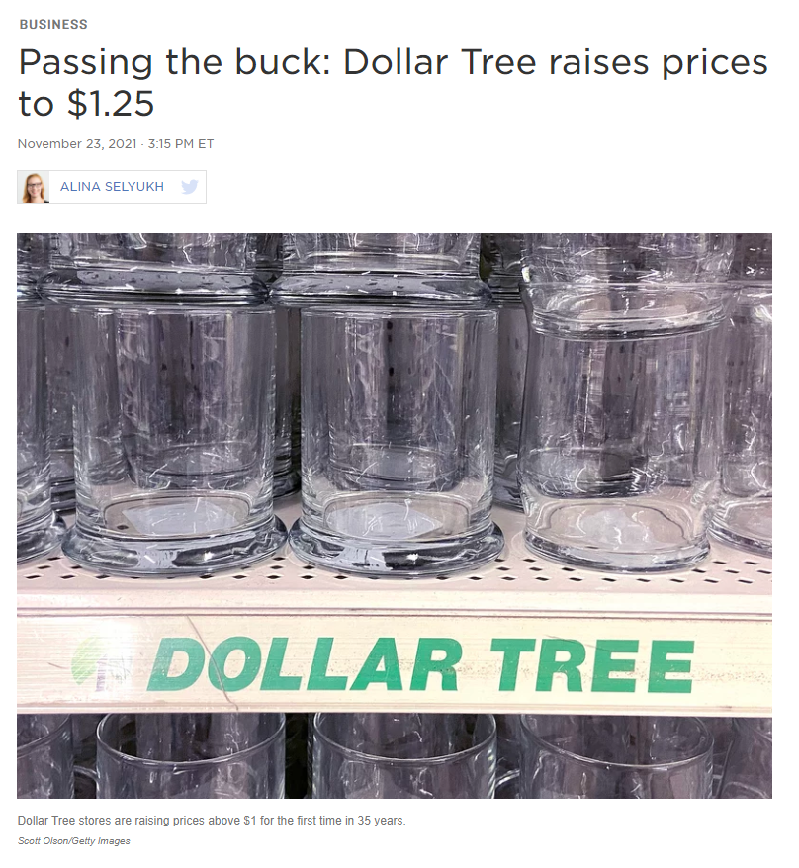

Slide 24
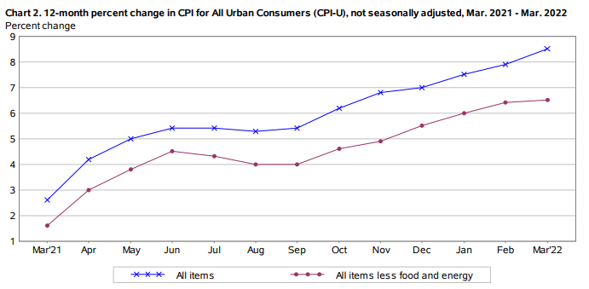
Inflation

Slide 25
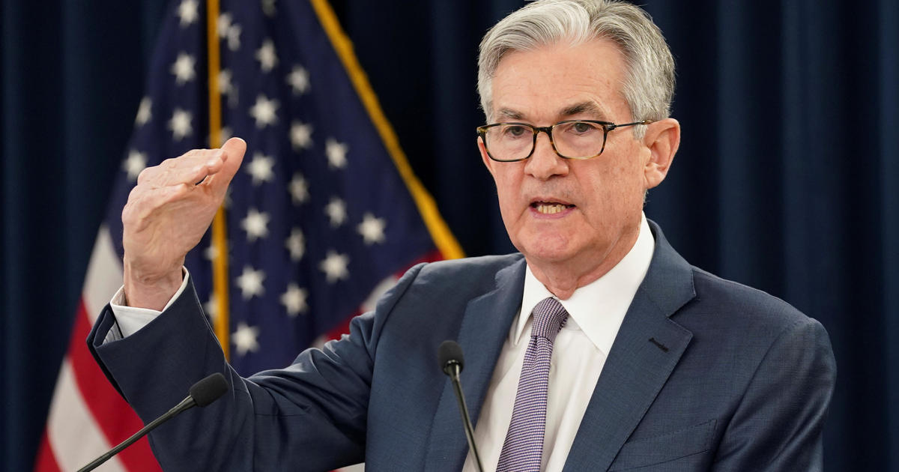
Transitory

Slide 26
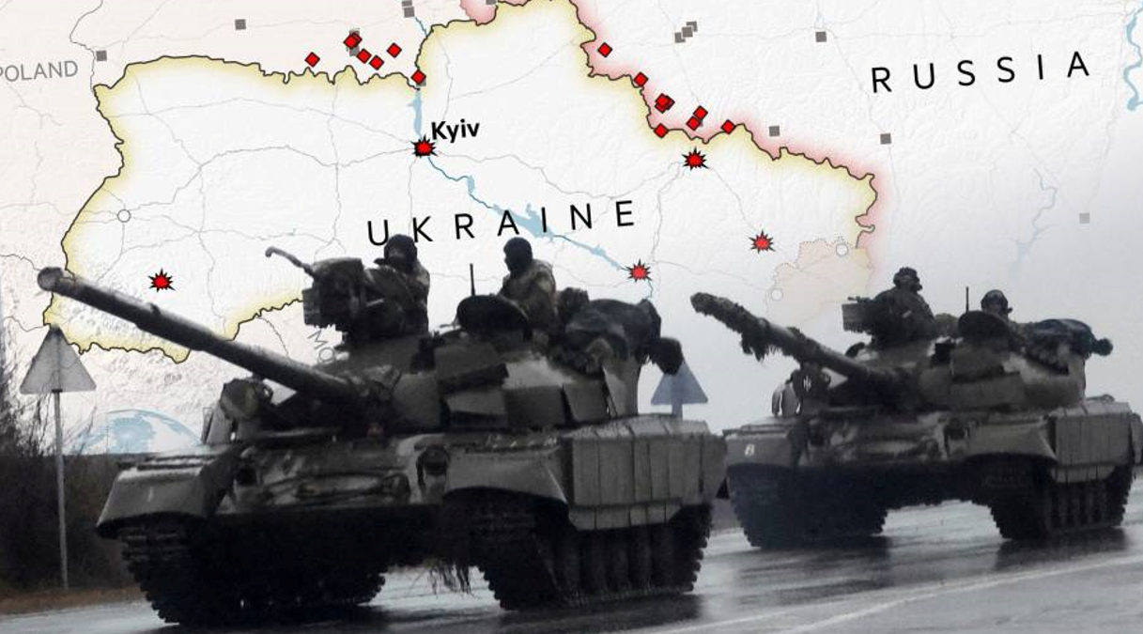
Conflict

Slide 27
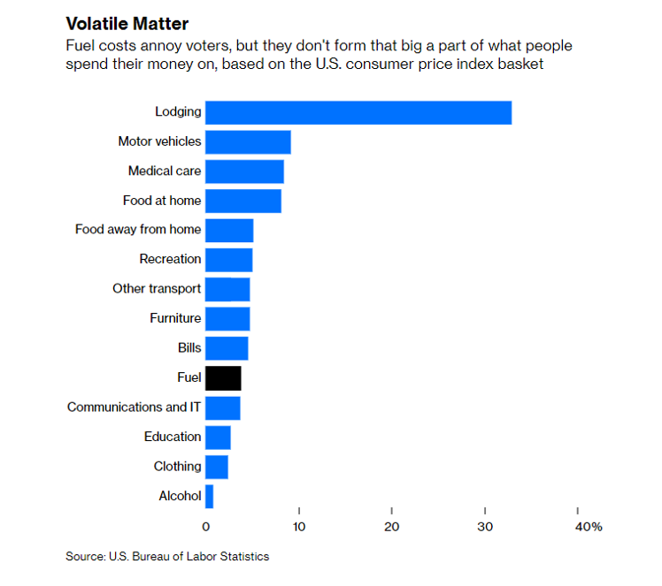
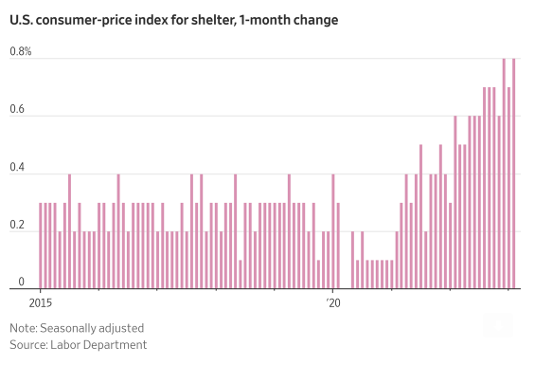
Spillover

Slide 28
Labor

Slide 29
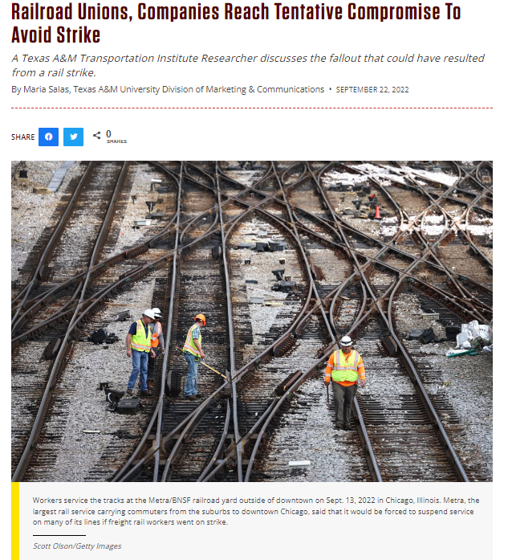
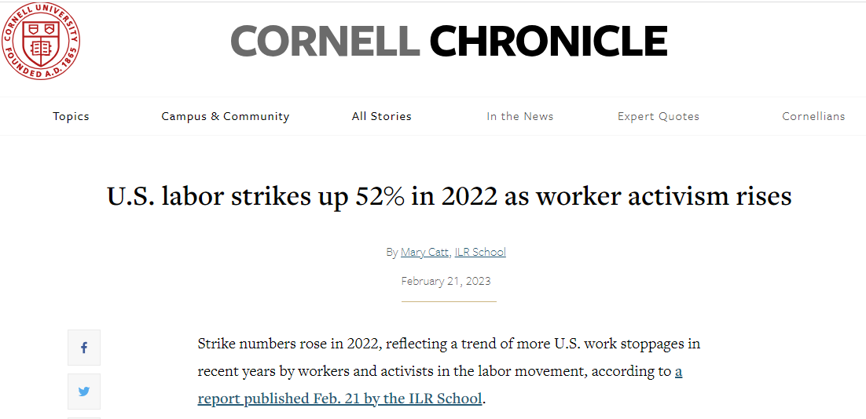
Wage

Slide 30
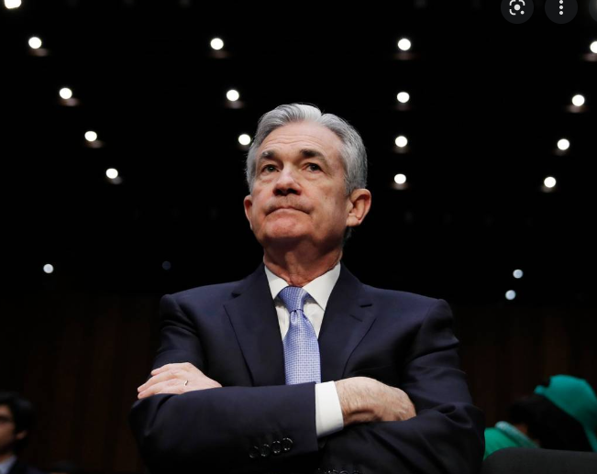
Resolve

Slide 31
Fed Funds

Slide 32
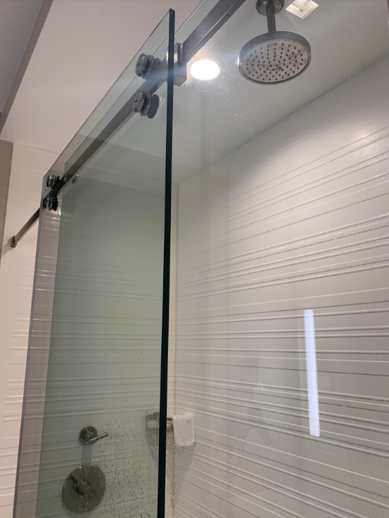
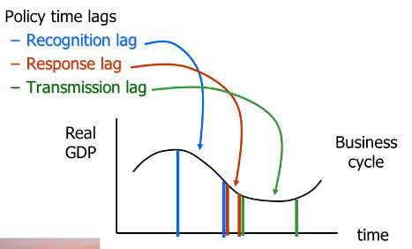
Lags

Slide 33
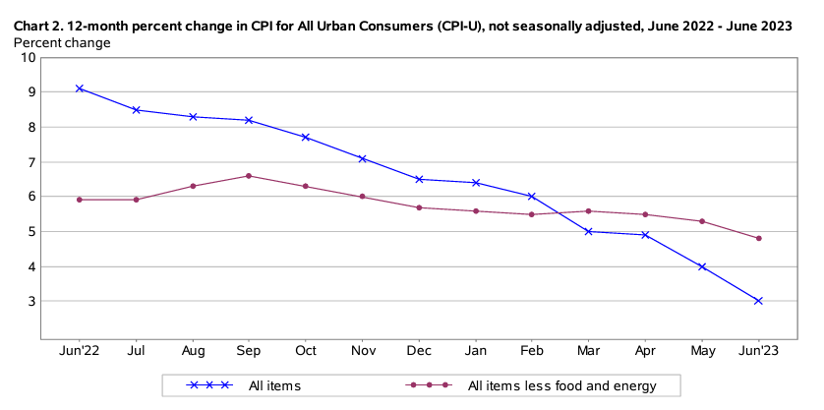
Inflation

Slide 34
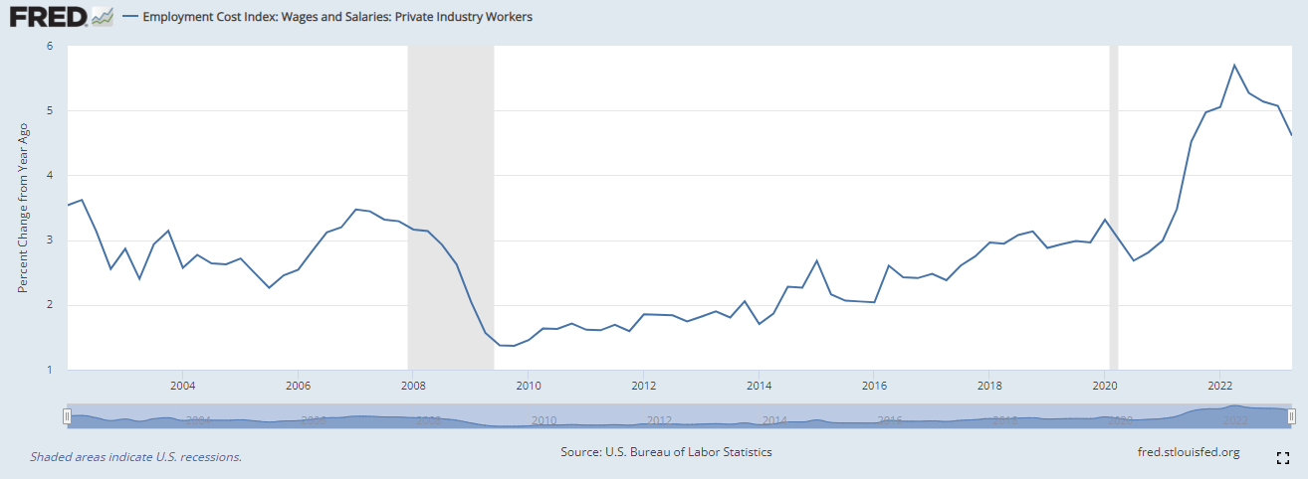
Wages

Slide 35
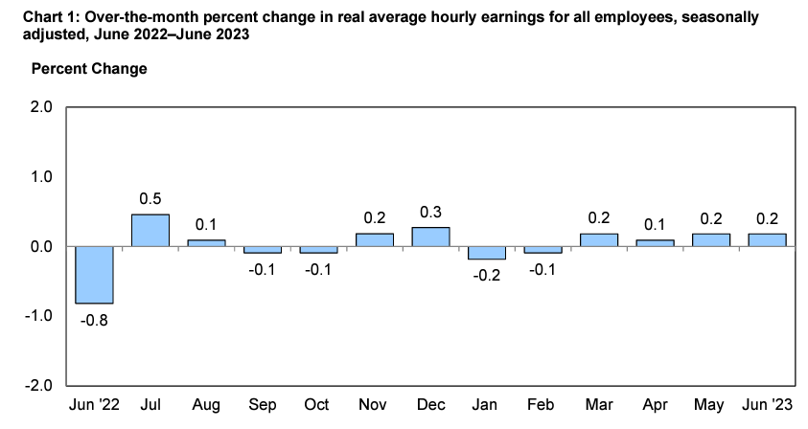
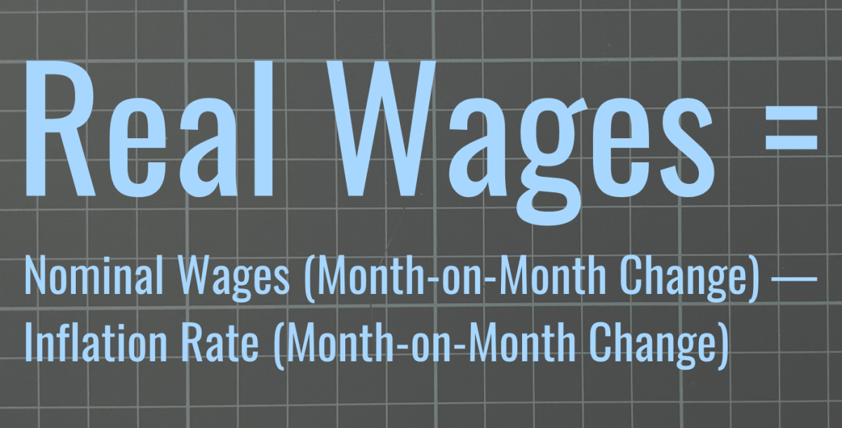
Driver

Slide 36
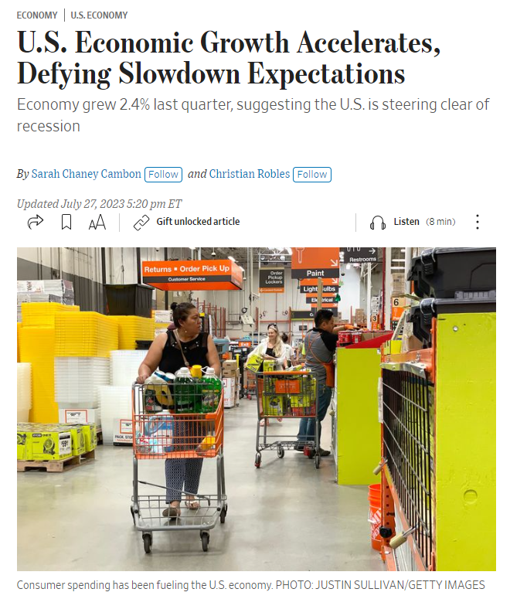
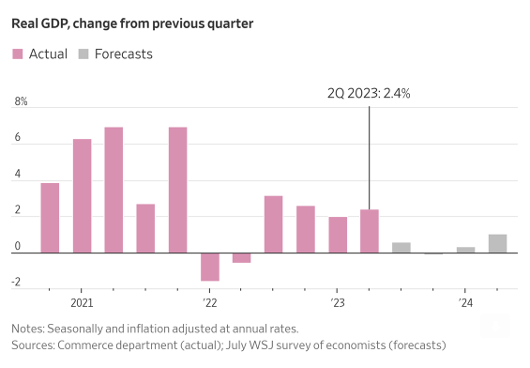
Growth

Slide 37
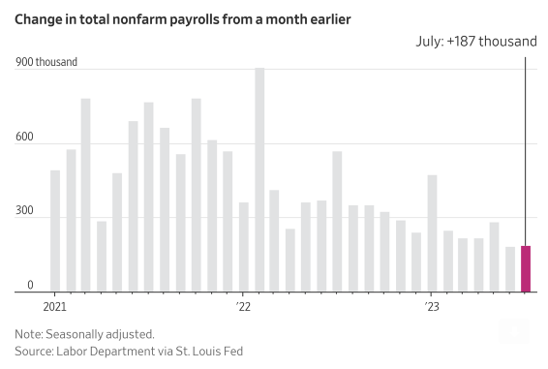
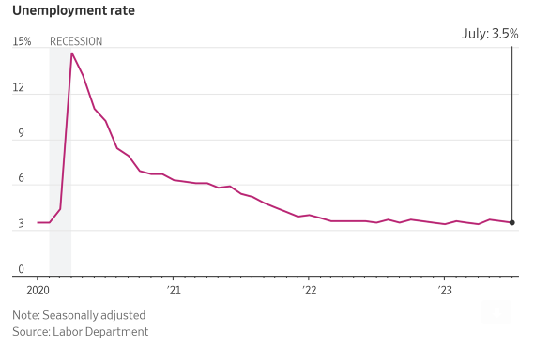
Employment

Slide 38
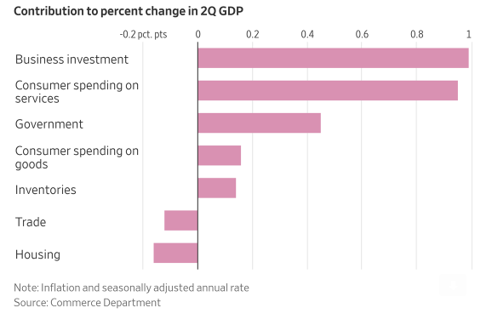
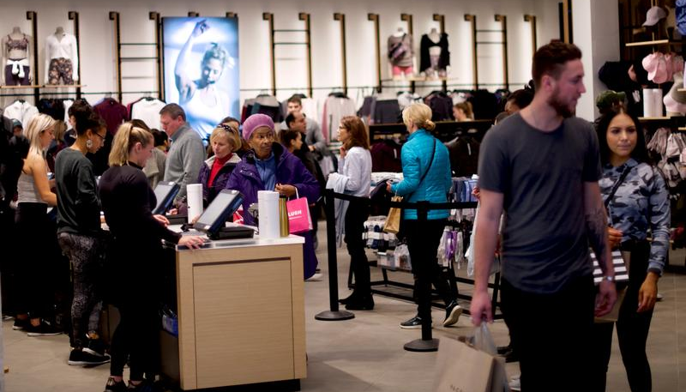
Circular Flow

Slide 39
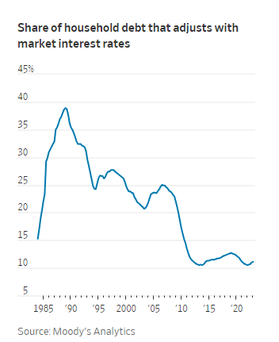
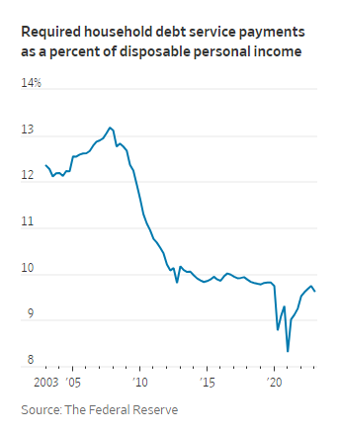
What Hikes?

Slide 40
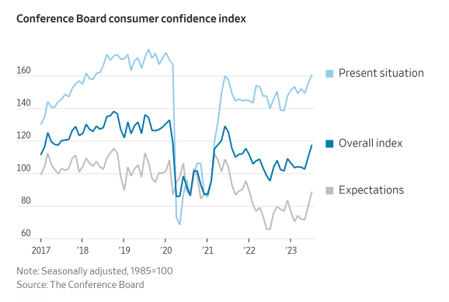
Confidence

Slide 41
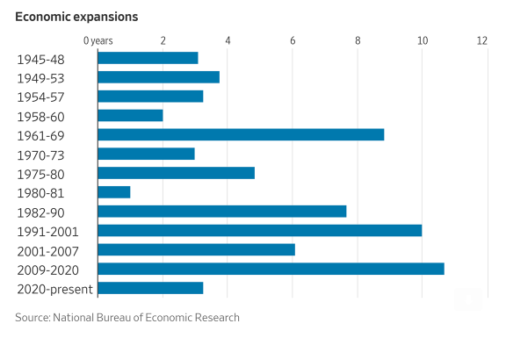
Expansion

Slide 42
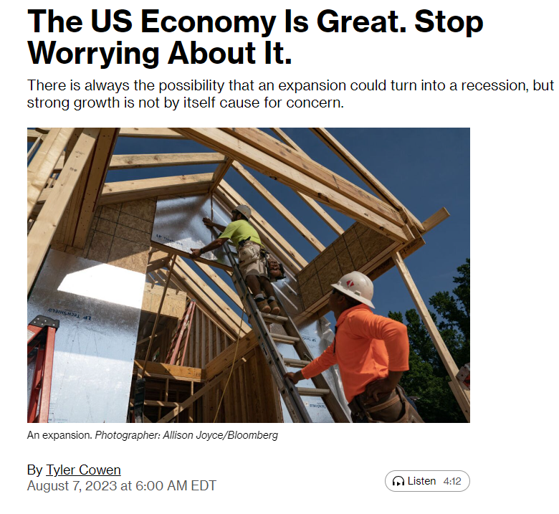
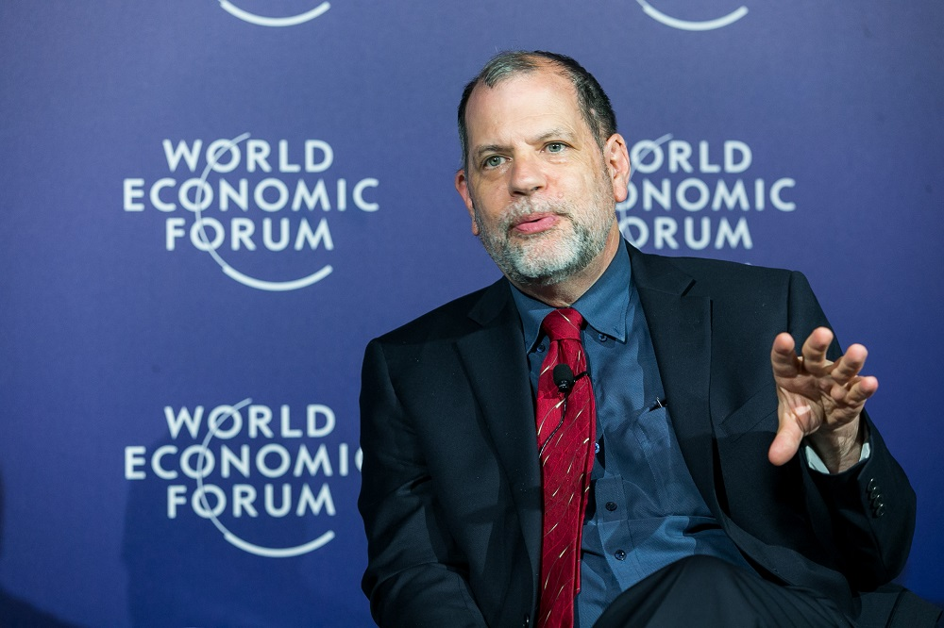
Good Place

Slide 43
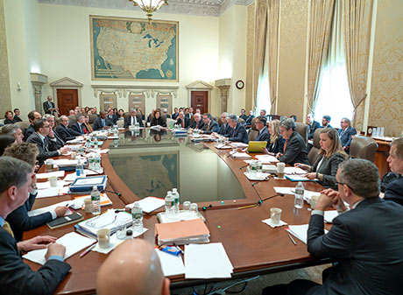
But Worrisome

Slide 44
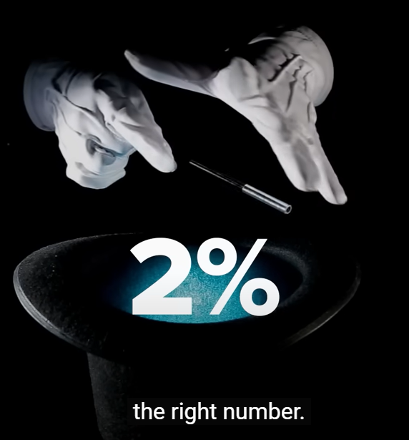
Inflation Target

Slide 45
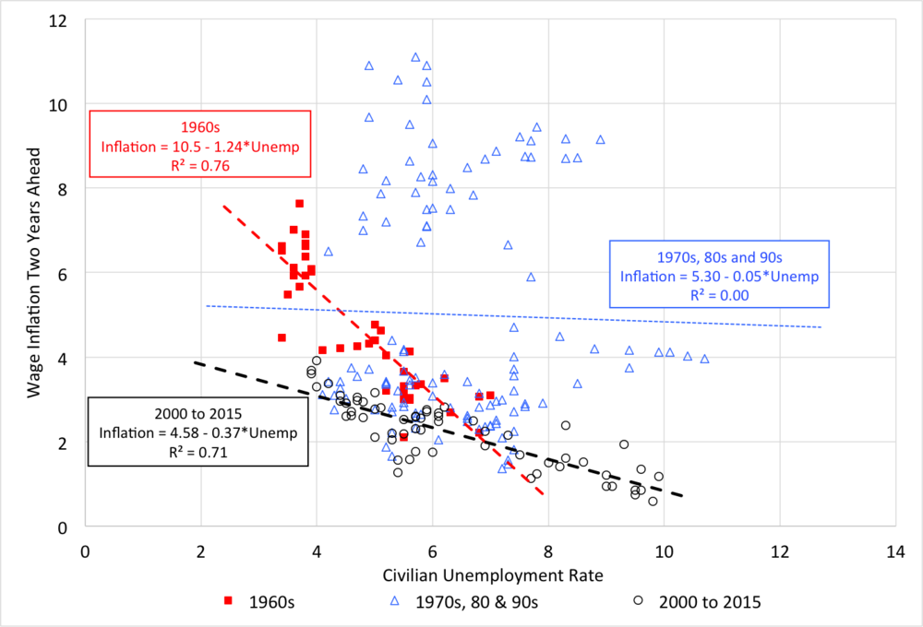
Okun

Slide 46
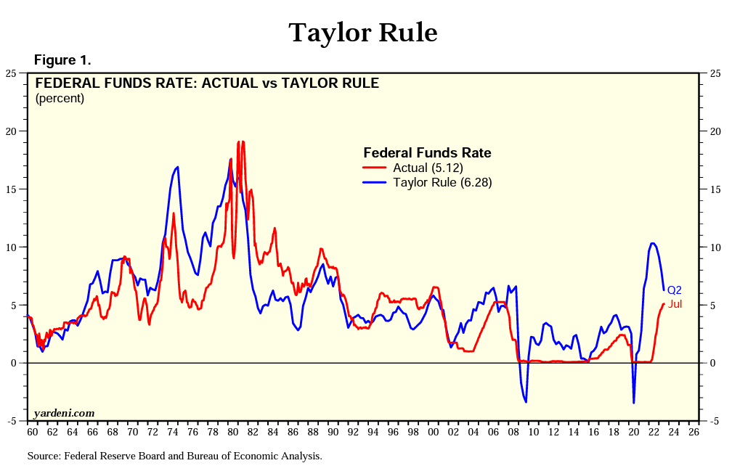
Next Move?

Slide 47
Next Move?

Slide 48
Data Dependent

Slide 49
Meanwhile…

Slide 50
Canaries

Slide 51
Savings

Slide 52
Canaries

Slide 53
Canaries

Slide 54
Manufacturing

Slide 55
Leading Index

Slide 56
Fiscal Drag

Slide 57
Recession Is Coming! Get Ready

Slide 58
Efficiency

Slide 59
October 2022

Slide 60
October 2022
What is embedded finance? Put simply, embedded finance is the placing of a financial product in a nonfinancial customer experience, journey, or platform.

Slide 61
Partnership
No Lift…
No costs (or obligation)
No set up & subscription fee
Bank and credit relationships stay the same
Quantified annual savings
Competitive FX rates & no fees

Slide 62
FX Market

Slide 63
OTC Pricing

Slide 64
Sell-side (& Mark-up)

Slide 65
Scandals

Slide 66
Study
In our one-year sample, we have 10,087 clients and 204 dealers.

Slide 67
Competition

Slide 68
Auction

Slide 69
Nuisance

Slide 70
Savings

Slide 71
Pricing Analysis
Date of Transaction (NOT Settlement Date)
Foreign Currency & Amount Bought
US Dollar Amount Paid

Slide 72
Case Study

Slide 73
Good Luck!

Slide 74
HQ Address – Washington DC
1201 New York Ave NW, Suite 300
Washington, DC 20005
Contact Info >> Dr. John Min, Chief Economist
Email: jmin@monexusa.com
Website: MonexUSA.com/Jmin
LinkedIn: MonexUSA
Twitter: @Monex_USA
Telephone
+ 1 (800) 834-2497, ext 153
Stay Connected With Us
Powered by Forex Experts to Grow and Protect Your Global Business
Disclaimer: This presentation was prepared exclusively for the benefit and internal use of the Monex USA client to whom it is directly addressed and delivered (including such client's subsidiaries, the "Company'') in order to assist the Company in evaluating, on a preliminary basis, the feasibility of a possible transaction or transactions and does not carry any right of publication or disclosure, in whole or in part, to any other party. This presentation is for discussion purposes only and is incomplete without reference to, and should be viewed solely in conjunction with, an oral briefing provided by Monex USA. Neither this presentation nor any of its contents may be disclosed or used for any other purpose without the prior written consent of Monex USA. The information in this presentation is based upon any forecasts supplied to us and reflects prevailing conditions and our views as of this date, all of which are accordingly subject to change. Monex USA’s opinions and estimates constitute Monex USA’s judgment and should be regarded as indicative, preliminary and for illustrative purposes only. In preparing this presentation, we have relied upon and assumed, without independent verification, the accuracy and completeness of all information available from public sources or which was provided to us by or on behalf of the Company or which was otherwise reviewed by us. In addition, our analyses are not and do not purport to be appraisals of the assets, stock, or business of the Company or any other entity. Monex USA makes no representations as to the actual value which may be received in connection with neither a transaction nor the legal, tax or accounting effects of consummating a transaction. Unless expressly contemplated hereby, the information in this presentation does not take into account the effects of a possible transaction or transactions involving an actual or potential change of control, which may have significant valuation and other effects. Monex USA's policies on data privacy can be found at https://www.monexusa.com/privacy-policy/. This presentation does not constitute a commitment by any Monex USA or related entity to extend or arrange credit or to provide any other services. This message has been prepared by personnel in the Sales and Trading Departments of Monex USA. It is not a research report and is not intended as such.

