Slide 1
SAP Innovation Awards 2023
World-Class Scan-Based Trading Solution
Winner
Walgreens Boots Alliance
Walgreens Boots Alliance is an SAP 10th Anniversary Innovation Awards 2023 Winner! Read our story #SAPinnovation
Notes:
Editor: Please enter title and short description (limit to 100 words) below.
Entry Support Requestor: Place the below information in the Entry Form.
Title:
Description:

Slide 2
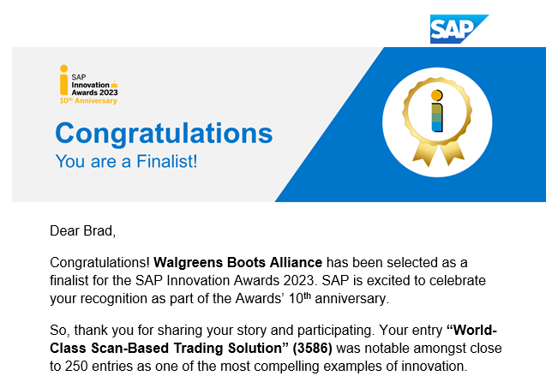
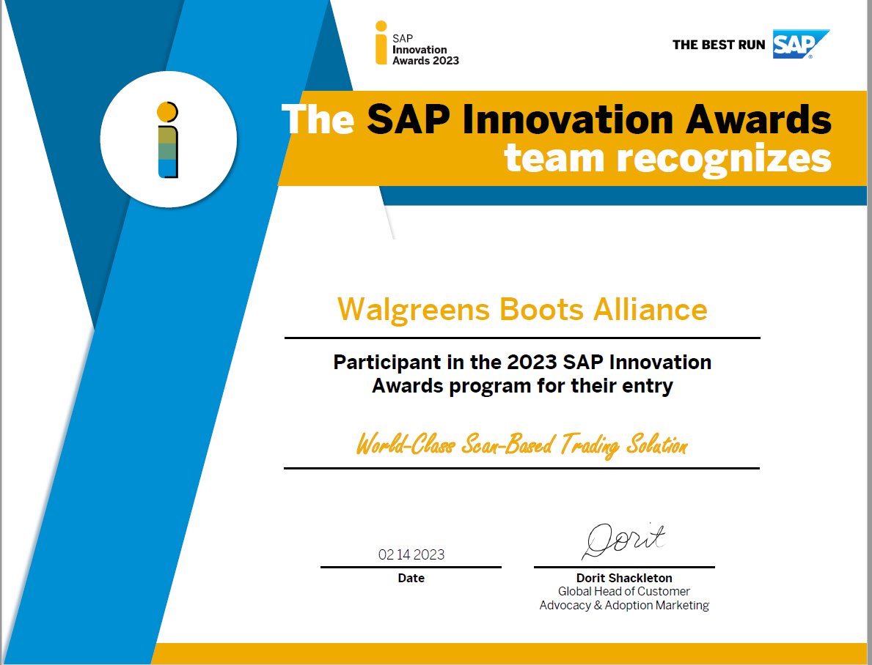

Slide 3
Walgreens Boots Alliance
Deerfield. IL
Retailer
325,000
https://www.walgreensbootsalliance.com/
Our segment operates 8,886* drugstores in 50 states, the District of Columbia, Puerto Rico and the U.S. Virgin Islands. About 78 percent of the U.S. population lives within five miles of a Walgreens or Duane Reade pharmacy.
We sell prescription and non-prescription drugs, as well as a wide assortment of retail products, including health and wellness, beauty, personal care and consumables and general merchandise. We filled approximately 819.6 million prescriptions in fiscal 2022, including immunizations.
We are also focused on creating neighborhood health destinations within our stores, and a more modern pharmacy aligned to providing a wider range of healthcare services. Across the U.S., we have more than 85,000 healthcare service providers, including pharmacists, pharmacy technicians, nurse practitioners and other health-related professionals. Through them, in addition to our focus on providing high-quality, personalized patient care, we also expect to continue to play a growing role in government and employer efforts to control escalating healthcare costs.
We’ve taken further steps to develop these neighborhood health destinations, working with our strategic partners such as VillageMD to provide an integrated primary care and pharmacy model that aims to drive better health outcomes, reduce costs and provide a differentiated patient experience.

Slide 4
World-Class Scan-Based Trading Solution
Walgreens Boots Alliance
Walgreens was using an old process known as “Legacy” that was running on a mainframe, outside of SAP to create invoices for paying its Scan-Based Trading (SBT) Vendors for sales activity. Since the point-of-sales data needed for generating the invoices was being stored within SAP, that data needed to be transferred out to Legacy. This transfer required several distinct interfaces that were contributing to data inaccuracies, which in turn were causing incorrect invoicing. In addition, since invoicing was run weekly for most vendors, they were not receiving a timely delivery of the actionable information they needed.
,
To overcome the deficiencies of the Legacy process, Walgreens developed an enhanced, daily invoicing flow in SAP that provides data at the article, UPC, and store level.
In addition to benefiting from consistently on-time, accurate payments, Walgreens vendors have also gained timely, actionable visibility into what is selling in each store. Because of this view, vendors are benefiting from:
Maximization of stock in individual stores
Better forecasting of product production
Minimized in-store scouting of inventory
Elimination of an invoicing person
11%
Decrease in invoicing errors
2.3M
Items invoiced on peak days
2-3
Hours needed to run invoices on peak days

Slide 5
“
Walgreens is a world-class organization, therefore we needed a world-class consignment program that benefits our organization. That objective was met with the tools and environments delivered by SAP.
Brad Trychta, Senior Director Enterprise Financial Services Walgreens Boots Alliance
”

Slide 6
The Walgreens SBT environment, as now configured, makes it a lot easier for Walgreens to meet and/or exceed participation in the Supply Chain offerings by Diversity businesses.
Walgreens was facing the challenge of delivering on-time, consistently accurate invoices to our Scan-Based Trading vendors. Issues were being caused by the fact that Point-of-Sale (POS) data used for generating invoices needed to be transported out of SAP to a Legacy process that was running in a mainframe environment. This transfer required multiple steps through distinct interfaces, which was causing data inaccuracies. Fixing the results of these inaccuracies was requiring daily extra steps by both Walgreens and vendor employees. Vendors were not receiving information at the high level that Walgreens is committed to providing.

Slide 7
In order to eliminate the inaccuracies that were inherent in the non-SAP Legacy workflow, and to provide a daily record of sales activity to SBT vendors, Walgreens needed to migrate SBT invoice creation over to SAP. One of the biggest challenges in this move and therefore a key objective was to differentiate SBT merchandise invoicing from Walgreens Owned merchandise invoicing, which was already running in SAP. Tight controls would be needed to maintain this distinction and prevent inadvertent payments to vendors.
SAP provided the environment, the tools, and the expertise needed for implementing a new invoice creation process that met our goal of providing an improved flow of data to our Scan-Based Trading vendors.

Slide 8
An impending elimination of the mainframe environment in which the Legacy SBT invoice creation was running precipitated the need for an overhaul of the process. Driving the discussion regarding the direction to take was the high percentage of errors that were being experienced in Legacy caused by need to transfer sales activity data out of SAP to Legacy. These errors ran as high as 10%, causing incorrect payments of $117,000,000 over 3 months. By migrating SBT invoice creation into the SAP environment and across multiple SAP applications, the error rate has dropped to essentially zero on most days. At most, the error rate is one half of 1 percent of all invoices. On peak days, SAP enables Walgreens to handle 1.2 million SBT transactions, which represents 2.3 million items sold. Most significantly, the processing of this volume requires only 2 to 3 hours and causes no discernable impact to other concurrent SAP processes.
In the Scan-Based Trading process, the cost-of-goods to a vendor is recorded when an item is scanned at the register. In the old Legacy process, this point-of-sale (POS) data was transmitted from SAP to Legacy and then back to SAP via a multi-step path:
POS -- SAP -- CAR -- BW -- MSSDW – Mainframe -- Oracle -- SAP
Once in Legacy, the data was used to generate invoices on behalf of the vendors. Inherent in this multi-step hand off was the potential and indeed reality of dropped or degraded data that resulted in the creation of inaccurate invoices.
In the new process being run in SAP, the cost-of- goods is captured the same way, however, the path is now shorter with less translations of the data:
POS -- CAR -- SAP -- CAR
Via a daily MRKO process, the cost-of-goods is converted to article-level invoices that are created on behalf of the vendors. At the completion of this process, a control report is generated to ensure that all invoiced transactions were successfully copied to the CAR environment, which is the signal needed for the CAR to generate the UPC-level data files for transmission to the vendors.

Slide 9
With the new SAP-based, SBT invoice creation process, Walgreens was able to decrease invoice errors by 11%, while moving to a daily delivery of invoices for all vendors, who can leverage the invoice data. Not only are these vendors receiving accurate, on-time payments, they benefit from actionable information that allows them to:
Maximize stock in individual stores
Better forecast product production
Minimize in-store scouting of inventory
Eliminate an invoicing person
The improved process enabled Walgreens to:
Migrate from the mainframe Legacy systems and use all SAP systems for processing
Add control tables to ensure only consignment inventory is self-invoiced
Enhance RKWA table to better enable UPC reporting
Add Fiori Tile for vendor self-service reporting on multiple levels of SBT data

Slide 10
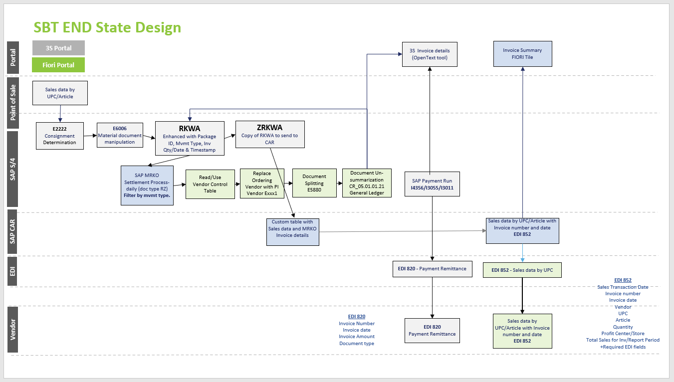

Slide 11
Since implementation, the new SAP-based SBT invoice creation process has been providing daily, actionable sales data to Walgreens vendors. This has created greater vendor satisfaction, which is a top goal for Walgreens. This also helps support the larger goal of transferring non-SBT vendors to the SBT model. This move not only benefits vendors, it offers a cash-flow benefit to Walgreens, as well as a reduction in the store staffing required for scanning-in merchandise upon delivery into the store, which has inherent potential for errors. With SBT, tracking of merchandise happens upon point-of-sale scanning. From there, the invoicing process begins, now less complicated and with significantly less errors because of the switch to SAP.

Slide 12
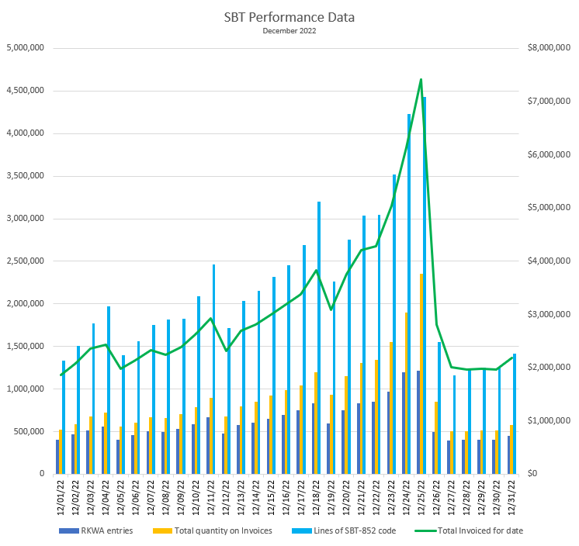

Slide 13
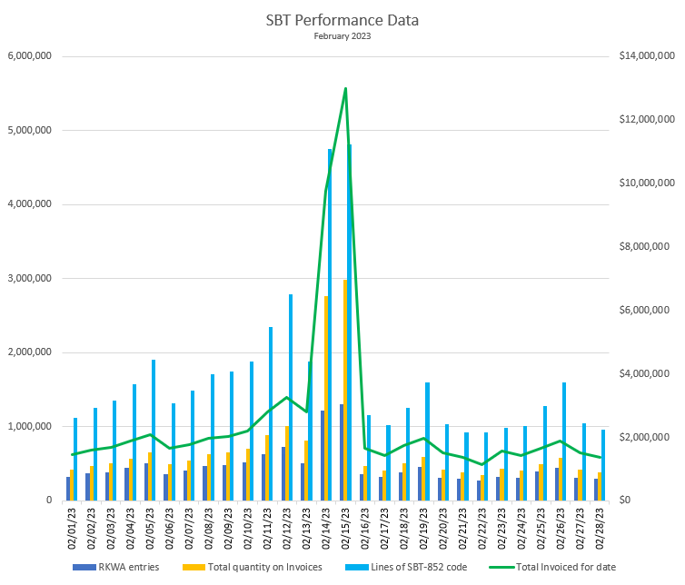

Slide 14
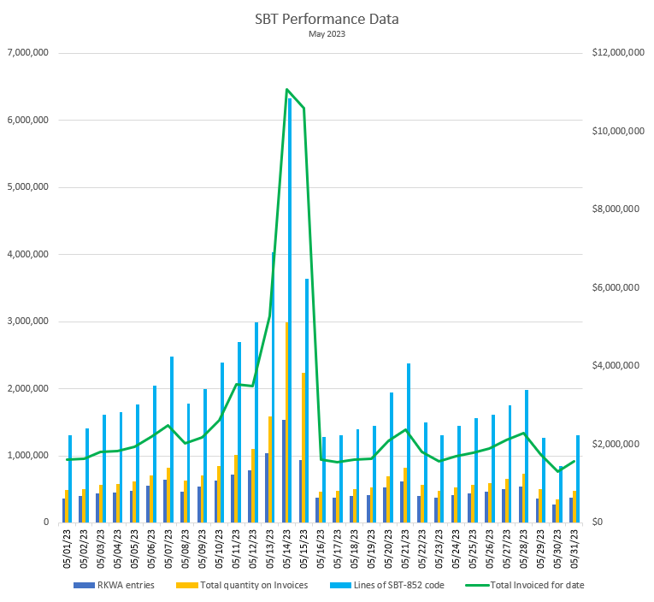

Slide 15
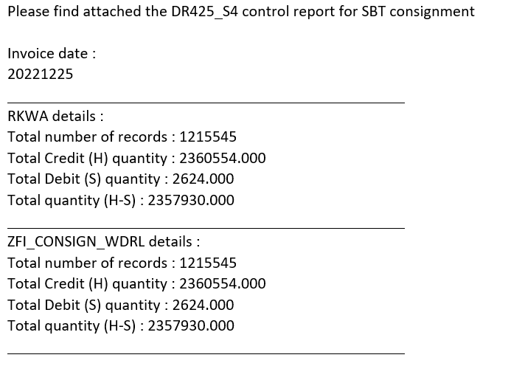
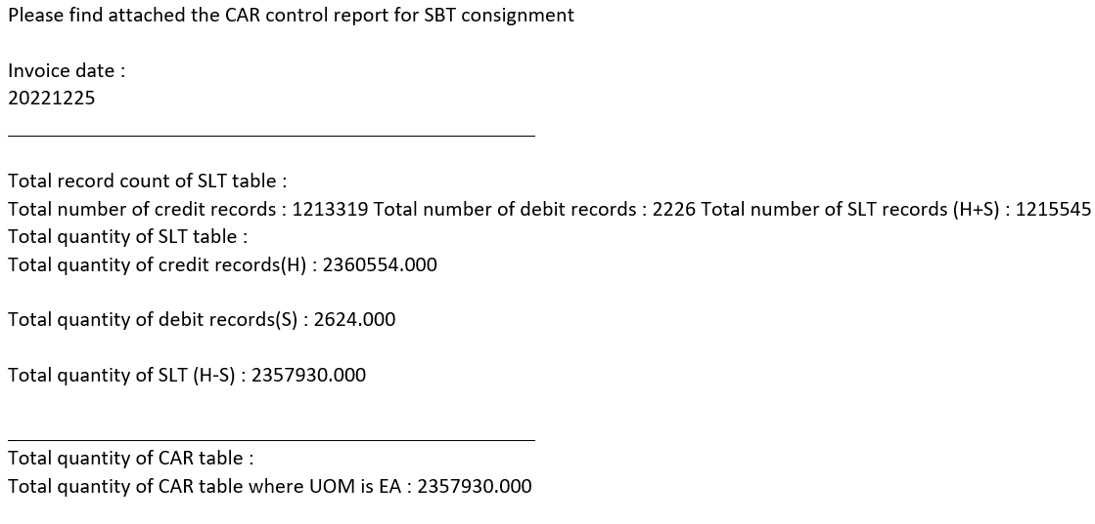

Slide 16
